Slide 1

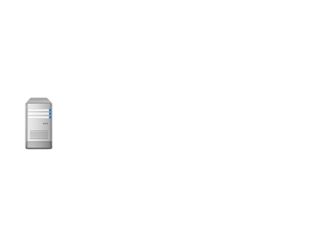
URL: http://35.175.56.234:58080
Http Connector
58080
URL: https://35.175.56.234:58081
Secure HTTP Connector
58081
Control Center
Web Container (WAS)
58082
35.175.56.234
Cognos Dispatcher 9300

Slide 2
Sterling B2B Integrator
XXX
Control Center
35.175.56.234
192.168.1.215
192.168.1.107
Database
1433
192.168.1.62

