Slide 1
Arquitectura
Sterling y Exchange Microsoft Graph

Slide 2



















Azure
email | View users' email address
Mail.ReadBasic.All | Read basic mail in all mailboxes
Mail.ReadWrite | Read and write mail in all mailboxes
MailboxSettings.Read | Read all user mailbox settings
MailboxSettings.ReadWrite | Read and write all user mailbox settings
openid | Sign users in
Access to Office365 mailbox for a Java application
https://developer.microsoft.com
https://graph.microsoft.com
6
Migrar
sfgdomiciliacion
Microsoft graph API
Azure AD B2C
App Registration
4
API Permissions
Certificates
Client Secret
Buzon Exchange 365
1
2
3
5
Corporate Data Center
Sterling N1
1
ID provisionin through directory
sinchronization
Office 365
Admin Center
Azure Active Directory
/gfssterling
2
3
4
Sterling N2
sfg_domiciliacion
app.4.4.1.sh
cacerts
Certificates
Cipher
Cifrar config
Internet
https://login.microsoftonline.com
5
Proxy
latam-proxy-SLV.glb.lnm.bns
4
3
2
1
sfg_domiciliacion
6
Azure Active Directory
8
7
ADFS
STS

Slide 3







jdk-17.0.12_7
https://maven.apache.org
https://mvnrepository.com
Artifactory
sterling-msgraph-sdk-java
pom.xml
O365InboxAttachmentToDisk 5.2.0-beta.jar
Bitbucket
GitHub
Repository
Get Code
Build
Unit Test
Static Code Analysis
Publish Artifact

Slide 4



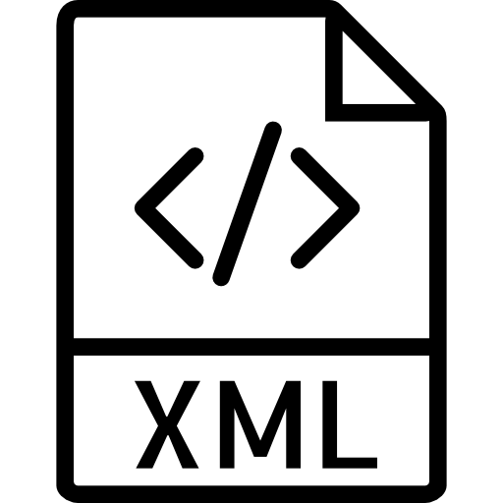











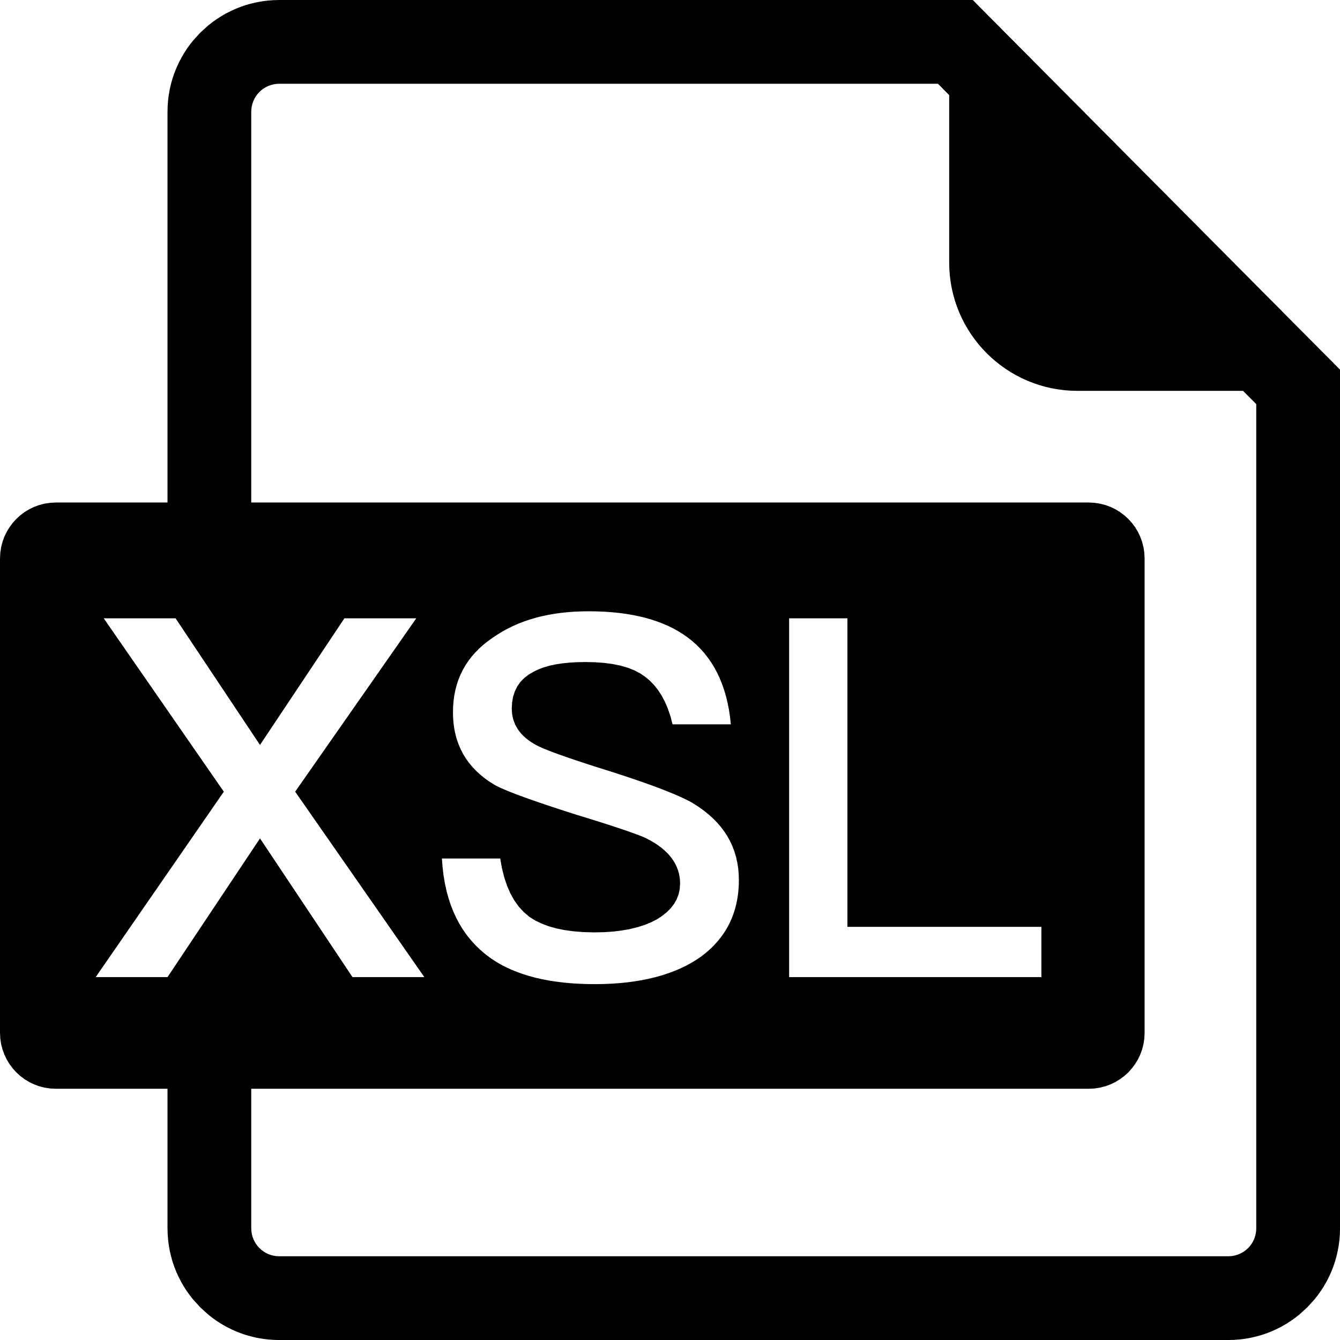

Codelist
6 am a 7pm cada 20 min
Sender Code | 01
Receiver Code | 1
Description | Datos Office 365
Text1 : remitentes | sterlingdev@desarrollocolpatria.com|
Text2 | Contactos_Chat*
Text3 | RIG0020000108
Text4 | /RIGHTNOW_MAIL_EWS/RIG/00200/00108
Text5 | Netapp
Text6 : remitentes | sterlingdev@desarrollocolpatria.com|
Text7 | sfg_domiciliacion@edtech.com.co
Text8 | ACTIVE|INACTIVE
Text9
BP_EWS_XML_PUT
BP_QUERY_MAIL_ALL_GET
XSLT_EWS_GET
N1FSA_EWS_OUTPUT_XML
20 min (hoy)
BP_EWS_STERLINGEWS_GET
BP_EWS_GET
BP_EWS_AGREEMENT_FOLDER_MOVE
mail-attachment
Procesado
10 min (hoy)
Template
workflowid
GTB0000100002
BP_FS_MAIL_GET
BP_AGUASPEREIRA_GET
GTB0000100002
Canal
domain
Mailbox
Mailbox
GTB0000100002
Partner Productor
Partner Consumidor
user
GTB0000100002
Bussines Process
Custom Protocol
Template
protocolo
partener
CommanLine Adapter
Datos de Conexión
Adapter
Canal
Codelist
XSLT
Filesystem Adapater

Slide 5

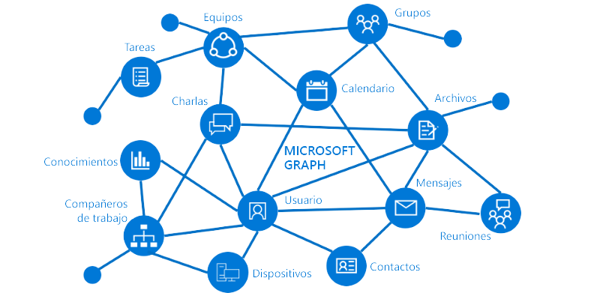
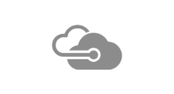
Sterling Colombia
Mexico
secret
Usuario y password
443
1
Adquire token via autorization code
sts.services.sbgendbca.com
DigiCert Global G2 TLS RSA SHA256 2020 CA1
DigiCert Global Root G2
Azure Active Directory
Java app – Sterling
SADBOGCA522
10.236.10.122
Proxy
latam-proxy-SLV.glb.lnm.bns
Internet
App Registrtion
443
2
graph.microsoft.com/.default
3
APP_UAT_BFD8_Sterling
pki-bns-prod
2048 offline root
APP_QAT_BFD8_Sterling
tenandID
CliemntID
Secrets
4
Microsoft Graph
developer.microsoft.com
graph.microsoft.com
login.microsoftonline.com
gdl4.subca.scotiabank.com.mx
2048 offline root
Usuario y ssl
Azure
Personas de proxy
Validación de inspección ssl de certificados
Luis nafate o avimael santos

Slide 6
Sterling Colombia
Mexico
1
Adquire token via autorization code
sts.services.sbgendbca.com
DigiCert Global G2 TLS RSA SHA256 2020 CA1
DigiCert Global Root G2
Azure Active Directory
Java app – Sterling
10.236.10.166
Proxy
latam-proxy-SLV.glb.lnm.bns
Internet
App Registrtion
APP_UAT_BFD8_Sterling
pki-bns-prod
2048 offline root
2
graph.microsoft.com/.default
3
APP_QAT_BFD8_Sterling
tenandID
CliemntID
Secrets
4
Microsoft Graph
developer.microsoft.com
graph.microsoft.com
login.microsoftonline.com
gdl4.subca.scotiabank.com.mx
2048 offline root
Azure

Slide 7
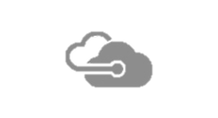
Sterling Colombia
Mexico
1
Adquire token via autorization code
sts.services.sbgendbca.com
DigiCert Global G2 TLS RSA SHA256 2020 CA1
DigiCert Global Root G2
Azure Active Directory
Java app – Sterling
10.236.10.166
Proxy
latam-proxy-SLV.glb.lnm.bns
Internet
App Registrtion
APP_UAT_BFD8_Sterling
pki-bns-prod
2048 offline root
2
graph.microsoft.com/.default
APP_QAT_BFD8_Sterling
ae491d93-f18f-46e8-9768-2bd331213948
08457e7f-0883-49e7-b537-ab68ccb2a95f
Microsoft Graph
Microsoft Azure ECC TLS Issuing CA 04
DigiCert Global Root G3
developer.microsoft.com
graph.microsoft.com
login.microsoftonline.com
DigiCert SHA2 Secure Server CA
DigiCert Global Root CA
DigiCert SHA2 Secure Server CA
DigiCert Global Root CA
Azure

Slide 8
Mexico
secret
Usuario y password
443
1
Adquire token via autorization code
sts.services.sbgendbca.com
DigiCert Global G2 TLS RSA SHA256 2020 CA1
DigiCert Global Root G2
dominio de encripcion
Azure Active Directory
8000
443
F5 - Proxy
latam-proxy-SLV.glb.lnm.bns
Internet
mpls
App Registrtion
Java app – Sterling
IpDatos: 10.33.147.33
IpNat: 10.33.148.33
2
graph.microsoft.com/.default
3
APP_QAT_BFD8_Sterling
tenandID
CliemntID
Secrets
duplex close of SSLSocket
4
443
Microsoft Graph
APP_UAT_BFD8_Sterling
pki-bns-prod
2048 offline root
developer.microsoft.com
graph.microsoft.com
login.microsoftonline.com
gdl4.subca.scotiabank.com.mx
2048 offline root
Usuario y ssl
f5
Administra network
David Benito – Juan Hernandez
Personas de proxy
Validación de inspección ssl de certificados
Luis nafate o avimael santos

Slide 9
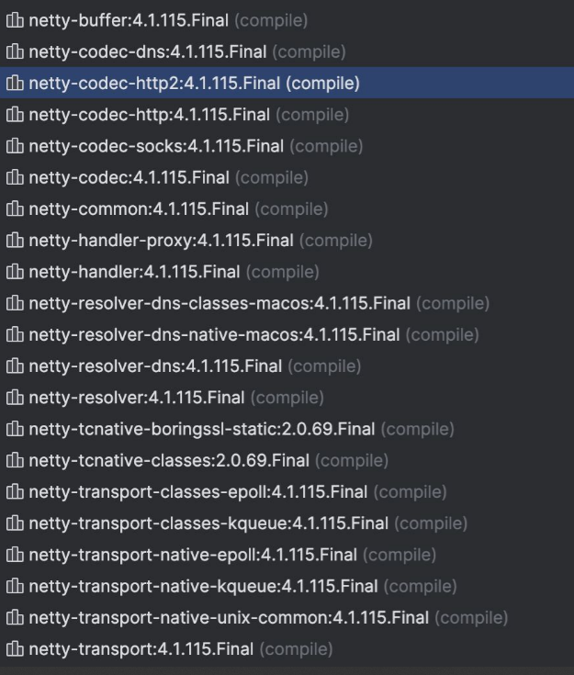
[main] INFO com.azure.core.http.netty.implementation.NettyUtility - {"az.sdk.message":"The following Netty versions w ere found on the classpath and have a mismatch with the versions used by azure-core-http-netty. If your application r uns without issue this message can be ignored, otherwise please align the Netty versions used in your application. Fo r more information, see https://aka.ms/azsdk/java/dependency/troubleshoot.","azure-netty-version":"4.1.110.Final","az ure-netty-native-version":"2.0.65.Final","classpath-netty-version-io.netty:netty-common":"unknown (not found and is required)","classpath-netty-version-io.netty:netty-handler":"unknown (not found and is required)","classpath-netty-version-io.netty:netty-handler-proxy":"unknown (not found and is required)","classpath-netty-version-io.netty:netty-buffer":"unknown (not found and is required)","classpath-netty-version-io.netty:netty-codec":"unknown (not found and is r equired)","classpath-netty-version-io.netty:netty-codec-http":"unknown (not found and is required)","classpath-netty-version-io.netty:netty-codec-http2":"unknown (not found and is required)","classpath-netty-version-io.netty:netty-transport-native-kqueue":"4.1.110.Final","classpath-native-netty-version-io.netty:netty-tcnative-boringssl-static":"2.0.65.Final"}
netty-common
netty-handler
netty-handler-proxy
netty-buffer
netty-codec
netty-codec-http
netty-codec-http2
netty-transport-native-kqueue":"4.1.110.Final”
netty-tcnative-boringssl-static":"2.0.65.Final"
Librerias en folder y meter en classpath

