Slide 1
Say “Hello” to Alexa
A.I. ASSISTENT
GIOVANI DECUSATI
Notes:
Introduce: Greetings, Name, Role
Goals: tiny experience during Westpac Hackathon
Devices available for shopping
How to start with Alexa
Open:
https://developer.amazon.com/alexa/console/ask?
https://console.aws.amazon.com/lambda/home?region=us-east-1&#/functions

Slide 2
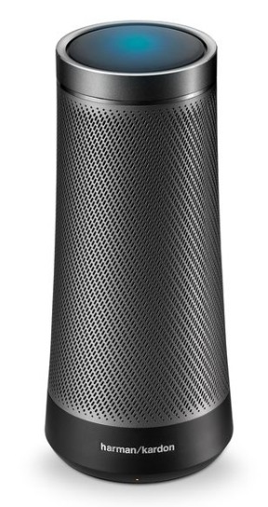
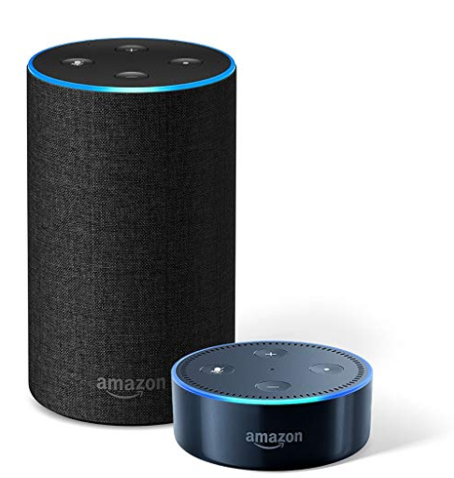
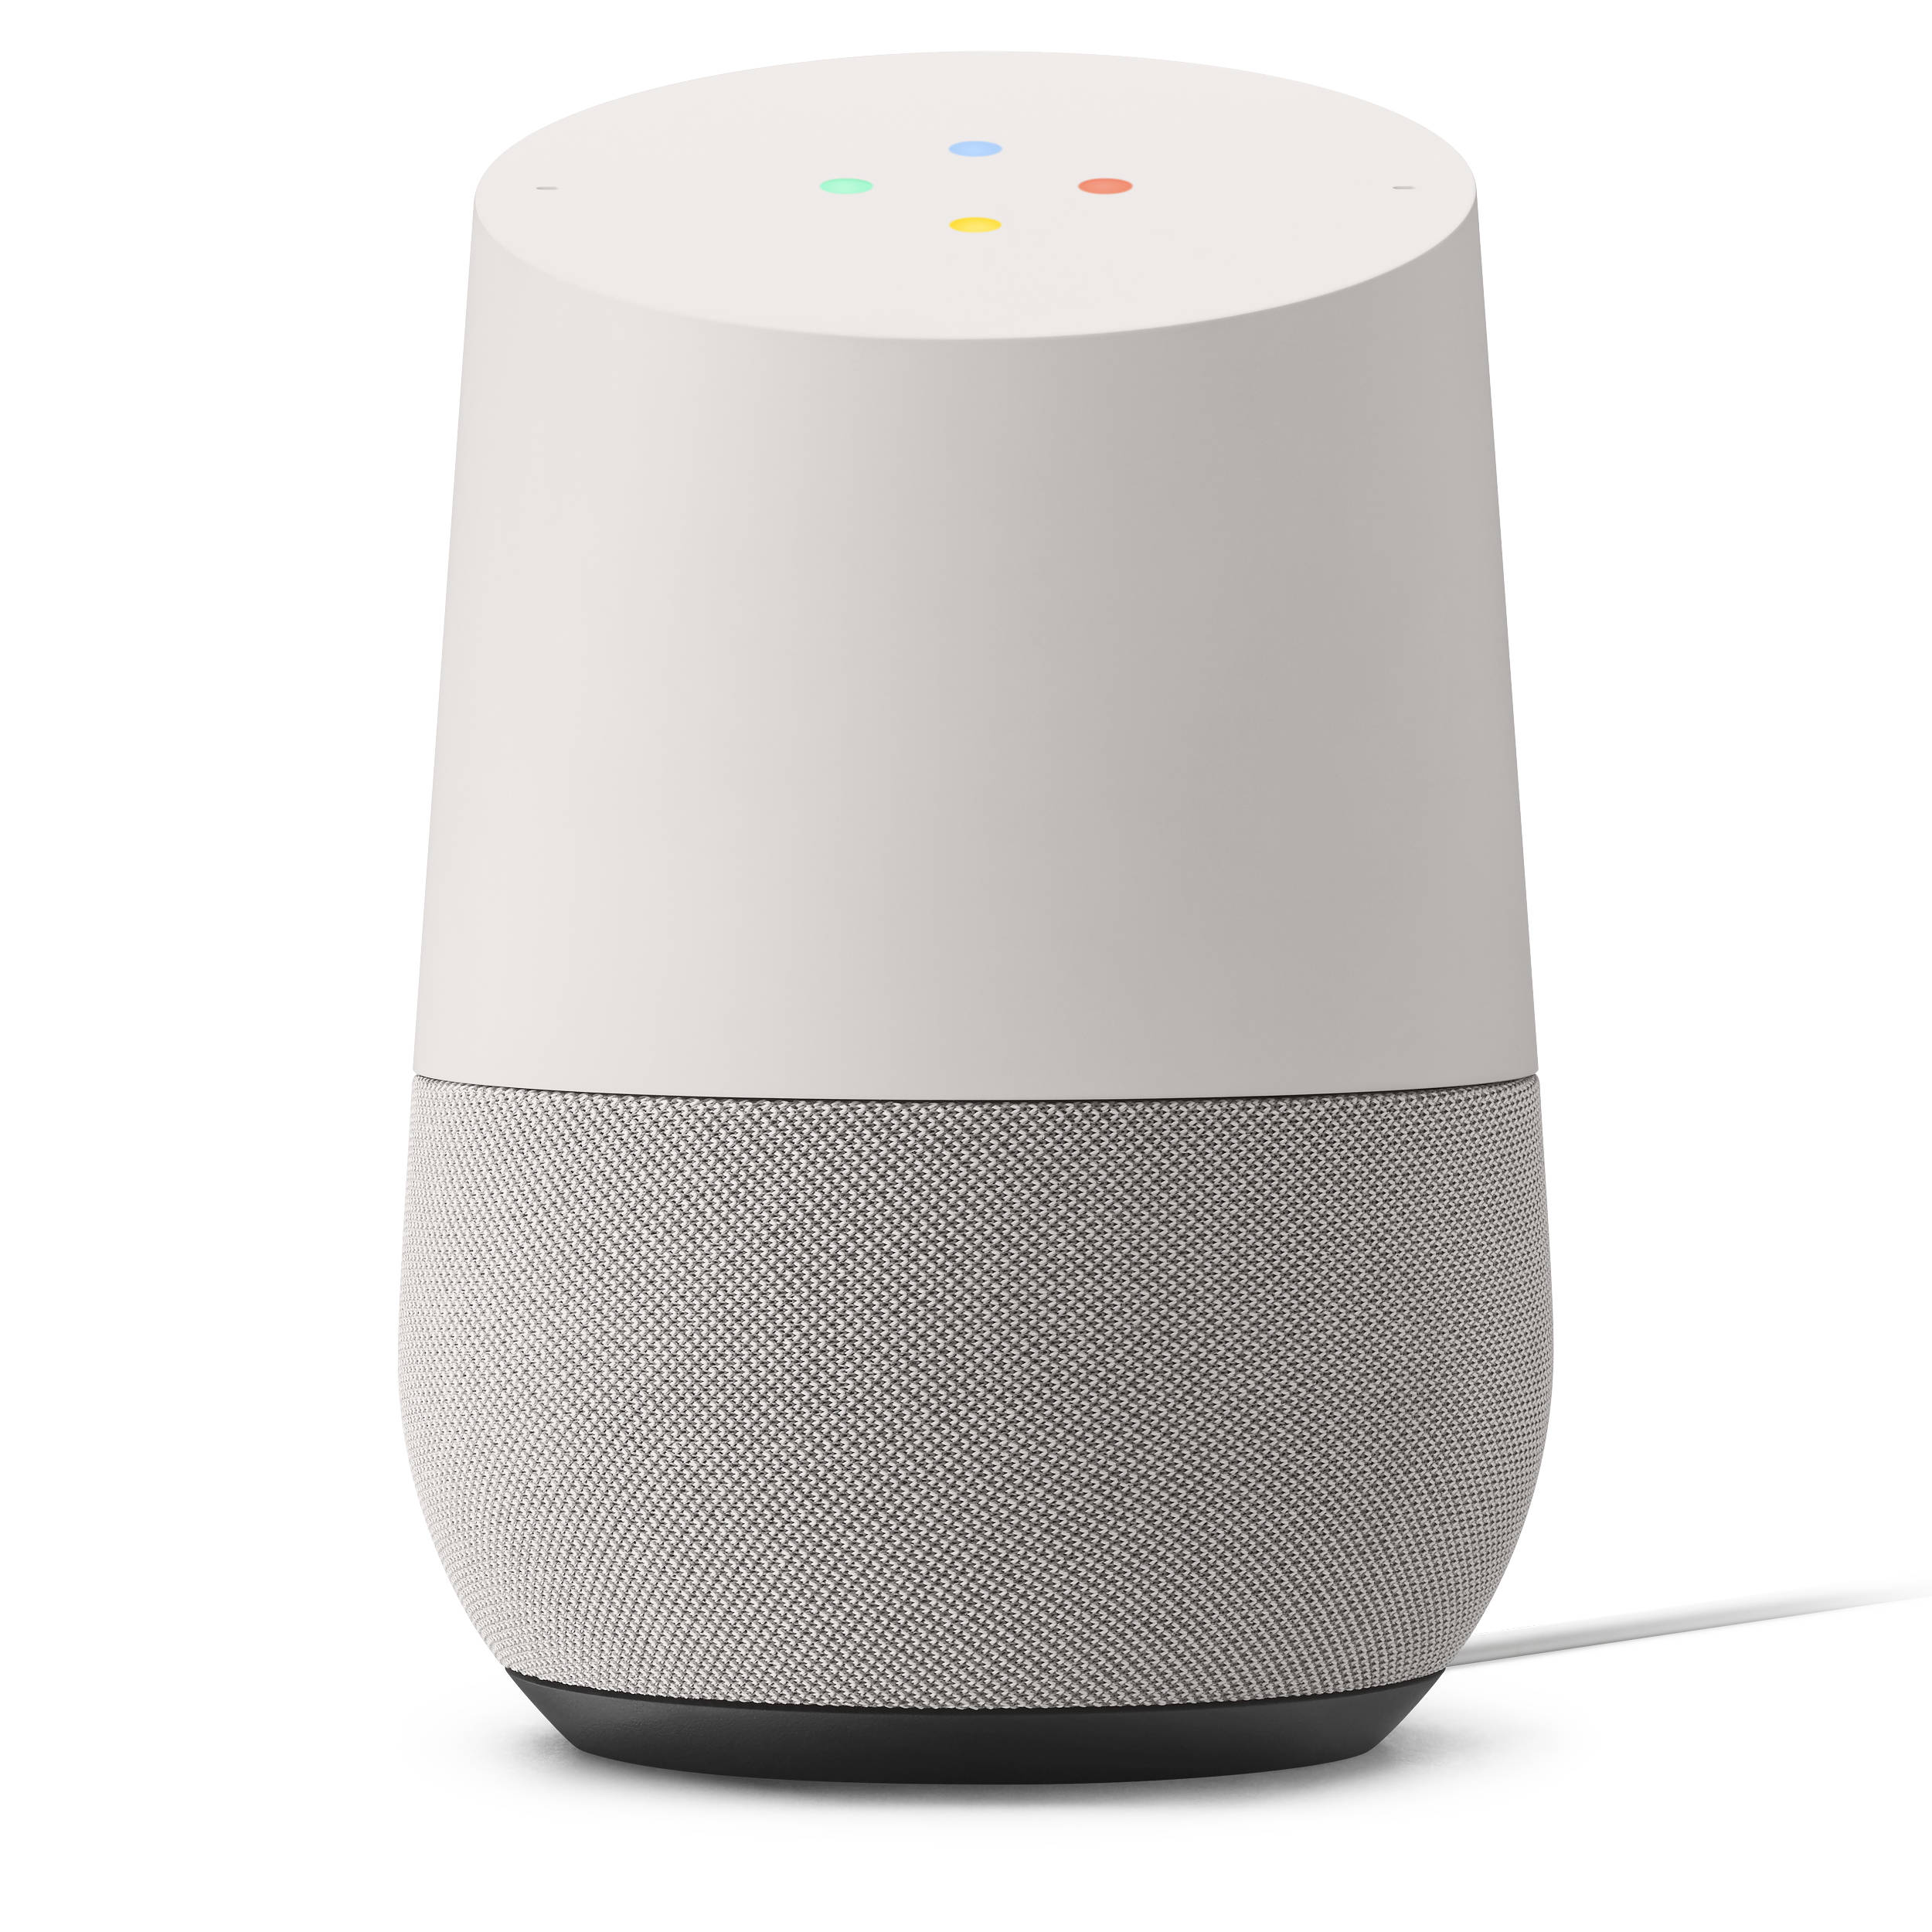
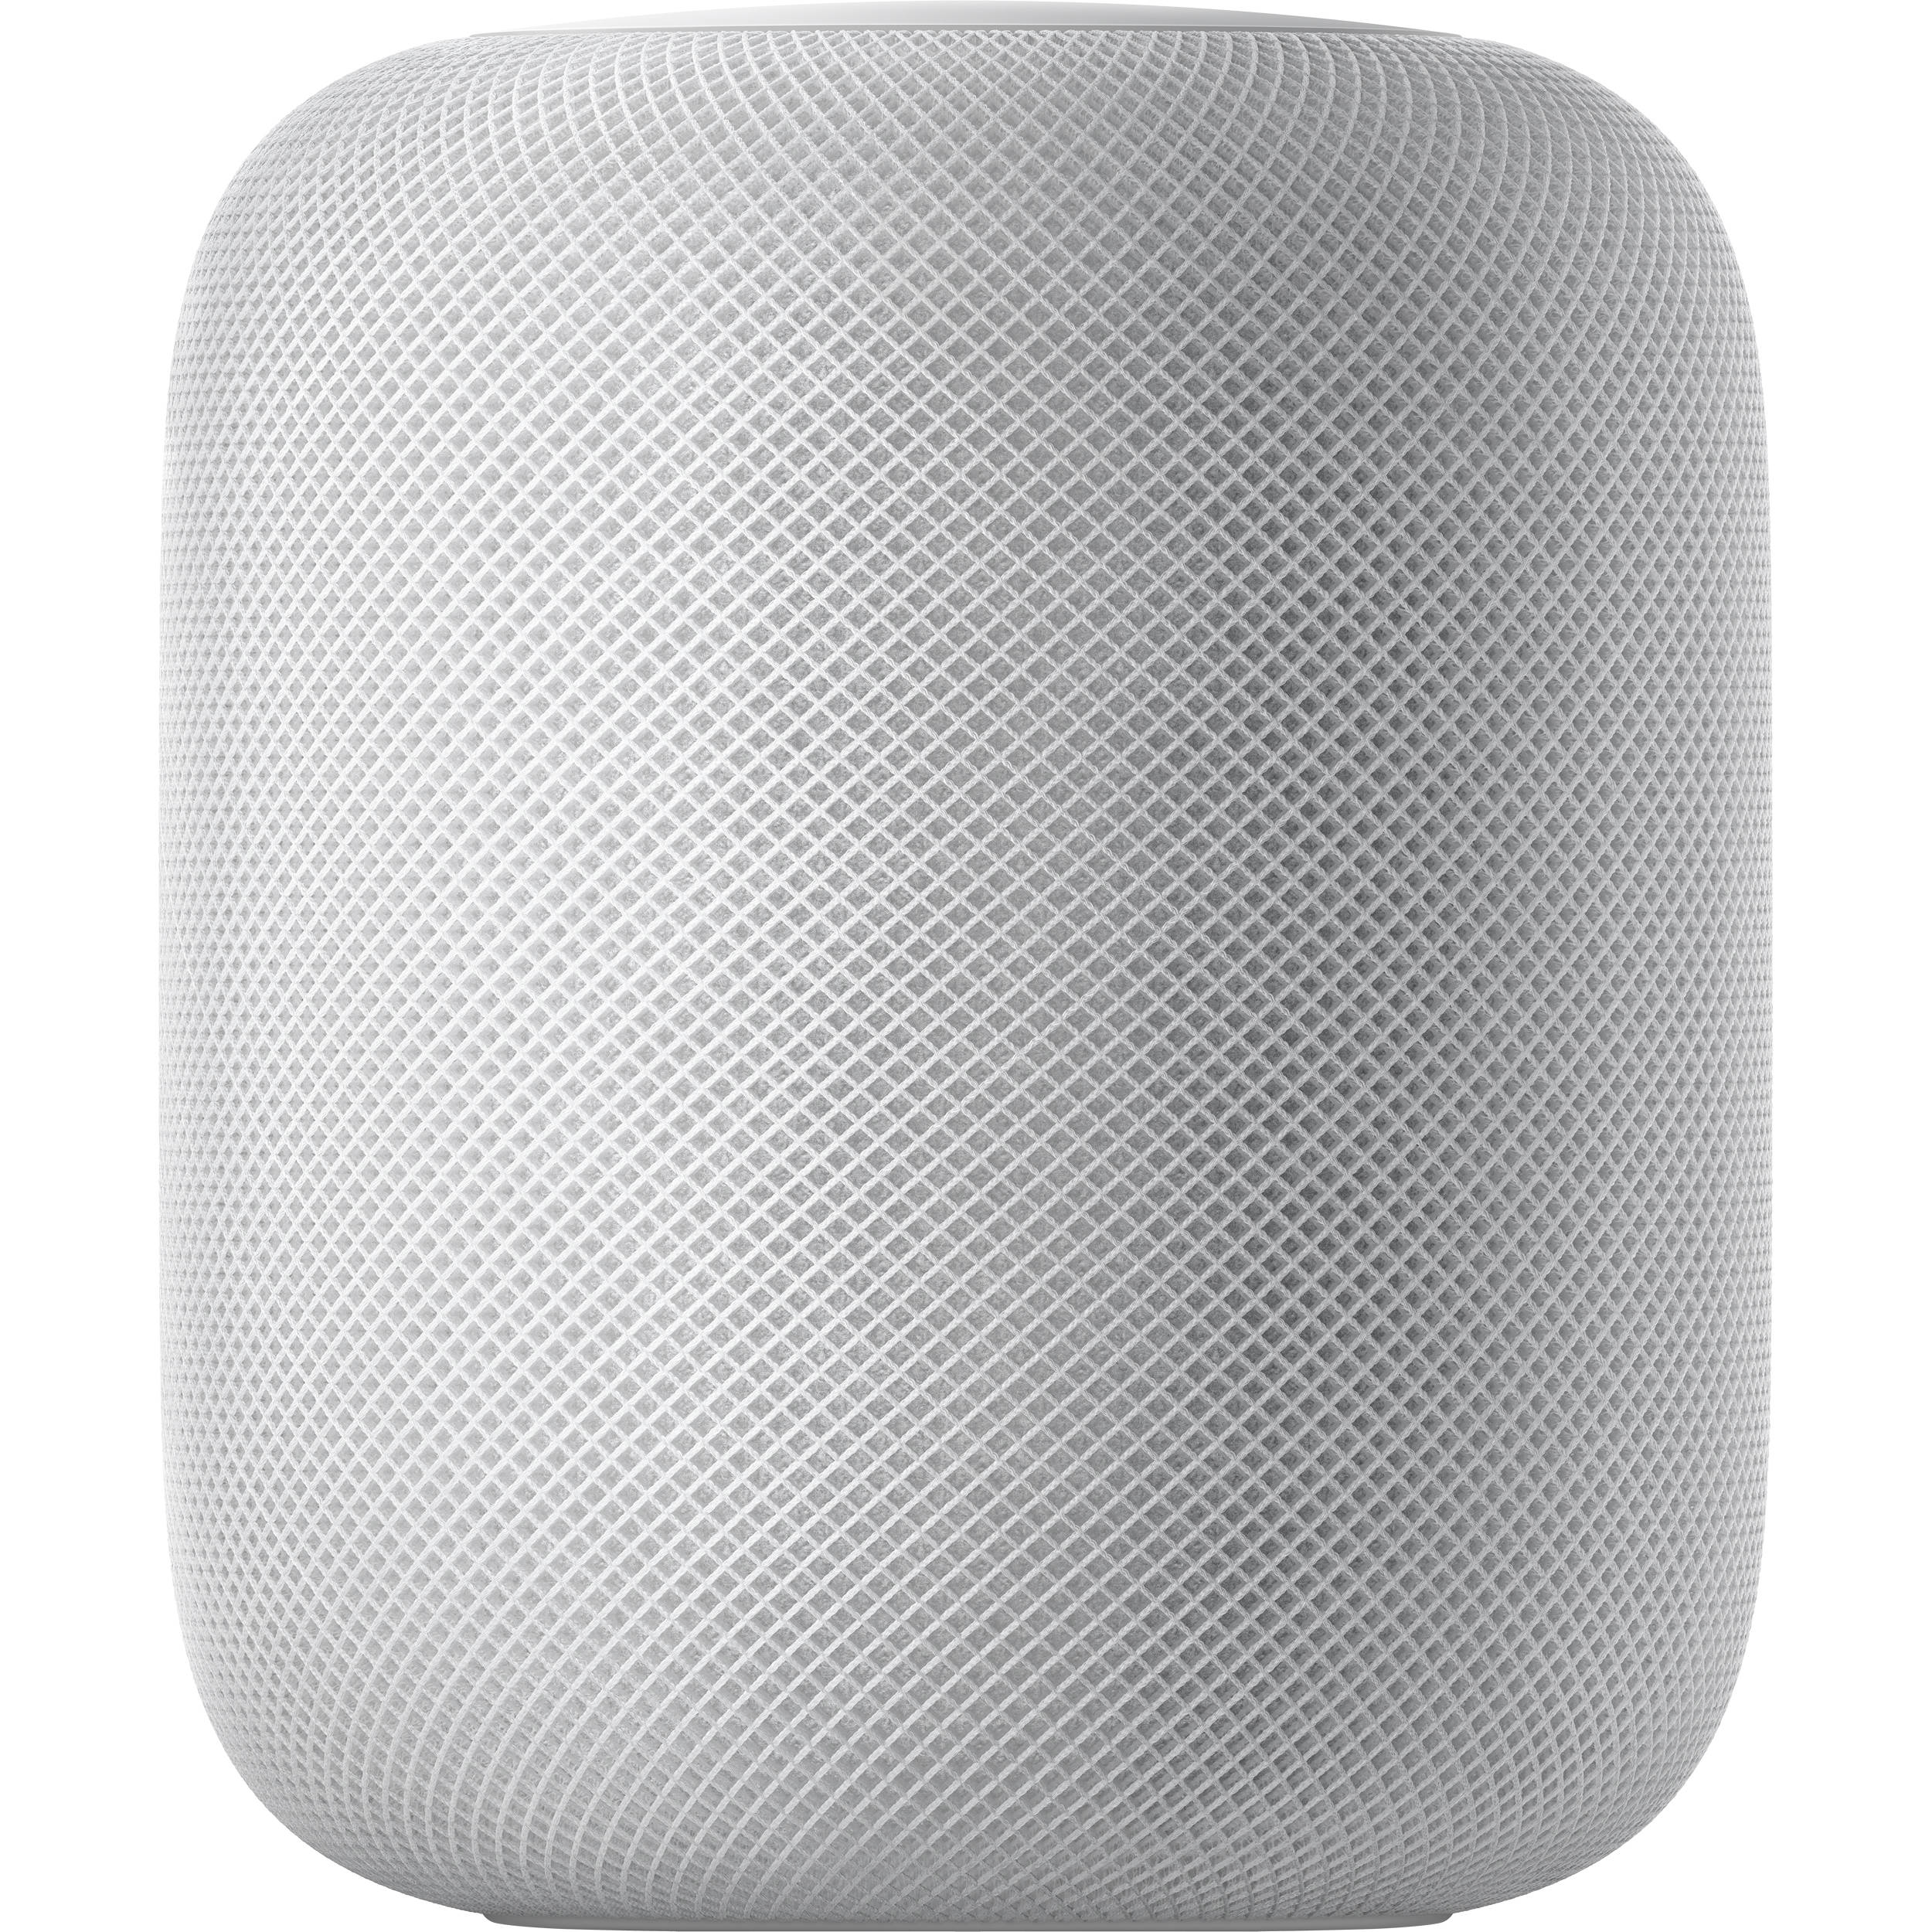
SPEAKERS
HARMAN/KARDON
INVOKE
$199
ECHO, ECHO DOT
$149/59
HOME POD
$499
GOOGLE HOME
$199
Notes:
- Echo Dot the user can add many devices he can to cover all the rooms in a house and wait for the answer from the closest device through an ESP (Echo Spatial Perception) feature.
References:
https://www.businessnewsdaily.com/10315-siri-cortana-google-assistant-amazon-alexa-face-off.html
https://au.pcmag.com/harman-kardon-invoke/50169/review/harman-kardon-invoke

Slide 3
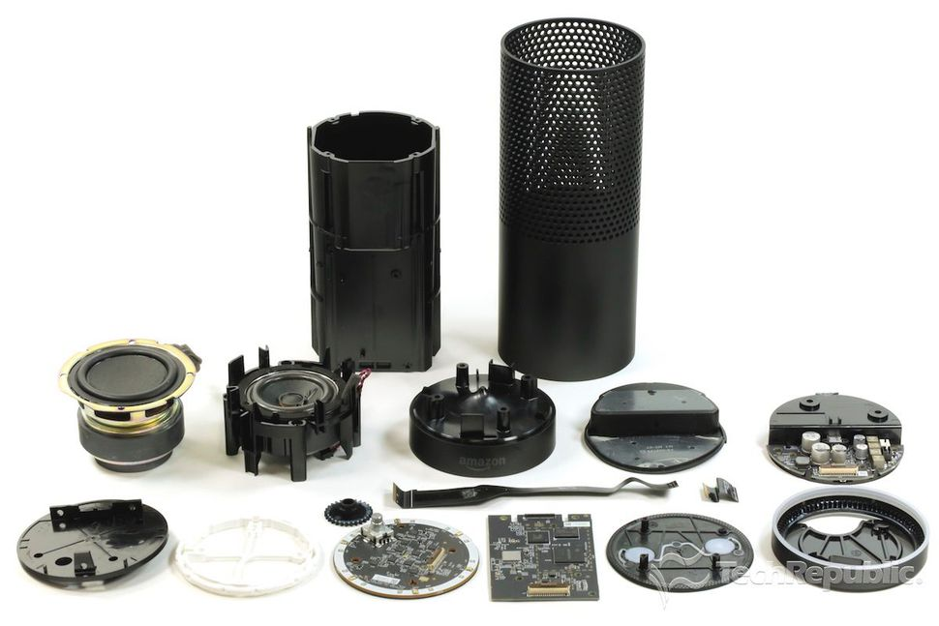
Notes:
Not a Rocket Science
Merely sound box
You can build you own device with a speaker, microphone and an Raspbery Py Board.
So where is the intelligence behind this devices?

Slide 4
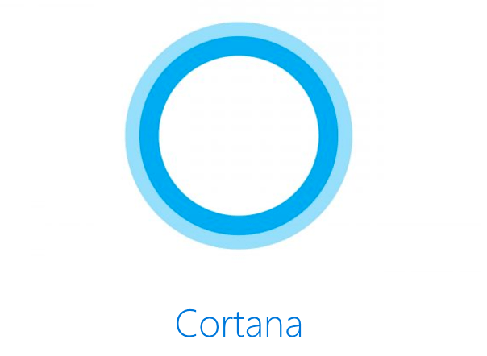

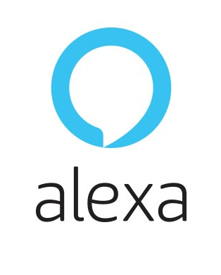
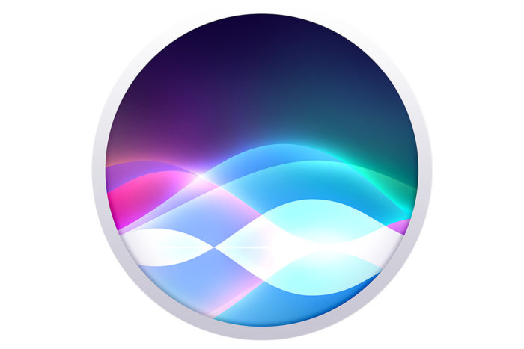
CHATBOTS – A.I.
Notes:
This mechanism can interpret user intends, utterances, slots and answer with a fulfilment for your intend
A bot is an app that users interact with in a conversational way using text, graphics (cards), or speech.
It may be a simple question and answer dialog, or a sophisticated bot that allows people to interact with services in an intelligent manner using pattern matching, state tracking and artificial intelligence techniques well-integrated with existing business services.
Reference:
https://www.wired.com/story/best-smart-speakers/

Slide 5
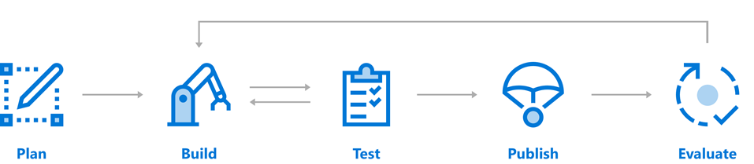
Bot Service
Notes:
Plan:
- You must be aware of design guidelines to create more realistic communication and identify user needs extracting behaviour from the human commands and responses. Maybe a new task leaded by the design team.
Build:
Choose your langue C# (MS), Node (AWS/MS), Java (AWS)
CLI Tools, VSTUDIO, VSCODE, Web Platform
Lambada Functions (serveles block of code) trigged by the Bot
Test:
- SDK to automated test, Emulators, Web Test, Device
Publish:
Approved by Amazon, this process can take a couple of days
Deploy directly to the device just need to register the device in your developer account
Evaluate:
Monitoring with AppInsights
Console.Log and read trace messages on Amazon Console or using Amazon SDK debug locally
References: https://docs.microsoft.com/en-us/azure/bot-service/bot-service-overview-introduction?view=azure-bot-service-3.0

Slide 6
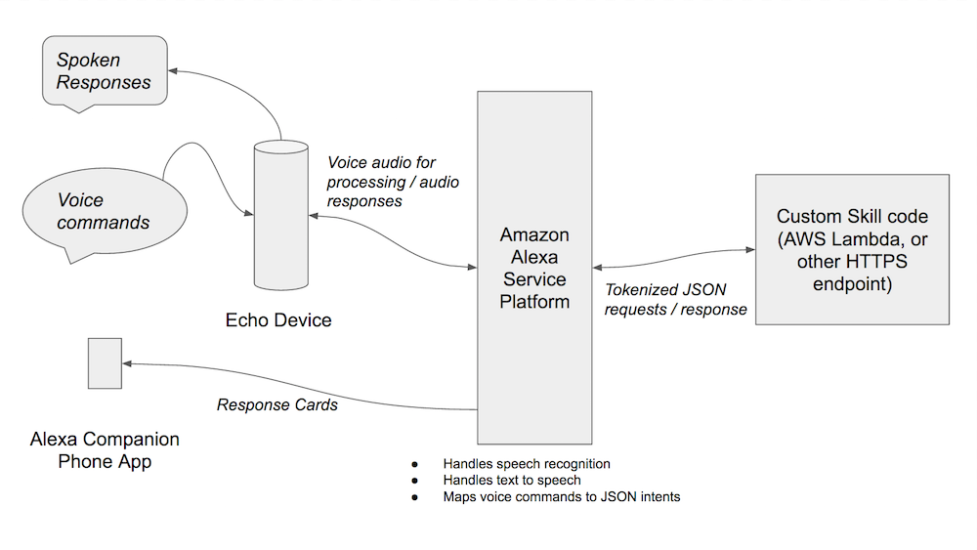
Notes:
Invoke message like “Alexa, Cortana, Google, Siri”
Amazon Echo sends the audio to Alexa Plataform – located on amazon cloud infrastructure.
Does the hard work

Slide 7
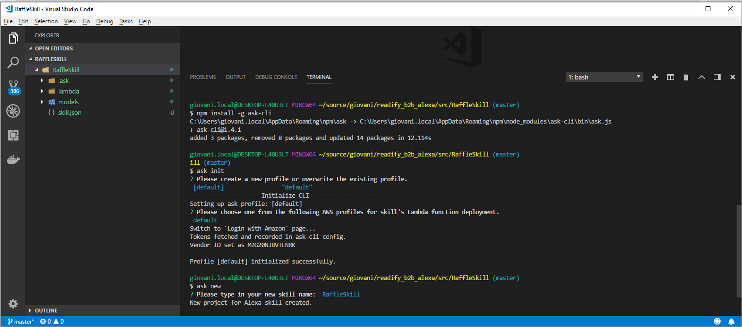
alexa cli
Notes:
ask init to connect your local environment to your amazon account
ask new to scaffolding the soultion
ask deploy
ask clone
ask simulate
Invocation Name
Intents: FallbackIntent, CancelIntent, HelpIntent, StopIntent
Interactive Model
https://github.com/alexa/skill-sample-nodejs-hell
Testing
https://developer.amazon.com/alexa/console/ask
Debugging
https://developer.amazon.com/blogs/post/tx24z2qzp5rrtg1/new-alexa-technical-tutorial-debugging-aws-lambda-code-locally
Monitoring
https://console.aws.amazon.com/lambda/
Logging
CloudWatch
Difficulties:
Changed require('https’) to sync-request
Debugging, monitor and login
References:
https://developer.amazon.com/docs/smapi/quick-start-alexa-skills-kit-command-line-interface.html

Slide 8
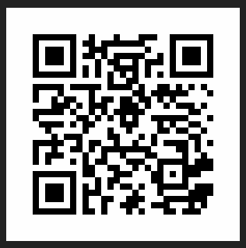
DEMO
Fill the form
We will riffle the winner!
https://rafflleb2b-app.azurewebsites.net/

Slide 9

https://github.com/giovanidecusati/readify-b2b-alexa
Notes:
According with some research chatbot will be indistinguishable from humans by 2029
live together with some answers out of context
““Human queries assume a respondent understands context, which chatbots currently lack today. Animals, however, pick up on context queues by combining sense systems together, such as speech and vision. Companies should develop models that encourage cross-modal integration to create more adaptive, human-like chatbots.” In the other words, we need more data to analyse to answer more accurate queries. ”
References:
https://www.cio.com/article/3149087/artificial-intelligence/how-chatbots-like-siri-will-get-smarter.html
https://medium.com/marketing-and-entrepreneurship/11-amazing-facts-you-might-not-know-about-chatbots-8cdf331181f8

