Slide 1
Say “Hello” to Alexa
A.I. ASSISTENT

Slide 2
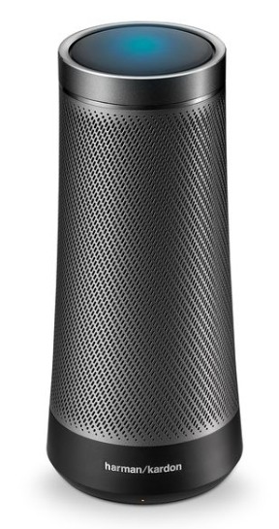
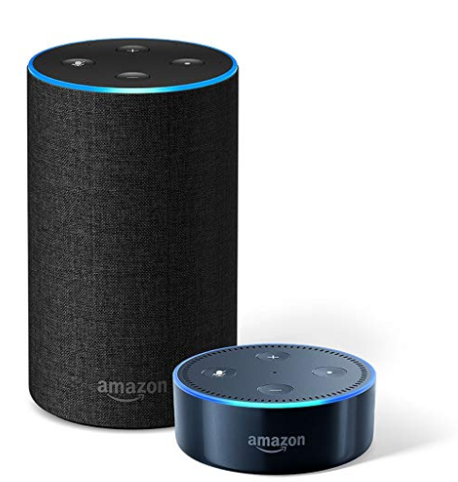
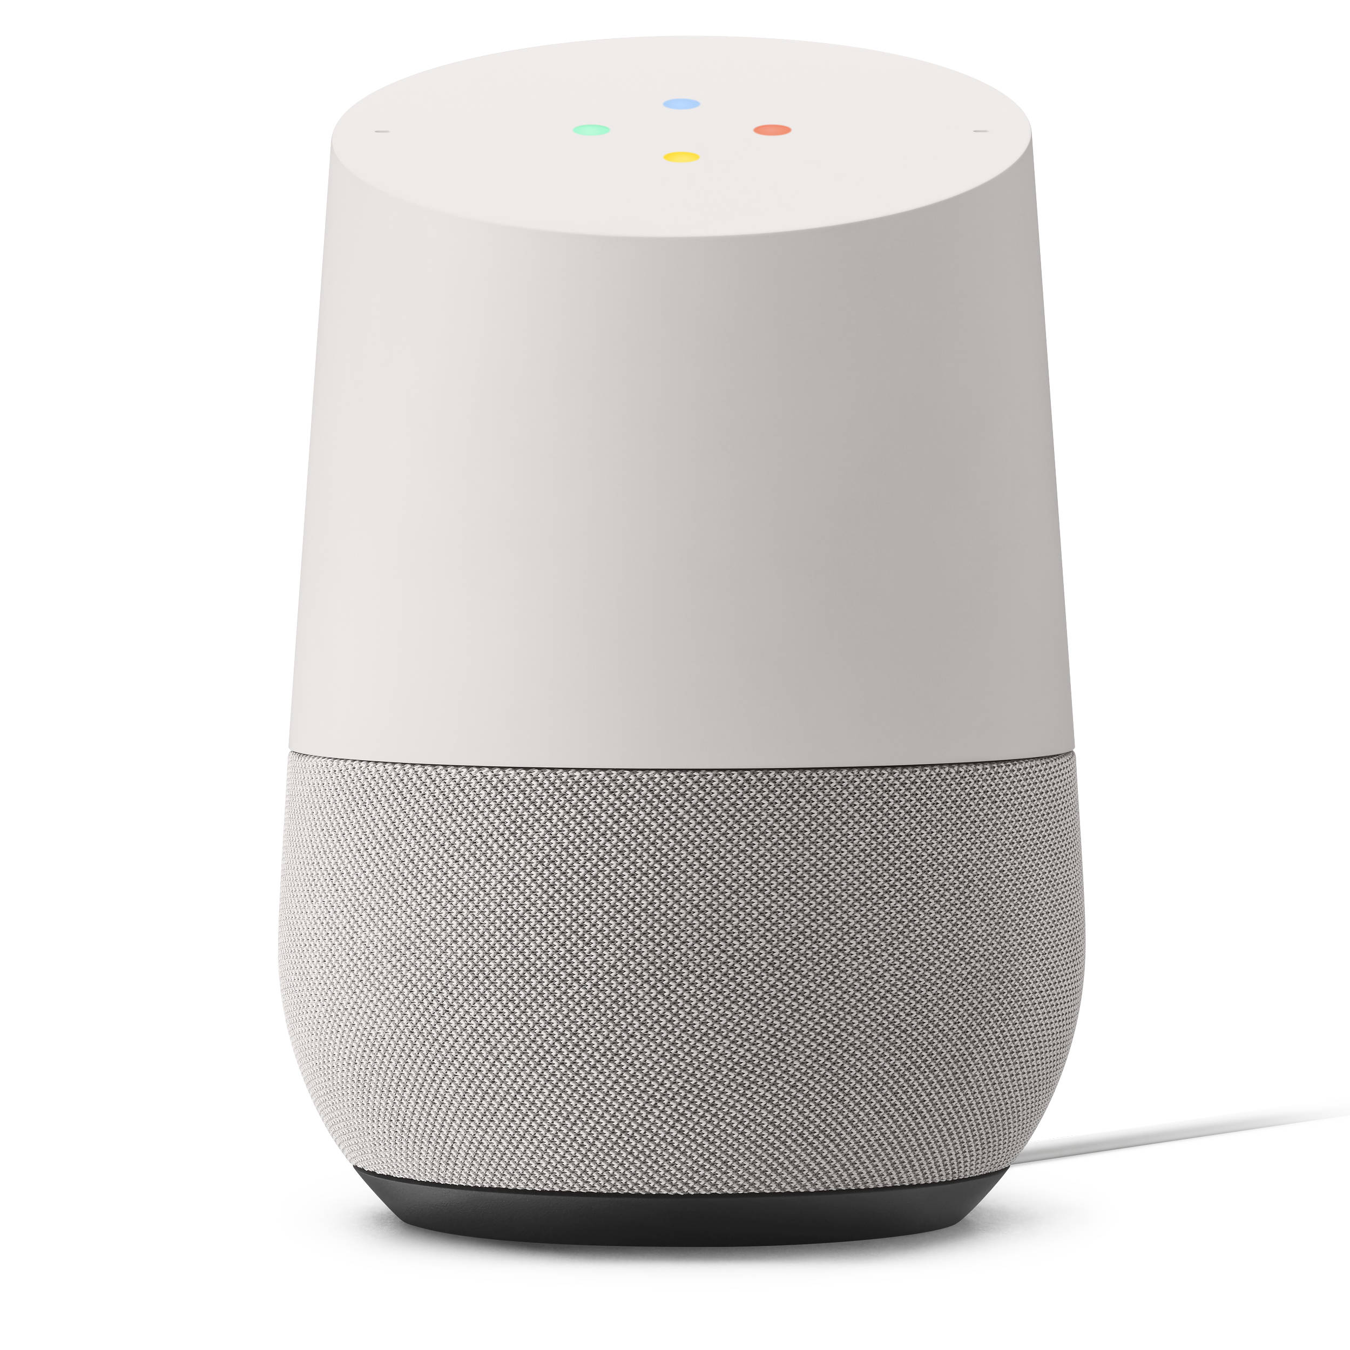

SPEAKERS
HARMAN/KARDON
INVOKE
$199
ECHO, ECHO DOT
$149
HOME POD
$499
GOOGLE HOME
$199
Notes:
References:
https://www.businessnewsdaily.com/10315-siri-cortana-google-assistant-amazon-alexa-face-off.html
https://au.pcmag.com/harman-kardon-invoke/50169/review/harman-kardon-invoke

Slide 3
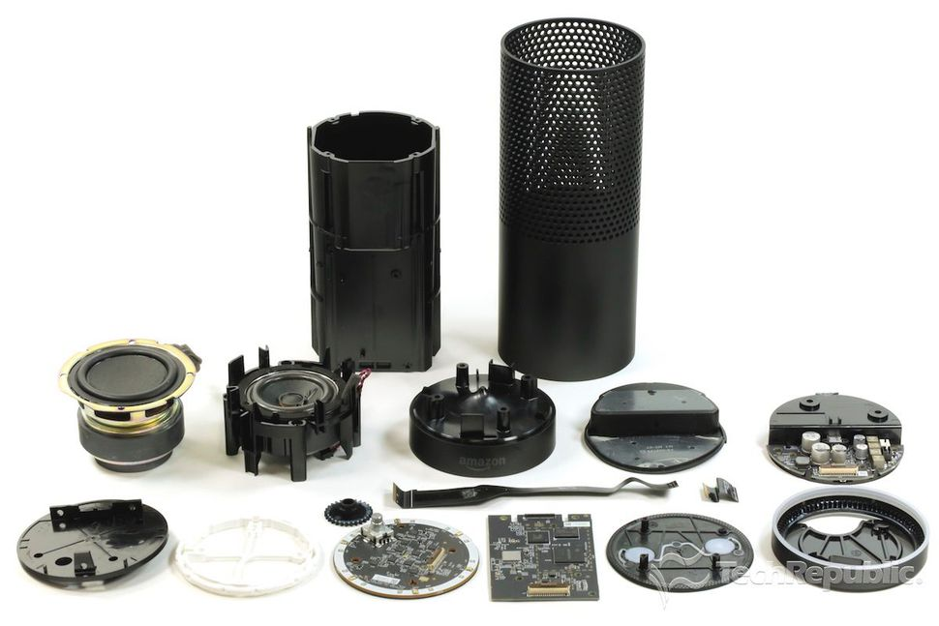

Slide 4
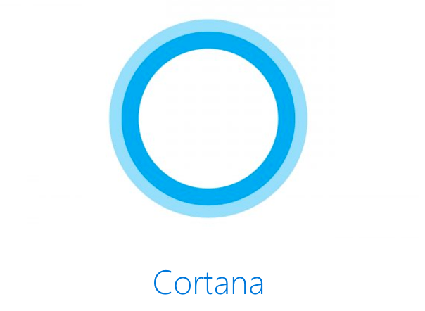

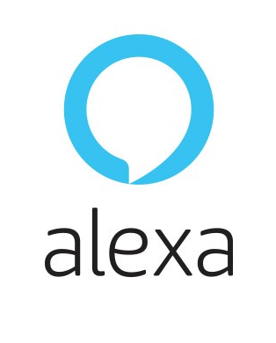

ARTIFICIAL INTELIGENCE
Notes:
https://www.wired.com/story/best-smart-speakers/

Slide 5
A.I. LANGUAGE
Australia: English
Brazil: Portuguese
Canada: English/French
China: Chinese (Simplified)
France: French
Germany: German
India: English
Italy: Italian
Japan: Japanese
Mexico: Spanish
Spain: Spanish
United Kingdom: English
United States: English
Australia: English
Canada: English/French
Germany: German
India: English
Japan: Japanese
United Kingdom: English
United States: English
Arabic
Chinese
Danish
Dutch
English
Finnish
French
German
Hebrew
Italian
Japanese
Korean
Malay
Norwegian
Portuguese
Russian
Spanish
Swedish
Thai
Turkish
Dialects for Chinese, Dutch, English, French, German, Italian and Spanish
Australia: English
Canada: English/French
Germany: German
India: English
Japan: Japanese
United Kingdom: English
United States: English
Notes:
https://www.globalme.net/blog/language-support-voice-assistants-compared

Slide 6
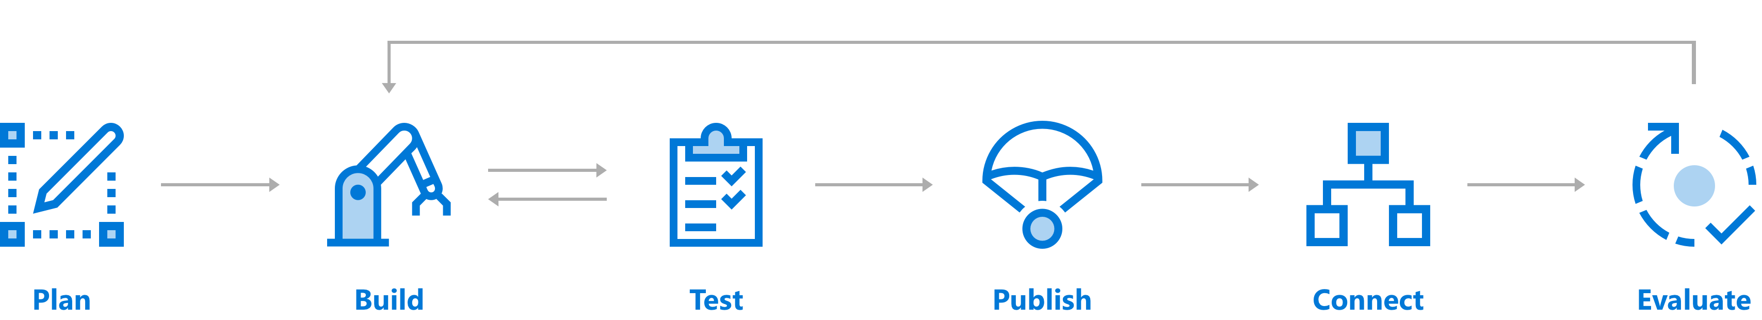
Bot Service
Notes:
Plan:
Check design guidelines for best practices
Identify your needs and extract behaviors (User Experience and Design Techniques may applied.)
Build:
Choose your langue C# (MS), Node (AWS/MS), Java (AWS)
CLI Tools, VSTUDIO, VSCODE, Web Platform
Test:
Emulators
Web Test
Device
Publish:
Functions
Connect:
Facebook, Messenger, Kik, Skype, Slack, Microsoft Teams, Telegram, text/SMS, Twilio, Skype and Cortana
Evaluate
- Monitoring with AppInsights
A bot is an app that users interact with in a conversational way using text, graphics (cards), or speech. It may be a simple question and answer dialog, or a sophisticated bot that allows people to interact with services in an intelligent manner using pattern matching, state tracking and artificial intelligence techniques well-integrated with existing business services.
Cortana is a speech-enabled channel that can send and receive voice messages in addition to textual conversation. A bot intended to connect to Cortana should be designed for speech as well as text. A Cortana skill is a bot that can be invoked using a Cortana client. Publishing a bot adds the bot to the list of available skills.
References: https://docs.microsoft.com/en-us/azure/bot-service/bot-service-overview-introduction?view=azure-bot-service-3.0

Slide 7
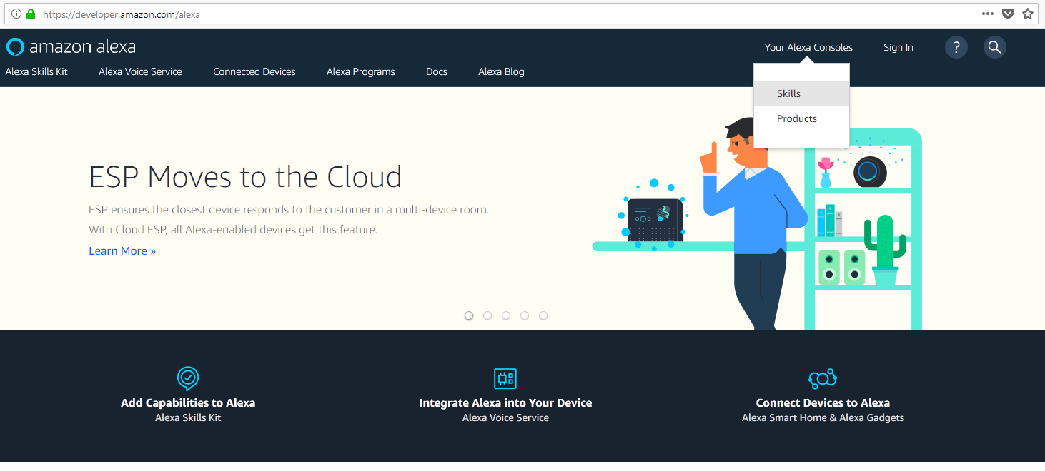
Alexa console
Notes:
- https://developer.amazon.com/alexa
- https://developer.amazon.com/alexa/console/ask

Slide 8
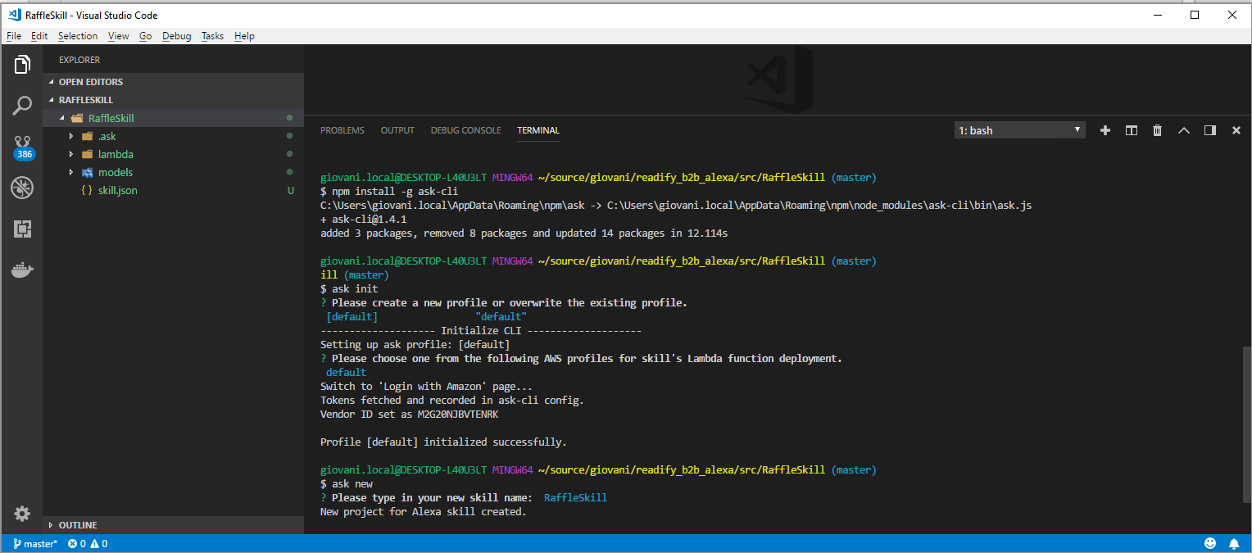
alexa cli
Notes:
https://developer.amazon.com/docs/smapi/quick-start-alexa-skills-kit-command-line-interface.html
ask deploy
ask clone
ask simulate
Invocation Name
Intents: FallbackIntent, CancelIntent, HelpIntent, StopIntent
Interactive Model
https://github.com/alexa/skill-sample-nodejs-hell
Testing
https://developer.amazon.com/alexa/console/
Debugging
https://developer.amazon.com/blogs/post/tx24z2qzp5rrtg1/new-alexa-technical-tutorial-debugging-aws-lambda-code-locally
Monitoring
https://console.aws.amazon.com/lambda/
Logging
CloudWatch
Difficulties:
Changed require('https’) to sync-request
Debugging, monitor and login

Slide 9
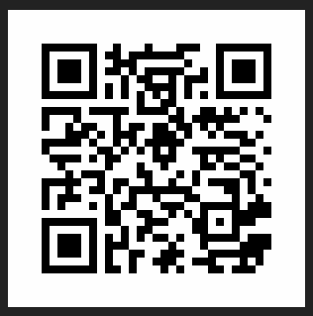
DEMO
Fill the form
We will riffle the winner!
https://rafflleb2b-app.azurewebsites.net/

