Slide 1
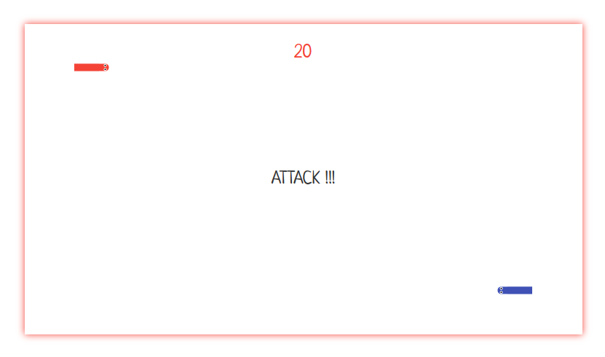
When time decreases
to 0, switch attacker
and defender
Your snake is
always red
Eat one fruit,
grow one body
Your opponent’s
snake is always blue
Battle field color tells
who is the attacker

