Slide 1
Sentiment analysis on League of legends community comments
Project by Giovanna Ferraro (giovanf@stud.ntnu.no)

Slide 2
Table of contents
Twitch overview
Emotes
Project goal
Data collection and lexica
Model development
Results and discussion
Predictions

Slide 3

Twitch overview
Twitch is the most popular live-streaming platform (2021)
At this moment there are 2,830,00 people watching Twitch
31 million daily active users
Live chats it’s a crucial aspect of the platform
Emotes as a new form of language
Notes:
What are the steps to create a new language:
Define the purpose and scope
Develop the phonology
Create the grammar
Define the vocabulary:
Test and refine the language
Promote and use the language

Slide 4










emotes
pepega
4Head
Trihard
LuL
Triumphbib
pogchamp
CoolStoryBob
kappa
cmonbruh
kekw

Slide 5
Project goal
Sentiment Analysis of League of Legends comments on Twitch
Challenges
Few known lexicon for emotes sentiment
The sentiment of each emote is context-dependant
Social media language issues
No specific grammar

Slide 6
Data collection and lexica
VADER lexicon
Unlabeled Twitch comments
Emoji lexicon
Weakly labeled Twitch comments
Labeled Twitch comments
+
=
+
Custom-made emotes lexicon
Final dataset

Slide 7
Model development
Step 1
Step 2
Accuracy 0.63
F1 score 0.62
NOT ENOUGH!
Distribution-based classifier
Deep learning approach [*]
LSTM
BiLSTM
* Model courtesy: https://github.com/sergiovirahonda/TweetsSentimentAnalysis

Slide 8
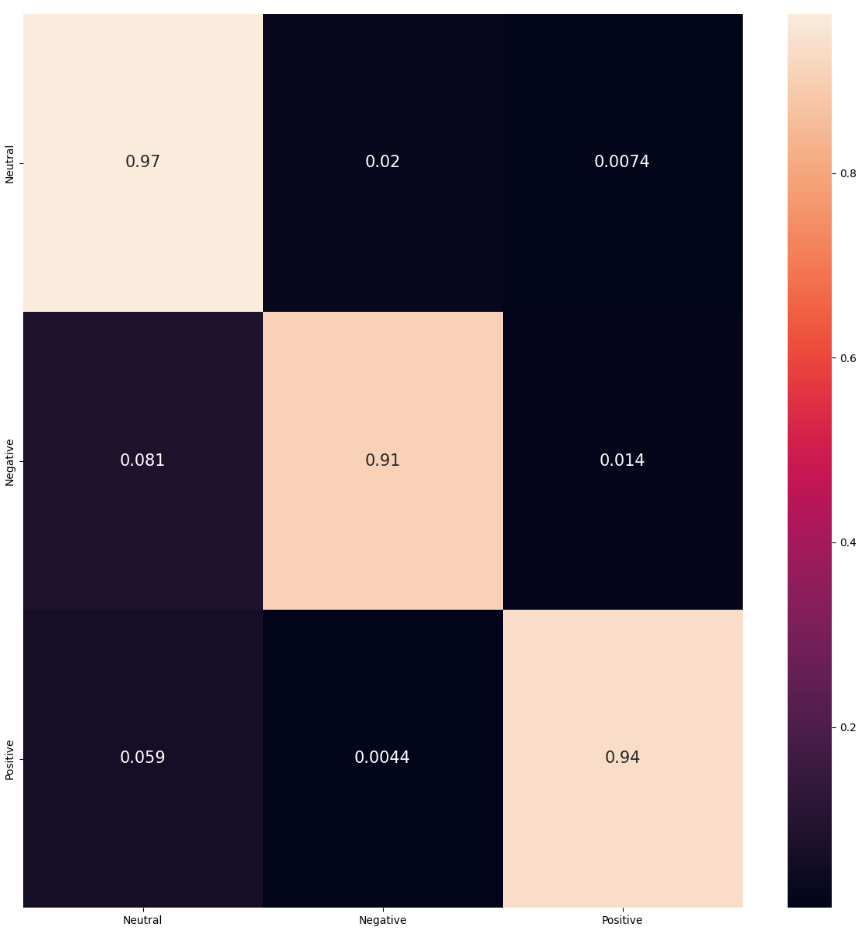
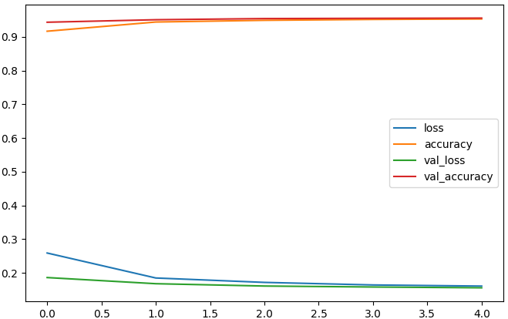
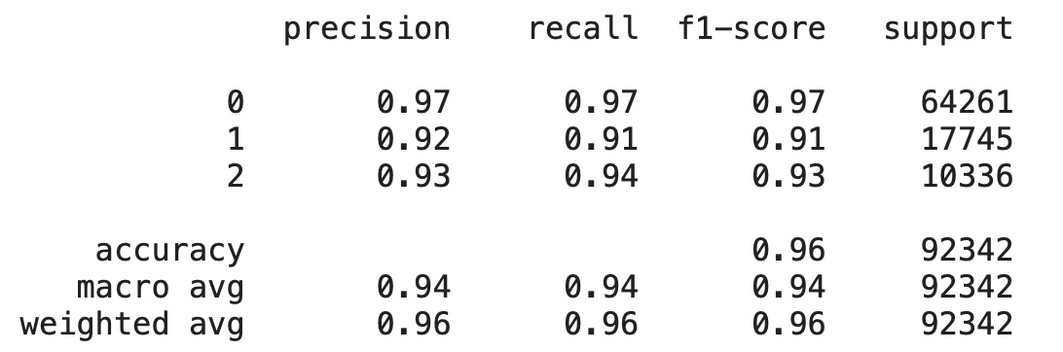
Results and discussion - LSTM model

Slide 9
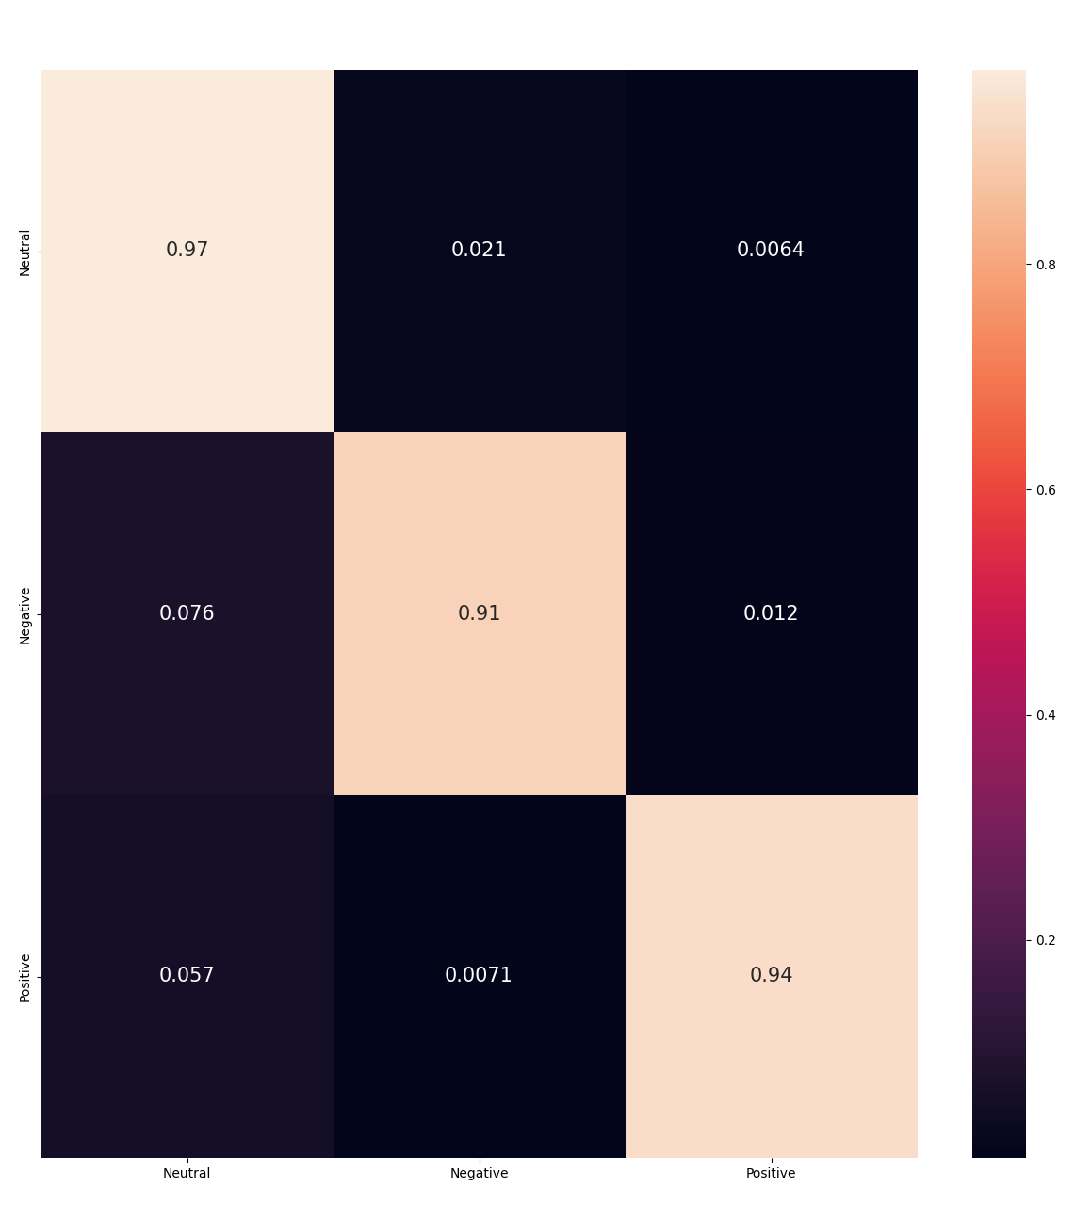
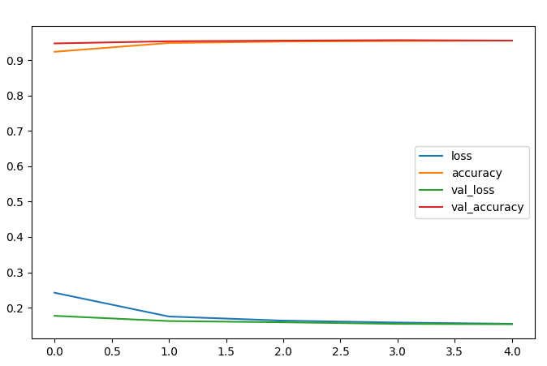
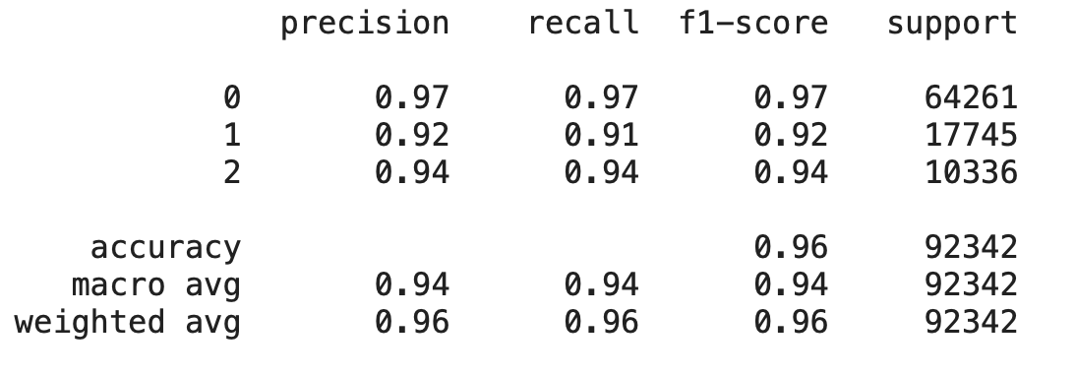
Results and discussion – BiLSTM model

Slide 10
TUSEN TAKK

