Slide 1
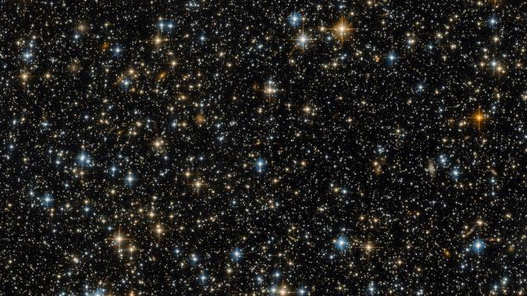


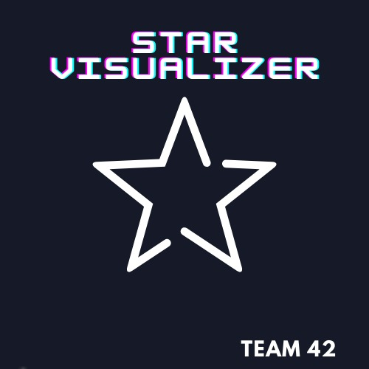
STAR VISUALIZER
Team 42

Slide 2
IDEA The player will create its own star. The player will see the star twinkling and its end of life, through simplified but attracting sequence of images.
VISION The aim is to improve the knowledge about the presence of luminosity variability of the stars, one of the useful tool to better know our universe.
VALUES
# LEARN BY DOING
# EDUCATION
# INNOVATION

Slide 3
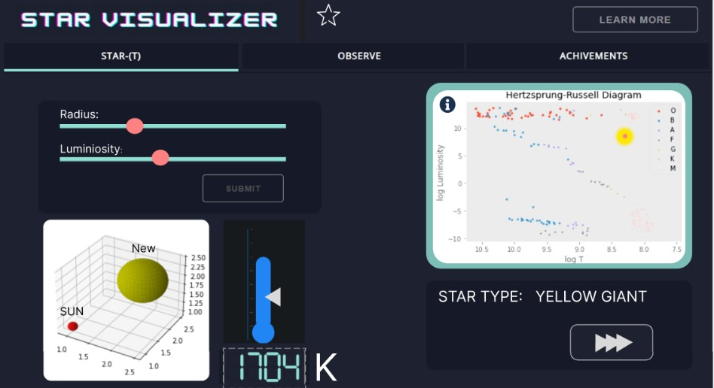
Game mechanics
Star selection: luminosity of the star and dimensions with respect to the Sun

Slide 4
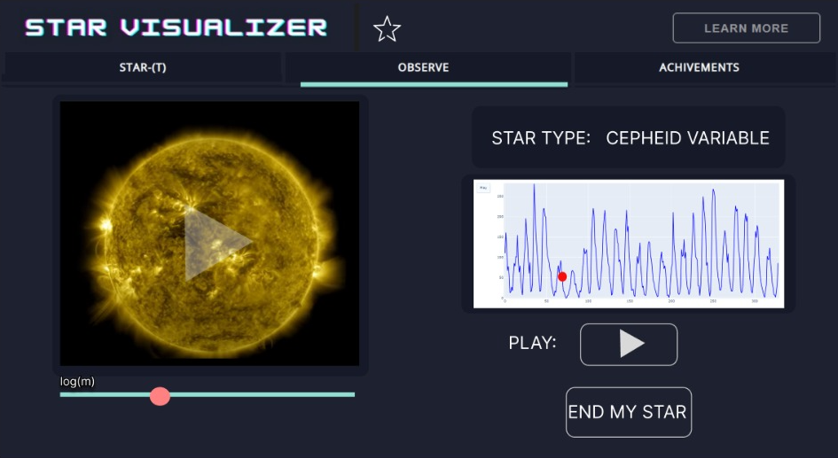
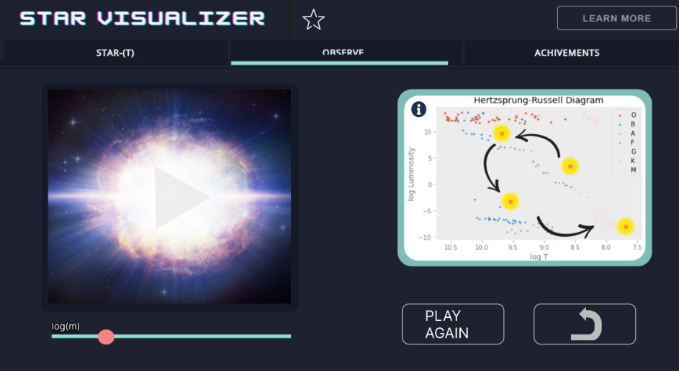
Game mechanics
According to the previous parameters, it’s possible to see in a user-friendly graphic the evolution of luminosity of the star.
It’s also possible to see the long-term evolution of the star up to the end of its life cycle.

Slide 5
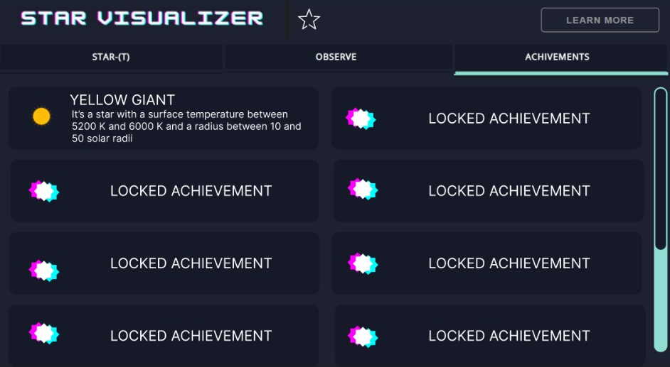
Game achievements
For each discovered star, the player will unlock a different achievement, with the name of the star and a short description of it.
This allows the player to reuse more and more time this visualizer to collect all the achievements and understand luminosity variation of the star.

Slide 6




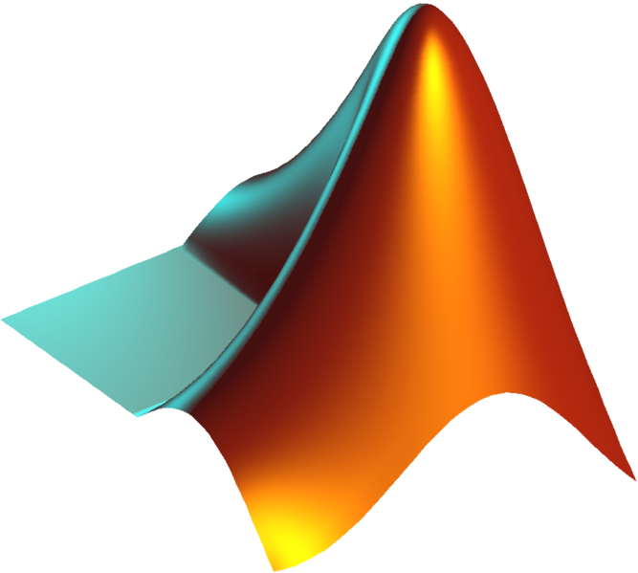

Data integration and usage
Data from space agency
Data coming from different sources have been used to gain information about variability and evolution of stars.
Data from scientific literature
Numerical analysis

Slide 7
The future of the project
The project has an infinite possibility of future development: up to now, the team developed distinct widgets, so the first thing to do will be to develop a complete autonomous webapp, connecting all the widgets.
Scientific improvements
At the moment, only a limited number of cases were analyzed and implemented: in the future, a more complete and detailed set of stars will be available in the app. In particular, based on the TESS data analysis and BRITE constellation data.

