Slide 1

FORMAL METHODS FOR SECURE SYSTEMS
Barbieri Giovanni
Cavedoni Federico

Slide 2





INTRODUCTION
ANTI-MALWARE ANALYSIS STATIC ANALYSIS DYNAMIC ANALYSIS

Slide 3

FAKEBANK
A FakeBank malware is a type of malicious software designed to target devices, especially mobile devices like smartphones and tablets, with the purpose of stealing financial information, particularly login credentials for online banking services or payment apps. It is often masquerades as a legitimate banking app or service to deceive users and steal their financial data.
We had 4 different apks belonging to the fakebank family:
• 1ef6e1a7c936d1bdc0c7fd387e071c102549e8fa0038aec2d2f4bffb7e0609c3
• 4aeccf56981a32461ed3cad5e197a3eedb97a8dfb916affc67ce4b9e75b67d98
• 191108379dccd5dc1b21c5f71f4eb5d47603fc4950255f32b1228d4b066ea512
• b9cbe8b737a6f075d4d766d828c9a0206c6fe99c6b25b37b539678114f0abffb

Slide 4

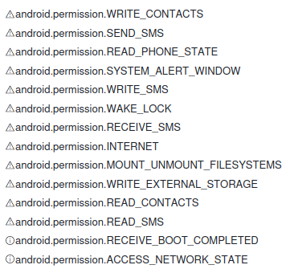
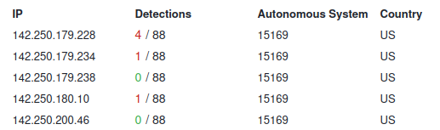
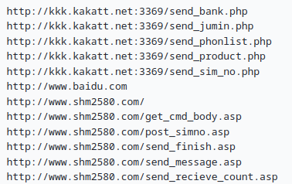
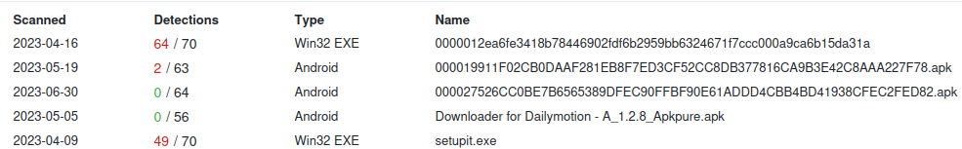
FAKEBANK-ANTI MALWARE ANALYSIS
We chose to focus our analysis on the file ending with the string "09c3", as we found several reports of threats compared to the other apks, in particular relating to the accessed IP addresses.
Permissions
URLs
We used the sample ‘a512’
IP Addresses

Slide 5
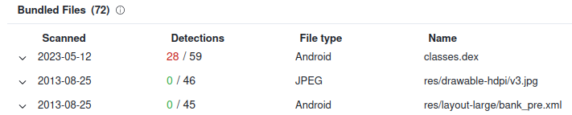
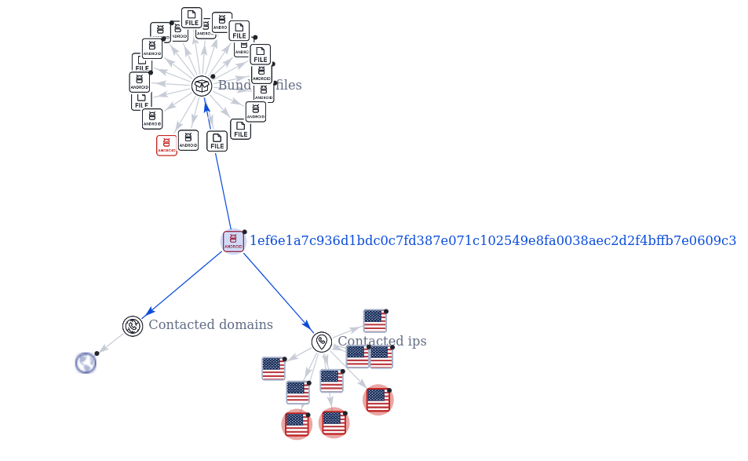
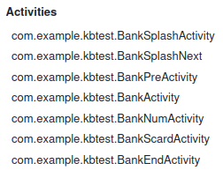
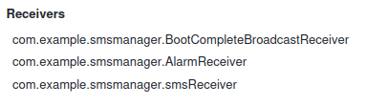

FAKEBANK-ANTI MALWARE ANALYSIS
Bundled Files
Relation Graph
Activities
Recievers
Services
For Receivers, Activites and Services we used ‘a512’ sample

Slide 6
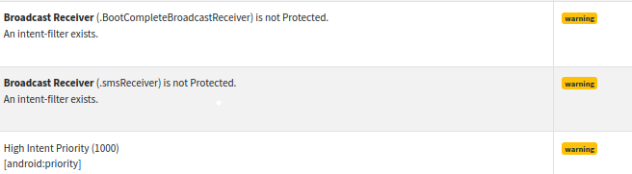
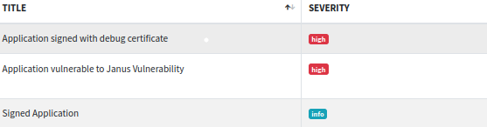
FAKEBANK-STATIC ANALYSIS
Manifest Analysis
Certificate Analysis
Java Code Analysis

Slide 7
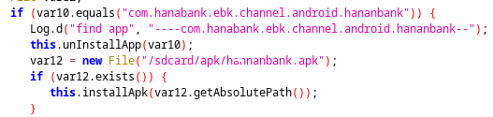
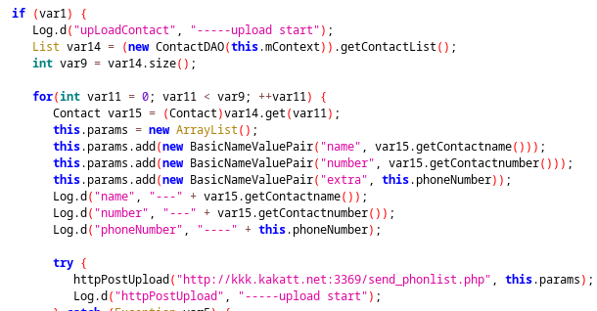
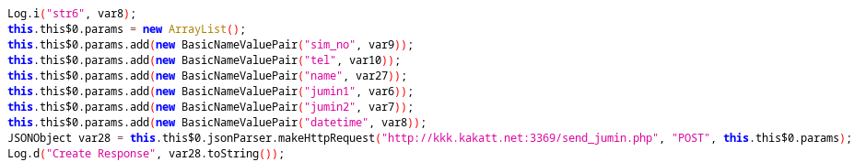
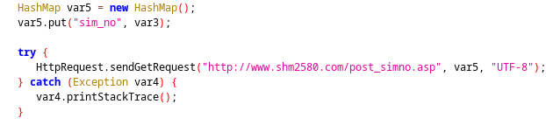
FAKEBANK-STATIC ANALYSIS
Activities
removeApplications
upLoadContact
doInBackground
Receivers
BootCompleteBroadcastReceiver

Slide 8
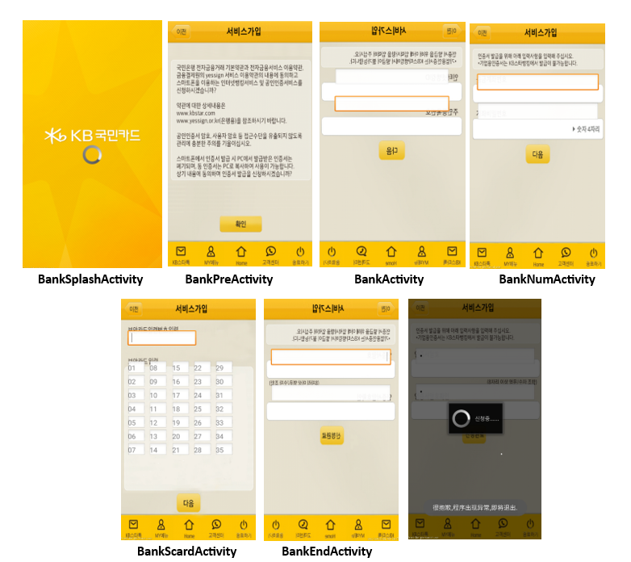
FAKEBANK-DINAMIC ANALYSIS

Slide 9

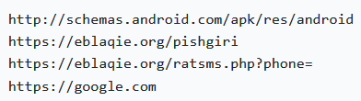
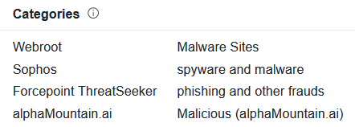

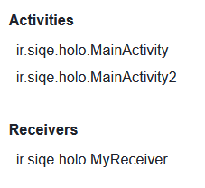

IRANIAN JUSTICE ANTI MALWARE ANALYSIS
Let's now move on to the analysis of the fifth apk not belonging to the FakeBank family.
The popular threat label is trojan.smsspy/piom, same label family as the samples analyzed previously.
URLs
Contacted domains
Activities and Receivers
Permission

Slide 10

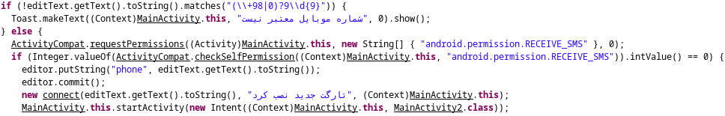
IRANIAN JUSTICE-STATIC ANALYSIS
Manifest/certificate analysis
The certificate analysis produced the same results as the samples.
The Manifest analysis, in addition to the previous results, produced a further warning.
Java code analysis
MainActivity.java

Slide 11
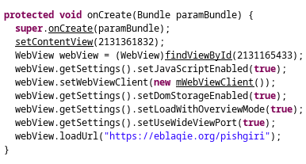
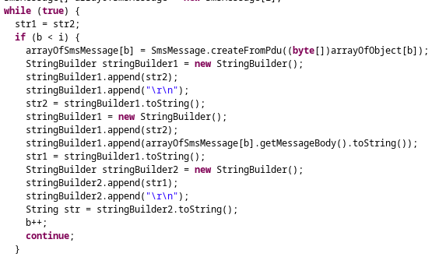
IRANIAN JUSTICE-STATIC ANALYSIS
MainActivity2.java
The MainActivity2.java file upon creation loads a specific url ("https://eblaqie.org/pishgiri") which we have seen to be a malicious site.
MyReceiver.java
The MyReciever.java file has an OnReceive function which, whenever the phone receives a message, saves the received message in an array and then sends the saved message to an external link ("https://eblaqie.org/ratsms.php ?phone=") via the connect function, as in the case of MainActivity.java.

Slide 12
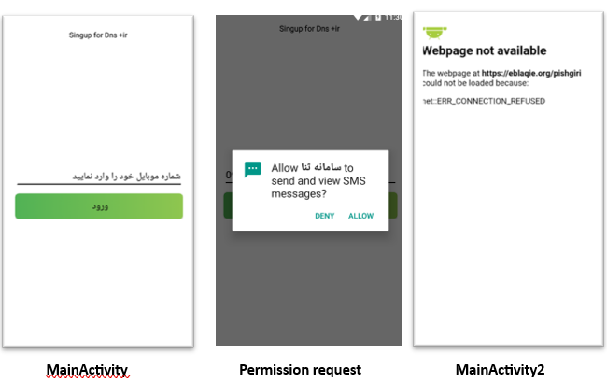
IRANIAN JUSTICE-DINAMIC ANALYSIS

Slide 13

IRANIAN JUSTICE PHISHING
Furthermore, by performing this type of analysis, we deduced that this application was posing as the Iranian justice body.
In fact we have in the logo that at the top we find the emblem of Iran, in the center the symbol of justice and at the bottom the phrase وهﻗﮫﯾﺋﺎﺿﻗوریﮭﻣﺟ یﻣﻼﺳارانﯾا which means Judiciary of the Islamic Republic of Iran.
This hypothesis is also confirmed by the fact that the application requires a number from Iran.

Slide 14

CONCLUSIONS
In conclusion we can say that both samples, although under different covers, had the same purpose. In fact, they are two applications that, using the phishing technique, steal sensitive data from users and spy on their communications.
This despite the two were completely different from the outside, as the first sample claims to be a bank (FakeBank) while the second apk claims to be the Iranian justice institution.
We have seen that also the other samples carried out actions consistent with those analyzed in more detail, even if they too with different coverages but still exploiting the phishing technique.

Slide 15
Thank YOU for THE attention
Barbieri Giovanni
Cavedoni Federico

