Slide 1


Name: Giovanni Barros
Date: 04 September 2026
https://github.com/giovannibianchinidebarros/IBM-Applied-Data-Science-Capstone

Slide 2

Outline
Executive Summary
Introduction
Methodology
Results
Conclusion
Appendix

Slide 3
Executive Summary
Methodologies
Collected data via API and web scraping
Cleaned data and engineered features
Performed exploratory data analysis (EDA) using visualization and SQL
Built interactive visual analytics using Folium
Results
Identified key factors influencing successful landings
Developed classification models to predict landing success

Slide 4
Introduction
Project background and context
SpaceX advertises Falcon 9 rocket launches on its website at a cost of $62 million, while other providers charge upwards of $165 million each.
SpaceX’s Falcon 9 launches like regular rockets, but much of the savings comes from the fact that SpaceX can reuse the first stage.
Therefore, if we can determine whether the first stage will land, we can estimate the cost of a launch.
Problems you want to find answers
What factors influence the successful landing of a Falcon 9 first stage?
Can we develop a machine learning model to accurately predict the landing outcome?

Slide 5

Section 1

Slide 6
Methodology
Executive Summary
Data collection methodology:
Data collected from the SpaceX API
Performed web scraping to collect Falcon 9 historical launch records from Wikipedia
Perform data wrangling
Converted raw data into a cleaner and more structured format that is ready for analysis
Perform exploratory data analysis (EDA) using visualization and SQL
Perform interactive visual analytics using Folium and Plotly Dash
Perform predictive analysis using classification models
Build, tune and evaluate classification models

Slide 7
Data Collection
From the SpaceX API
Web scraping historical launch records from Wikipedia

Slide 8
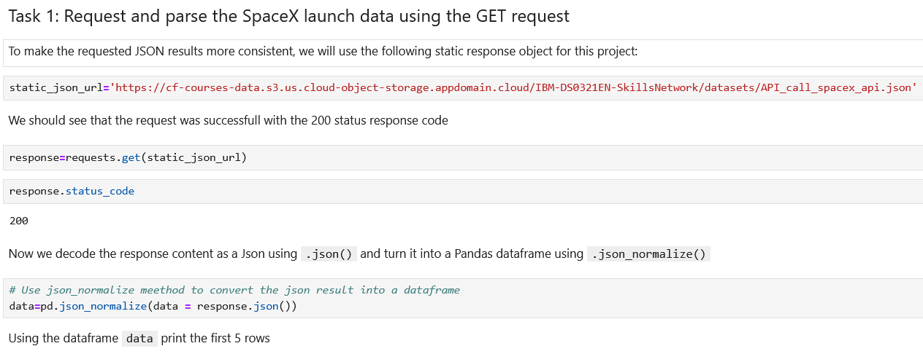
Data Collection - SpaceX API
Data collection methodology:
We start requesting rocket launch data from SpaceX API, using the requests.get method.
Then we decode the response content as a Json using .json() and turn it into a Pandas dataframe using .json_normalize()
GitHub URL:
https://github.com/giovannibianchinidebarros/IBM-Applied-Data-Science-Capstone/blob/main/Module-1-Introduction/01-Data-Collection-with-API.ipynb

Slide 9
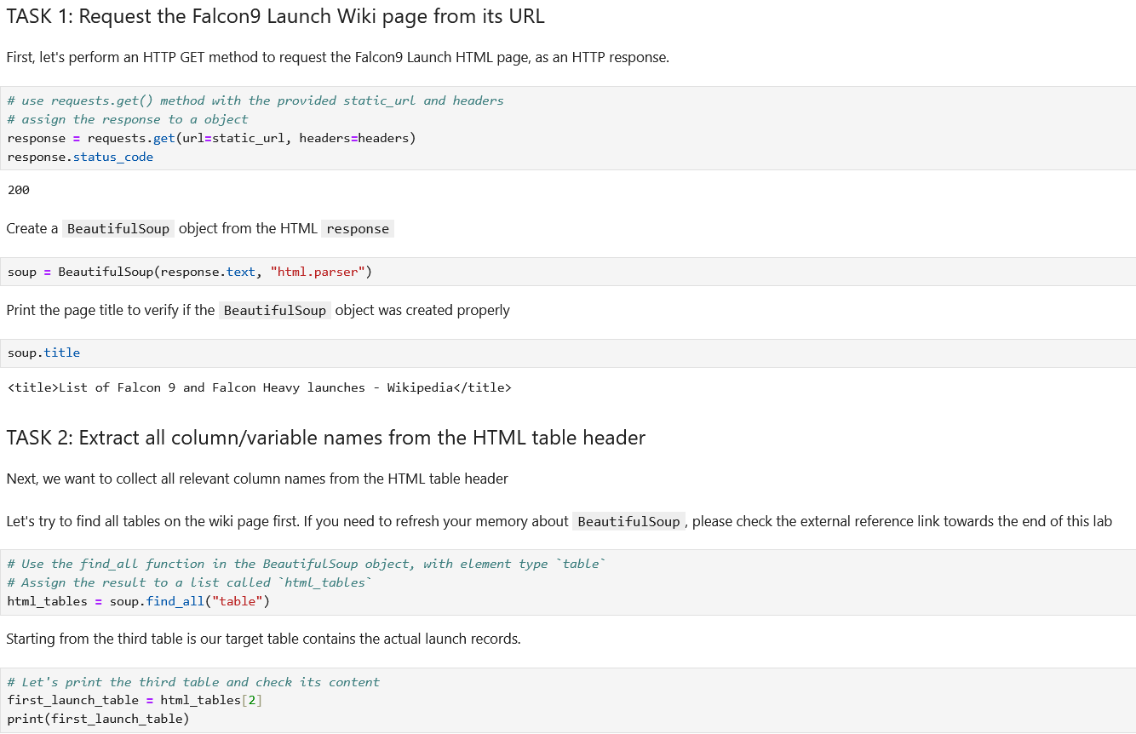
Data Collection - Scraping
Data collection methodology:
Perform an HTTP GET method to request the Falcon9 Launch HTML page.
Create a BeautifulSoup object from the HTML response.
Extract all column/variable names from the HTML table header
Extract all column/variable names from the HTML table header
Create a data frame by parsing the launch HTML tables
GitHub URL:
https://github.com/giovannibianchinidebarros/IBM-Applied-Data-Science-Capstone/blob/main/Module-1-Introduction/02-Data-Collection-with-Webscraping.ipynb

Slide 10
Data Wrangling
How data were processed:
Cleanup missing values
Calculate the number of launches on each site
Calculate the number and occurrence of each orbit
Calculate the number and occurence of mission outcome of the orbits
Create a landing outcome label from Outcome column
GitHub URL:
https://github.com/giovannibianchinidebarros/IBM-Applied-Data-Science-Capstone/blob/main/Module-1-Introduction/03-Data-Wrangling.ipynb

Slide 11
EDA with Data Visualization
Charts plotted and why:
Scatter plot to visualize the relationship between Flight Number and Launch Site
Scatter plot to visualize the relationship between Payload Mass and Launch Site
Bar chart to visualize the success rate for each orbit type
Scatter plot to visualize the relationship between FlightNumber and Orbit type
Line chart to Visualize the launch success yearly trend
GitHub URL:
https://github.com/giovannibianchinidebarros/IBM-Applied-Data-Science-Capstone/blob/main/Module-2-Exploratory-Data-Analysis-(EDA)/05-EDA-with-Visualization.ipynb

Slide 12
EDA with SQL
SQL queries performed:
Display the names of the unique launch sites in the space mission
Display 5 records where launch sites begin with the string 'CCA’
Display the total payload mass carried by boosters launched by NASA (CRS)
Display average payload mass carried by booster version F9 v1.1
List the date when the first succesful landing outcome in ground pad was acheived.
List the names of the boosters which have success in drone ship and have payload mass greater than 4000 but less than 6000
List the total number of successful and failure mission outcomes
List all the booster_versions that have carried the maximum payload mass, using a subquery with a suitable aggregate function.
List the records which will display the month names, failure landing_outcomes in drone ship ,booster versions, launch_site for the months in year 2015.
GitHub URL:
https://github.com/giovannibianchinidebarros/IBM-Applied-Data-Science-Capstone/blob/main/Module-2-Exploratory-Data-Analysis-(EDA)/04-EDA-with-SQL.ipynb

Slide 13
Build an Interactive Map with Folium
Map created and added to the folium map:
Used folium.Circle to mark all launch sites on a map
Used marker_cluster and folium.Marker to mark the success/failed launches for each site on the map
Used folium.PolyLine to draw a line from the launch site to the closest coastline, railway, highway
GitHub URL:
https://github.com/giovannibianchinidebarros/IBM-Applied-Data-Science-Capstone/blob/main/Module-3-Interactive-Visual-Analytics-and-Dashboards/06-Launch-Site-Location-Visual-Analytics-with-Folium.ipynb

Slide 14
Build a Dashboard with Plotly Dash
Plots/graphs and interactions you have added to a dashboard:
Pie Charts to show the total launches by site.
Scatter plots to show the relationship between payload mass and launch success
GitHub URL:
https://github.com/giovannibianchinidebarros/IBM-Applied-Data-Science-Capstone/blob/main/Module-3-Interactive-Visual-Analytics-and-Dashboards/spacex-dash-app.py

Slide 15
Predictive Analysis (Classification)
Explored different classification models:
Logistic Regression
Decision Tree
K Nearest Meighbors
Support Vector Classifier
Model Tuning:
Used GridSearchCV to find the best hyperparameters for the machine learning models
Model Evaluation:
Cross-Validation Techniques
Calculated the accuracy of the models and identified which one performs the best
GitHub URL:
https://github.com/giovannibianchinidebarros/IBM-Applied-Data-Science-Capstone/blob/main/Module-4-Predictive-Analysis/07-Machine-Learning-Prediction.ipynb

Slide 16
Results
Exploratory data analysis results
Interactive analytics demo in screenshots
Predictive analysis results

Slide 17

Section 2

Slide 18
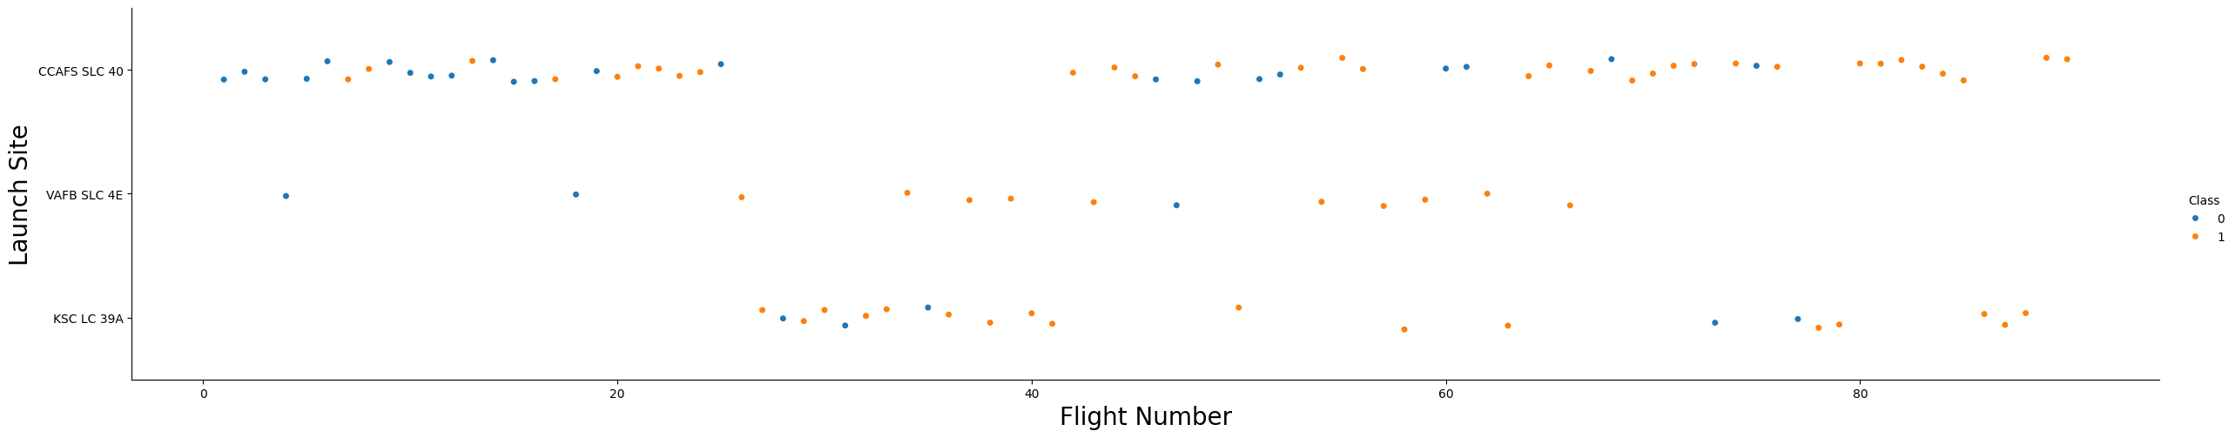
Flight Number vs. Launch Site
All sites feature a combination of successful and failed landings.

Slide 19
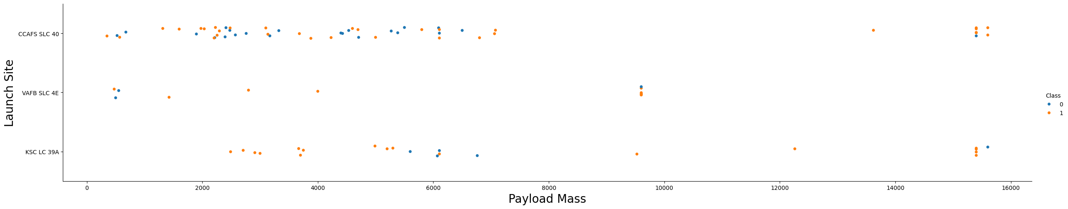
Payload vs. Launch Site
For the VAFB-SLC launchsite there are no rockets launched for heavypayload mass(greater than 10000)

Slide 20
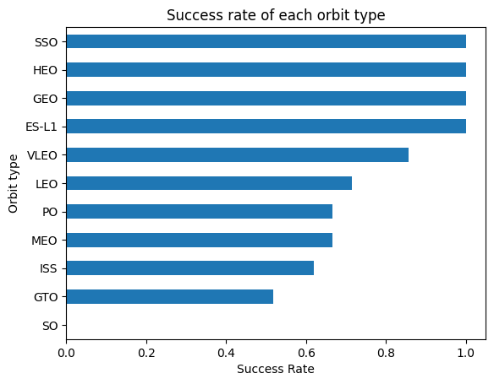
Success Rate vs. Orbit Type

Slide 21
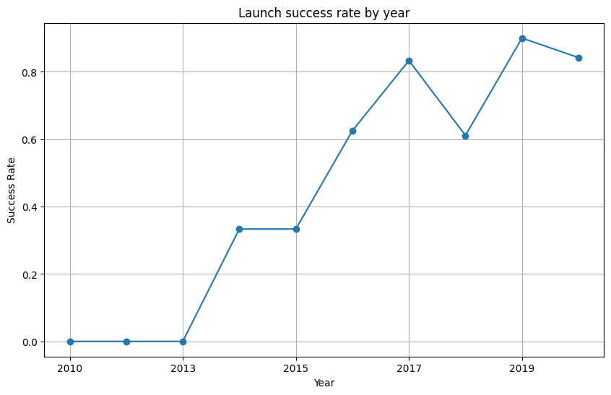
Launch Success Yearly Trend
We can observe that the success rate since 2013 kept increasing till 2020

Slide 22
All Launch Site Names
CCAFS LC-40
VAFB SLC-4E
KSC LC-39A
CCAFS SLC-40

Slide 23
Conclusions
Success rate since 2013 kept increasing till 2020
SSO, LEO, GEO and ES-L1 Orbits had the best success rates.
Decision Tree classification had the best model score

Slide 24


