Slide 1
CrowdTrust
Giovanni Charles, Adam Fiksen, Ryan Jackson, Sahil Jain, John Walker
Supervisor: Emil Lupu

Slide 2
I have a collection of 100 photos of birds, and know which ones are robins. I don’t know anything about birds?
“How can I get an accurate result set?”

Slide 3
Crowdsourcing
What is it?
Why is it needed?
Who uses it?

Slide 4


What’s out there
Main competitors:
  Amazon’s Mechanical Turk
  Microworkers
  StackOverflow/Wikipedia

Slide 5
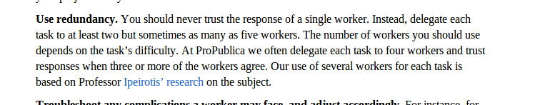

Slide 6
Proposed Solution
General purpose online crowdsourcing platform
Analyses the crowd
Gives accurate results

Slide 7
Demo
To come...

Slide 8
Under the bonnet

Slide 9
What’s the right answer?
Based on how good you are?

Slide 10
How good are you?

Slide 11
The EM Algorithm

Slide 12
Adaptations

Slide 13
Software Engineering Practices
Pair Programming
Testing each other’s code
Informative workspace
Stand up meetings
Database Token

Slide 14



Collaboration Tools

Slide 15

Enhancements
Hybrid computing
Dynamic pricing model
Mobile app

Slide 16
Conclusions
Successfully developed a generic framework
Generalised EM algorithm to obtain optimum number of people to ask.
Produced an easy to use website which allowed people to complete tasks

Slide 17
Thank you for listening!
Questions?

