Slide 1

E-288 Experiment:
The b quark Discovery
Celotto Giovanni 2052372
17/06/2022

Slide 2

Overview of the presentation
Historical background
In the 70s which particles were known to exist?
Which particles were predicted to exist?
E-288 experiment: dielectron phase and dimuon phase I
The false resonance
E-288 experiment: dimuon phase II
Experimental apparatus: absorbers and detectors
Data Analysis
Further Studies
Conclusion and perspectives

Slide 3
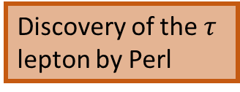
Introduction: The History
1973
1974
1975
30 June
1977
October
1977
SLAC and BNL: observation of the famous resonance J/ψ meson
Discovery of the b quark: E-288 experiment by Leon Lederman at Fermilab
u, d, s observed.
Third generation quarks are needed to explain CP violation in kaon decay
Discovery of the $τ$ lepton by Perl
Confirmation of the discovery by DESY and at the CESR (USA)
Notes:
In 1973, Makoto Kobayashi and Toshihide Maskawa predicted the existence of a third generation of quarks to explain observed CP violations in kaon decay
The proposal of Kobayashi and Maskawa heavily relied on the GIM mechanism put forward by Sheldon Glashow, John Iliopoulos and Luciano Maiani( predicted the existence unobserved charm, the strange was already observed in 1968.
The goal of the E70/E288 CF (subsequently joined by S, for Stony Bro ok) collab oration at Fermilab was to do a complete survey of all leptons pro duced using the highest-intensity extracted proton b eam from the new Fermilab Main Ring 300 GeV (eventually upgraded to 400 GeV) accelerator
the GIM mechanism (or Glashow–Iliopoulos–Maiani mechanism) is the mechanism through which flavour-changing neutral currents (FCNCs) are suppressed in loop diagrams. It also explains why weak interactions that change strangeness by 2 (ΔS = 2 transitions) are suppressed, while those that change strangeness by 1 (ΔS = 1 transitions) are allowed, but only in charged current interactions.
In November 1974 teams at Brookhaven National Laboratory (BNL) and the Stanford Linear Accelerator Center (SLAC) simultaneously announced the discovery of the J/ψ meson.
GIM became part of the Standard Model.
With the acceptance of the GIM mechanism, Kobayashi and Maskawa's prediction on the existence of a third generation quark also gained in credibility.
Their case was further strengthened by the discovery of the tau by Martin Lewis Perl's team at SLAC between 1974 and 1978.[13] The tau announced a third generation of leptons, breaking the new symmetry between leptons and quarks introduced by the GIM mechanism. Restoration of the symmetry implied the existence of a fifth and sixth quark.
In 1975 the names Top and Bottom were given in analogy to Up and Down.

Slide 4
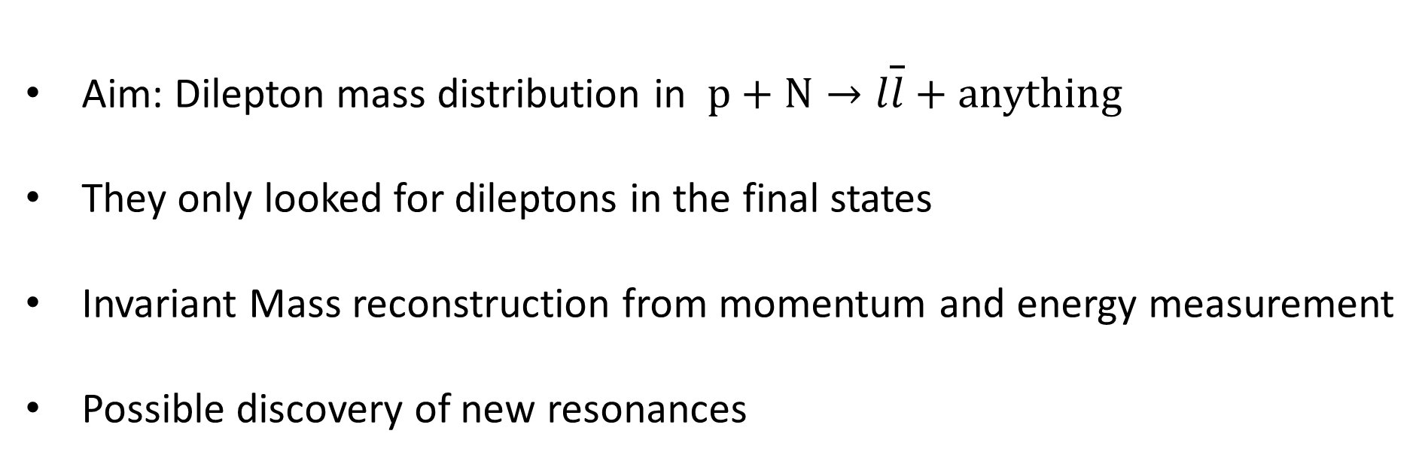
Aim of the experiment
Aim: Dilepton mass distribution in $p+N→l\overline{l}+anything$
They only looked for dileptons in the final states
Invariant Mass reconstruction from momentum and energy measurement
Possible discovery of new resonances

Slide 5
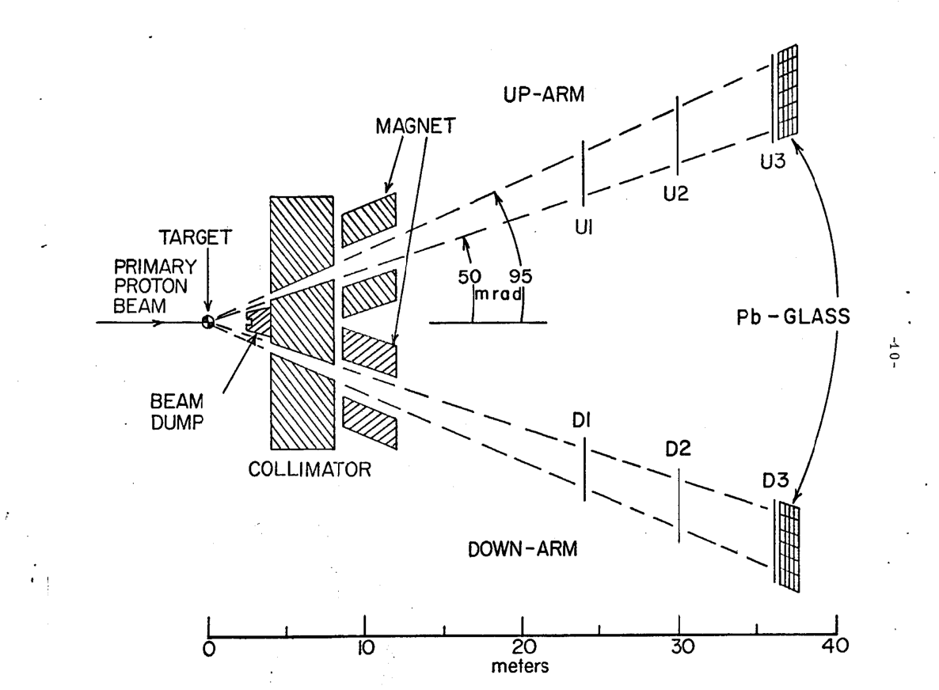
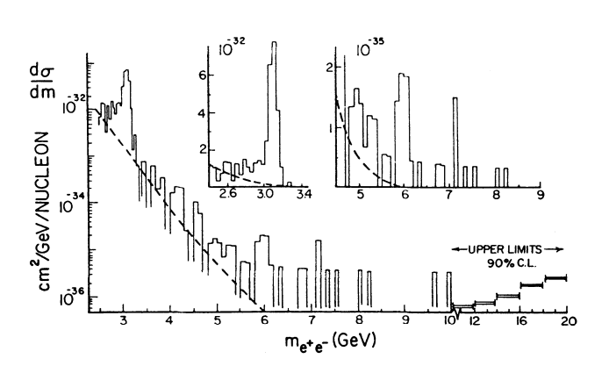
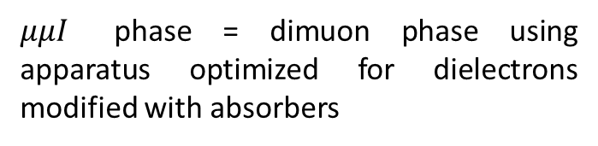

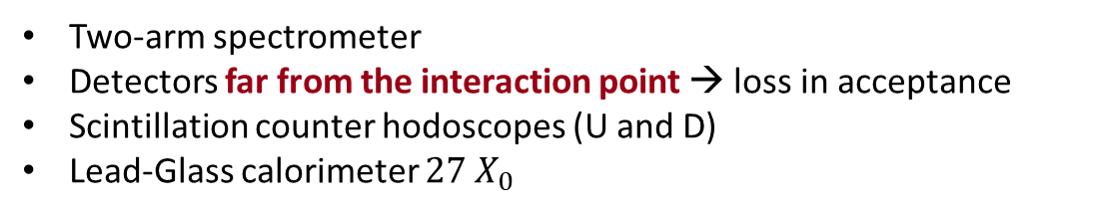

First run: dielectron phase and $μμI$ phase
Spectrometer for dielectron phase
$e^{−}e^{+}$ mass distribution spectrum
Two-arm spectrometer
Detectors far from the interaction point → loss in acceptance
Scintillation counter hodoscopes (U and D)
Lead-Glass calorimeter $27 X_{0}$
$μμI$ phase = dimuon phase using apparatus optimized for dielectrons modified with absorbers

Slide 6
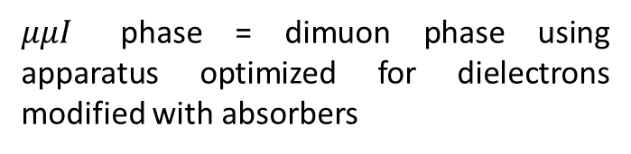
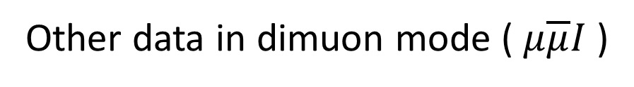
First run: dielectron phase and $μμI$ phase
ϒ if the resonance was TRUE
Oops-Leon if FALSE
$μμI$ phase = dimuon phase using apparatus optimized for dielectrons modified with absorbers
Other data in dimuon mode ($μ\overline{μ}I$)
Oops-Leon
Notes:
We took dielectron data until 1976
The ?rst lo ok revealed a clustering of events near 6 GeV; the probability of such a clustering anywhere in the plot was estimated conservatively at one chance in 50. We thus gave talks suggesting that this might b e evidence for a new resonance. Je? Weiss did an \availability search" of the Greek alphab et and found that the Greek letter Upsilon was not yet used (Iota was rejected since it resembles a question-mark | in hindsight, it would have been a better choice!). Walter Innes added that the name allowed us to make a Leon-typ e joke | Upsilon if the resonance is real, and the similar-sounding \Oops-Leon“ if the resonance is false
In the spring of 1976, we took some data in the dimuon mode, using the detector setup optimized for dielectrons. This provided only a factor of 5 increase in sensitivity | but that was sufficient to show that the 6 GeV \resonance“ was an \Oops-Leon" and not an \Upsilon.
Subsequent data collected by the same experiment in 1977 revealed that the resonance had been such a coincidence after all.[2] However, a new resonance at 9.5 GeV was discovered using the same basic logic and greater statistical certainty,[3] and the name was reused (see Upsilon particle).

Slide 7

$μμII$ phase
Revert to electrons and other bumps are seen at 9.51 and 9.67 GeV
The significance of this clustering was much stronger than the Oops-Leon
Optimization for dimuon in the final states
How can the apparatus be optimized to look for dimuons?
Notes:
The significance of this clustering was thus much stronger than the \Oops-Leon.“
It is well known that by searching for muons in the final state in hadronic interactions, one could reach much higher sensitivity than by searching for electrons.
This involved putting ABSORBERS just downstream of the interaction point to absorb all the hadronic debris from the interactions, reducing the rates of particles in the detectors by orders of magnitude.
Furthermore, there would be no neutral envelope to worry about, making possible the placement of detectors much closer to the bending magnet and giving a factor of 3-5 increase in acceptance. Thus, the sensitivity for dimuons could be about two orders of magnitude higher than for dielectrons.
Meaning: since no neutrals are present (p0 k0 already decayed after the absorber there is no need to put detectors far away, we can put them very close gaining in statistiscs (acceptance))
Unfortunately, the absorbers traversed by the muons would result in multiple scattering, worsening the eventual di-lepton mass resolution
The trick is to put the densest absorber near the interaction point, and only low-Z absorber afterwards. This leads to a smearing of the production-angle measurement, but not to a large error in momentum determination.
The resultant mass resolution would be about 2% near 10 GeV mass, in contrast to the 30% or so mass resolution for Leon's BNL dimuon spectrum.

Slide 8
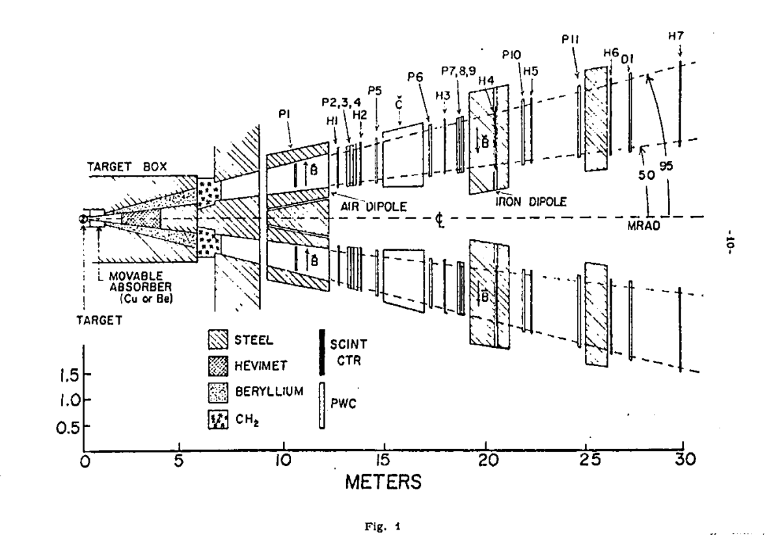
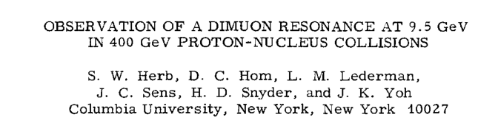

E-288: the apparatus
$$p+N→μ\overline{μ}$$

Slide 9


E-288: the apparatus
Beryllium 18 $X_{0}$ thick
$$p+N→μ\overline{μ}$$
Hadron Filter
Closer detectors
Huge gain in acceptance
Notes:
Steel as collimators and to provide magnetic fields they used solid-steel magnet in each arm
Beryllium (18 interaction lengths) is used as a hadron filter, covering the 50-95 mr (70-llO" CM) horizontal and ?lO mr vertical aperture in each arm.
Why Be? Low Z→ No degradation in momentum measurement due to multiple scattering.
Movable absorber of Be or Cu
Hevimet (compound of tunsten) at 0 degree used to minimize particle leakage from outside the aperture

Slide 10
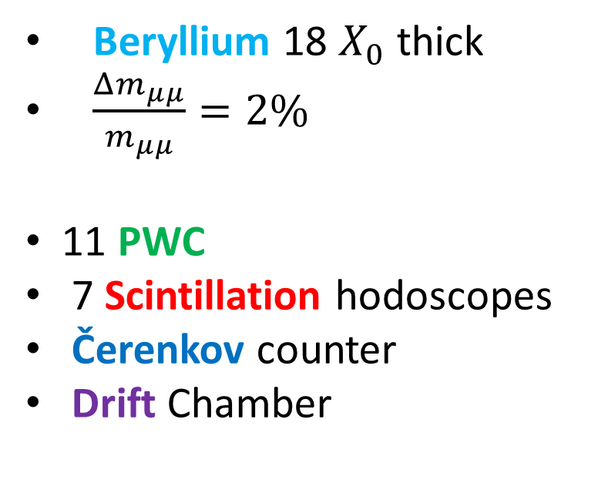
E-288: the apparatus
Beryllium 18 $X_{0}$ thick
$\frac{Δm_{μμ}}{m_{μμ}}=2\%$
11 PWC
7 Scintillation hodoscopes
Čerenkov counter
Drift Chamber
$$p+N→μ\overline{μ}$$
Notes:
Conventional PWC's and scintillation hodoscopes serve to define
the muon trajectory downstream of the air dipole.
FollowLng the PWC's is a solid iron magnet (1.8 m long, energized to 20 kG) used to partially refocus the muons vertically and to redetermine the muon momentum to ?15%
A threshold zeeenko" counter on each arm also helps prevent possible low momentum muon triggers. gas Cherenkov counters to differentiate among pi's, K's and p‘s

Slide 11
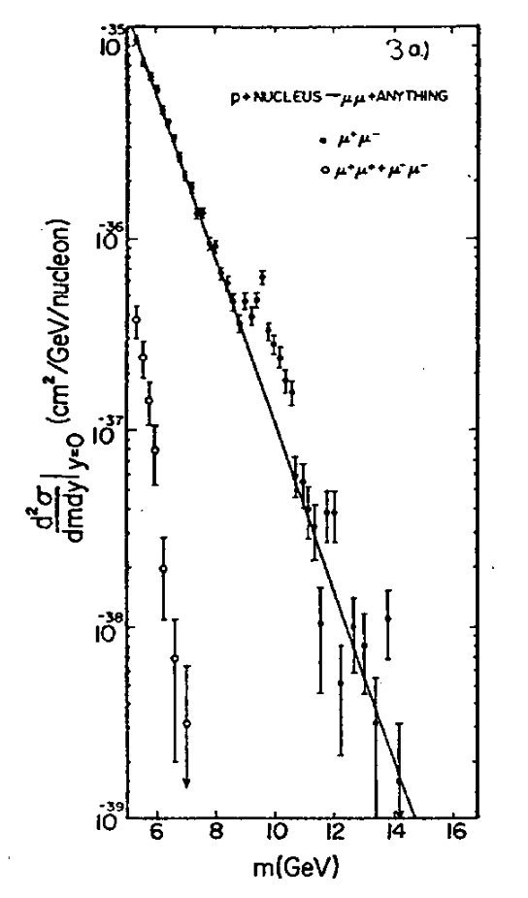
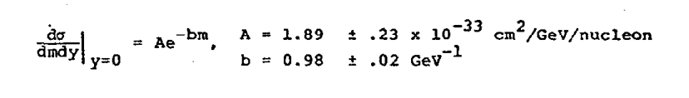
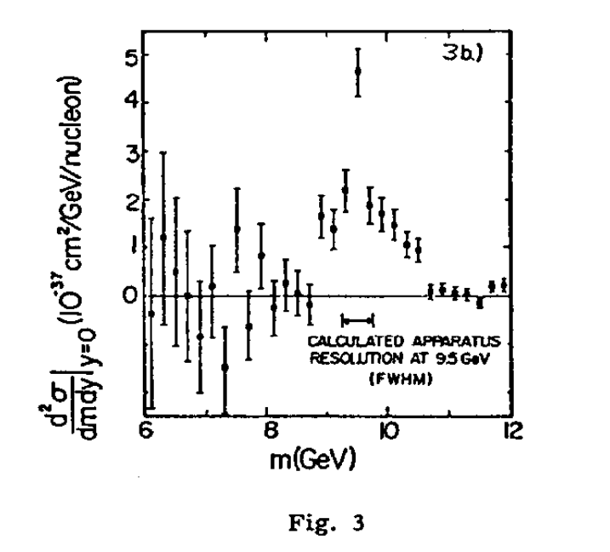
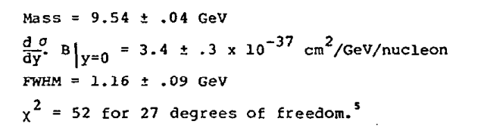

The b quark discovery
$χ^{2}=$ 21/19
Notes:
At every extraction, namely at every accelerator cycle,
10^11 protons hit the target.
1.6· 10^16 protons on target, considering the total exposure
A sample of 9000 mu+mu- events with m mm >5GeV was obtained.
The mu+mu- mass distribution is shown before and after subtracting a continuum (non-resonating) background.
Informati i dati sono sommati di Cu e Pt?

Slide 12
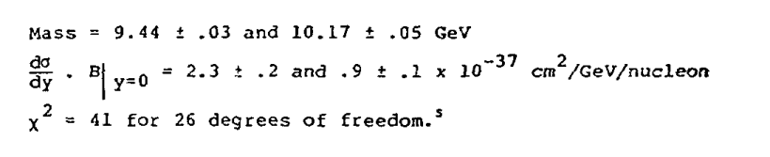
The b quark discovery
$χ^{2}=$ 21/19
Notes:
At every extraction, namely at every accelerator cycle,
10^11 protons hit the target.
1.6· 10^16 protons on target, considering the total exposure
A sample of 9000 mu+mu- events with m mm >5GeV was obtained.
The mu+mu- mass distribution is shown before and after subtracting a continuum (non-resonating) background.
Informati i dati sono sommati di Cu e Pt?

Slide 13
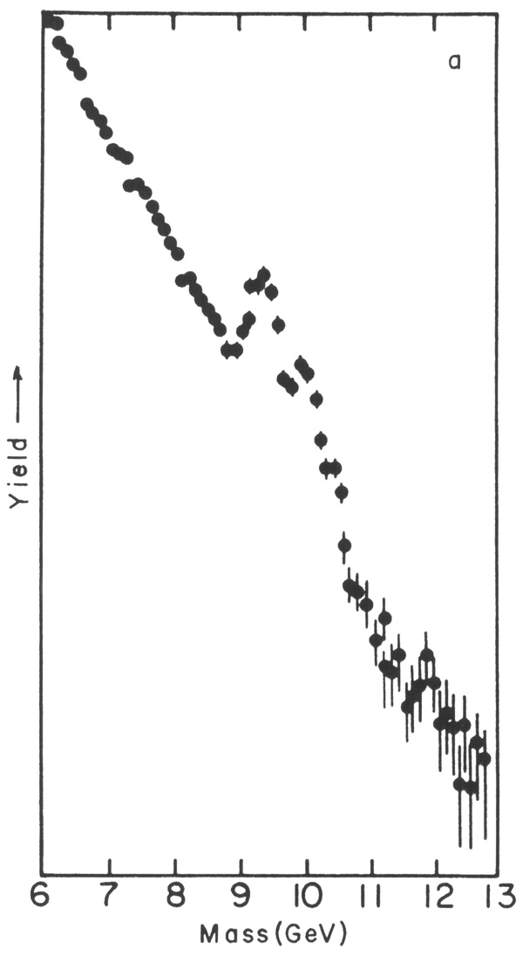
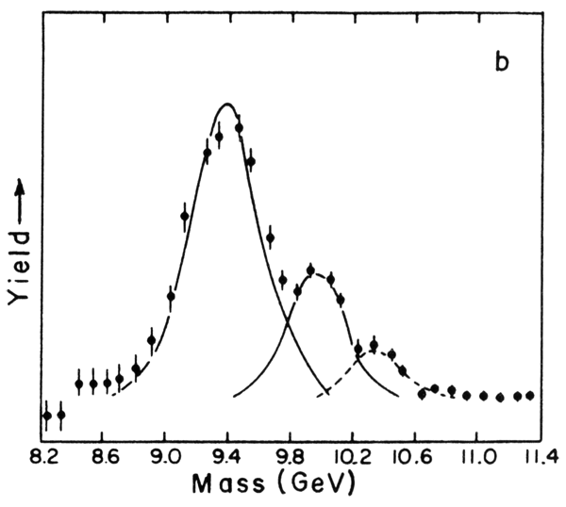



Physical or Experimental Width?
By the end of August 26.000 events above 5GeV and approximately 1200 events above continuum.
A multiple-resonance interpretation was becoming statistically inescapable.
Are we sensitive to the physical or just to the experimental width of the state?
$$Υ(1S)$$
$$Υ(2S)$$
$$Υ(3S)$$
Notes:
It is interesting to compare the widths with ones of the charmonium
Lifetimes of bottomonium are smaller even if the initial mass is very large
However we must consider that c can decay into s and this decay is not suppressed by the CKM matrix
Whereas the decay b->t cannot occur so a suppression due to the change of generation must be considered (change of one or two families)
It’s even more interesting to consider the fourth excited state because it has a mass of large enough that the decay to Bo antiB0 is possible and this is not suppressed, therefore its width is much larger
Another observation: e+e- experiments when someone knows where to look, we can tune our detector and perform a scan in energy

Slide 14
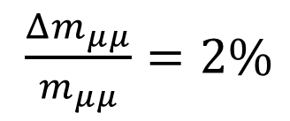
Physical or Experimental Width?
$$Υ(1S)$$
$\frac{Δm_{μμ}}{m_{μμ}}=2\%$
$$FWHM=2.355⋅2\% ⋅9.5 GeV=0.5 GeV$$
FWHM = 0.5 GeV
$$Υ(2S)$$
$$Υ(3S)$$

Slide 15
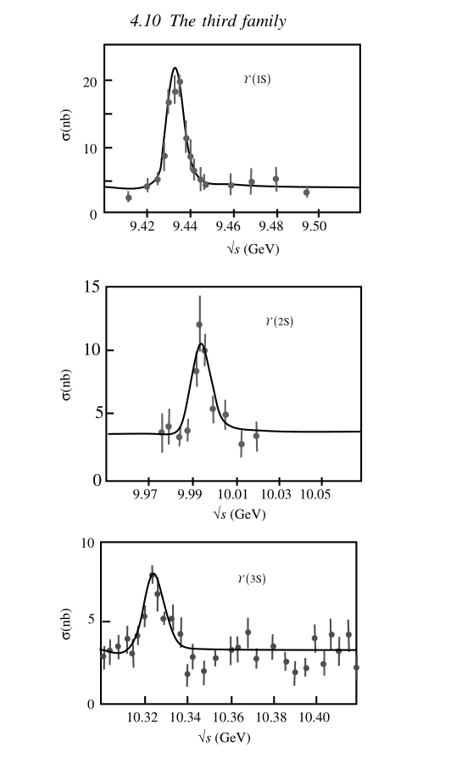
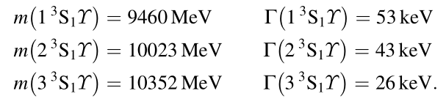
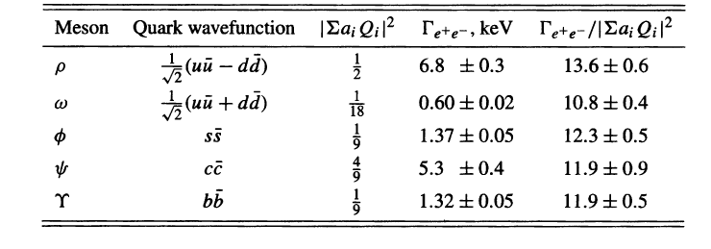
Precision Study: first excited states
Which are the quarks inside these states?
Notes:
It is interesting to compare the widths with ones of the charmonium
Lifetimes of bottomonium are smaller even if the initial mass is very large
However we must consider that c can decay into s and this decay is not suppressed by the CKM matrix
Whereas the decay b->t cannot occur so a suppression due to the change of generation must be considered (change of one or two families)
It’s even more interesting to consider the fourth excited state because it has a mass of large enough that the decay to Bo antiB0 is possible and this is not suppressed, therefore its width is much larger
Another observation: e+e- experiments when someone knows where to look, we can tune our detector and perform a scan in energy

Slide 16
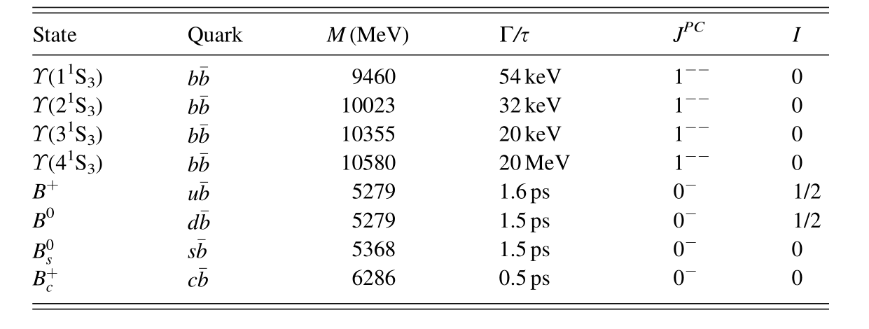
Precision Study: first excited states
Notes:
It is interesting to compare the widths with ones of the charmonium
Lifetimes of bottomonium are smaller even if the initial mass is very large
However we must consider that c can decay into s and this decay is not suppressed by the CKM matrix
Whereas the decay b->t cannot occur so a suppression due to the change of generation must be considered (change of one or two families)
It’s even more interesting to consider the fourth excited state because it has a mass of large enough that the decay to Bo antiB0 is possible and this is not suppressed, therefore its width is much larger
Another observation: e+e- experiments when someone knows where to look, we can tune our detector and perform a scan in energy

Slide 17
Conclusions and perspectives
Description of the E-288 experiment and the discovery of the b quark
The theoretical prediction of its existence relied on the GIM mechanism, symmetry arguments and CP violations
In 1982 L. Lederman and M. L. Perl were awarded the Wolf Prize in Physics
« for their experimental discovery of unexpected new particles establishing a third generation of quarks and leptons. »
The search for the top quark started (CDF and DØ )

Slide 18
References
Hom et al, Observation of High-Mass Dilepton Pairs in Hadron Collisions at 400 GeV. Phys. Rev. Lett., 36(21), 1976
Herb et al, Observation of a Dimuon Resonance at 9.5 GeV in 400-GeV Proton-Nucleus Collisions. Phys. Rev. Lett., 39(5), 1977
Yoh, The Discovery of the B quark at Fermilab in 1977: The Experiment coordinator’s story. AIP Conf. Proc., 424(1), 1998
D. M. Kaplan, The Discovery of the Upsilon Family, 1994.
A. Bettini, Introduction to Elementary Particle Physics, “The third family”, 2008
Donald H. Perkins, Introduction to High Energy Physics, “Charm and beauty: the heavy quarkonium states”,2021
F. Halzen and A.D. Martin, Quarks And Leptons: An Introductory Course in Modern Particle Physics

Slide 19
BACKUP-SLIDES
E-288 Experiment:
The b quark Discovery
Celotto Giovanni 2052372
17/06/2022

Slide 20
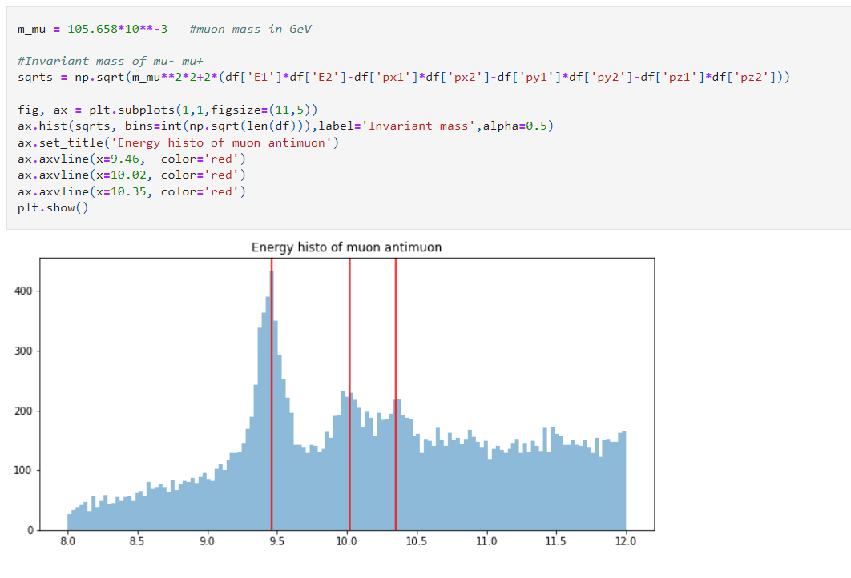
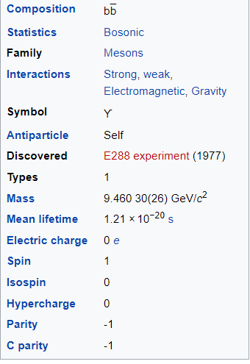
BackupSlides: OpenAcces Data

Slide 21
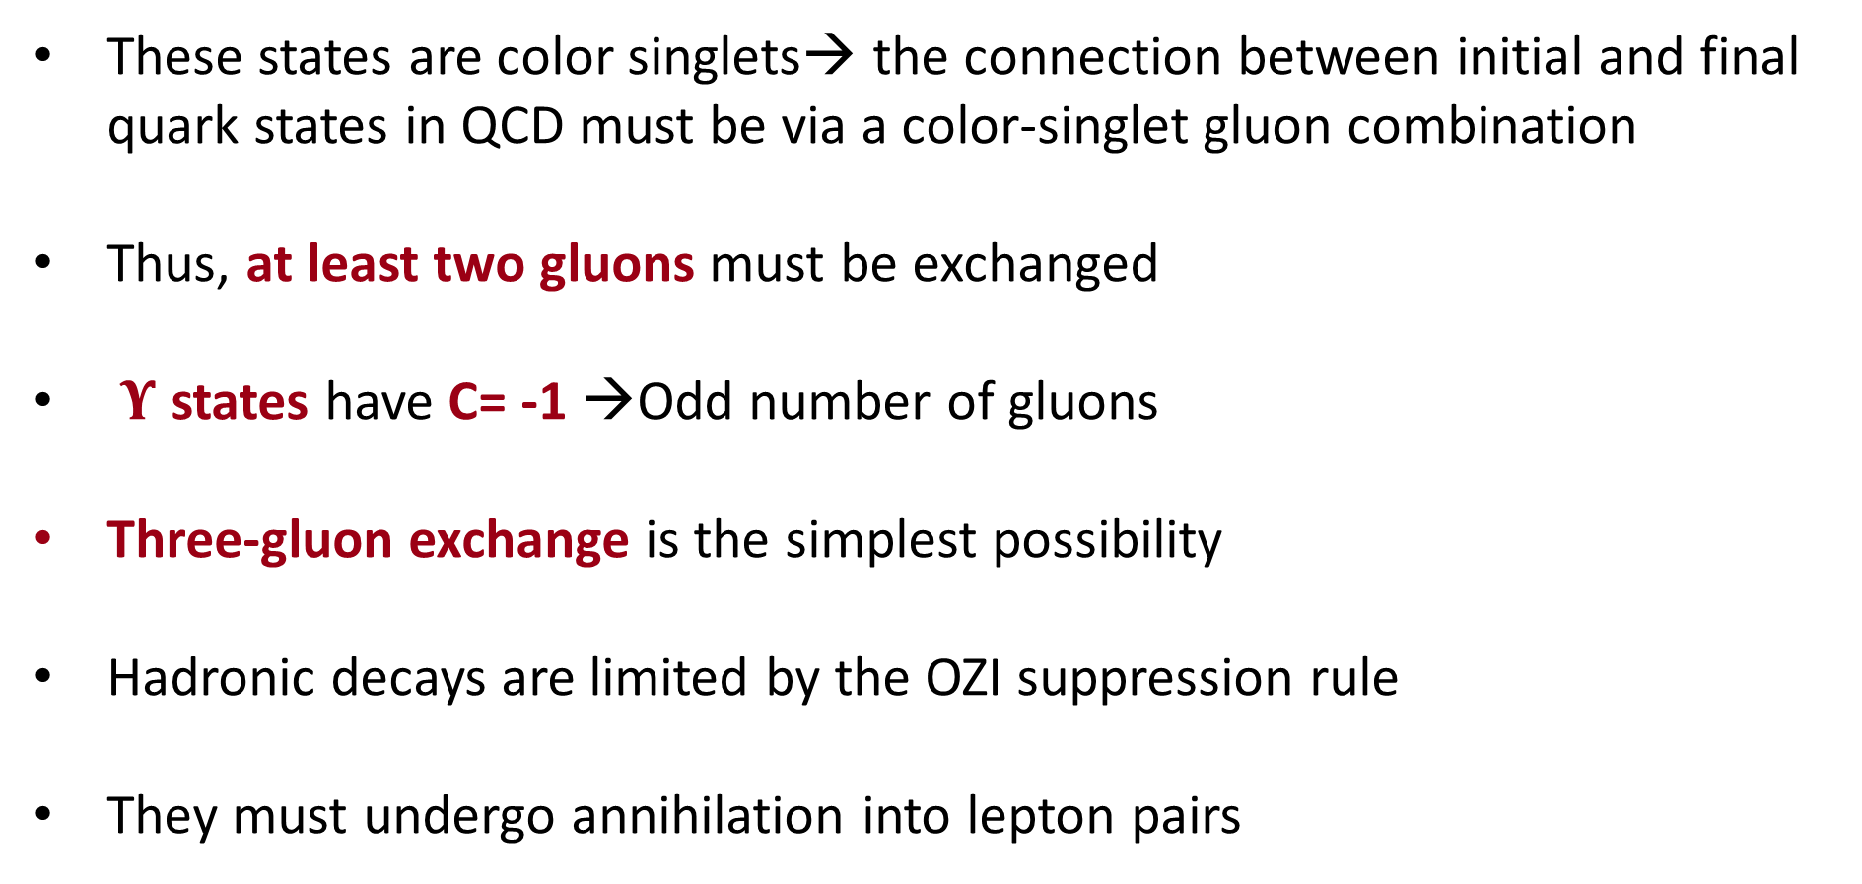
Why so narrow?
These states are color singlets→ the connection between initial and final quark states in QCD must be via a color-singlet gluon combination
Thus, at least two gluons must be exchanged
$Υ$ states have C= -1 →Odd number of gluons
Three-gluon exchange is the simplest possibility
Hadronic decays are limited by the OZI suppression rule
They must undergo annihilation into lepton pairs

Slide 22
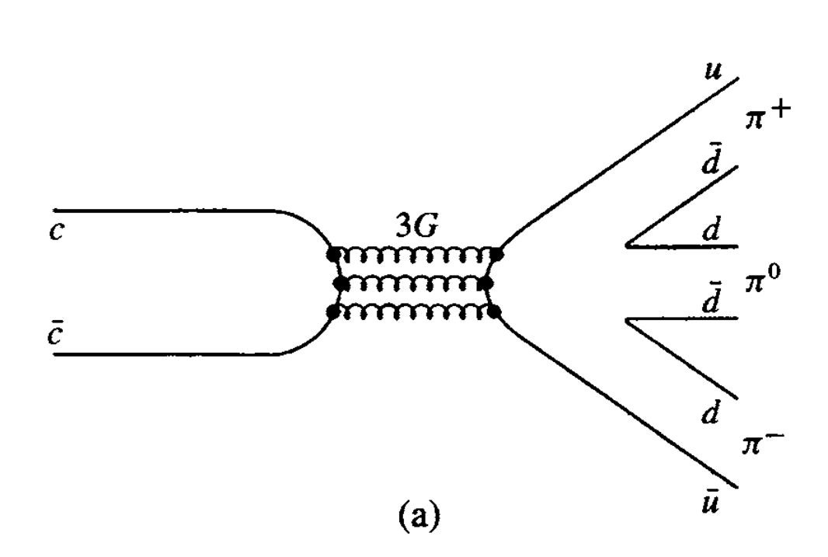

Why so narrow? OZI rule!
Three-gluon exchange is the simplest possibility
Hadronic decays are limited by the OZI suppression rule
They must undergo annihilation into lepton pairs
b
$$\overline{b}$$

Slide 23
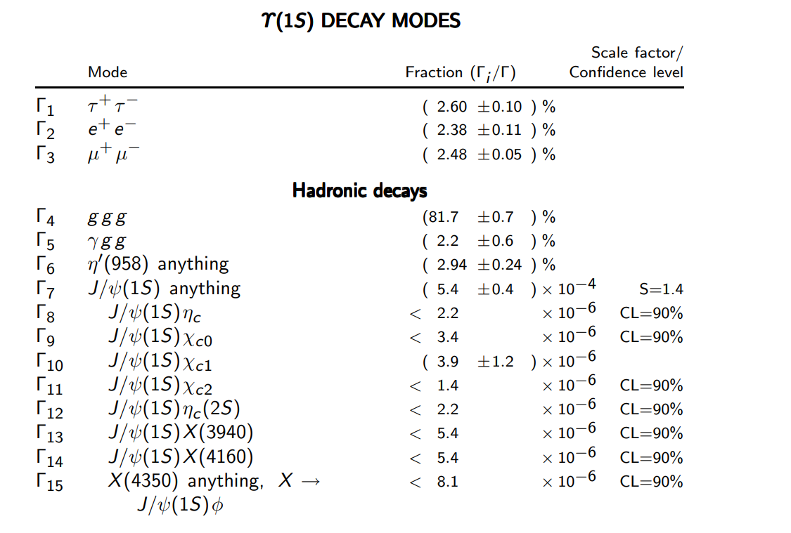
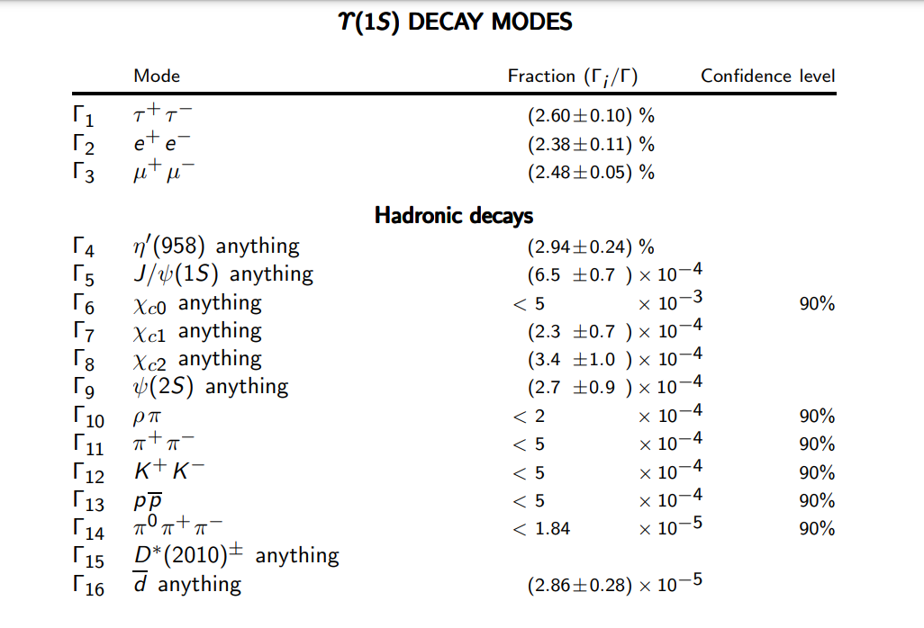

$Υ\left(1S\right)$ From PDG

