Slide 1


COMPUTER ENGINEERING MASTER DEGREE
INTERNET OF THINGS
PROJECT DISCUSSION
Volt Vault
PROFESSORS
GROUP MEMBERS
GIUSEPPE ANASTASI
CARLO VALLATI
FRANCESCA RIGHETTI
GIOVANNI LIGATO GIUSEPPE SORIANO
University of Pisa

Slide 2





ROOM STATUS
CRITICAL ROOM
CAMBIARE IN CO
MOVEMENT SENSOR
CO2 SENSOR
HVAC SYSTEM
AUTOMATIC DOOR
MANUAL OPENING
TEMPERATURE and HUMIDITY SENSOR

Slide 3
VAULT STATUS
VAULT
CO
MOVEMENT SENSOR
CO SENSOR
HVAC SYSTEM
AUTOMATIC DOOR
DASHBOARD
MANUAL OPENING
TEMPERATURE and HUMIDITY SENSOR

Slide 4
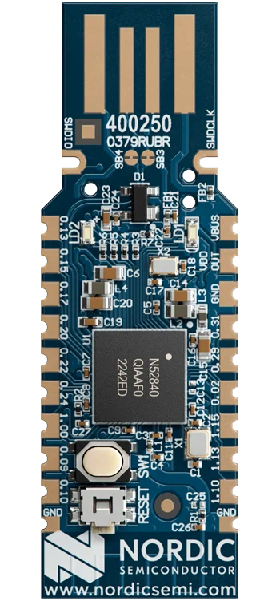



VAULT STATUS
+
AUTOMATIC DOOR
MOVEMENT SENSOR
+
MANUAL OPENING
nRF52840
Dongle
BORDER ROUTER
CLOUD APPLICATION
NORDIC
LAPTOP
CoAP SERVER FOR REGISTRATION
TEMPERATURE and HUMIDITY SENSOR
USER INPUT
ML MODEL
USER APPLICATION
DATABASE
CO SENSOR
HVAC SYSTEM
GRAFANA

Slide 5
VAULT STATUS
VAULT
CO
MOVEMENT SENSOR
CO SENSOR
HVAC SYSTEM
AUTOMATIC DOOR
DASHBOARD
MANUAL OPENING
TEMPERATURE and HUMIDITY SENSOR

Slide 6






ML MODEL
HVAC SYSTEM
USER INPUT
CLOUD APPLICATION
BORDER ROUTER
CoAP SERVER FOR REGISTRATION
+
AUTOMATIC DOOR
+
VAULT STATUS
+
USER APPLICATION
MOVEMENT SENSOR
MANUAL OPENING
GRAFANA
DATABASE
CO
TEMPERATURE and HUMIDITY SENSOR
CO SENSOR

Slide 7
ROOM STATUS
CRITICAL ROOM
MOVEMENT SENSOR

