Slide 1


MASTER'S DEGREE IN COMPUTER ENGINEERING
INTERNET OF THINGS
PROJECT DISCUSSION
Volt Vault
PROFESSORS
GROUP MEMBERS
GIUSEPPE ANASTASI
FRANCESCA RIGHETTI
CARLO VALLATI
GIOVANNI LIGATO GIUSEPPE SORIANO
University of Pisa

Slide 2





VAULT STATUS
VAULT
CO
MOVEMENT SENSOR
CO SENSOR
HVAC SYSTEM
AUTOMATIC DOOR
DASHBOARD
MANUAL OPENING
TEMPERATURE and HUMIDITY SENSOR

Slide 3
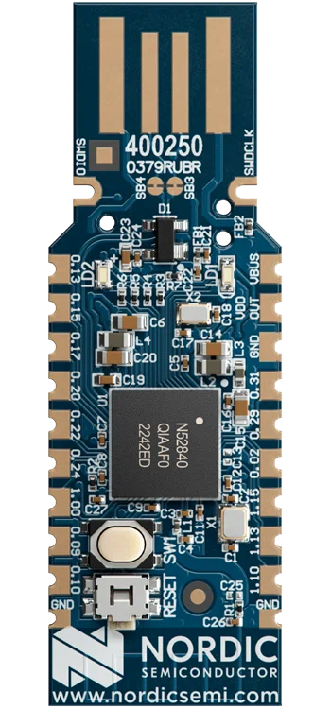






WSN
ML MODEL
HVAC SYSTEM
USER INPUT
CLOUD APPLICATION
BORDER ROUTER
CoAP SERVER FOR REGISTRATION
+
AUTOMATIC DOOR
+
VAULT STATUS
+
USER APPLICATION
MOVEMENT SENSOR
MANUAL OPENING
GRAFANA
DATABASE
CO
TEMPERATURE and HUMIDITY SENSOR
CO SENSOR

