Slide 1

A Stacked Ensemble Classifier for an Intrusion Detection System (IDS) in the
Edge of IoT and IIoT Networks
Tuesday, Jun 28th, 2022
Giovanni Oliveira
Priscila Lima

Slide 2
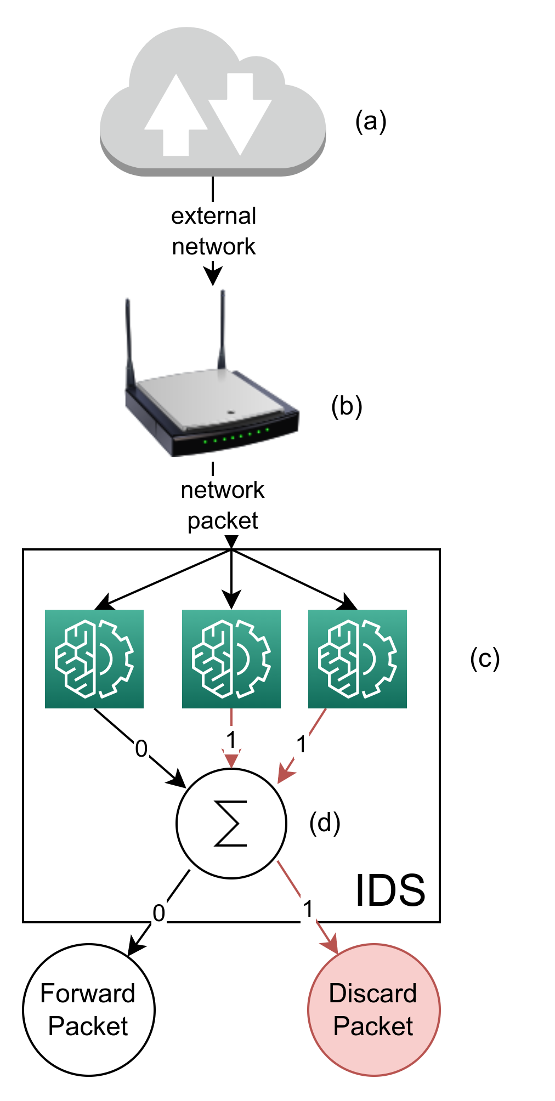
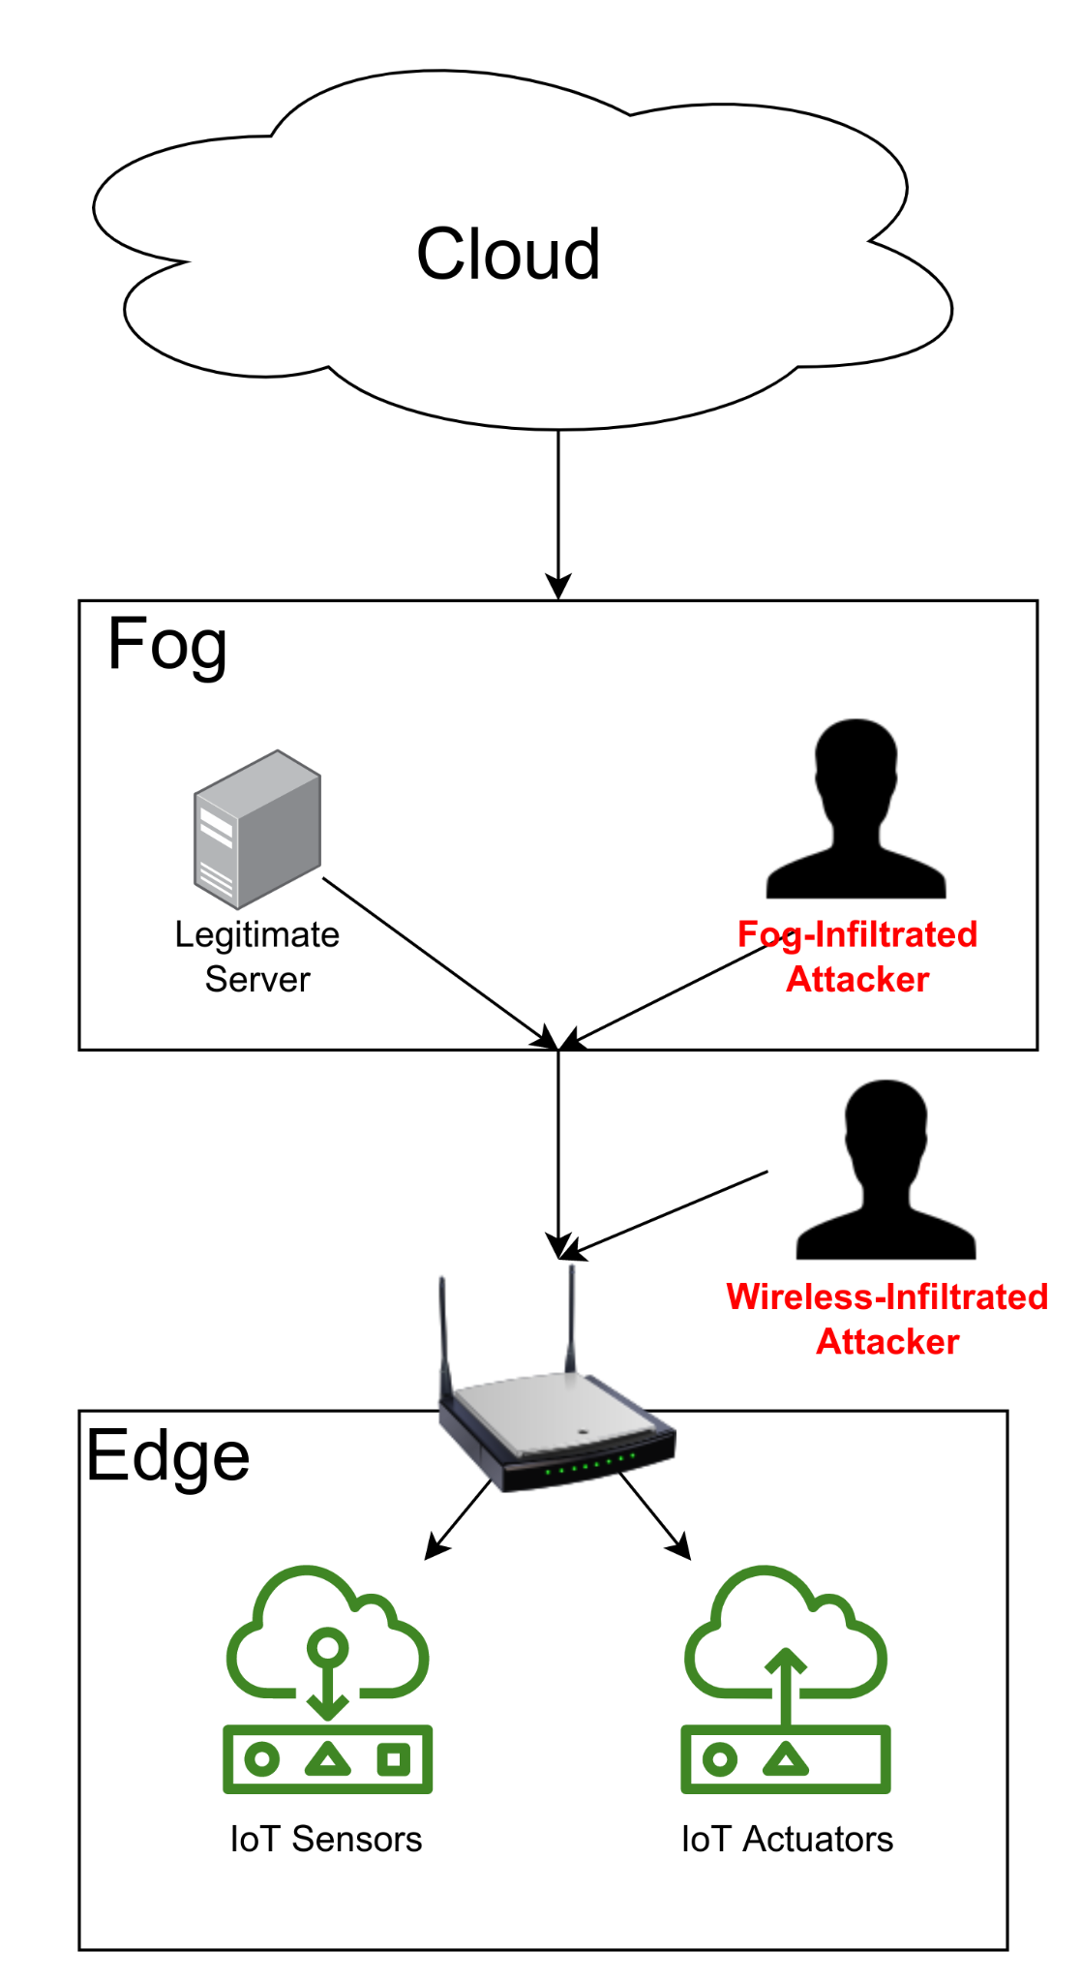
Proposed Solution
Base Models:
Naive Bayes (NB)
Random Forest (RF)
Support Vector Machine (SVM)
Multi-Layer Perceptron (MLP)
Gradient Boost Tree (GBT)
Extreme Gradient Boosting (XGB)
K-Nearest Neighbours (KNN)
Deep Neural Network (DNN)
LSTM
GRU

Slide 3
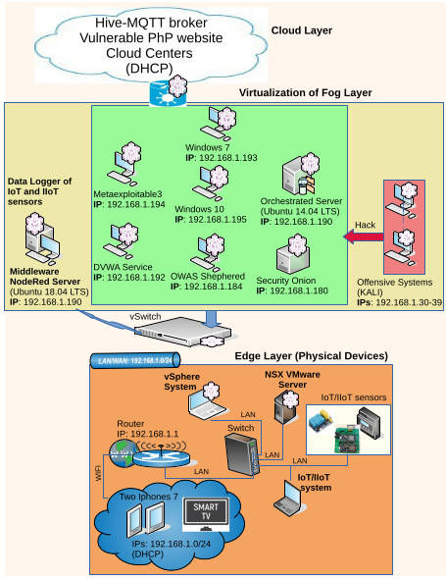
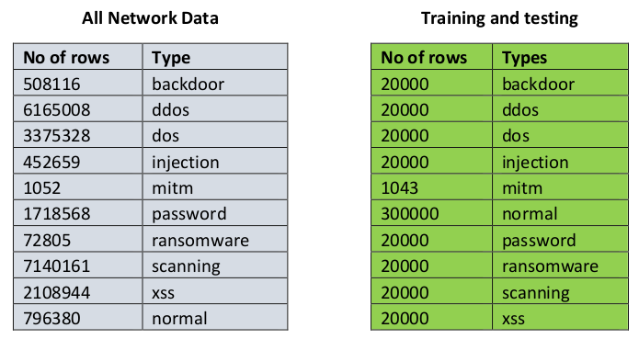
Testbed
Smart Things
Fridge, Garage door, GPS sensor, Motion sensor, Thermostat, Weather monitor and Modbus, to simulate industrial scenarios.

Slide 4
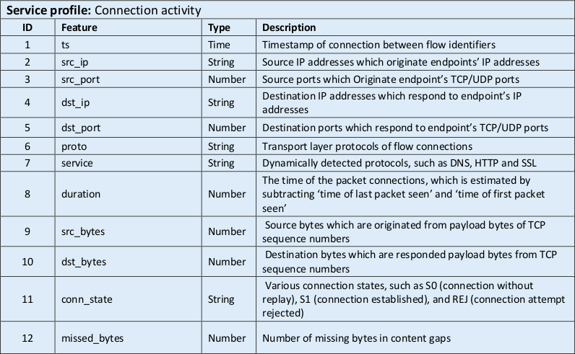
Features
Additional feature profiles:
Statistical
DNS
SSL
HTTP
Violation

Slide 5
Features
Additional feature profiles:
Statistical
DNS
SSL
HTTP
Violation

Slide 6
Selected Features
Source Port: Int
Destination Port: Int
Protocol: TCP/UDP

Slide 7
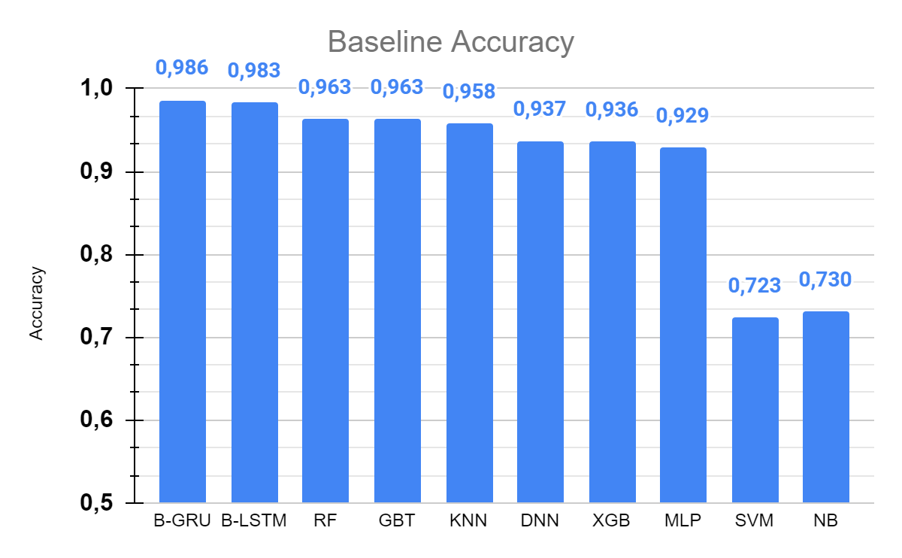
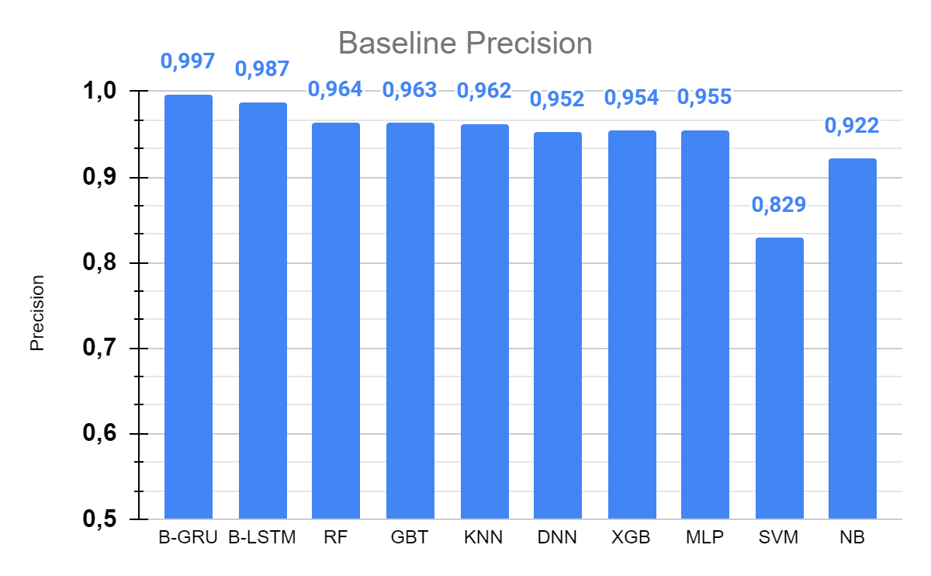
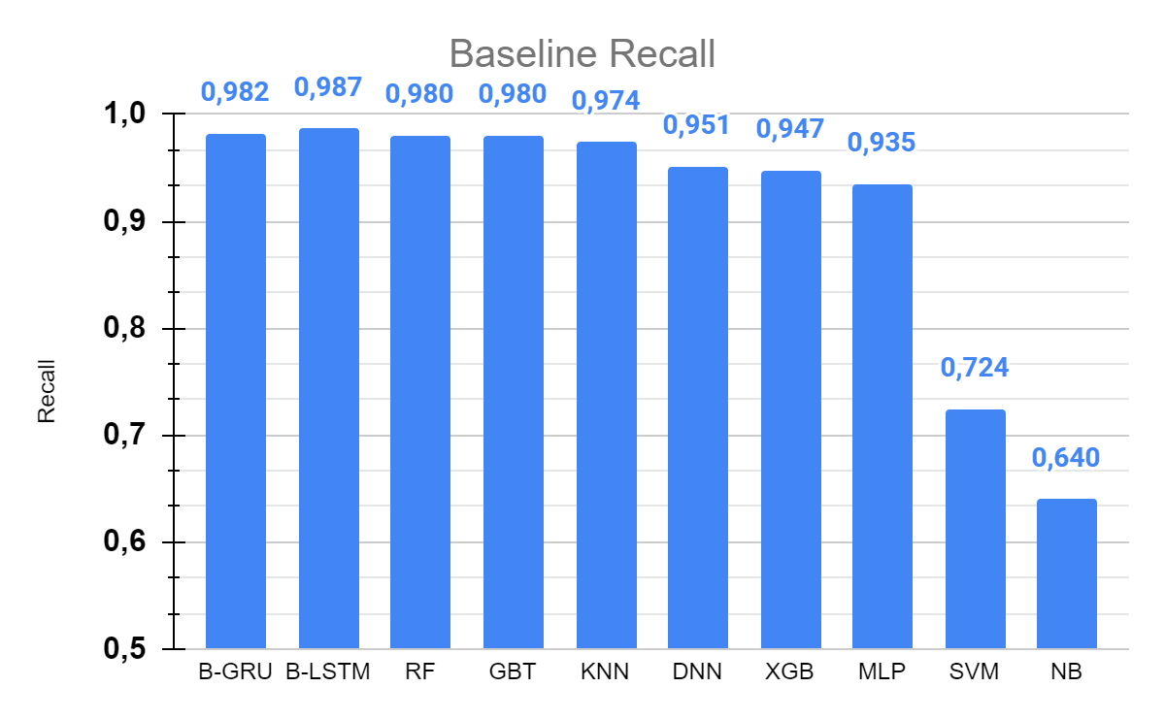
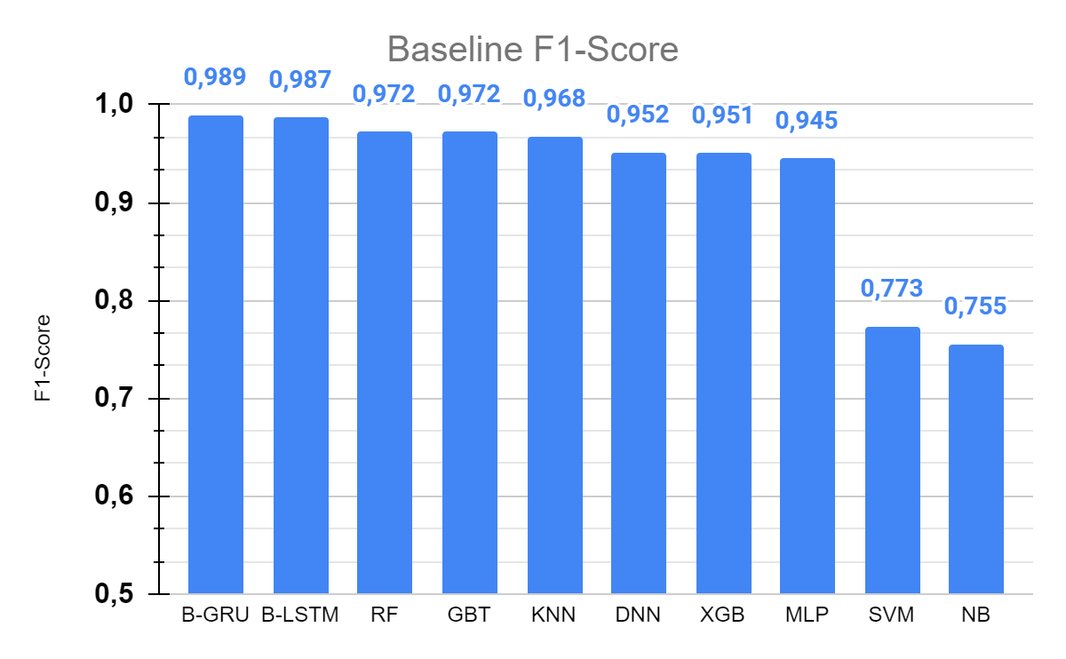
Base Models’ Results

Slide 8
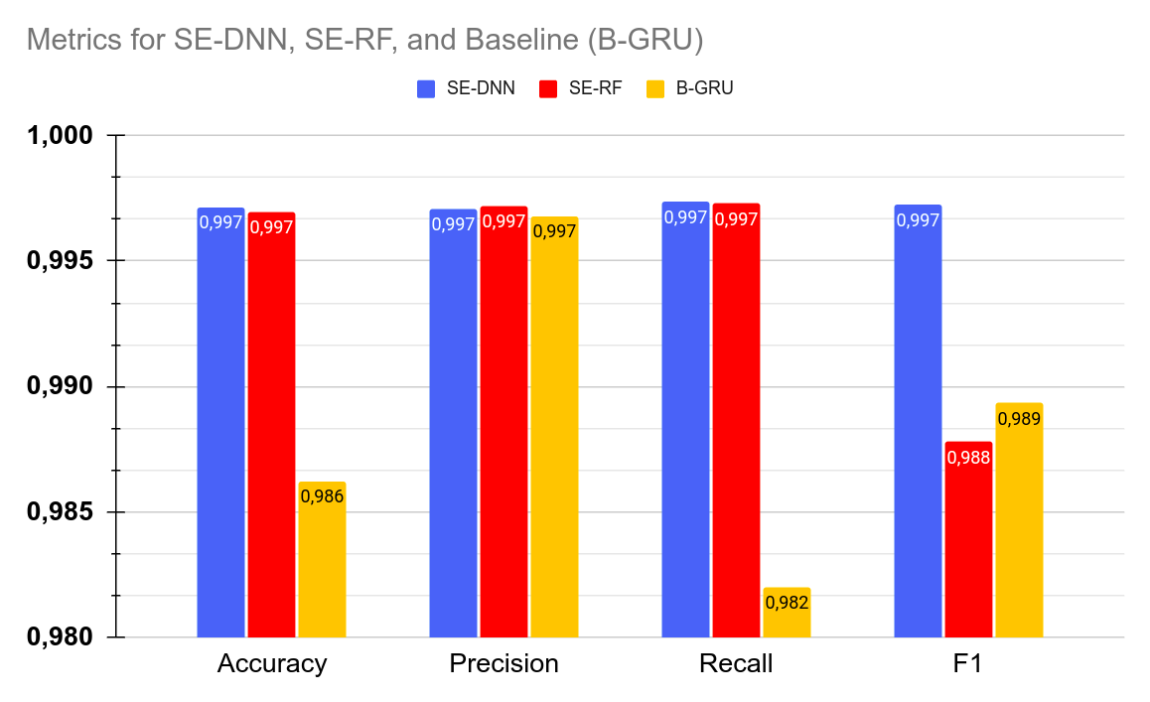
Ensembles’ Results

