Slide 1
Multitemporal Analysis of Vegetation Health and Landscape Heterogeneity
The Impact of 2019-2020 Bushfires in the Blue Mountains National Park, Australia
Student: Giovanni Premoli
Student ID Number: 0001188103
Course: Spatial Ecology in R
Academic Year: 2025/2026

Slide 2
Table of contents
Introduction
Spectral Structure
Visual Interpretation (RGB plots)
Vegetation Health Index (DVI and NDVI)
Landscape Structure
  Data Compression (PCA)
  Landscape Heterogeneity (SD)
Quantifying Change
Land Cover Classification
Statistical Synthesis (ggplot2)
Conclusions

Slide 3
Introduction
Objective: assess the ecological impact of late 2019 – early 2020 bushfires in Australia through the application of several remote sensing and statistical analysis
Study Area: Blue Mountains National Park (Australia)
Data Source: Sentinel-2 TC and FC images (Copernicus Browser)
Comparison Period: 2019 (pre-fire) – 2020 (post-fire)
Tools: R studio

Slide 4
Packages
library(terra)
library(ggplot2)
library(patchwork)
library(viridis)
library(imageRy)

Slide 5
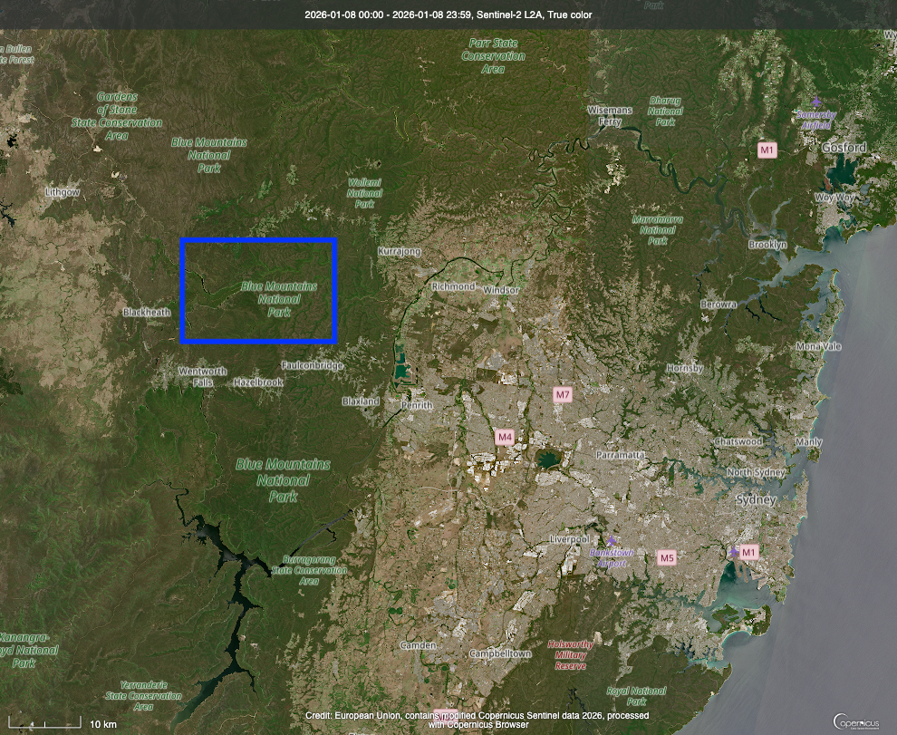
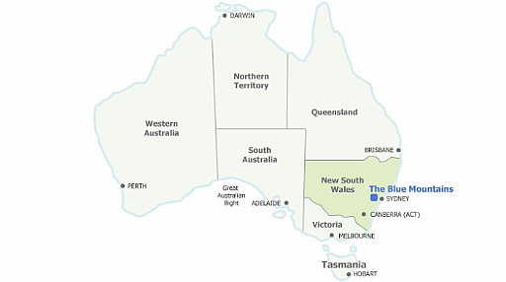
Study Area

Slide 6
Spectral Structure

Slide 7
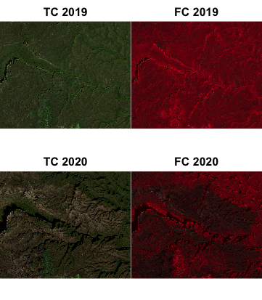
True Color and False Color
tc19 <- rast("2019_TC.jpg")
fc19 <- rast("2019_FC.jpg")
tc20 <- rast("2020_TC.jpg")
fc20 <- rast("2020_FC.jpg")
par(mfrow=c(2,2))
plot(tc19, main = "TC19")
plot(fc19, main = "FC19")
plot(tc20, main = "TC20")
plot(fc20, main = "FC20")
The differences between 2019 and 2020 can also be observed in the visible spectrum.
False Color composition emphazises some large areas of reduced NIR reflection caused by the bushfires.

Slide 8
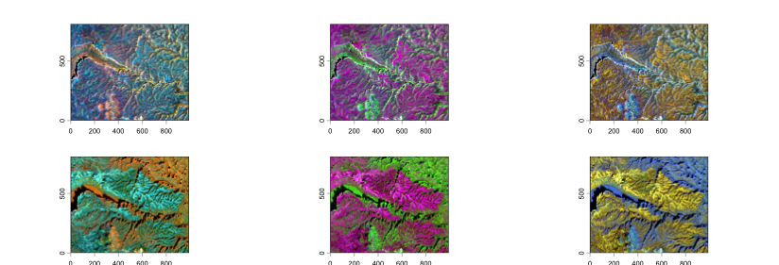
Visual Interpretation (RGB plots)
2019
2020
NIR on red: 2020 red color is less continuous -> reduction in NIR reflectance due to fires. The vegetation is less healthy.
NIR on green: 2020 more defined patches
-> Increased spatial contrast.
The vegetation is more stressed or regrowing.
NIR on blue: 2020 more landscape heterogeneity.
Multispectral RGB colouring, obtained by combining different spectral bands, highlights an increase in spatial heterogeneity between 2019 and 2020. While the overall geomorphological structure remains recognizable, post-fire images show a more fragmented spectral pattern, consistent with vegetation health reduction and patchy recovery following the disturbance.

Slide 9
Code for RGB plots
# Extracting the bands from 2019 images. Useful to classify the objects and extract more information from the data.
# From the TC image I'm taking the red (r), blue (b) and green (g) bands.
r19 <- tc19[[1]]
g19 <- tc19[[2]]
b19 <- tc19[[3]]
# From the FC image I'm taking the NIR band.
nir19 <- fc19[[1]]
# Combining the bands in a single object.
stack19 <- c(r19, g19, b19, nir19)
# Extracting the bands from 2020 images.
# From the TC image I'm taking the red (r), blue (b) and green (g) bands.
r20 <- tc20[[1]]
g20 <- tc20[[2]]
b20 <- tc20[[3]]
# From the FC image I'm taking the NIR band.
nir20 <- fc20[[1]]
# Combining the bands in a single object.
stack20 <- c(r20, g20, b20, nir20)
# Visualizing the images with different colors:
par(mfrow=c(3,2))
im.plotRGB(stack19, r=4, g=2, b=3)
im.plotRGB(stack19, r=1, g=4, b=3)
im.plotRGB(stack19, r=1, g=2, b=4)
im.plotRGB(stack20, r=4, g=2, b=3)
im.plotRGB(stack20, r=1, g=4, b=3)
im.plotRGB(stack20, r=1, g=2, b=4)

Slide 10
Vegetation Health Index
DVI = NIR -red
2019: DVI range covers from -75 to 179.
2020: DVI range covers from -90 to 200.
- Decrease in minimum range in 2020 (-90). This indicates areas where red reflectance exceed the NIR reflectance, a clear sign of clorophyll loss: with less photosynthesis, red wavelengths are less absorbed and so vegetation is less or stressed.
- Higher maximum value in 2020 (200), it's likely not due to better vegetation, but rather to different atmospheric illumination or the high overall reflectance of exposed bare rocks or soil, which can reflect strongly across the entire spectrum.
DVI consent to observe the raw physical behavior of the spectral of the NIR-red bands and the direct loss of photosynthetic efficiency. NDVI is essential to normalize the data by filtering out potential "noise" caused by different illumination or atmospheric conditions.

Slide 11
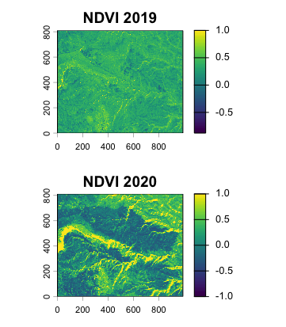
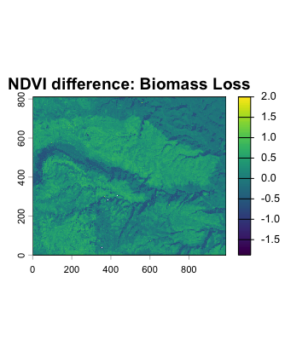
Vegetation Health Index
NDVI
2019: mean elevated and homogeneous values. Spatial continuous consistency along valleys and slopes. Structurally stable landscape.
2020: generalized diminution of NDVI values, large areas with low NDVI. Pattern more fragmented and more evident contrast between near patches. Caused by the loss of biomass, by the vegetation's stress and by the disomogeneous effects of fire.
While pre-fire NDVI values appear relatively high and spatially continuous, post-fire conditions are characterized by reduced NDVI and a fragmented spatial pattern, reflecting heterogeneous vegetation damage and early recovery processes.

Slide 12
Code for NDVI
ndvi19 <- (nir19 - r19)/(nir19 + r19)
ndvi20 <- (nir20 - r20)/(nir20 + r20)
par(mfrow=c(3,1))
plot(ndvi19, col=viridis(100), main="NDVI 2019")
plot(ndvi20, col=viridis(100), main="NDVI 2020")
ndvi_diff <- ndvi19 - ndvi20
plot(ndvi_diff, col=viridis(100), main="NDVI difference: Biomass Loss")

Slide 13
Landscape Structure

Slide 14
Data Compression (PCA)
Data Reduction: Sentinel-2 provides multiple spectral bands (Red, Green, Blue, NIR) that are often highly correlated and redundant.
Information Concentration: PCA transforms these bands into new, uncorrelated variables called Principal Components.
Variance captured: In this study, the first two components (PC1 and PC2) explain ~76.59% (2019) and ~70.15% (2020) of the total landscape variability.
Objective: Isolating the most important ecological signals to calculate spatial heterogeneity without the "noise" of redundant data.

Slide 15
Code for PCA
# Running the Principal Component Analysis on the 2019 stack.
pca19 <- im.pca(stack19)
# Standard Deviations obtained from R:
# pca1 = 22.300805
# pca2 = 13.894895
# pca3 = 8.694020
# pca4 = 2.365775
# Calculating the total variability as the sum of SDs of the components.
tot19pca <- sum(22.300805, 13.894895, 8.694020, 2.365775)
# 47.2555
# Estimating the percentage of information represented by each axis.
22.300805*100/47.2555 # 47.19% (PC1)
13.894895*100/47.2555 # 29.40% (PC2)
8.694020*100/47.2555 # 18.40% (PC3)
2.365775*100/47.2555 # 5.01% (PC4)
# PC1 and PC2 together cover ~76.59% of the original information, which is enough to describe the landscape structure.
compactpca19 <- pca19[[1]] + pca19[[2]]
# Running the Principal Component Analysis on the 2020 stack.
pca20 <- im.pca(stack20)
# Standard Deviations obtained from R:
# pca1 = 30.18312
# pca2 = 28.80024
# pca3 = 19.72079
# pca4 = 5.34542
# Calculating the total variability as the sum of SDs of the components.
tot20pca <- sum(30.18312, 28.80024, 19.72079, 5.34542)
# 84.04957
# Estimating the percentage of information represented by each axis.
30.18312*100/84.04957 # 35.91% (PC1)
28.80024*100/84.04957 # 34.26% (PC2)
19.72079*100/84.04957 # 23.46% (PC3)
5.34542*100/84.04957 # 6.36% (PC4)
# PC1 and PC2 together cover ~70.15% of the original information, which is enough to describe the landscape structure.
compactpca20 <- pca20[[1]] + pca20[[2]]

Slide 16
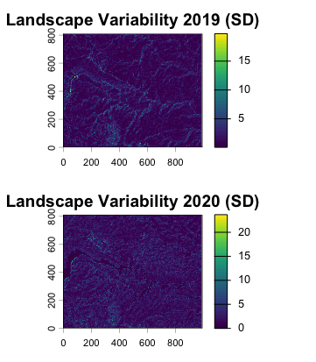
Landscape Heterogeneity (SD)
2019: SD values generally low and spatially coherent, relative homogeneous landscape. Main geomorphological structures are recognizible but not too spatially discontiuous.
2020: While maintaining a similar global distribution, low increment of variability, with a stronger presence of high SD pixels (yellow) and a more fragmented distribution. Outputs consistent with an heterogenous stress event like fire. The fire acted as a "disturbing agent" thet broke the spatial continuity noticed in 2019 and generated "disorder".
Differences between 2019 and 2020 are mainly expressed in terms of fine-scale spatial heterogeneity and highlight a general increment in spatial complexity in post-fire period.

Slide 17
Code for SD
# Calculating the Standard Deviation (pcsd19), based on the principal components, to measure the spatial hetereogeneity of the landscape. I'm applying focal() function to calculate SD in a 3x3 moving window.
# Areas with high SD indicate high landscape complexity.
pcsd19 <- focal(compactpca19, matrix(1/9,3,3), fun=sd)
# Calculating the Standard Deviation (pcsd20), based on the principal components, to measure the spatial hetereogeneity of the landscape. I'm applying focal() function to calculate SD in a 3x3 moving window.
pcsd20 <- focal(compactpca20, matrix(1/9,3,3), fun=sd)
par(mfrow=c(2,1))
plot(pcsd19, col=viridis(100), main = "Landscape Variability 2019 (SD)")
plot(pcsd20, col=viridis(100), main = "Landscape Variability 2020 (SD)")

Slide 18
Quantifying Change

Slide 19
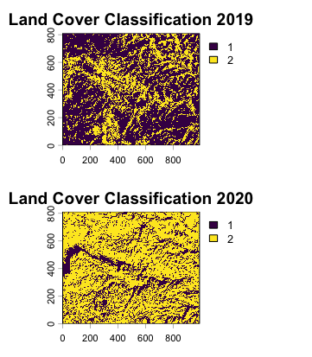
Land Cover Classification
2019: "Forest" coverage -> 31.89005%
2020: "Forest" coverage -> 29.38597%
Net loss = ~2.5% of "Forest" coverage
2019: large and continuous patches of the two classes. Reflects moderate landscape variability and a structural stable environment, consistent with a healthy forest.
2020: increased fragmentation and a more irregular distribution of small patches.
Due to unsupervised classification function the numbers of the two classes are inverted between 2019 and 2020. The classification results indicate a reduction of 2.5% in Forest class in 2020 after bushfires.
Although, because the classification is unsupervised, class proportions represent changes in spatial configuration and spectral similarity rather than true gain or loss in forest covered area. This pattern is consistent with the general loss of NDVI in 2020 and increased landscape fragmentation.
"Forest "= high NDVI vegetation
Others = low NDVI surfaces (stressed vegetation, soil, rocks, burned areas)
Others
"Forest"
"Forest"
Others

Slide 20
Code for Classification
# Classifying the image into 2 clusters: "Forest" (vegetation) and Others (rocks/water/bare soil).
cl19 <- im.classify(stack19, num_clusters=2)
cl20 <- im.classify(stack20, num_clusters=2)
# Calculating the frequencies to get the percentage of land cover of each land cover class.
f19 <- freq(cl19) # Number of pixels for each class
tot19 <- ncell(cl19) # Total number of pixels in the image
p19 <- f19*100/tot19 # Percentage for each class
p19
# Class 1 ("Forest") = 31.89005%
# Class 2 (Others) = 68.10995%
f20 <- freq(cl20)
tot20 <- ncell(cl20)
p20 <- f20*100/tot20
p20
# Class 1 (Others) = 70.61403%
# Class 2 ("Forest") = 29.38597%
par(mfrow=c(2,1))
plot(cl19, main = "Land Cover Classification 2019")
plot(cl20, main = "Land Cover Classification 2020")

Slide 21
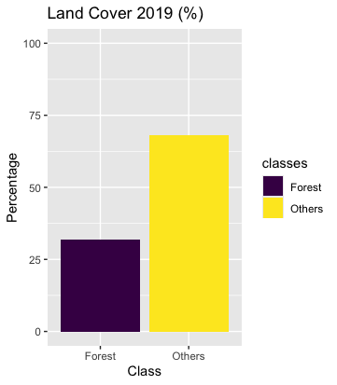

Statistical Synthesis (ggplot2)

Slide 22
Code for ggplot2
# Building a dataframe to visualize the class percentage from 2019 and 2020.
y19 <- c(31.89, 68.11) # Forest, Others
y20 <- c(29.39, 70.61) # Forest, Others
classes <- c("Forest", "Others")
# Creating the dataframe
dataF <- data.frame(classes, y19, y20)
dataF
# Visualizing a clear quantitative representation
F19 <- ggplot(dataF, aes(x=classes, y=y19, fill=classes)) + geom_bar(stat="identity") + scale_fill_viridis_d(option="D") + ylim(c(0, 100)) + labs(title="Land Cover 2019 (%)", y="Percentage", x="Class")
F20 <- ggplot(dataF, aes(x=classes, y=y20, fill=classes)) + geom_bar(stat="identity") + scale_fill_viridis_d(option="D") + ylim(c(0, 100)) + labs(title="Land Cover 2020 (%)", y="Percentage", x="Class")
F19 + F20

Slide 23
Thank you!

