Slide 1

History of Bitcoin
Lorella Landi
Giovanni Ruocco
Andrea Gaetano Ferrara

Slide 2
Introduction
The goal of this project is to illustrate the data regarding the global phenomenon of Bitcoin giving an interesting insight of its behavior during its first steps in life. More precisely we will show its characteristics connections in the year 2010, year of its introduction in the global market.

Slide 3

Outline
Dataset
Technologies
Visualizations
Case Studies
Related Works

Slide 4
Dataset
General Information
The Bitcoin database we analyzed was extracted from the Kaggle database «Bitcoin Blockchain Historical Data.»
From this we decided to study the transactions and informations to them connected such as inputs, outputs and Bitcoin value exchanged.
Format : JSON
Dimension : 58 MB
Years : 2010
AS rule: #tuples * #transactions + (#INPUT_tuples * input count) + + (#OUTPUT_tuples ∗ output count) =
= 9 ∗ 117.345 + (3 ∗ 184.469) + (3 ∗ 165.426) = 2.105.790 values

Slide 5




Technologies
The technologies used to create this project are some of the most used tools in the field of data manipulation and visualization.
In fact, to manage and format the data we used Python and JavaScript; while for data visualization we recurred to d3.js, Bootstrap and the already mentioned JavaScript

Slide 6
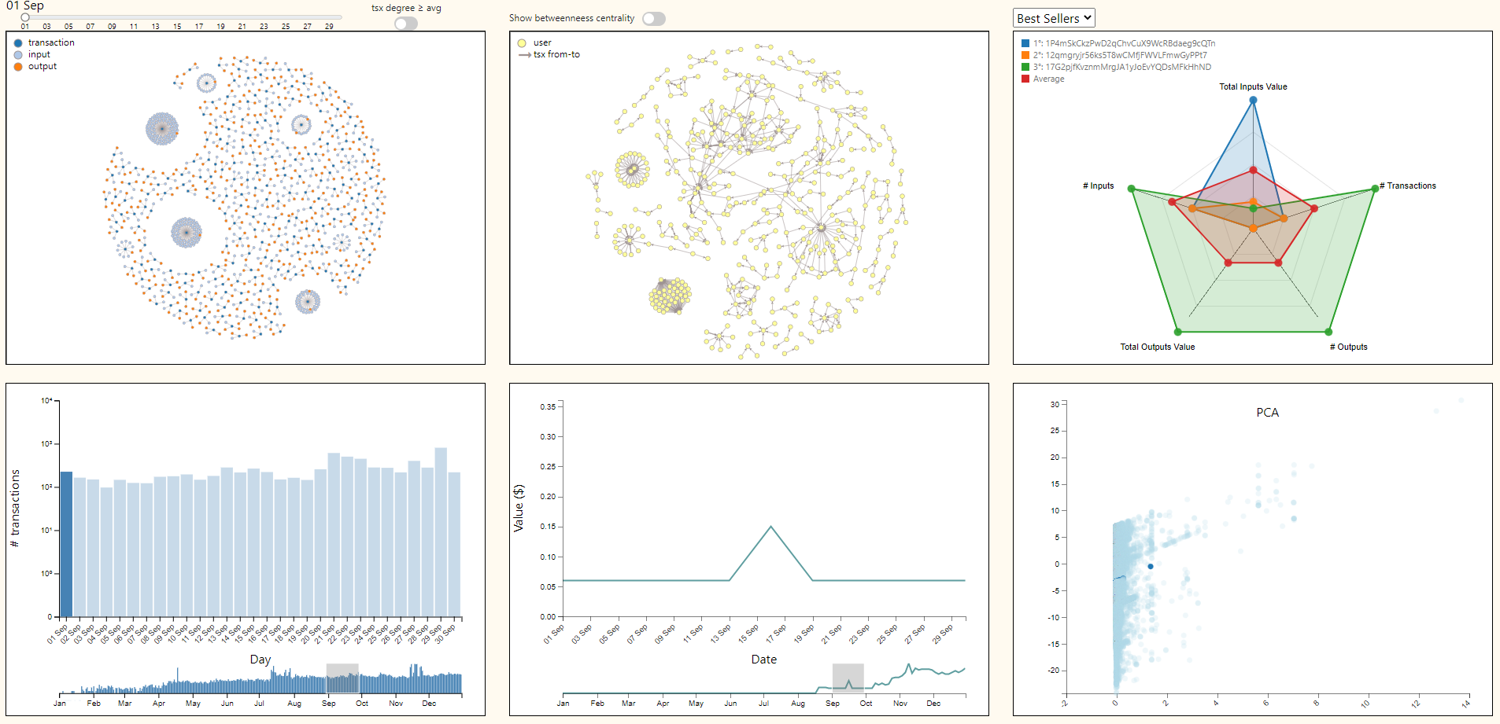
Project Overview

Slide 7
Features Rundown
Our project was thought mainly to give some insight and interesting information on the year most significative for the development of the Bitcoin phenomenon. We aimed to do this through several visualization briefly explained in what follows:
Transactions Graph – It allows the user to select one or more transactions in a single day and retrieve all connected information.
Network Graph – It shows how users are connected.
Radar Chart – Shows the top users participating in the selected transactions ranked on value exchanged.
Transaction Bar Chart – Displays the number of transaction executed each day.
Prices Line Chart – It shows the close value of Bitcoin per day.
PCA – Dimensionality reduction of transactions’ parameters.

Slide 8
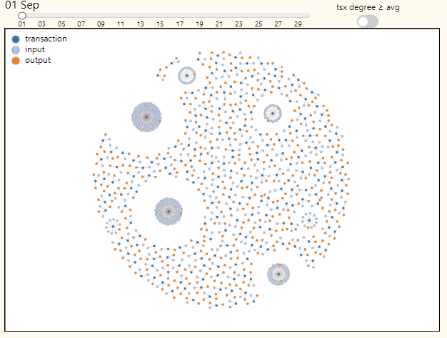
Transactions Graph
The Transactions Graph shows all the transactions that occurred in each day. Each transaction is connected to its inputs and outputs which correspond to people in the network.
The user can brush to select one or more transaction to show its information throughout the project. Moreover, we implemented some filters to help select only the more significant transactions.

Slide 9
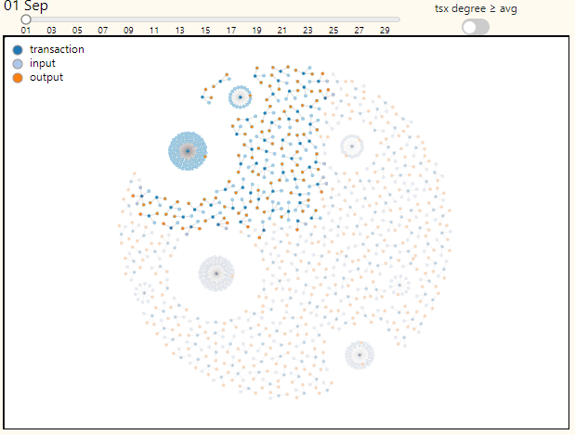
Transactions Graph
The Transactions Graph shows all the transactions that occurred in each day. Each transaction is connected to its inputs and outputs which correspond to people in the network.
The user can brush to select one or more transaction to show its information throughout the project. Moreover, we implemented some filters to help select only the more significant transactions.

Slide 10
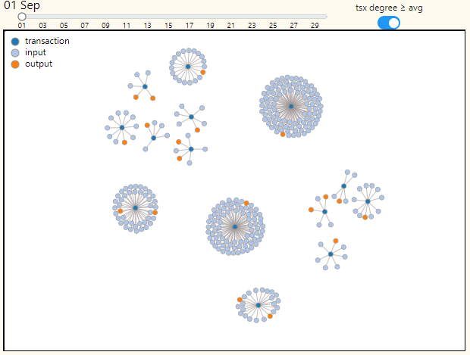
Transactions Graph
The Transactions Graph shows all the transactions that occurred in each day. Each transaction is connected to its inputs and outputs which correspond to people in the network.
The user can brush to select one or more transaction to show its information throughout the project. Moreover, we implemented some filters to help select only the more significant transactions.

Slide 11
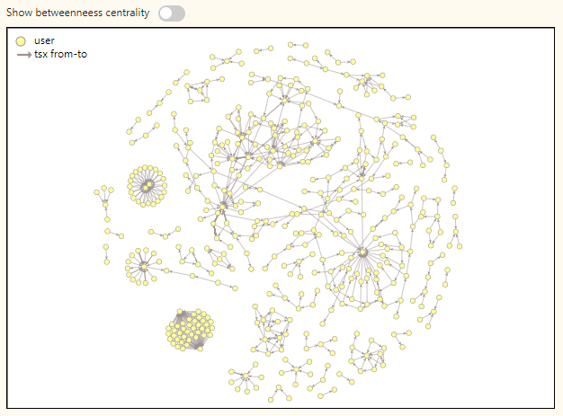
Network Graph
The Network Graph shows how users are connected: two users are connected to each other when one is input of a transaction where the other user is output.
We also added a filter to highlight the betweenness centrality of the nodes.

Slide 12
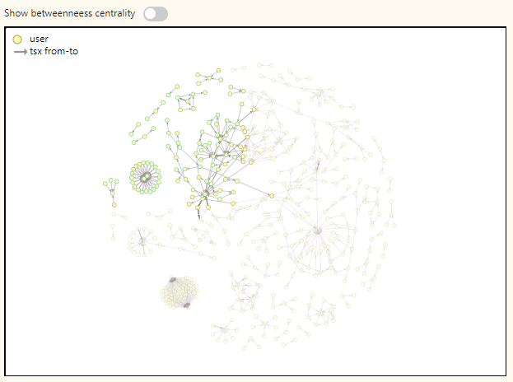
Network Graph
The Network Graph shows how users are connected: two users are connected to each other when one is input of a transaction where the other user is output.
We also added a filter to highlight the betweenness centrality of the nodes.

Slide 13
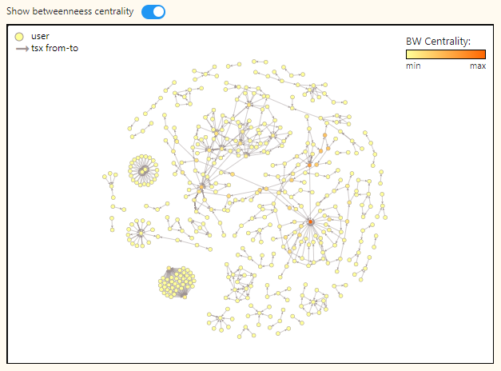
Network Graph
The Network Graph shows how users are connected: two users are connected to each other when one is input of a transaction where the other user is output.
We also added a filter to highlight the betweenness centrality of the nodes.

Slide 14
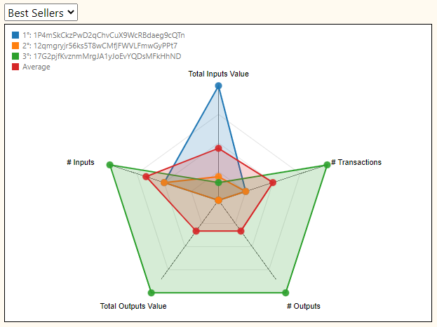
Radar Chart
The Radar Chart displays the differences in values in the top 3 addresses selected through the brush or simply in each day. The ranking parameter can be switched from Best Sellers to Best Buyers. Also, a line for the average is implemented to better show the difference of the top 3 from the rest of the selection.

Slide 15
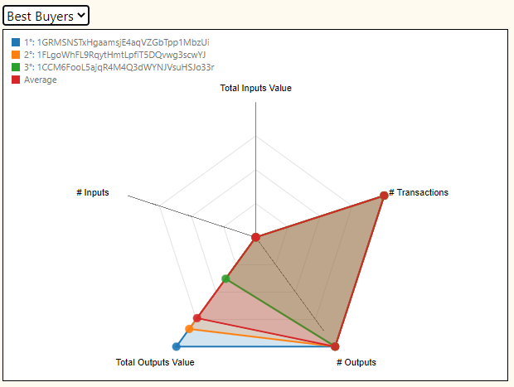
Radar Chart
The Radar Chart displays the differences in values in the top 3 addresses selected through the brush or simply in each day. The ranking parameter can be switched from Best Sellers to Best Buyers. Also, a line for the average is implemented to better show the difference of the top 3 from the rest of the selection.

Slide 16
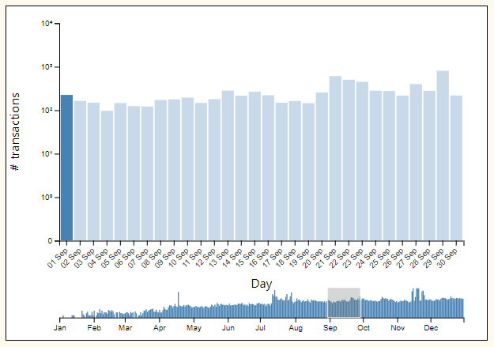
Transactions Bar Chart
The Transactions Bar Chart shows the number of transactions of each day. It can be brushed in any way, but it is focused on single months in order to better show the connection with the other graphs.

Slide 17
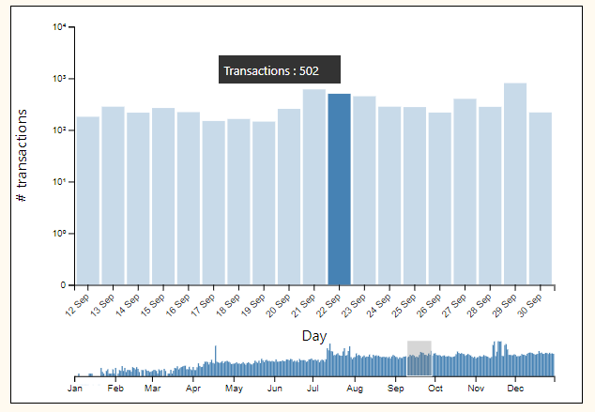
Transactions Bar Chart
The Transactions Bar Chart shows the number of transactions of each day. It can be brushed in any way, but it is focused on single months in order to better show the connection with the other graphs.

Slide 18
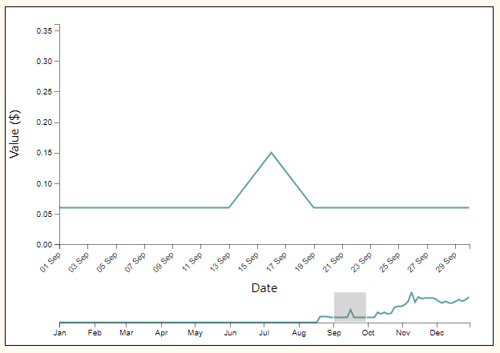
Prices Line Chart
The Prices Line Chart shows the close value of Bitcoin for each day of 2010.
We supposed that to an increase in transactions in a day an increase in value could be observed consequently, or vice versa.
In order to bring the user to a conclusion we added a percentage increase tooltip for the days.

Slide 19
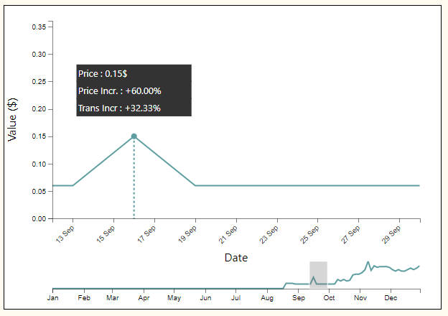
Prices Line Chart
The Prices Line Chart shows the close value of Bitcoin for each day of 2010.
We supposed that to an increase in transactions in a day an increase in value could be observed consequently, or vice versa.
In order to bring the user to a conclusion we added a percentage increase tooltip for the days.

Slide 20
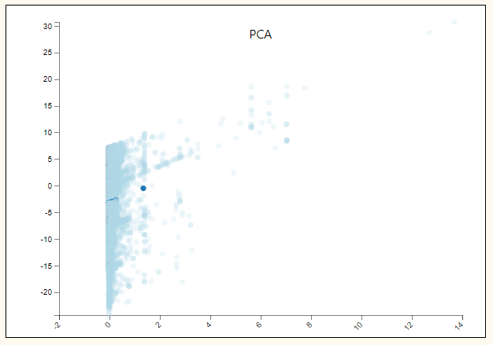
PCA
The PCA shows all the transactions analyzed in the project, takes the different parameters such as “input_value”, “output_value” and others and then reduces them to a 2-dimension graph that can be displayed.

Slide 21

Case Studies

Slide 22
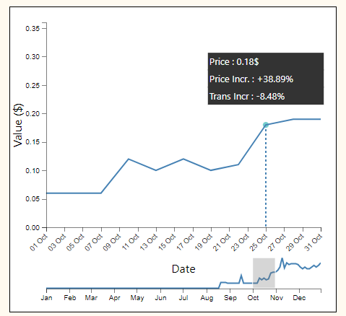
1. Case Study
Our first case study is the one in which a Bitcoin lover wants to ascertain whether an increase or decrease in the monetary value of Bitcoin corresponds to a change in the number of transactions. A tooltip has been added to help users reach a conclusion on the matter. It shows the changes in price and transactions of Bitcoin over time.

Slide 23
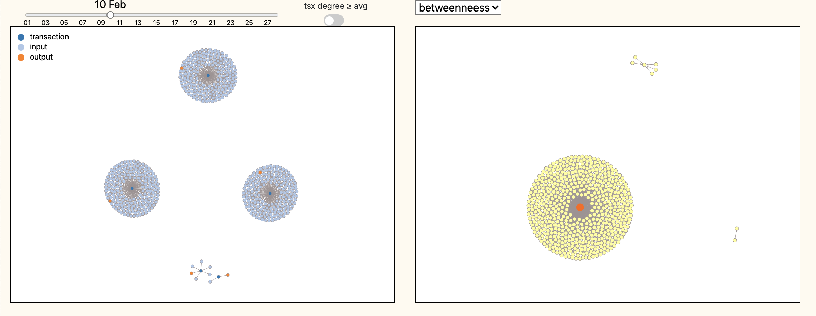
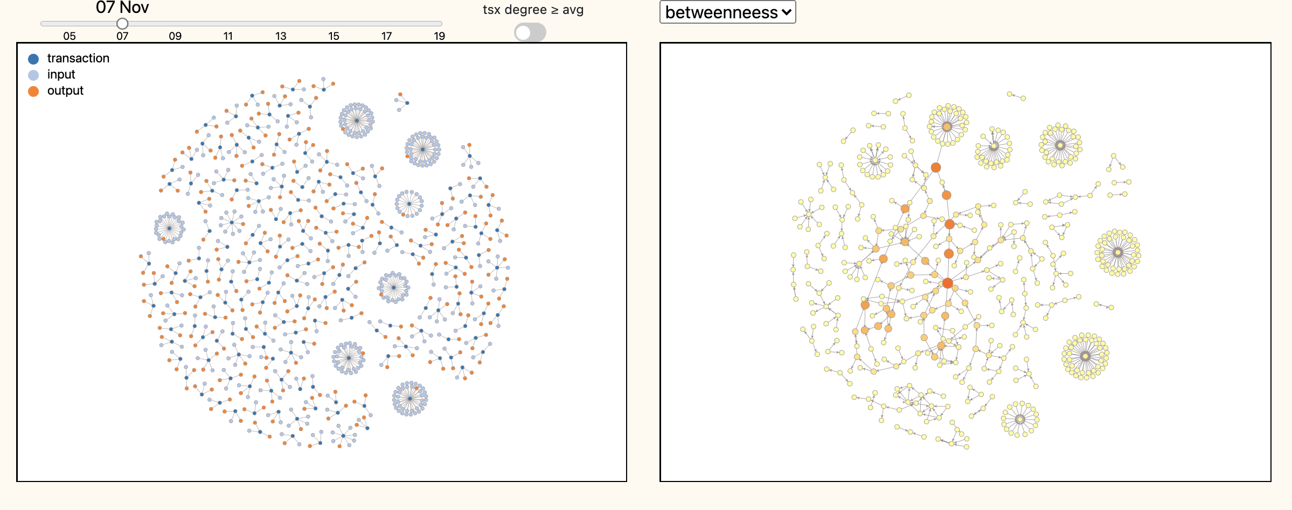
2. Case Study
We all know that one of the reasons why Bitcoin has had this important growth is its decentrality.It is reasonable to assume that in the first months of bitcoin's life, when fewer users had access to the system than today, the risk of a prevalent user on the market is higher. Thanks to the Transaction Graph and the Network Graph the user can observe this phenomenon.

Slide 24
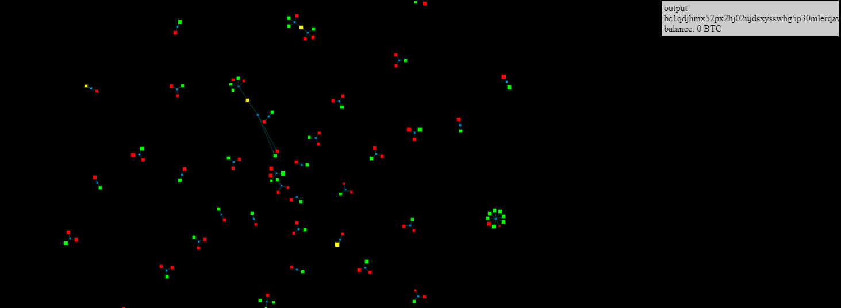
Related works
In the literature there are several different articles and visualization around Bitcoin, especially considering the mediatic attention it acquired in the last few years.
However, most of them focus their attention on the latest transaction in stead of studying the past.

Slide 25
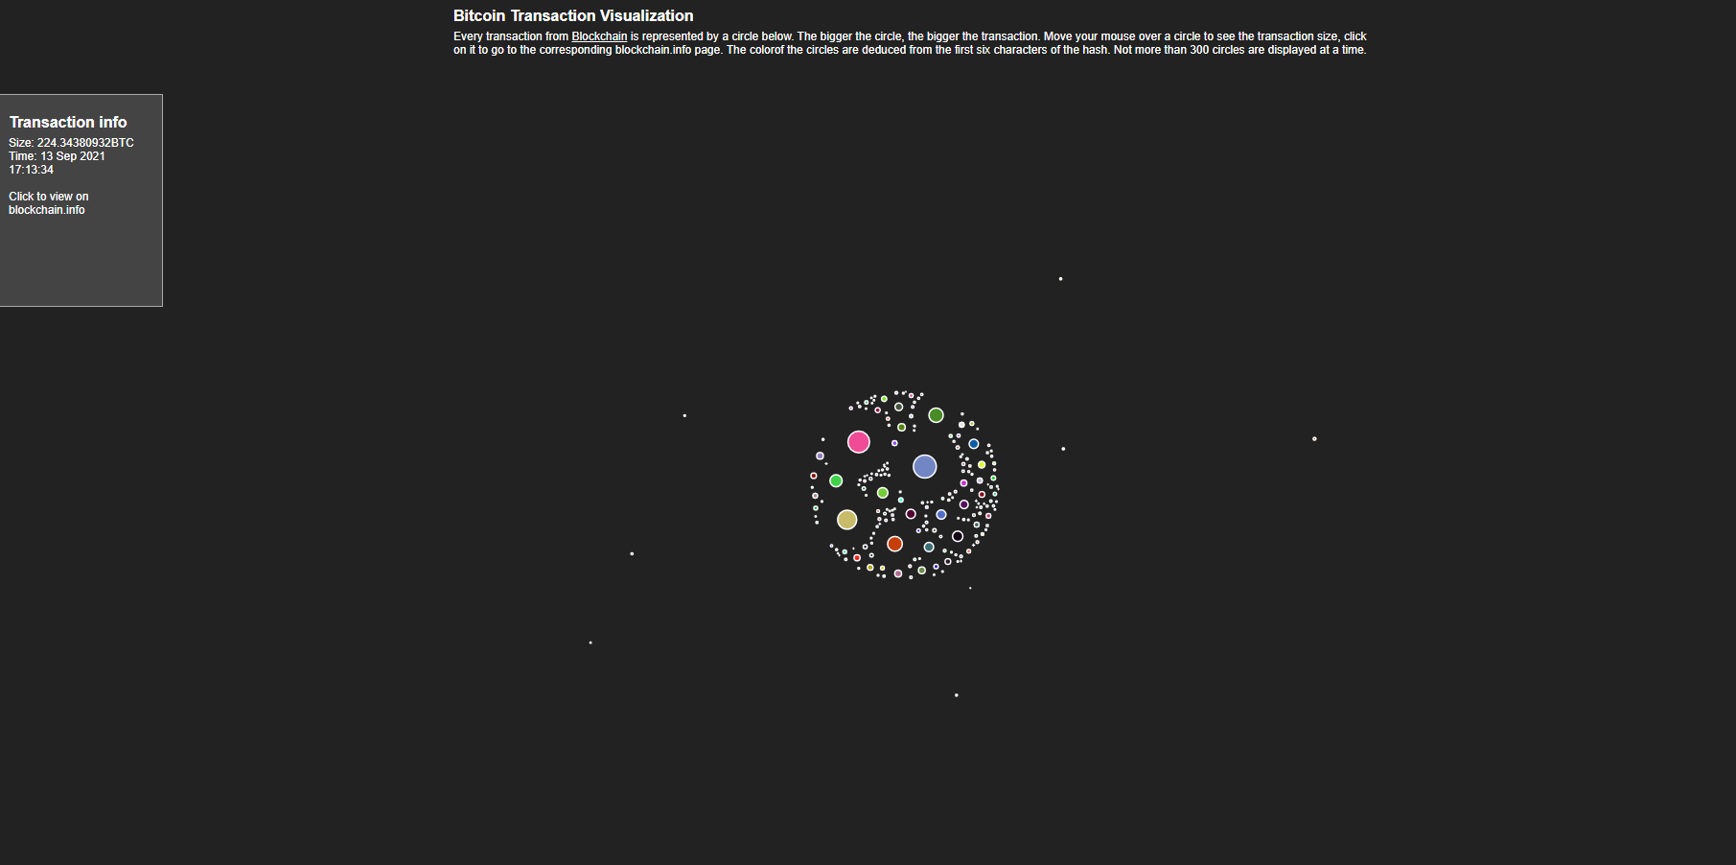
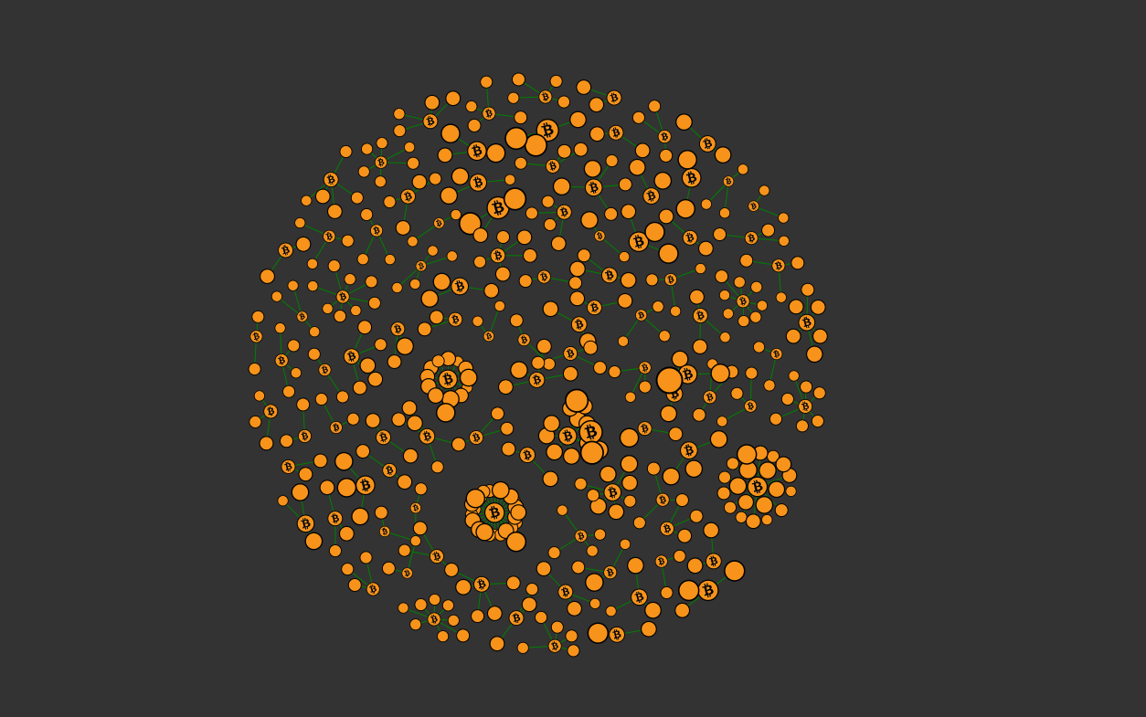
Related Works - Visualization

Slide 26
Thank you
Lorella Landi
Giovanni Ruocco
Andrea Gaetano Ferrara
Github : https://github.com/giovanniruocco/Bitcoin-Transactions

