Slide 1
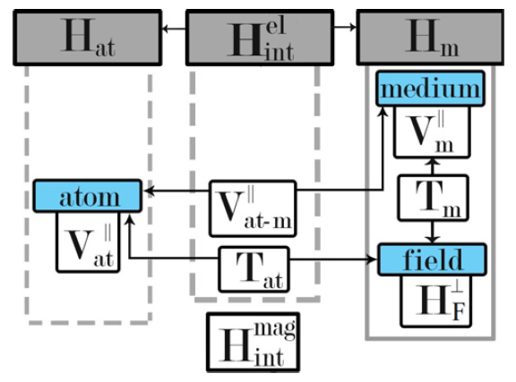

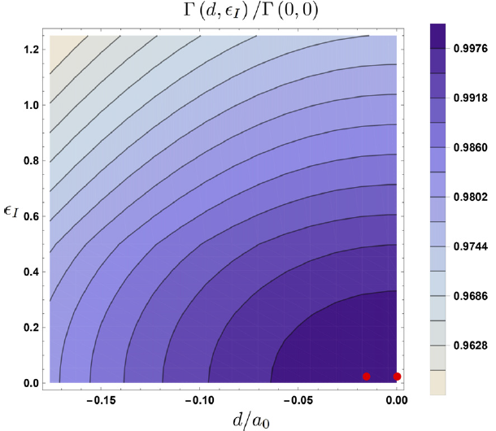
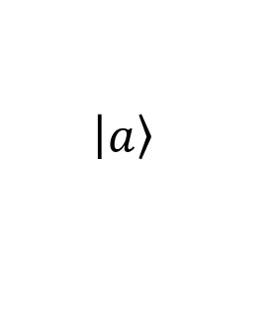

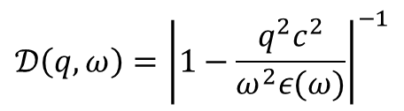

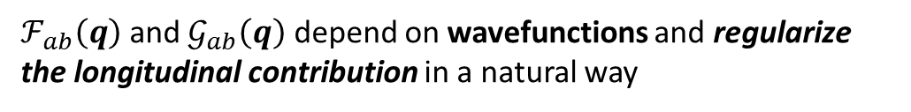

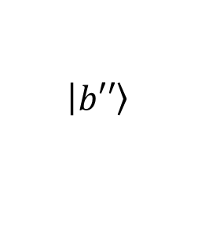
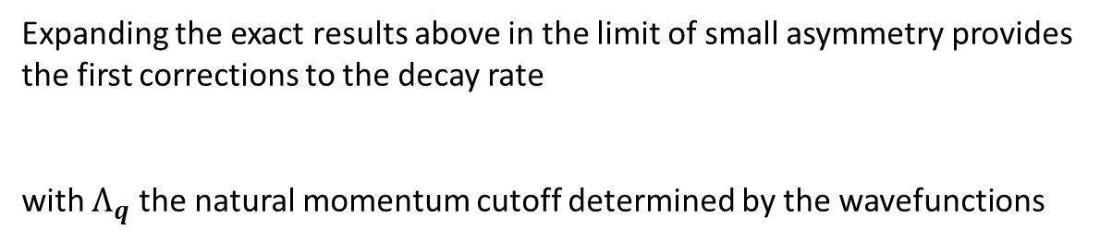

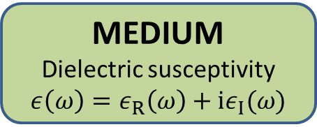
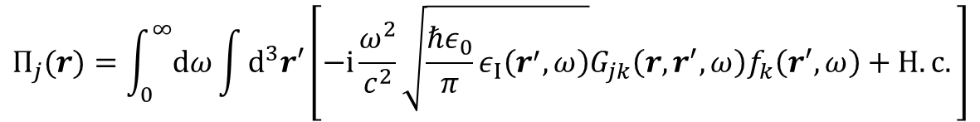
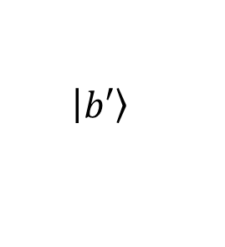
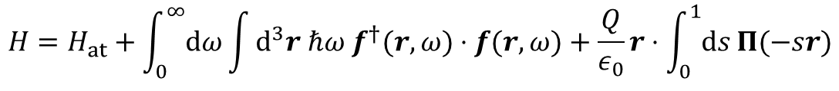


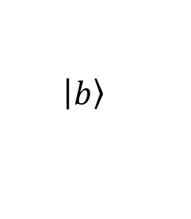

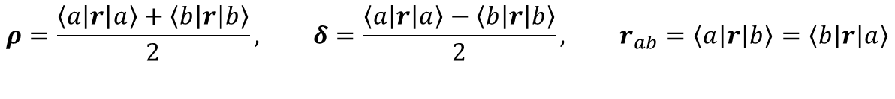

Light interaction with extended quantum systems in dispersive media
Giovanni Scala,^{1,2} Francesco V. Pepe,^{1,2} Paolo Facchi,^{1,2} Saverio Pascazio,^{1,2} and Karolina Słowik³
¹Dipartimento di Fisica, Università di Bari, I-70126 Bari, Italy
²INFN, Sezione di Bari, I-70125 Bari, Italy
³Institute of Physics, Nicolaus Copernicus University in Torun, 87-100 Torun, Poland
Abstract
We derive a light–matter interaction Hamiltonian to describe a quantum emitter embedded in a dispersive and absorptive environment. We include in this theory the spatial extension of the system, taken into account through its wavefunction. This enables us to overcome the divergence problem of the Green tensor propagator that arises from a point-like approximation of the quantum system. The formalism can be applied to generalize the expressions for the spontaneous emission rate and the Lamb shift for a quantum system defined by a spatially extended dipole.
The Hamiltonian
ATOM
Neutral bound system of charged particles
PHOTONS
Transverse electromagnetic field
MEDIUM
Dielectric susceptivity
$$ε\left(ω\right)=ε_{R}\left(ω\right)+iε_{I}(ω)$$
The model involves:
motion of the atomic charges
electromagnetic field energy
coupling between charges and (transverse) EM field
electromagnetic interaction of charges of the medium
APPROXIMATION: atom as extended dipole with negligible recoil and magnetic interaction
MEDIUM-ASSISTED ELECTROMAGNETIC FIELD
(transverse + longituinal)
$$H=H_{at}+\int_{0}^{∞}{dω}\int{d^{3}r ℏω f^{†}(r,ω)⋅f(r,ω)}+\frac{Q}{ε_{0}}r⋅\int_{0}^{1}{ds}Π(−sr)$$
M-A field mode Extended dipole interaction
Displacement
operator
$$Π_{j}(r)=\int_{0}^{∞}{dω}\int{d^{3}r′\left[−i\frac{ω^{2}}{c^{2}}\sqrt{\frac{ℏε_{0}}{π}ε_{I}\left(r^{′},ω\right)}G_{jk}\left(r,r^{′},ω\right)f_{k}\left(r^{′},ω\right)+H.c.\right]}$$
M-A field Green’s tensor
Decay rate in a translation-invariant medium
$$\left|\left.a\right\rangle \right.$$
$$Γ_{a}=\sum_{b≠a}{Θ(ω_{ab})\frac{Q^{2}ε_{I}\left(ω_{ab}\right)}{4π^{3}ℏε_{0}{\left|ε\left(ω_{ab}\right)\right|}^{2}}\int{d^{3}q\left[𝒟\left(\left|q\right|,ω_{ab}\right)𝒢_{ab}\left(q\right)+\left(1−𝒟\left(\left|q\right|,ω_{ab}\right)\right)\frac{{\left|ℱ_{ab}\left(q\right)\right|}^{2}}{{\left|q\right|}^{2}}\right]}}$$
$$ℏω_{ab}$$
$$q,ω_{ab}$$
Contribution of longitudinal field
$$\left|\left.b\right\rangle \right.$$
$$𝒟\left(q,ω\right)={\left|1−\frac{q^{2}c^{2}}{ω^{2}ε(ω)}\right|}^{−1}$$
$$\left|\left.b′\right\rangle \right.$$
$ℱ_{ab}\left(q\right)$ and $𝒢_{ab}\left(q\right)$ depend on wavefunctions and regularize the longitudinal contribution in a natural way
$$\left|\left.b′′\right\rangle \right.$$
Two-level atom with spatial asymmetry
Example
$$ρ=\frac{\left\langle a\left|r\right|a\right\rangle +\left\langle b\left|r\right|b\right\rangle }{2}, δ=\frac{\left\langle a\left|r\right|a\right\rangle −\left\langle b\left|r\right|b\right\rangle }{2}, r_{ab}=\left\langle a\left|r\right|b\right\rangle =\left\langle b\left|r\right|a\right\rangle$$
Quantum well with asymmetric electron wavefunctions
$$ρ≠0$$
$$δ=0$$
Decay rate with varying spatial asymmetry and imaginary susceptivity
$${Γ(ρ,ε}_{I})/Γ(0,0)$$
$$ℱ_{ab}\left(q\right)=−ie^{−iq⋅ρ}q⋅r_{ab}sinc\left(A\left(q\right)\right), 𝒢_{ab}\left(q\right)={\left|∇_{q}\left[q⋅r_{ab}\int_{0}^{1}{ds}sinc\left(sA\left(q\right)\right)e^{−isq⋅ρ}\right]\right|}^{2}$$
with $A\left(q\right)=\sqrt{{(q⋅r_{ab})}^{2}+{(q⋅δ)}^{2}}$
$$ε_{I}$$
Expanding the exact results above in the limit of small asymmetry provides the first corrections to the decay rate
with $Λ_{q}$ the natural momentum cutoff determined by the wavefunctions
$$Γ_{a}=Γ_{a,symm}\left[1+O\left({\left(Λ_{q}δ\right)}^{2}\right)+O\left({\left(Λ_{q}ρ\right)}^{2}\right)\right]$$
$$ρ/a_{0}$$
Main references
G. Scala, F. V. Pepe, P. Facchi, S. Pascazio, and K. Słowik, Light interaction with extended quantum systems in dispersive media, New J. Phys. 22, 123047 (2020).
M. Hillery and L. Mlodinow, Quantized fields in a nonlinear dielectric medium: a microscopic approach, Phys. Rev. A 55, 678 (1997).
W. Vogel and D.-G. Welsch, Quantum Optics (Wiley, New York, 2006)

