Slide 1

Software Engineering 2
Group 17
Demo Sprint 1 process

Slide 2

Process - Macro Statistics
Number of stories
Committed: 4
Done: 4
Total points
Committed: 16
Done: 16
Nr hours
Planned: 20h 15m
Spent: 33h 15m

Slide 3

Process - Detailed Statistics
Hours per task
Average: 2h
Standard deviation: 1h 25m
There are 4 tasks not included in the stories
Total hours estimation: 8h 15m
Total hours spent: 13h 45m
Total task estimation error ratio
No testing: 20h 15m / 33h 15m = 0.6
With testing (no hours estimation):
20h 15m / 40h 45m ~ 0.5

Slide 4
Process - Stories overview
Story #1 As a Customer I want to select the type of service so that I can fulfill my request
Story #2 As a Customer I want to see ticket number being served so that I can know if it's my turn
Story #3 As a Customer I want to see the number of people in queue for each service so that I can know how many people are in line
Story #7 As an Officer I want to call the next Customer so that I can serve him

Slide 5
Process - Detailed Statistics
Story ID | Number of tasks | Points | Total hours estimation | total hours spent
#1 | 3 | 5 | 4h 30m | 8h
#2 | 2 | 3 | 2h 30m | 2h
#3 | 2 | 3 | 1h | 3h 30m
#7 | 3 | 5 | 4h | 7h

Slide 6

Quality
Unit Testing:
Total hours estimated: /
Total hours spent: 3h
Nr of automated unit tests: 8
E2E/System testing:
Total hours estimated: /
Total hours spent: 30m
Code review
Total hours estimated: /
Total hours spent: 4h

Slide 7
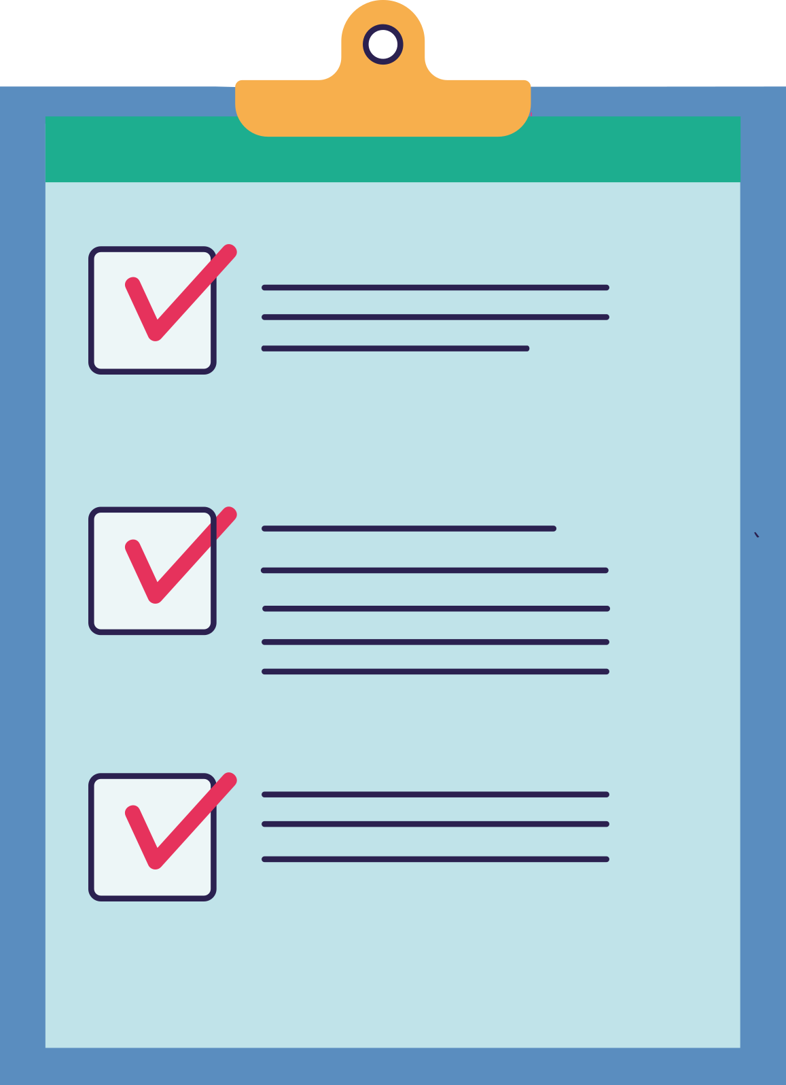
Assessment
All 4 Planned stories have been done
Inexperience caused to underestimate some tasks, also some important tasks like Testing and Code reviewing were not estimated.

Slide 8

Learned lessons
Preparing some common baselines for working on project.
Improving communication with teammates.
Select more descriptive definition of the tasks.
Don’t underestimate the time zones difference.

Slide 9

Improvement goals
Consider all the aspects of the project by adding more opportune tasks, especially for testing and code reviewing, and try to be more descriptive to avoid any kind of ambiguity.
Learn how to synchronize better as a team by communicating more often with other members and by making sure that everyone has a good understanding of what each is doing.

Slide 10

What we are proud of
Achieving all the goals we have set with minimal number of errors.

