Slide 1
Conclusions
Giovanni Vigna
UCSB
Fall 2024

Slide 2
Topics
History of hacking
Vulnerability modeling
Vulnerability analysis
Static analysis
Dynamic analysis
Challenge-based assignments, self-paced
Project: Application of AI to vulnerability analysis

Slide 3



Vulnerability Analysis and AI
Manual
Semi-Automated, Tool-based
Fully Automated
AI-based

Slide 4
Suggestions?

Slide 5
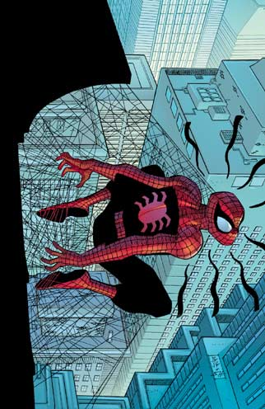
Final Comment
With great power comes great responsibility!
Also: Please fill the course evaluation!

