Slide 1
Targets and Contexts “Where are you looking, my friend?”
Giovanni Vigna
UCSB
Fall 2024

Slide 2
Targets and Contexts
Vulnerabilities are not identified in isolation
Vulnerabilities are found in a target, possibly in a specific context
Recreation of the correct context, execution of the target (dynamic analysis), and access to its internals, greatly affect the effectiveness of the analysis process
When execution is not possible, the analysis can only be based on the code (static analysis)

Slide 3
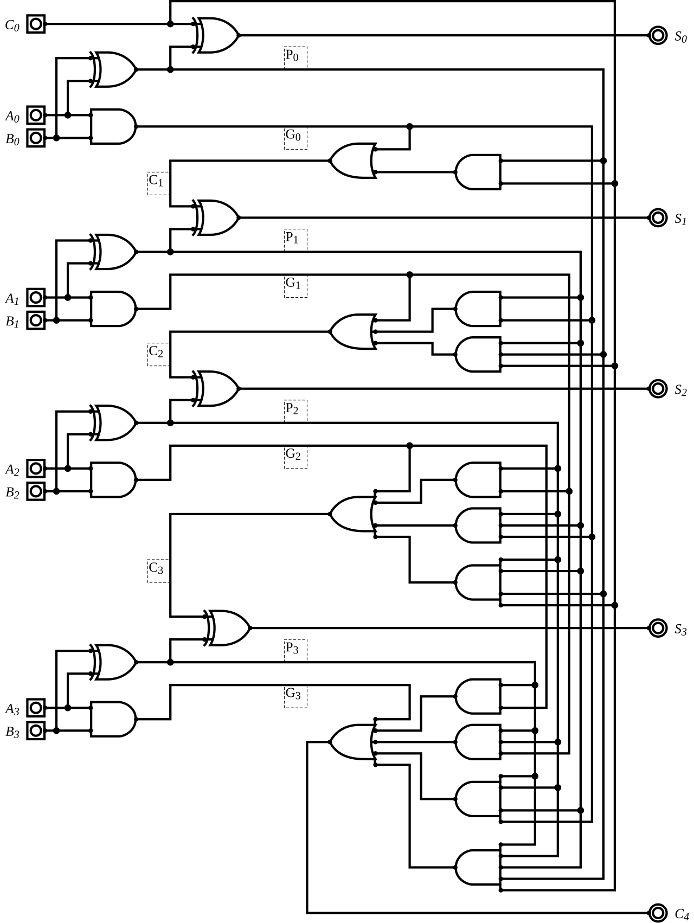
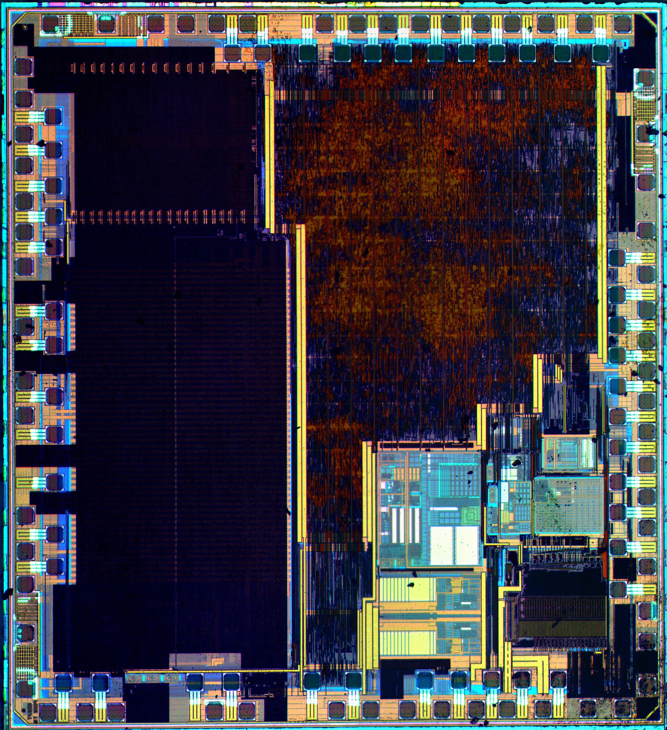
Basic Hardware
4-bit Binary adder
ARM Cortex-M3 Microcontroller

Slide 4
Firmware
Bare-metal firmware
No OS abstractions (processes, virtualized memory)
Monolithic code that runs on a specific hardware platform
Firmware based on specialized embedded OSs
Some OS abstractions
Focus on real-time performance (RTOS)
Firmware based on general-purpose OSs
Full OS abstractions
Access to specialized hardware through drivers

Slide 5
Firmware Re-hosting
Firmware is especially challenging to execute without the right hardware
Re-hosting is the process of executing firmware in an environment that does not include the original hardware
Emulators (e.g., QEMU and Simics) can be used to execute firmware (including monolithic firmware) without the hardware
Emulators can also be used to execute single programs contained in a firmware distribution

Slide 6
QEMU
QEMU is a machine emulator (https://www.qemu.org)
Supports a number of architectures
Full-system emulation
QEMU provides virtualized hardware on top of which an OS is installed
User-mode emulation
QEMU supports the cross-architecture execution of Linux or MacOS binaries

Slide 7
Firmware Context
Firmware usually receives inputs from peripheral (e.g., a heat sensor) or the network and produces outputs using actuators and other signals
Input is often provided using memory-mapped I/O (MMIO)

Slide 8
Operating Systems
Operating system can be the target of vulnerability analysis
A fault in an operating system causes a catastrophic end
Virtualization (or emulation) is used to execute operating systems in a controlled environment
Vulnerability analysis is made difficult by the complex nature of modern OSs and their concurrent execution models

Slide 9
Operating System Context
Operating systems receive input
From the external environment (e.g., the network)
From user applications, by means of system calls
Operating system produce output
Generating signals to the external environment (e.g., peripherals)
Returning system call values to user applications

Slide 10
Applications
Applications can be local or network-accessible
What an application can and cannot do depends on:
The characteristics of the application
Who launched the application
These aspects depend on the underlying operating system
Windows security model
MacOS security model
Linux security model
A vulnerability allows an attacker to perform actions beyond those intended by the application

Slide 11
The Life of an Application
Author writes code in high-level language
The application is translated in some executable form and saved to a file
Interpretation vs. compilation
The application is loaded in memory
The application is executed
The application terminates

Slide 12
Interpretation
The program is passed to an interpreter
The program might be translated into an intermediate representation
Python byte-code
Each instruction is parsed and executed
In most interpreted languages, it is possible to generate and execute code dynamically
Bash: eval “...”
Python: eval(“...”)
JavaScript: eval(“...”)
…

Slide 13
Compilation
The preprocessor expands the code to include definitions, expand macros
GNU/Linux: The C preprocessor is cpp
The compiler turns the code into architecture-specific assembly
GNU/Linux: The C compiler is gcc
gcc –S prog.c will generate the assembly
Use gcc’s –m32 option to generate 32-bit assembly

Slide 14
Compilation
The assembler turns the assembly into a binary object
GNU/Linux: The assembler is as
A binary object contains the binary code and additional metadata
Relocation information about things that need to be fixed once the code and the data are loaded into memory
Information about the symbols defined by the object file and the symbols that are imported from different objects
Debugging information

Slide 15
Compilation
The linker combines the binary object with libraries, resolving references that the code has to external object (e.g., functions) and creates the final executable
GNU/Linux: The linker is ld
Static linking is performed at compile-time
Dynamic linking is performed at run-time
Most common executable formats:
GNU/Linux: ELF
Windows: PE
Mac: Mach-O

Slide 16
Target Visibility and Access
A black-box target can only be probed by providing inputs and analyzing output
Access to executable code (binary) supports better understanding (and possibly debugging)
The availability of source code allows for deeper understanding of the target’s behavior
Access to a build environment allows one to create different versions of the target (e.g., to add instrumentation)

Slide 17
Target Slicing
Sometimes targets are too complex to be analyzed as a whole
Sometimes the sub-component of a target is difficult to reach
Slicing is the process of extracting from a target’s code base the subset of functionality that needs to be analyzed

Slide 18
Example
Original:
int main(int argc, char* argv[]) {
struct appenv *app;
app = initialization(argv[1]);
lengthy(argv[2]);
pass = getpass();
if (!verify(pass)) exit();
checkforupdates();
tobetested(app);
}
Slice:
int main(int argc, char* argv[]) {
struct appenv *app;
app = initialization(argv[1]);
tobetested(app);
}

Slide 19
Controlling Execution
Once a target and a context have been determined, the ability to control the target’s execution can be key in the vulnerability analysis process
Freezing execution allows the analyst to access intermediate states
In some cases, it is possible to move backward in the execution process

Slide 20
gdb
The GNU debugger is the basic tool for dynamic analysis
https://www.gnu.org/software/gdb/
A debugger allows one to examine the status of a program
Set breakpoints
Step through instructions
Inspect memory/CPU
Can be scripted through Python

Slide 21
rr
rr records the execution of a program and allows for its deterministic re-execution
Useful in the debugging of complex binaries in which might be difficult to replicate the conditions that brought the program to crash or malfunction
https://rr-project.org/

Slide 22
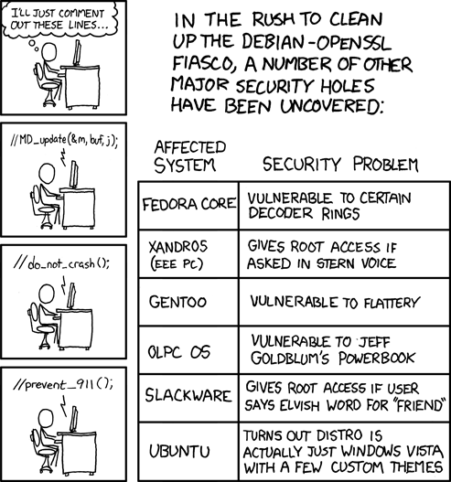
Conclusions
https://xkcd.com/424/

