Slide 1
Conclusions
Giovanni Vigna
UCSB
Fall 2023

Slide 2
Topics
History of hacking
Basic cryptography
Vulnerability analysis of applications (source code)
Vulnerability analysis of applications (binary code)
Vulnerability analysis of web applications
Basic security issues of smart contracts
Challenge-based assignments, self-paced
Project: Application of AI to vulnerability analysis
Not covered: Vulnerability analysis of kernel and firmware

Slide 3



Vulnerability Analysis and AI
Manual
Semi-Automated, Tool-based
Fully Automated
AI-based

Slide 4
Lessons Learned
Less time on crypto
More time on tooling
Cover kernel and firmware
Cover (more in depth) smart contracts
Give deadlines for challenges
Suggestions?

Slide 5
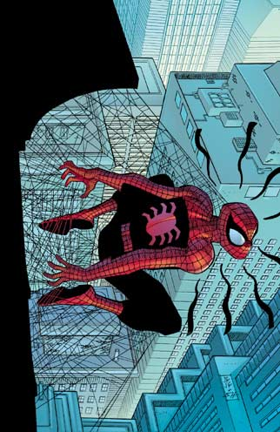
Final Comment
With great power comes great responsibility!
Also: Please fill the course evaluation!

