Slide 1










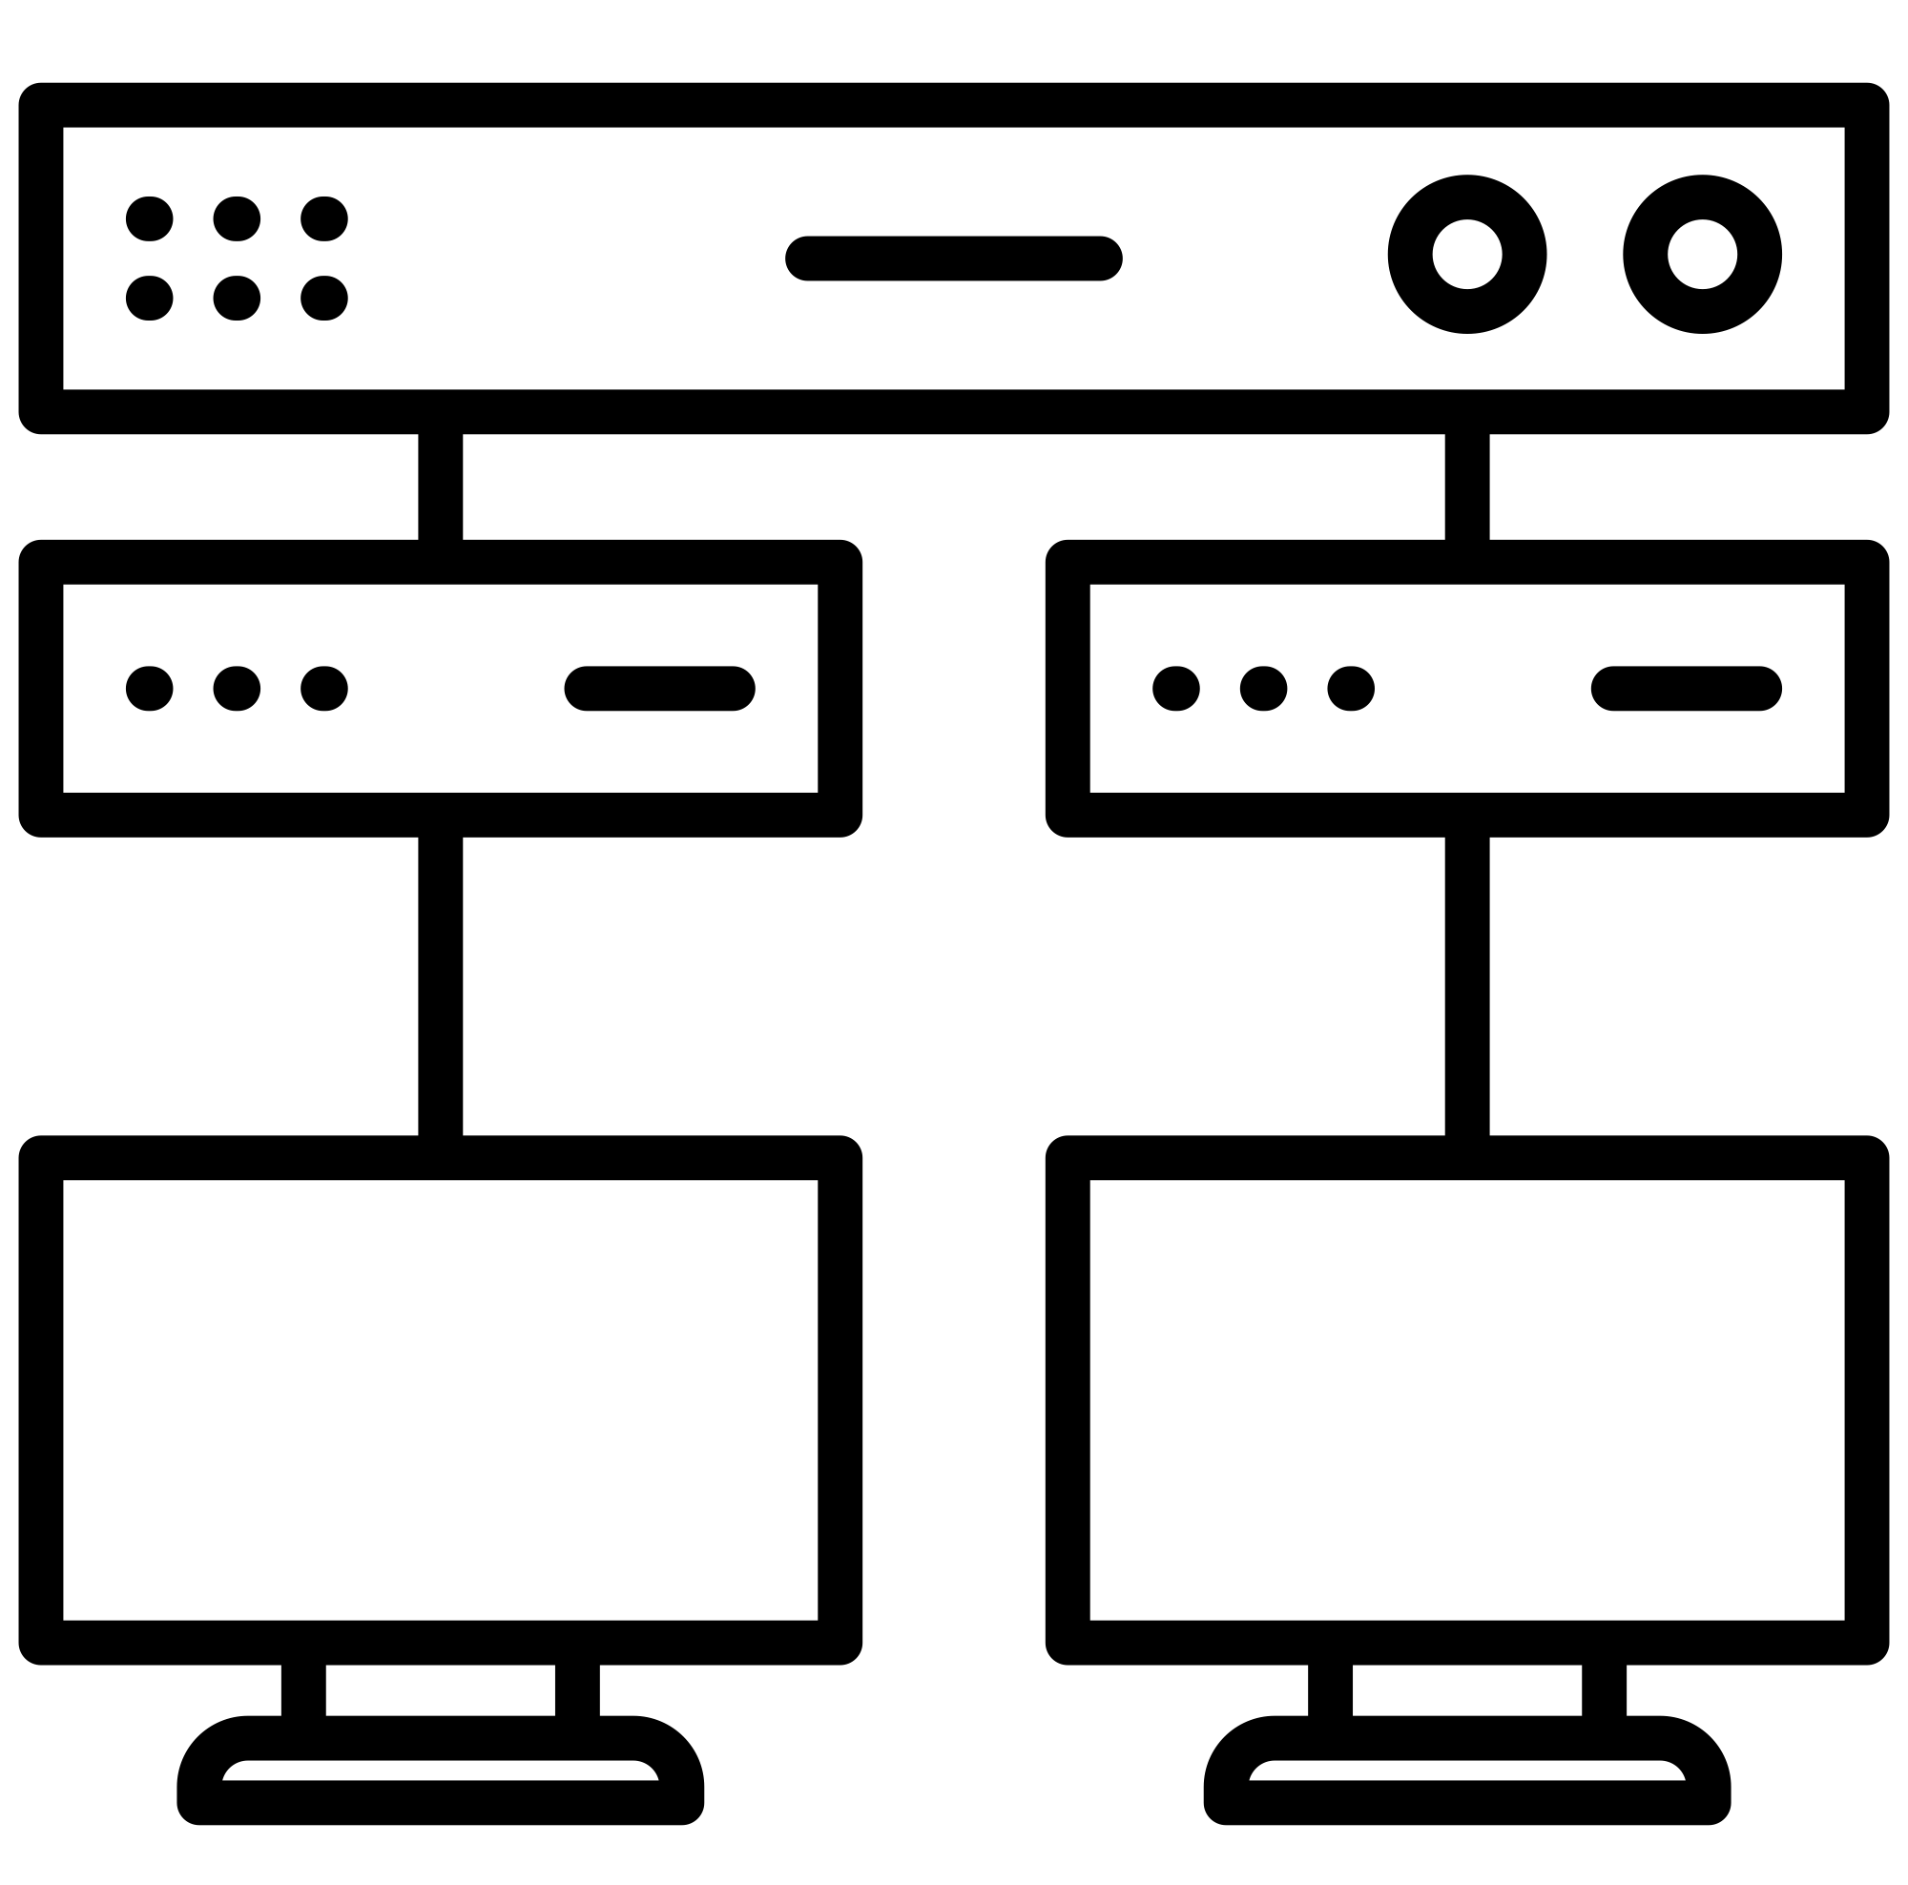
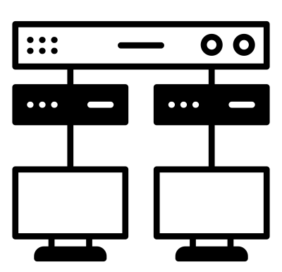




Target Infrastructure
Documentation
Digital Twin
Observer Agent
Red Team Agent
Red Team Agent
Knowledge Base Agents
Security Assessment
Human Expert
Observer Agent
Replication Agent
Red Team Agent
Knowledge Base
Replication Agent
Observer Agent
Observation Plan
Replication Agent
Observer Agent

