Slide 1
WORLD’S gdp Analysis
{python}
Giovanny Pacheco

Slide 2
Disclaimer:
The dataset used in this case study was downloaded from The World Bank’s website. The dataset was modified and prepared to simplify the analysis in this case study, but it can be downloaded in its original form here.
World Bank Open Data provides free and open access to global development data.

Slide 3
Research Description
The objective of this project is to research how the world has developed in the last ten years, analyzing real world data from the World Bank.
This dataset contains 10 years of percentage GDP growth, from 2006 to 2015.

Slide 4
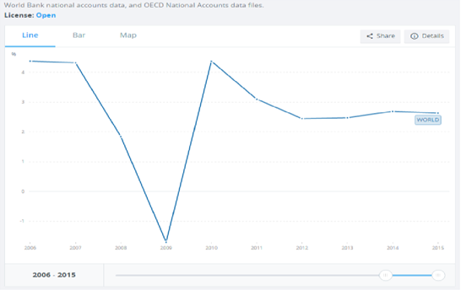
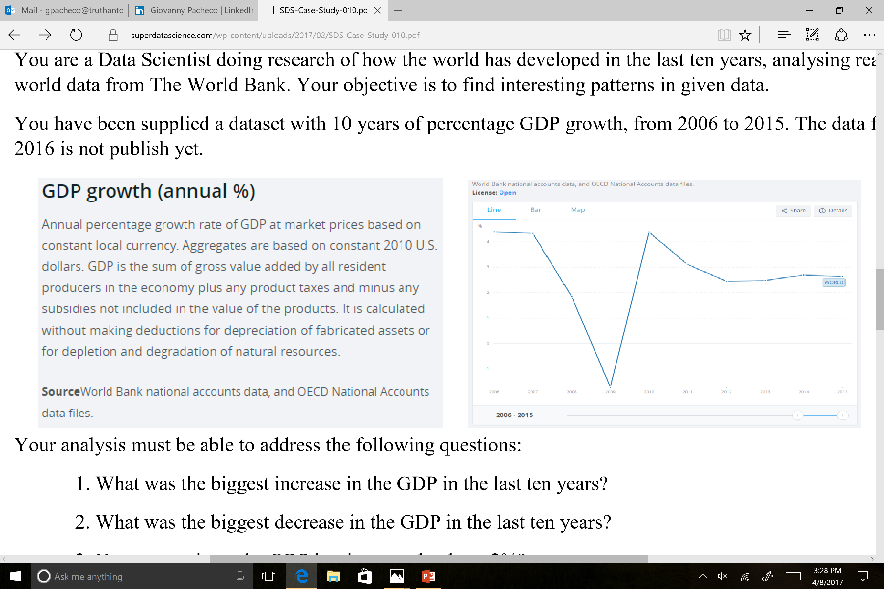

Slide 5
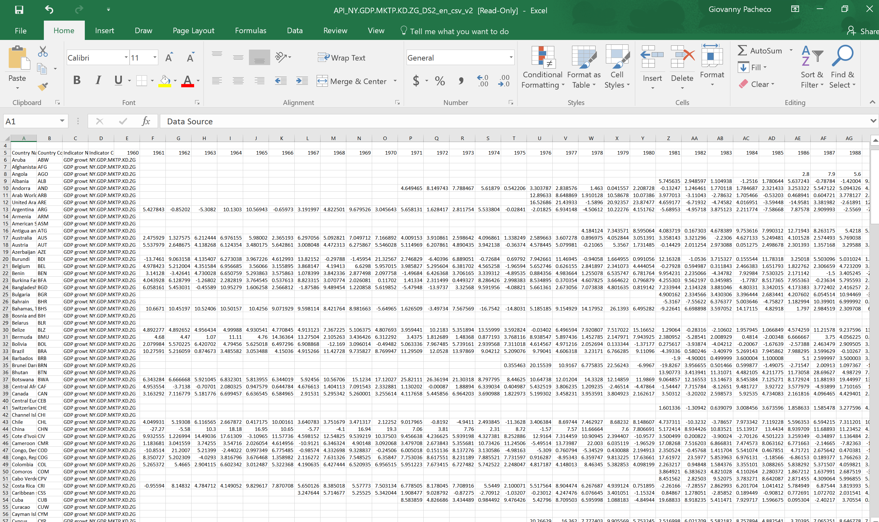

Slide 6
Analysis address the following
What was the biggest increase in the GPD in the last ten years?
What was the biggest decrease in the GDP in the last ten years?
How many times the GDP has increased at least 2%?
How many times the GDP has decreased?
What was the average growth of the last ten years?
Suppose that The Word’s GDP of 2004 and 2005 (both not present in the data provided) was respectively 45,619 and 47,207, expressed in billion dollars. Calculate the 2005 increase and check if the growth is above or below the average of the period between 2006 and 2015.
Which real world event is represented in this dataset?

Slide 7
World’s GDP Analysis from 2006 to 2015 in Jupyter Notebook
This notebook will solve the case study in three different ways:
The first one, so called brutal force, i.e. without using functions and packages.
The second a little bit more sophisticated, using NumPy package and advanced print statements.
The third one is advanced, using Pandas package to load the data.
I will show only the third method.

Slide 8
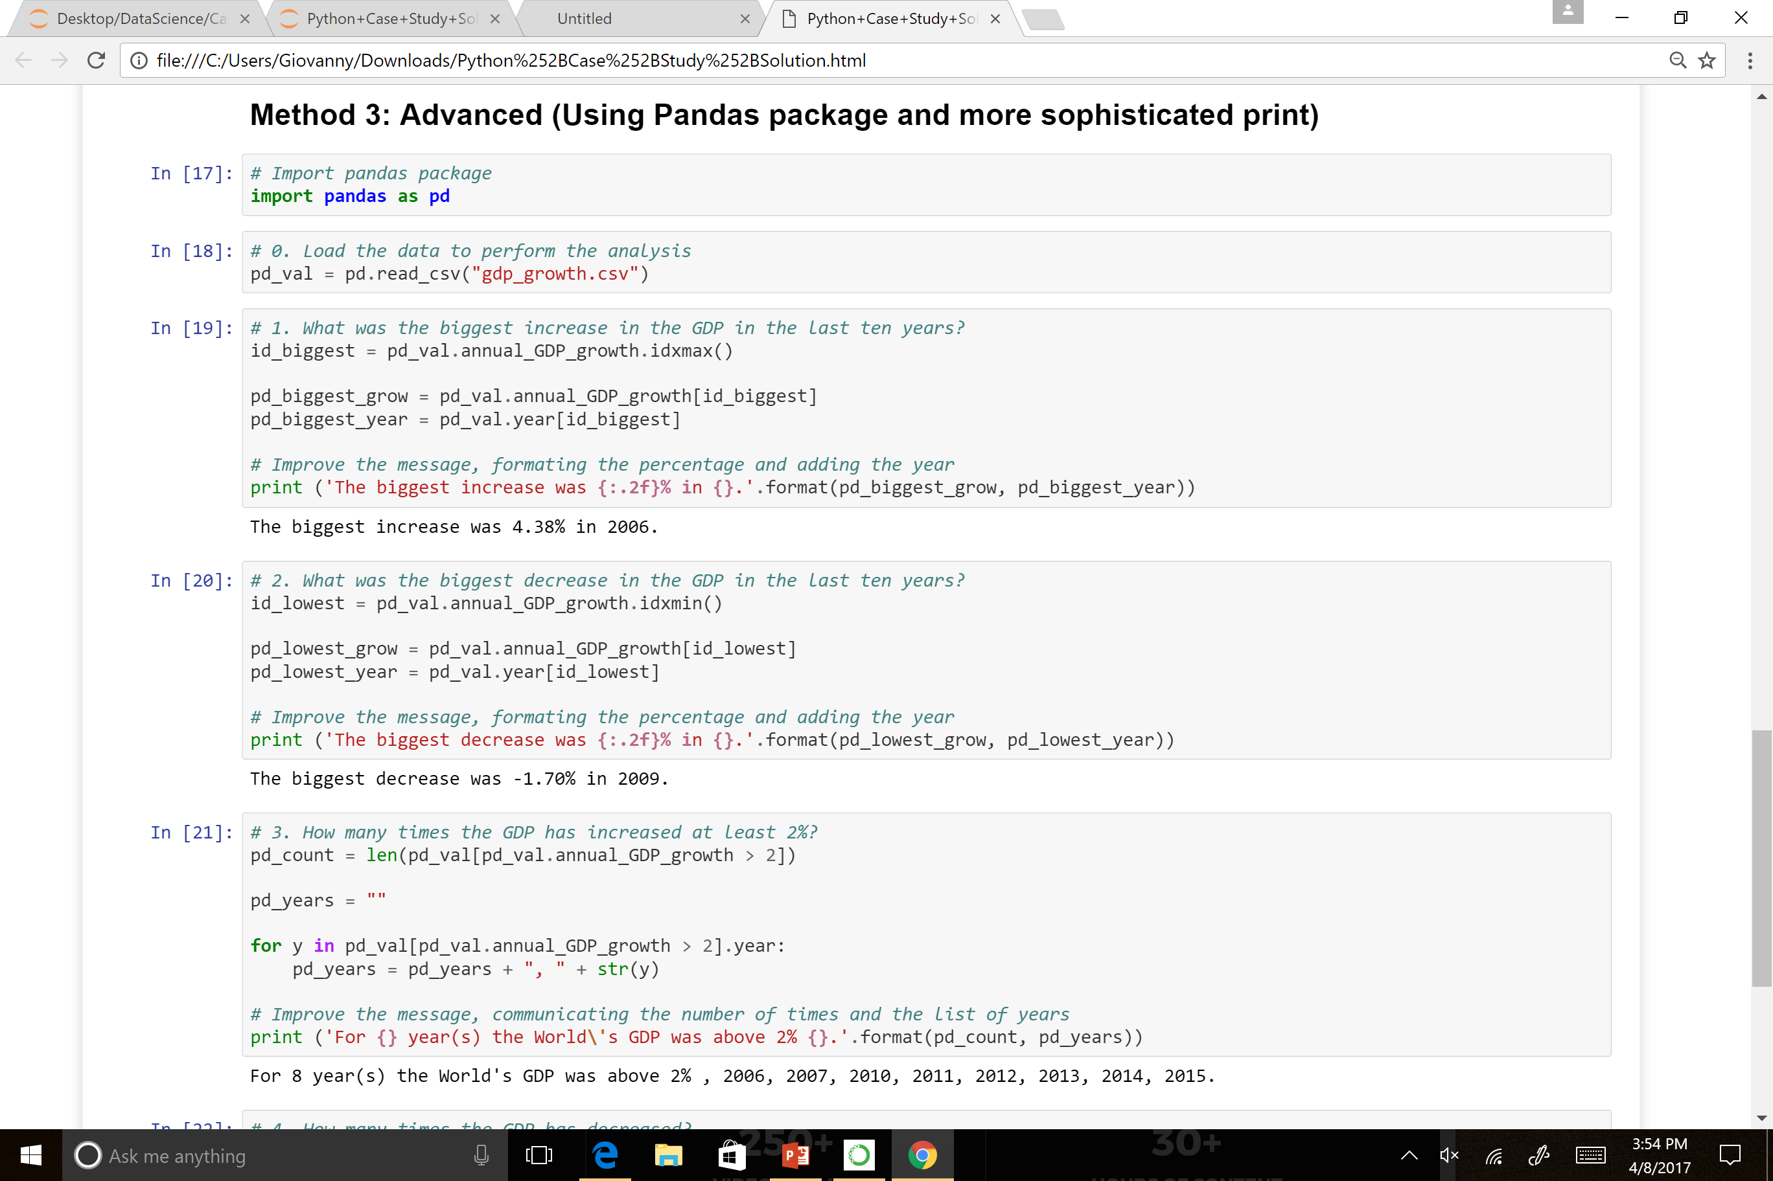

Slide 9
