Slide 1
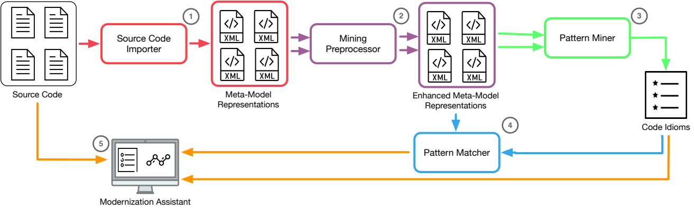
Mining patterns from single version
INTiMALS framework

Slide 2
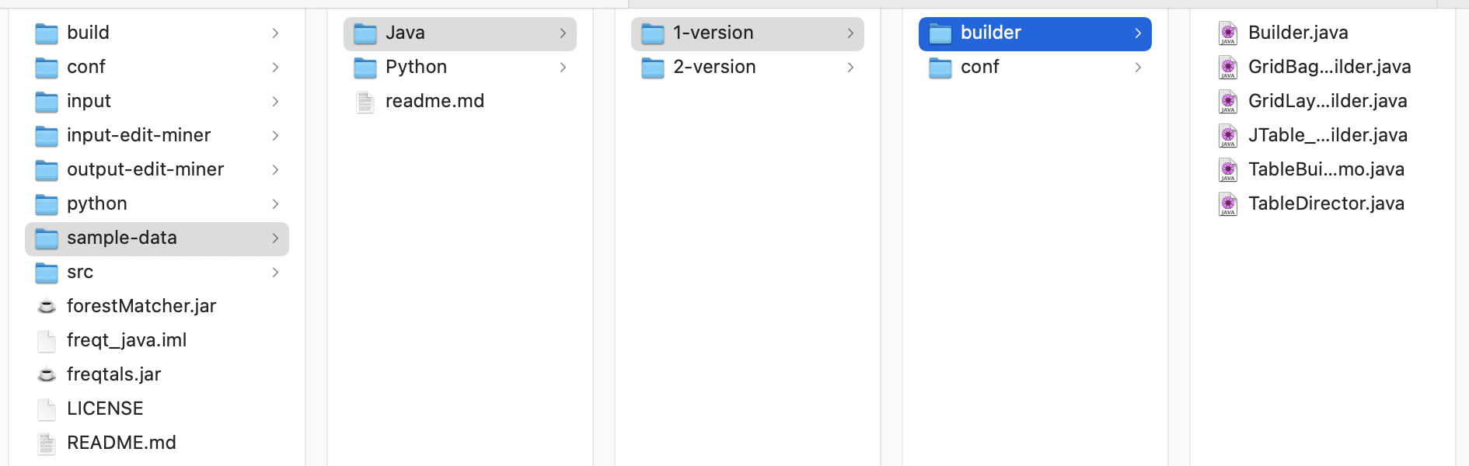
Source code importer
Java source code of the Builder project including 6 classes
sample-data can be found in the freqtals repository
https://gitlab.soft.vub.ac.be/intimals/freqtals/-/tree/master/sample-data

Slide 3
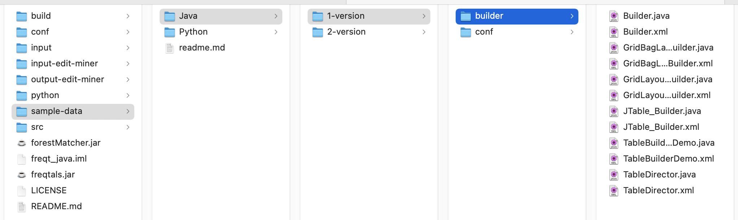
Running Source Code Importer
java -jar java-importer.jar import sample-data/Java/1-version/builder/
output of source code importer

Slide 4
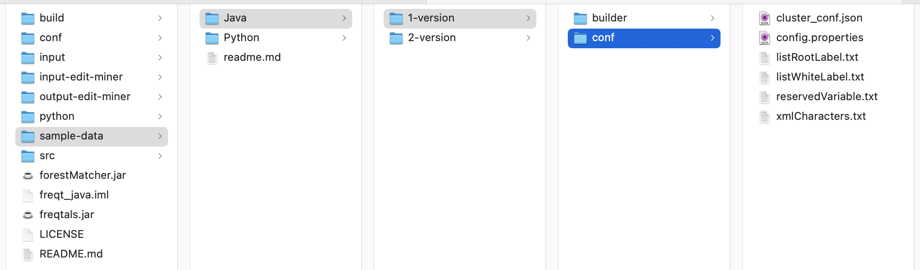
Running Pattern Miner
Configuration
Running Pattern Miner
  java -jar freqtals.jar sample-data/Java/1-version/conf/config.properties 2 builder

Slide 5
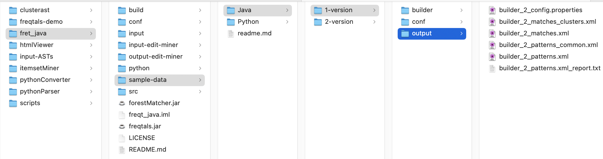
Output of Pattern Miner
Since the Pattern Matcher and Pattern Cluster are combined into the Pattern Miner, they are executed when running freqtals.jar
Output of these components

Slide 6
Output files
...conf.properties : configurations used to run the algorithm
...matches_clusters.xml : output of clustering algorithm
...matches.xml : output of Pattern Matcher
...patterns_common.xml : common pattern in each cluster
...patterns.xml : output by Pattern Miner
...report.txt : summarize the results of the Pattern Miner

Slide 7
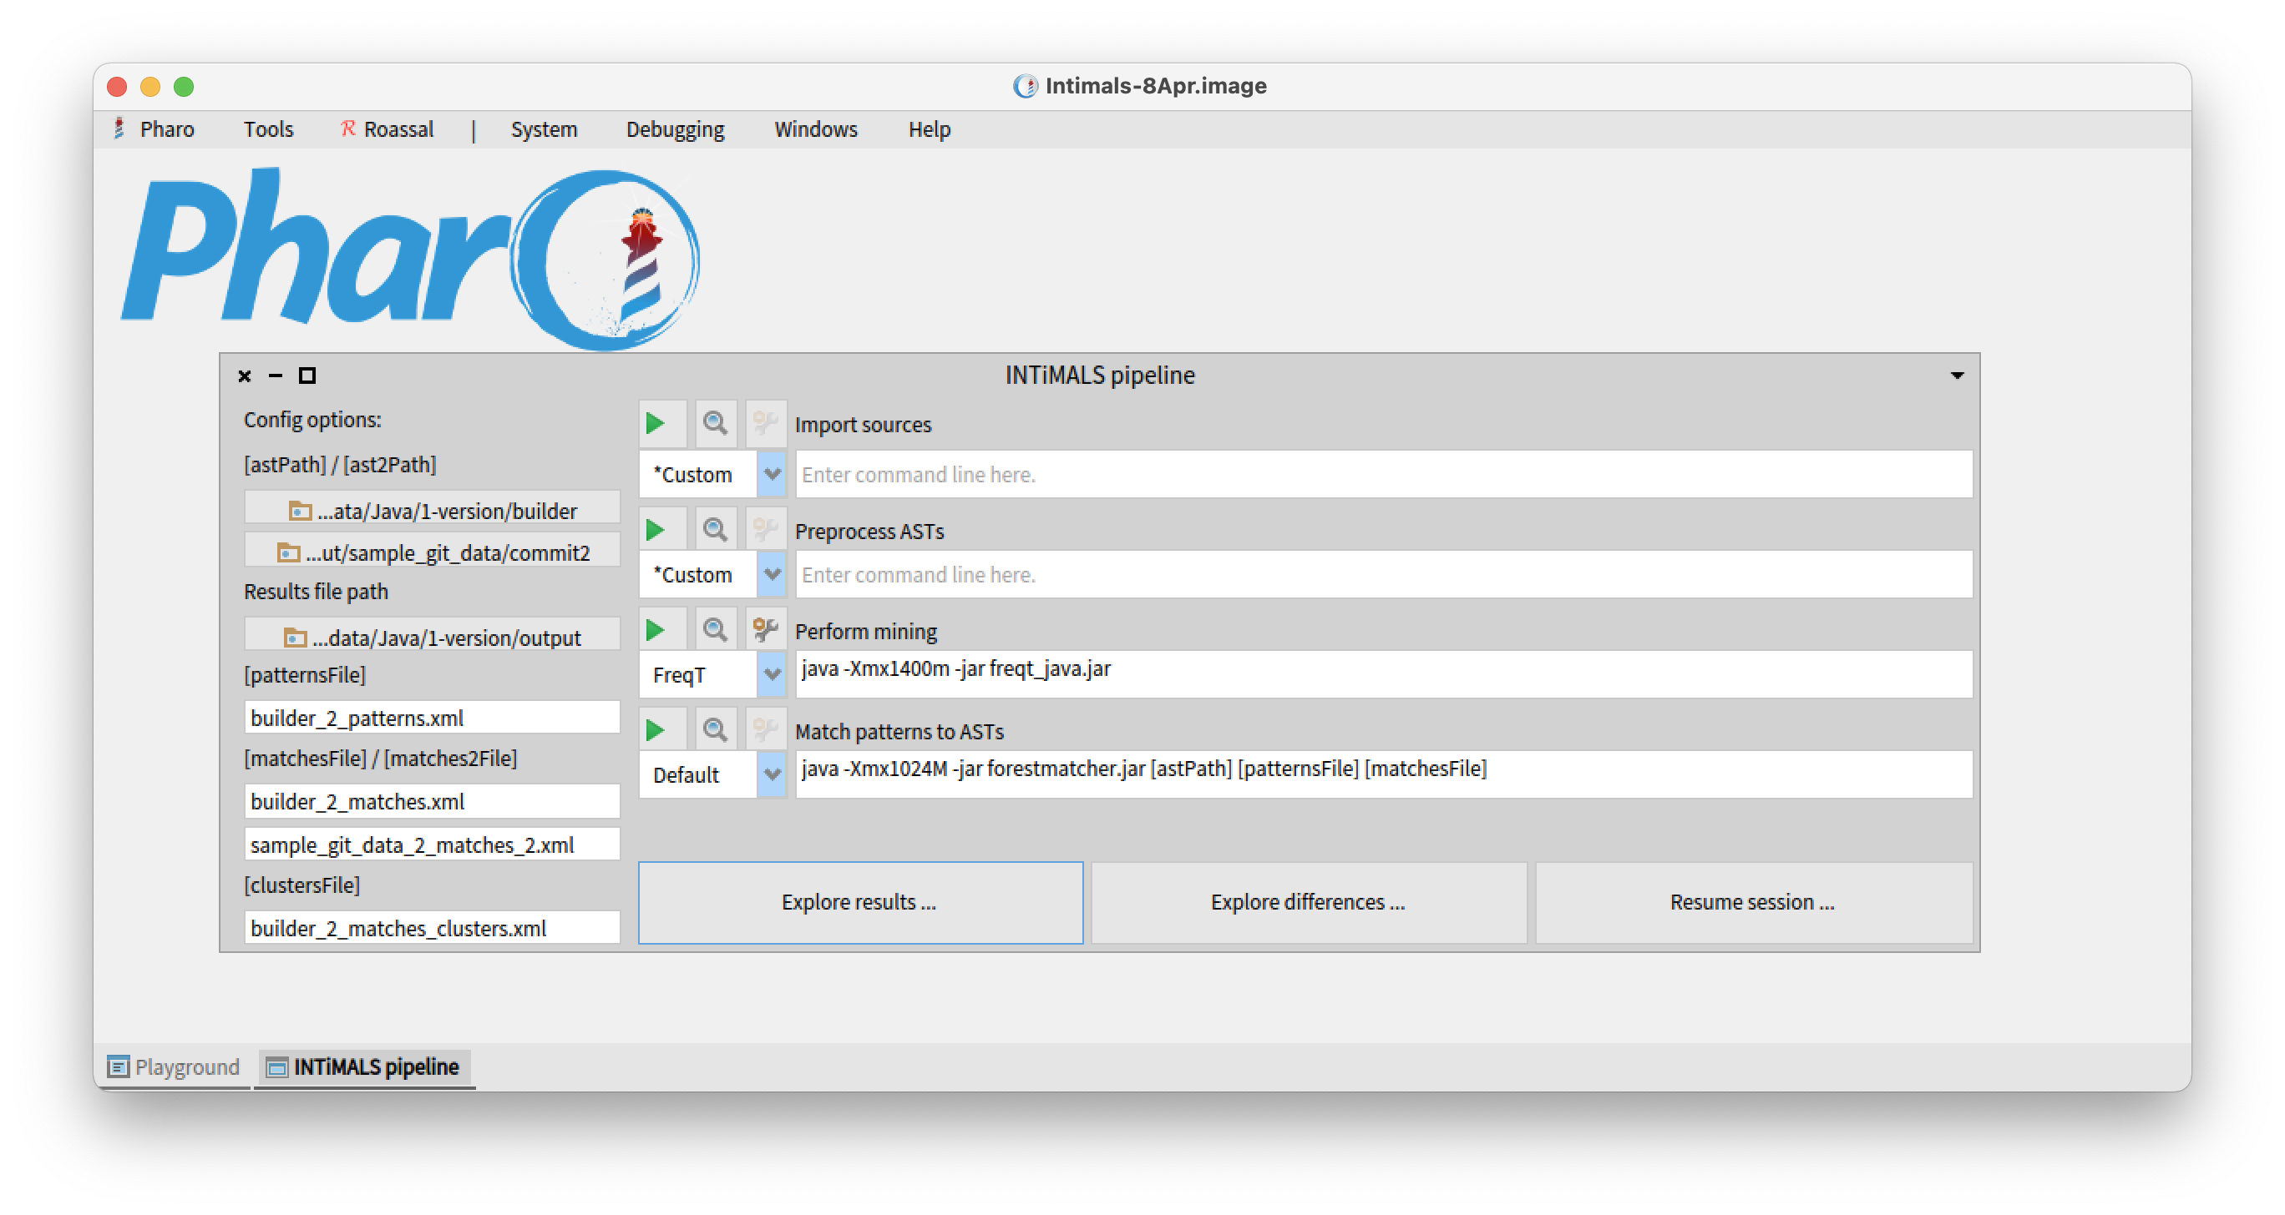
Visualization: select data

Slide 8
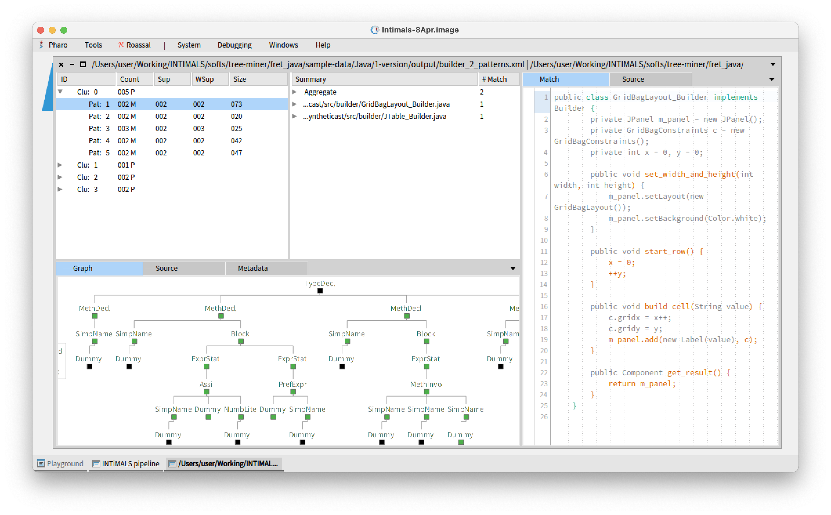
Visualization: browse result

Slide 10
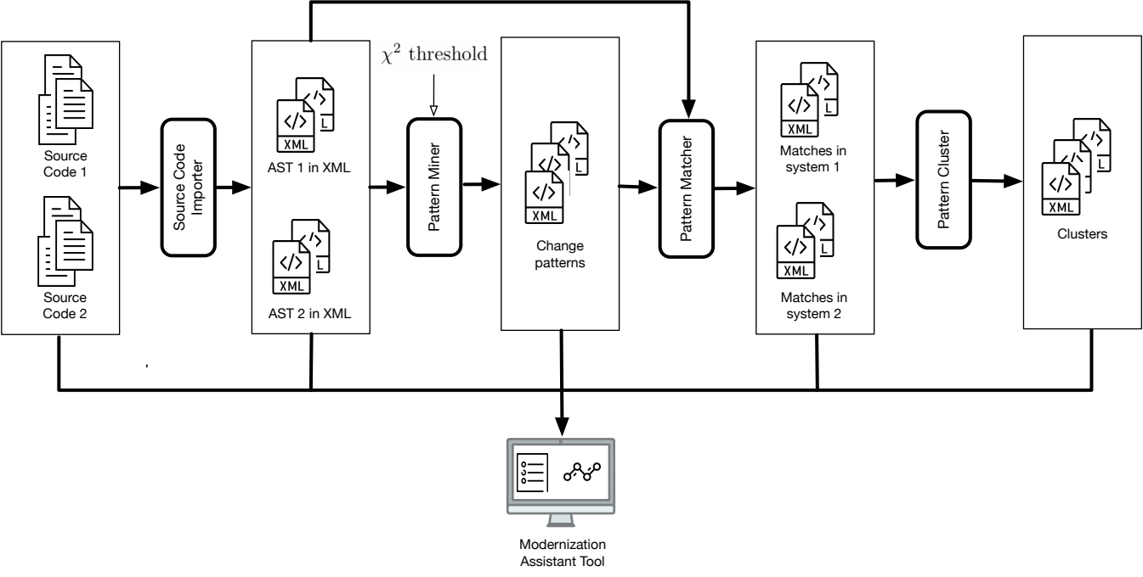
Mining patterns from two versions

Slide 11
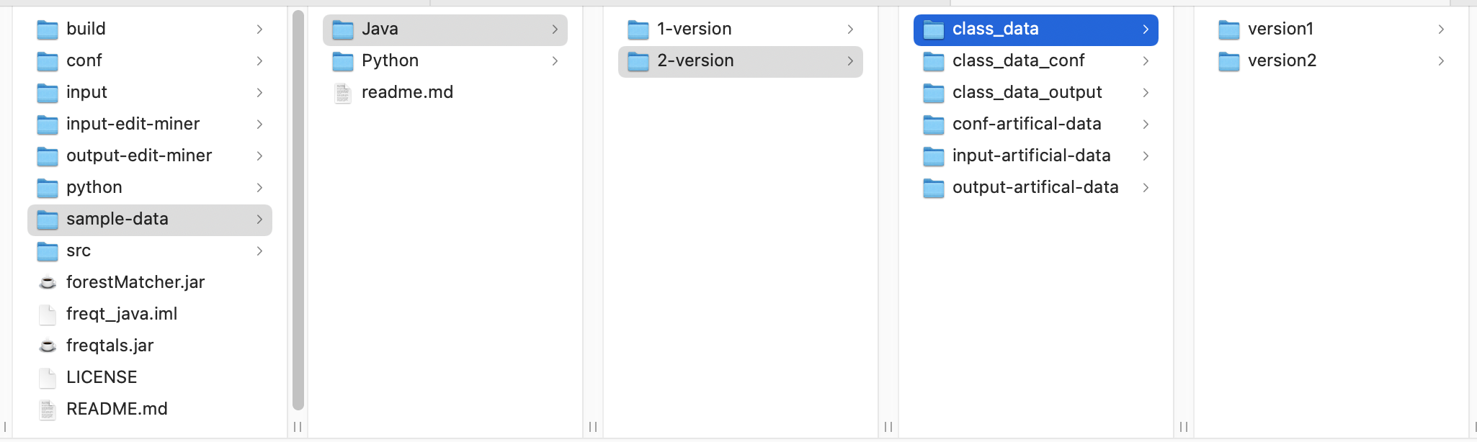
Source code importer
Using java-impoter to convert source code of 2 versions of a system
Input data for Pattern Miner

Slide 12
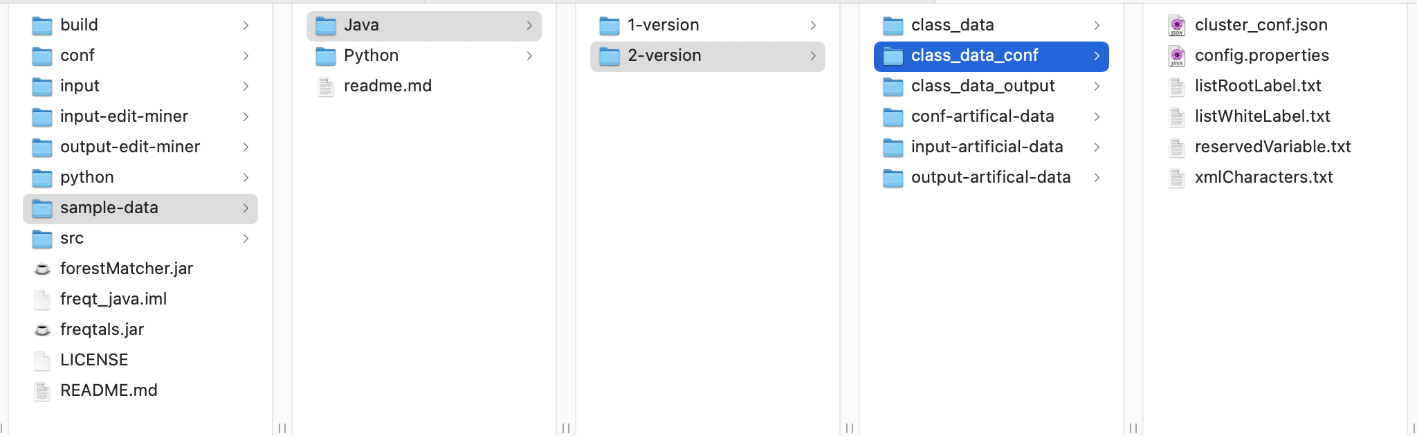
Running Pattern Miner
Configuration
Running Pattern Miner
java -jar freqtals.jar sample-data/Java/2-version/class_data_conf/config.properties 2 class_data

Slide 13
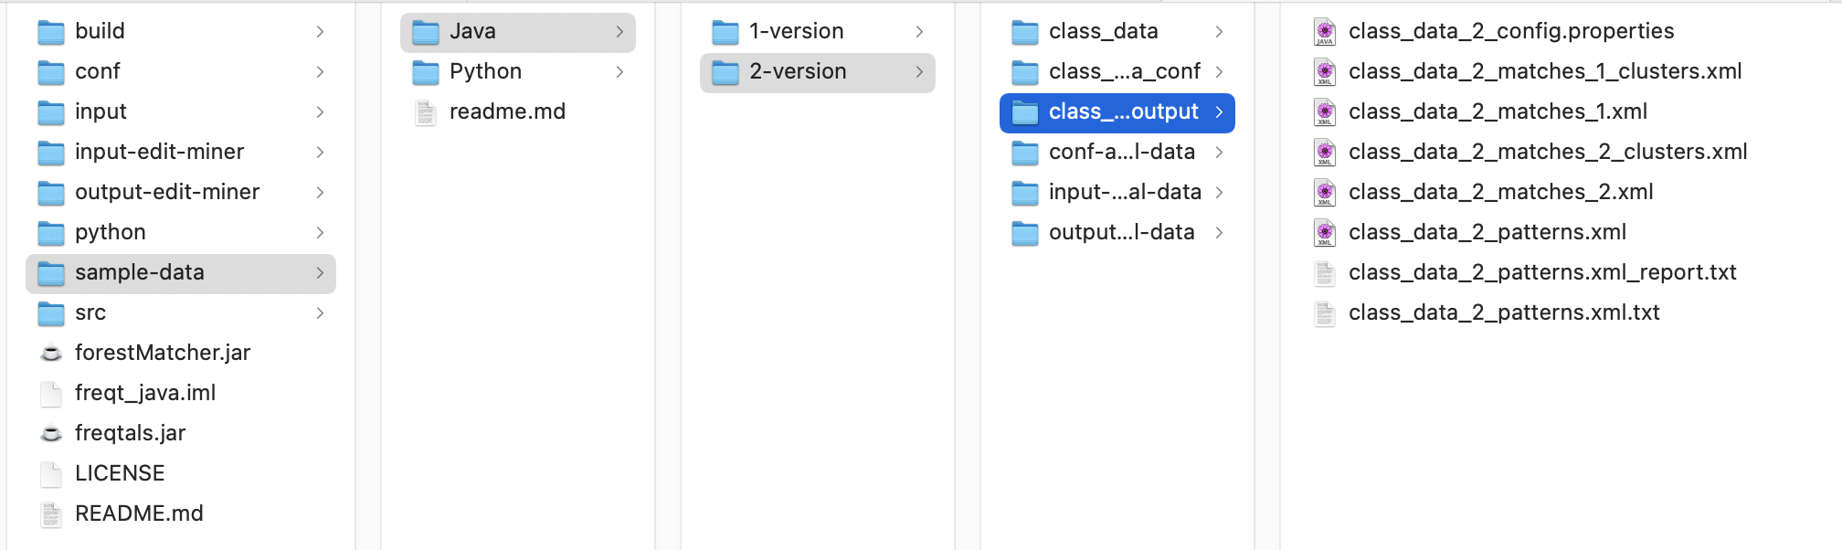
Output of Pattern Miner

Slide 14
Output files
...conf.properties : configurations used to run the algorithm
...matches_1_clusters.xml : clusters of patterns
...matches_1.xml : matches in version 1
...matches_2_clusters.xml : clusters of patterns
...matches_2.xml : matches in version 2
...patterns_common.xml : common pattern in each cluster
...patterns.xml : patterns
...report.txt : summarize the results of the Pattern Miner

Slide 15
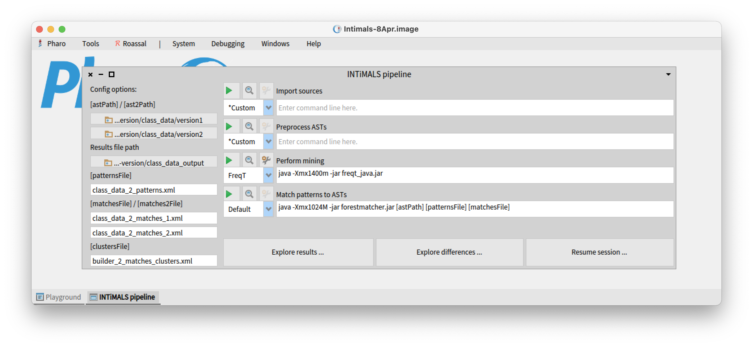
Visualization: select data

Slide 16
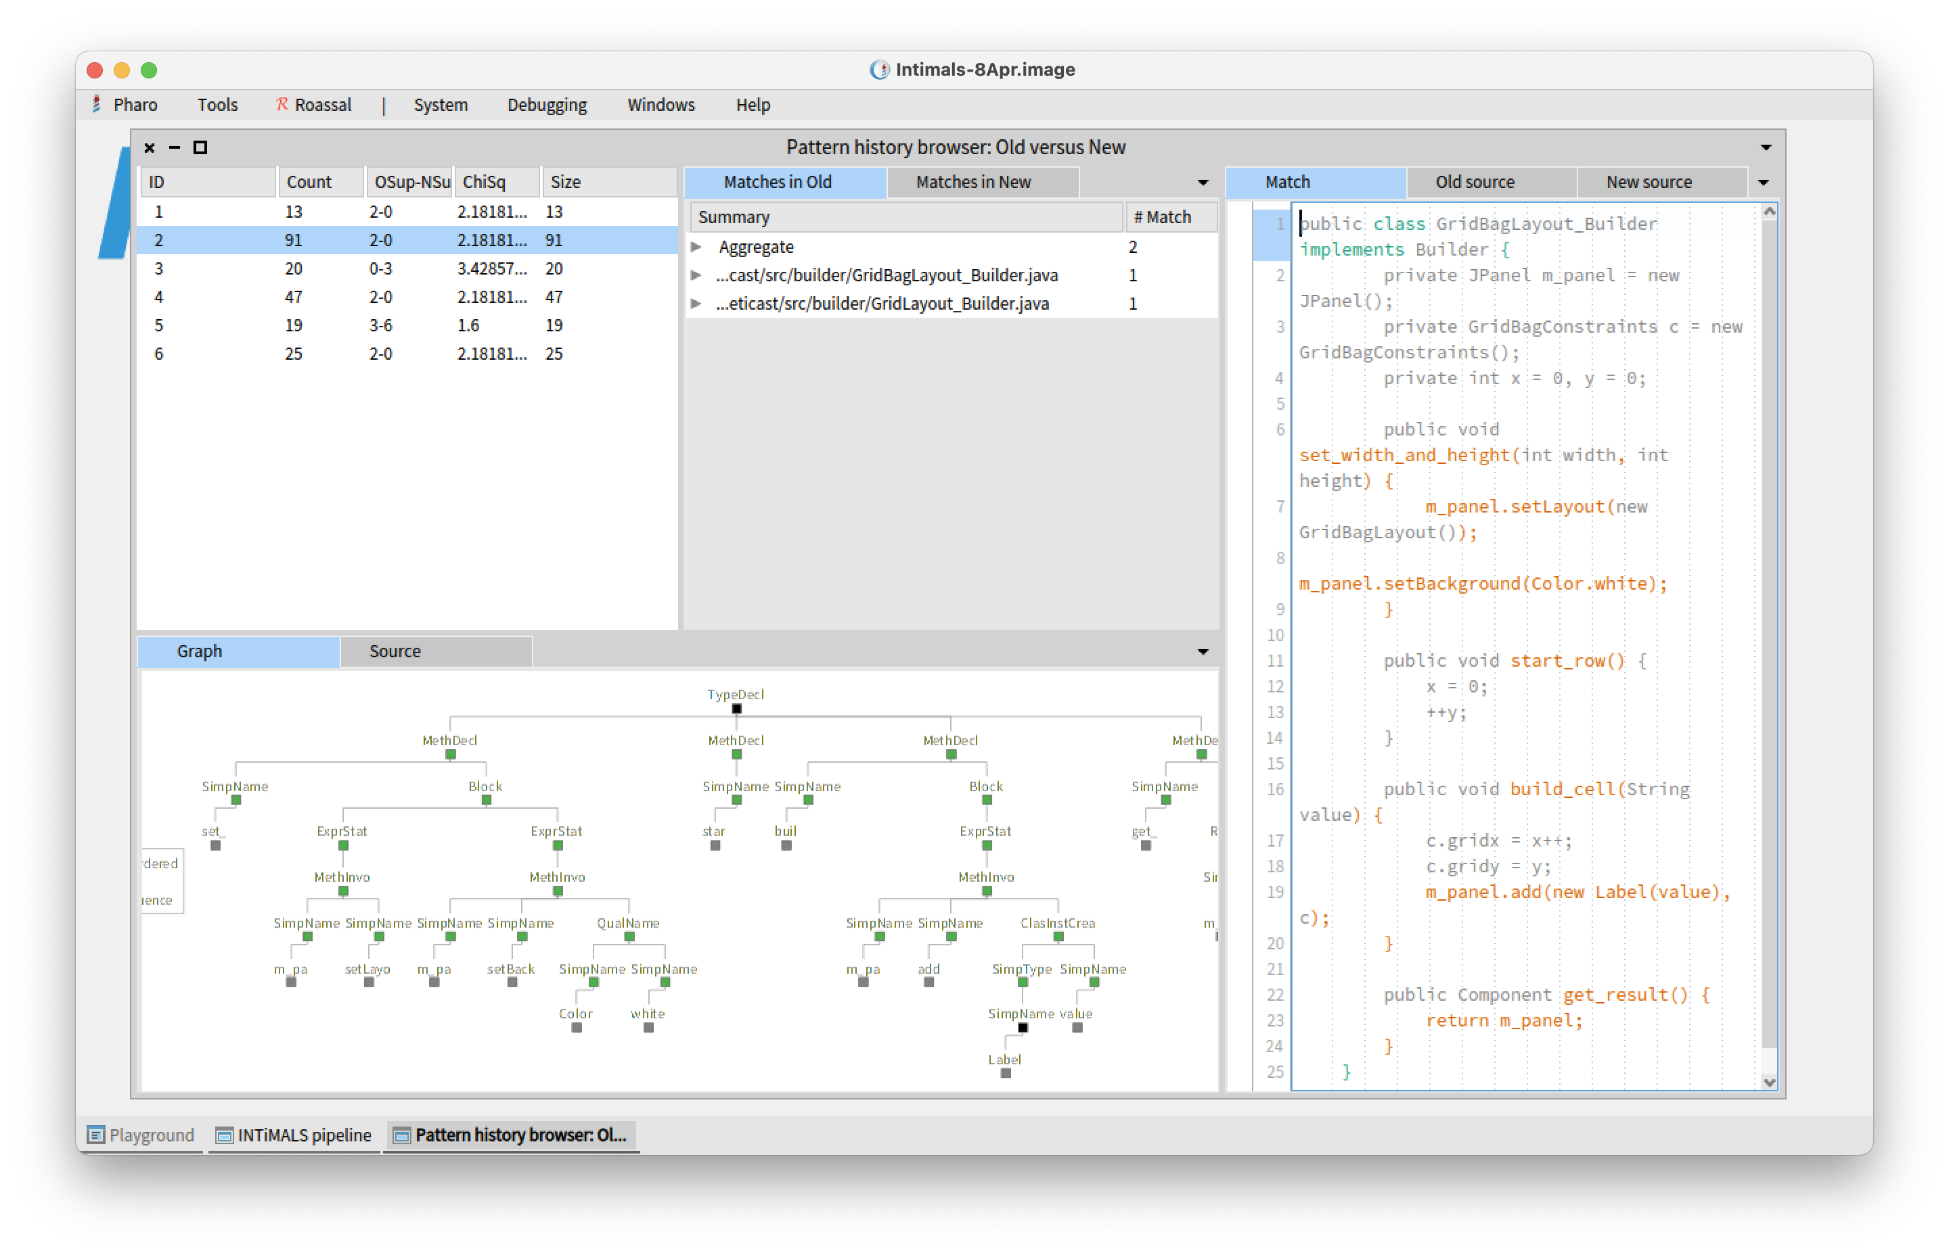
Visualization: browse result

Slide 18
Mining patterns from Python
Python sample data
  Python: sample-data/Python/sample_input_new
  Config: sample-data/Python/sample_input_new
Run Freqtals
  java -jar freqtals.jar sample-data/Python/conf/py-sample.properties 2 sample_input_new
Output: sample-data/Python/sample_output_new
Run htmlViewer.java to create html files
  java -jar htmlViewer.jar sample-data/Python/sample_input_new sample-data/Python/sample_output_new_1
Output html: sample-data/Python/sample_output_new/html

