Slide 1
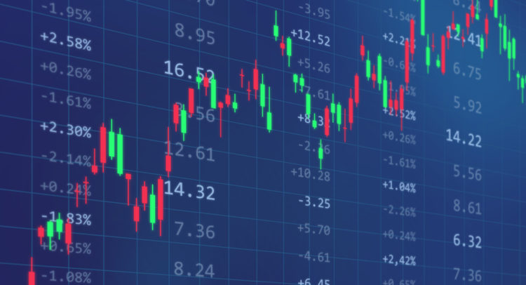

StocksPlayground
Elena Bianchini, Andrea De Murtas, Tiziano Finizzi

Slide 2
TABLE OF CONTENTS
01
02
03
PROJECT DESCRIPTION
USER STORIES AND MOCKUPS
FUNCTION POINTS
04
05
06
WORKFLOW ORGANIZATION
PRODUCT BACKLOG
DEMO OF THE APPLICATION
Services provided and infrastructure
Where we started from
The effort we expected
How we organized our work
How we realized the work
Let’s try!

Slide 3
01
PROJECT DESCRIPTION
Services provided and infrastructure

Slide 4




MAIN GOALS
STOCK MARKET
CRYPTO MARKET
Display the main features and trends of the stock market
Display the main features and trends of the crypto market
SEARCHED STOCK
FAVORITE STOCKS
Display the information about a searched stock
Save into a list the most interesting stocks

Slide 5
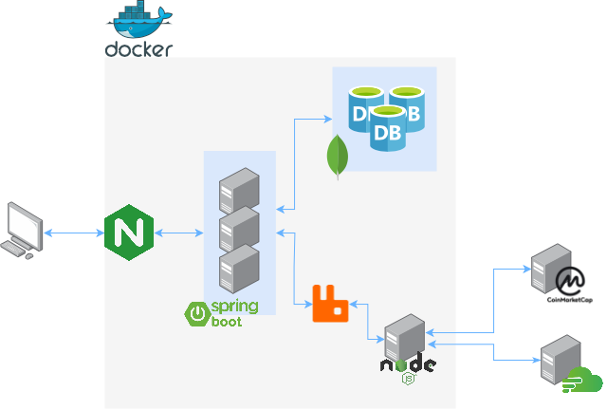
INFRASTRUCTURE
SPRING BOOT
FINNHUB
Main controller of the application
COINMARKETCAP
External Rest API services
NGINX
MONGODB
Load balancer
Primary-backup database
RABBITMQ
NODEJS
Message broker and RPC system
Manager of the external Rest API

Slide 6
02
USER STORIES AND MOCKUPS
Where we started from

Slide 7
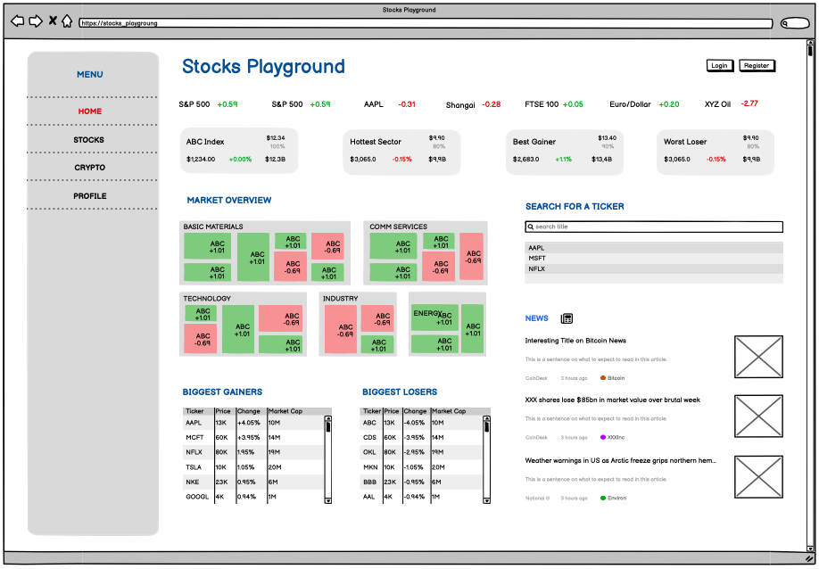
HOMEPAGE
As a website visitor, I want to be able to get information about the main stocks in each sectors, so that I can have an overview of the market’s state
As a website visitor, I want to be able to display a sliding view of the main tickers and their gains/losses, so that I can have an overview of the market’s state
As a website visitor, I want to be able to view which is the hottest sector in the market, so that I can have a better understanding of the trends
As a website visitor, I want to be able to know the biggest gainer and the biggest loser in a compact view, so that I can have an overview of the market’s state

Slide 8
HOMEPAGE
As a website visitor, I want to be able to get information about the main stocks in each sectors, so that I can have an overview of the market’s state
As a website visitor, I want to be able to display a sliding view of the main tickers and their gains/losses, so that I can have an overview of the market’s state
As a website visitor, I want to be able to view which is the hottest sector in the market, so that I can have a better understanding of the trends
As a website visitor, I want to be able to know the biggest gainer and the biggest loser in a compact view, so that I can have an overview of the market’s state

Slide 9
HOMEPAGE
As a website visitor, I want to be able to get information about the main stocks in each sectors, so that I can have an overview of the market’s state
As a website visitor, I want to be able to display a sliding view of the main tickers and their gains/losses, so that I can have an overview of the market’s state
As a website visitor, I want to be able to view which is the hottest sector in the market, so that I can have a better understanding of the trends
As a website visitor, I want to be able to know the biggest gainer and the biggest loser in a compact view, so that I can have an overview of the market’s state

Slide 10
HOMEPAGE
As a website visitor, I want to be able to get information about the main stocks in each sectors, so that I can have an overview of the market’s state
As a website visitor, I want to be able to display a sliding view of the main tickers and their gains/losses, so that I can have an overview of the market’s state
As a website visitor, I want to be able to view which is the hottest sector in the market, so that I can have a better understanding of the trends
As a website visitor, I want to be able to know the biggest gainer and the biggest loser in a compact view, so that I can have an overview of the market’s state

Slide 11
HOMEPAGE (2)
As a website visitor, I want to be able view a sorted list of the biggest gainers and the biggest losers, so that I can have an overview of the market’s state
As a webiste visitor, I want to be able to get informations about the main index, so that I can have an overview of the market’s state
As a webiste visitor, I want to be able to get an overview of the latests market news, so that I can be informed of meaningful events
As a webiste visitor, I want to be able to search for a specific stock, so that I can get the specific information I seek

Slide 12
HOMEPAGE (2)
As a website visitor, I want to be able view a sorted list of the biggest gainers and the biggest losers, so that I can have an overview of the market’s state
As a webiste visitor, I want to be able to get informations about the main index, so that I can have an overview of the market’s state
As a webiste visitor, I want to be able to get an overview of the latests market news, so that I can be informed of meaningful events
As a webiste visitor, I want to be able to search for a specific stock, so that I can get the specific information I seek

Slide 13
HOMEPAGE (2)
As a website visitor, I want to be able view a sorted list of the biggest gainers and the biggest losers, so that I can have an overview of the market’s state
As a webiste visitor, I want to be able to get informations about the main index, so that I can have an overview of the market’s state
As a webiste visitor, I want to be able to get an overview of the latests market news, so that I can be informed of meaningful events
As a webiste visitor, I want to be able to search for a specific stock, so that I can get the specific information I seek

Slide 14
HOMEPAGE (2)
As a website visitor, I want to be able view a sorted list of the biggest gainers and the biggest losers, so that I can have an overview of the market’s state
As a webiste visitor, I want to be able to get informations about the main index, so that I can have an overview of the market’s state
As a webiste visitor, I want to be able to get an overview of the latests market news, so that I can be informed of meaningful events
As a webiste visitor, I want to be able to search for a specific stock, so that I can get the specific information I seek

Slide 15
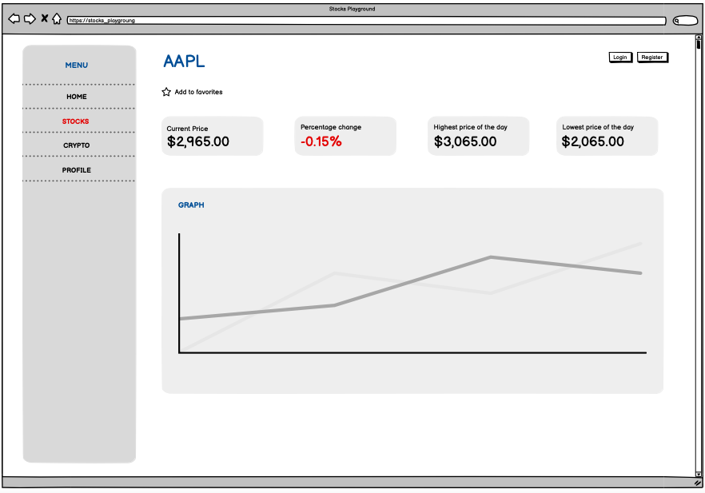
STOCKS PAGE
As a webiste visitor, I want to be able to view the information of a specific stock such as the candle stick graph, so that I can get the specific information I seek
As a website visitor, I want to be able to register an account, so that I can have a more personalized experience
As a webiste visitor, I want to be able to login to my account, so that I can have a more personalized experience
As a logged user, I want to be able to save my favorite stocks to keep track of my own interests

Slide 16
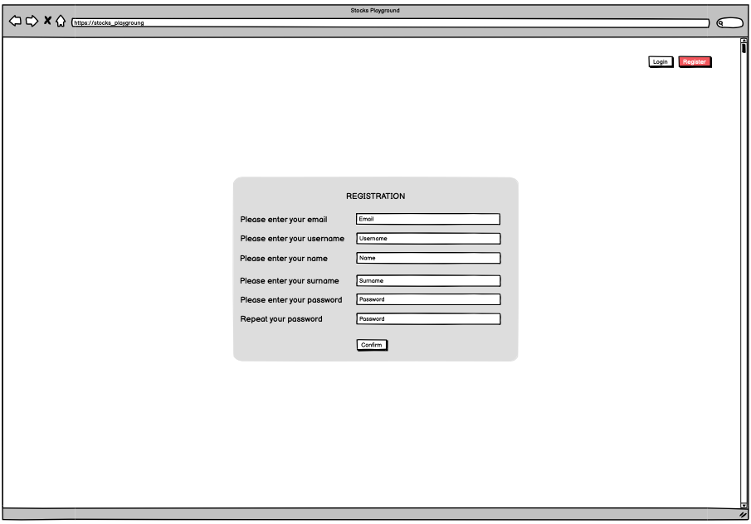
REGISTER PAGE
As a webiste visitor, I want to be able to view the information of a specific stock such as the candle stick graph, so that I can get the specific information I seek
As a website visitor, I want to be able to register an account, so that I can have a more personalized experience
As a webiste visitor, I want to be able to login to my account, so that I can have a more personalized experience
As a logged user, I want to be able to save my favorite stocks to keep track of my own interests

Slide 17
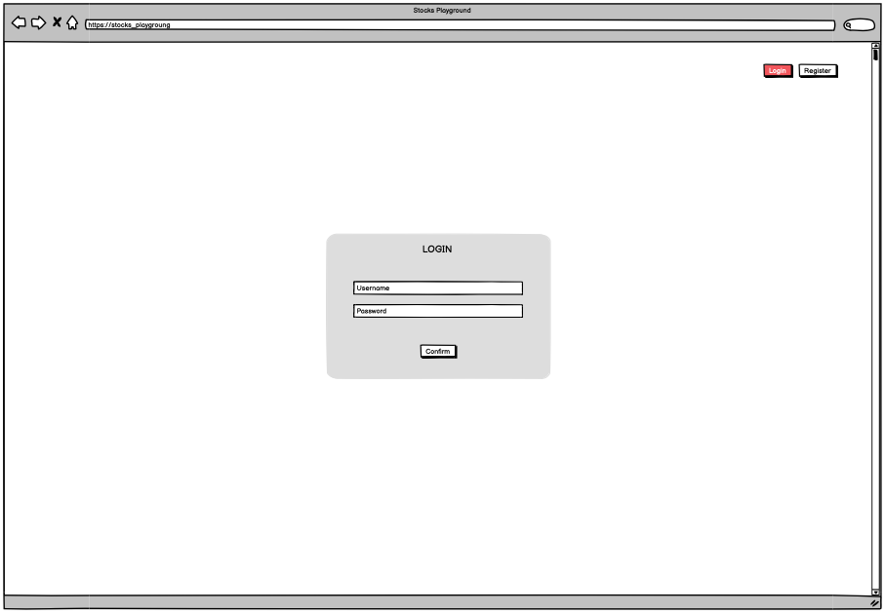
LOGIN PAGE
As a webiste visitor, I want to be able to view the information of a specific stock such as the candle stick graph, so that I can get the specific information I seek
As a website visitor, I want to be able to register an account, so that I can have a more personalized experience
As a webiste visitor, I want to be able to login to my account, so that I can have a more personalized experience
As a logged user, I want to be able to save my favorite stocks to keep track of my own interests

Slide 18
STOCKS PAGE (2)
As a webiste visitor, I want to be able to view the information of a specific stock such as the candle stick graph, so that I can get the specific information I seek
As a website visitor, I want to be able to register an account, so that I can have a more personalized experience
As a webiste visitor, I want to be able to login to my account, so that I can have a more personalized experience
As a logged user, I want to be able to save my favorite stocks to keep track of my own interests

Slide 19
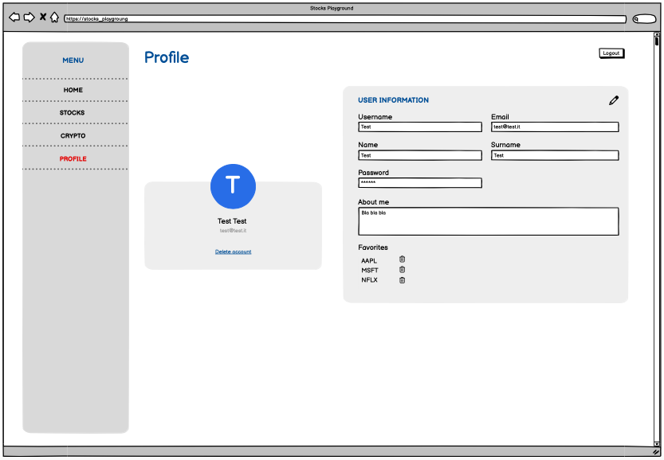
PROFILE PAGE
As a logged user, I want to be able to logout, so that I can terminate my session when I’m done using the website
As a logged user, I want to be able to delete my account, so that I can remove my account from the application
As a logged user, I want to customize my profile’s information, so that I can customize my experience
As a logged user, I want to be able to show my favorite stocks to keep track of my own interests

Slide 20
PROFILE PAGE
As a logged user, I want to be able to logout, so that I can terminate my session when I’m done using the website
As a logged user, I want to be able to delete my account, so that I can remove my account from the application
As a logged user, I want to customize my profile’s information, so that I can customize my experience
As a logged user, I want to be able to show my favorite stocks to keep track of my own interests

Slide 21
PROFILE PAGE
As a logged user, I want to be able to logout, so that I can terminate my session when I’m done using the website
As a logged user, I want to be able to delete my account, so that I can remove my account from the application
As a logged user, I want to customize my profile’s information, so that I can customize my experience
As a logged user, I want to be able to show my favorite stocks to keep track of my own interests

Slide 22
PROFILE PAGE
As a logged user, I want to be able to logout, so that I can terminate my session when I’m done using the website
As a logged user, I want to be able to delete my account, so that I can remove my account from the application
As a logged user, I want to customize my profile’s information, so that I can customize my experience
As a logged user, I want to be able to show my favorite stocks to keep track of my own interests

Slide 23
PROFILE PAGE (2)
As a logged user, I want to be able to delete my favorite stocks to keep track of my own interests
As a webiste visitor, I want to be able to get informations about the main cryptoccurencies into a treemap, so that I can have an overview of the crypto market’s state
As a webiste visitor, I want to be able to get informations about the most trending cryptoccurencies, so that I can have an overview of the crypto mar- ket’s state
As a webiste visitor, I want to be able to get informations about the most famous cryptoccurencies, so that I can have an overview of the crypto market’s state

Slide 24
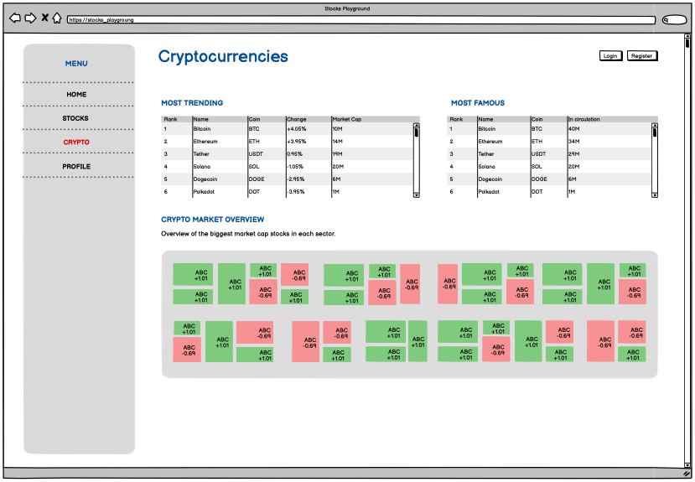
CRYPTO PAGE
As a logged user, I want to be able to delete my favorite stocks to keep track of my own interests
As a webiste visitor, I want to be able to get informations about the main cryptoccurencies into a treemap, so that I can have an overview of the crypto market’s state
As a webiste visitor, I want to be able to get informations about the most trending cryptoccurencies, so that I can have an overview of the crypto mar- ket’s state
As a webiste visitor, I want to be able to get informations about the most famous cryptoccurencies, so that I can have an overview of the crypto market’s state

Slide 25
CRYPTO PAGE
As a logged user, I want to be able to delete my favorite stocks to keep track of my own interests
As a webiste visitor, I want to be able to get informations about the main cryptoccurencies into a treemap, so that I can have an overview of the crypto market’s state
As a webiste visitor, I want to be able to get informations about the most trending cryptoccurencies, so that I can have an overview of the crypto mar- ket’s state
As a webiste visitor, I want to be able to get informations about the most famous cryptoccurencies, so that I can have an overview of the crypto market’s state

Slide 26
CRYPTO PAGE
As a logged user, I want to be able to delete my favorite stocks to keep track of my own interests
As a webiste visitor, I want to be able to get informations about the main cryptoccurencies into a treemap, so that I can have an overview of the crypto market’s state
As a webiste visitor, I want to be able to get informations about the most trending cryptoccurencies, so that I can have an overview of the crypto mar- ket’s state
As a webiste visitor, I want to be able to get informations about the most famous cryptoccurencies, so that I can have an overview of the crypto market’s state

Slide 27
03
FUNCTION POINTS
The effort we expected

Slide 28

FUNCTION POINTS
USERS
Store
ILF: 1 RET – 7 DET
7FP
EIF
EI
StocksPlayground
Insertion
EI: 1 FTR – 7 DET
3FP
Deletion
EI: 1 FTR – 7 DET
EO
EIF
3FP
EQ
Update
EI: 1 FTR – 7 DET
3FP
ILF
ILF
EIF
Add favorite stock
EI: 1 FTR – 1 DET
3FP
Remove favorite stock
EI: 1 FTR – 1 DET
3FP

Slide 29
FUNCTION POINTS
CACHED DATA
Store
ILF: 3 RET – 50 DET
10FP
EIF
EI
StocksPlayground
Insertion Stock Market
EI: 1 FTR – 30 DET
4FP
EO
EIF
Deletion Stock Market
EI: 1 FTR – 30 DET
4FP
EQ
ILF
ILF
Insertion Crypto Market
EI: 1 FTR – 15 DET
3FP
EIF
Deletion Crypto Market
EI: 1 FTR – 15 DET
3FP

Slide 30
FUNCTION POINTS
STOCK MARKET
Access
EIF: 2 RET – 30 DET
7FP
EIF
EI
StocksPlayground
Access
EIF: 1 RET – 15 DET
5FP
EO
EIF
Access
EIF: 1 RET – 15 DET
5FP
EQ
ILF
ILF
EIF

Slide 31
FUNCTION POINTS
CRYPTO MARKET
Access
EIF: 2 RET – 30 DET
7FP
EIF
EI
StocksPlayground
Access
EIF: 1 RET – 15 DET
5FP
EO
EIF
Access
EIF: 1 RET – 15 DET
5FP
EQ
ILF
ILF
EIF

Slide 32
FUNCTION POINTS
INFO OF A STOCK
Access
EIF: 2 RET – 30 DET
7FP
EIF
EI
StocksPlayground
Access
EIF: 1 RET – 15 DET
5FP
EO
EIF
Access
EIF: 1 RET – 15 DET
5FP
EQ
ILF
ILF
EIF

Slide 33
FUNCTION POINTS
VIEWS
Homepage
EO: 1 FTR – 30 DET
5FP
EIF
EI
StocksPlayground
Crypto page
EO: 1 FTR – 15 DET
4FP
EO
EIF
Stocks page
EQ: 1 FTR – 15 DET
3FP
EQ
ILF
ILF
Profile page
EQ: 1 FTR – 7 DET
3FP
EIF
Results of a searching
EQ: 1 FTR – 10 DET
3FP

Slide 34



COCOMO II
81 FP
4293 SLOC
7.6 months
FUNCTION POINTS
LINES OF CODE
ESTIMATED TIME
The result of the previous estimation
We used Java as programming language
Through the use of the COCOMO II tool

Slide 35
04
WORKFLOW ORGANIZATION
How we organized our work

Slide 36

SPRINT PLANNING
SPRINT 1
SPRINT 3
SPRINT 5
Completion of the homepage
Cryptocurrencies
Starting of the homepage
Account management
Management of the favorite stocks
SPRINT 2
SPRINT 4

Slide 37
05
PRODUCT BACKLOG
How we realized the work

Slide 38
PRODUCT BACKLOG
PRIORITY | SPRINT | TASK DESCRIPTION | ESTIMATED HOURS
High | 1 | Display a treemap with stocks information | 16
High | 1 | Display sliding view of main tickers | 8
High | 1 | Display the hottest sector in the market | 8
High | 1 | Display sorted list of biggest gainers and losers | 8
Med | 2 | Display the page loading | 4
High | 2 | Display information about main index | 16
Med | 2 | Display market news | 8
Med | 2 | Navigate to news website | 8
High | 3 | Register Account | 16
HIgh | 3 | Login to Account | 16

Slide 39
PRODUCT BACKLOG (2)
PRIORITY | SPRINT | TASK DESCRIPTION | ESTIMATED HOURS
High | 3 | Logout | 8
Med | 3 | Delete Account | 8
Low | 3 | Customize Account | 8
Med | 4 | Display cryptos info in a treemap | 16
Med | 4 | Get information about trending cryptos | 8
Med | 4 | Get information about most famous cryptos | 8
High | 5 | Search for specific stocks | 16
High | 5 | Display information about specific stock | 8
Med | 5 | Save favorite stocks | 8
Med | 5 | Show favorite stocks | 8
Med | 5 | Delete favorite stocks | 8

Slide 40
06
DEMO OF THE APPLICATION
Let’s try!

