Slide 1
Marketing Analyzer Project

Slide 2
Project Overview
It recommends target customers for products
The recommendation gives data about target customer attributes of (Age – Education – Marital Status – Income – Having Kids – Purchase Method “In Store/Online”)
The system needs from the client only purchase logs to run: “Customer X bought Y items of Z product”, The system needs to know any information about Customer X (point 2) and it’ll predict the rest

Slide 3
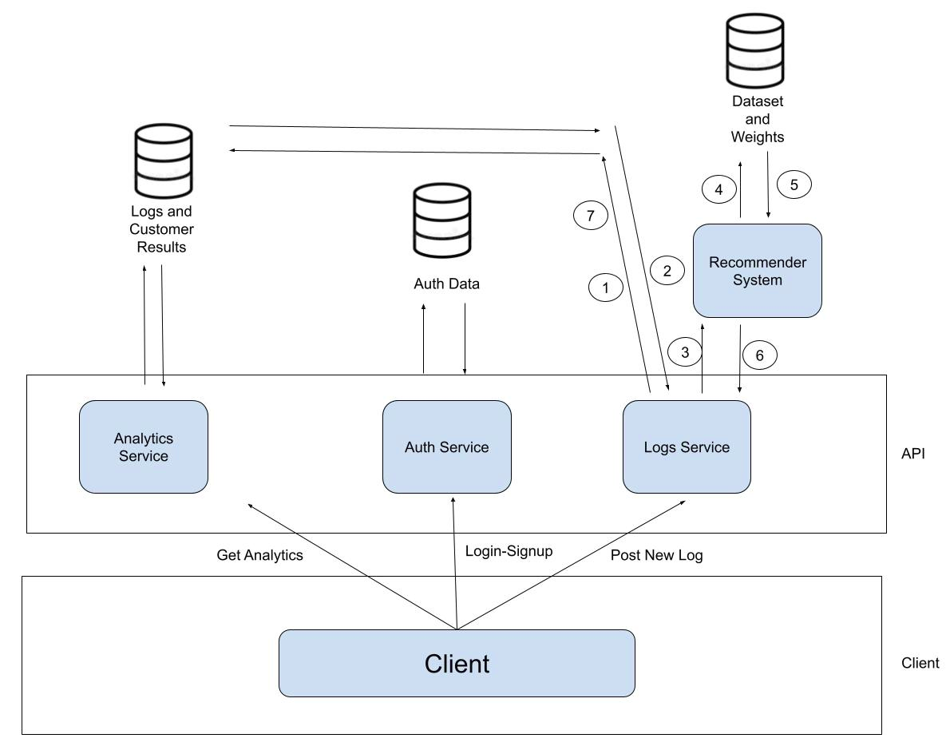
System Design Overview

Slide 4
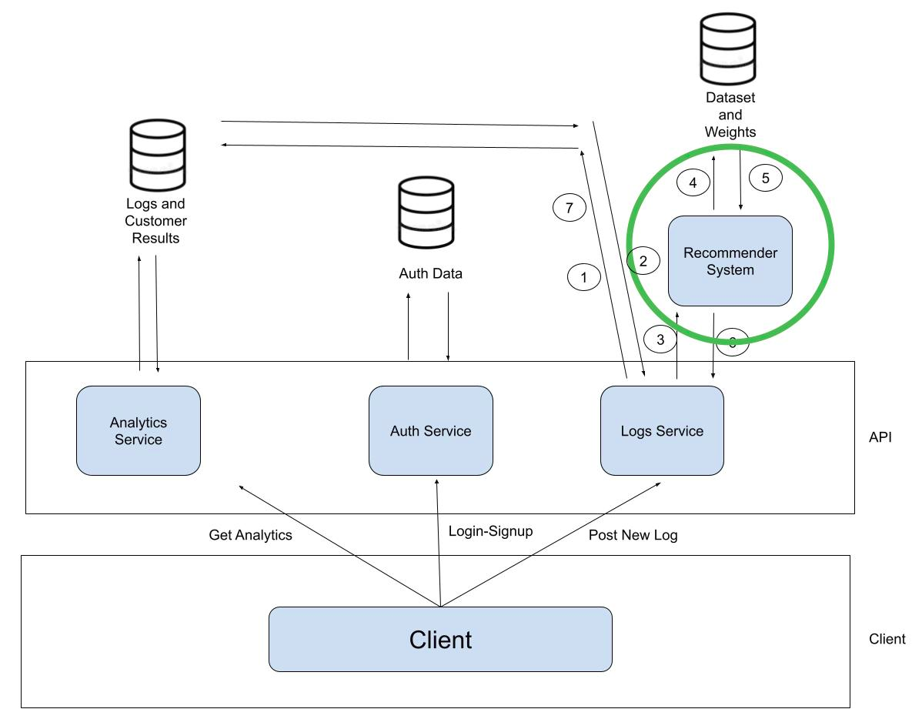
System Design Overview

Slide 5
Recommender System
Working Principle
It uses hybrid system of Content Based Recommendation and Collaborative Filtering Algorithm
It creates customers profiles domain from a data-set, creates product profile from purchase logs, infer the product profile in the customers domain and retrieves the nearest “K” customers
The results are the average of the “K” customers

Slide 6
Recommender System
Working Principle
Customer profile domain is per-configured in a database, the service fetches it only when it runs for the first time
With every request the services only checks the data-set weights version in the database, if it’s not equal the one it has, it updates the data-set

Slide 7
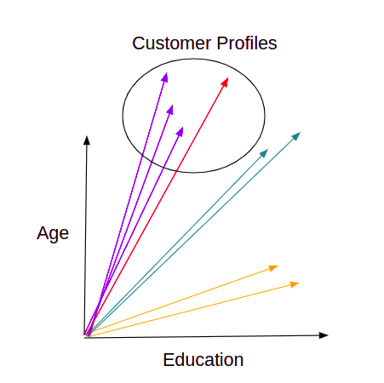
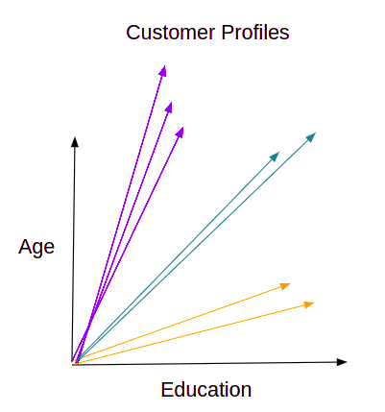
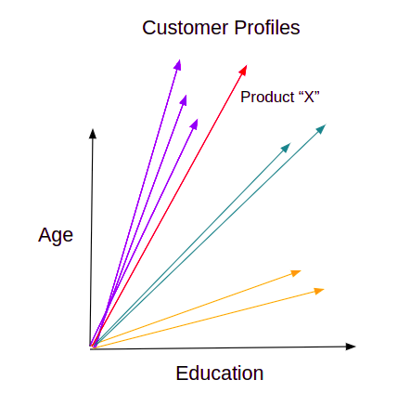
Recommender System
Working Principle

Slide 8
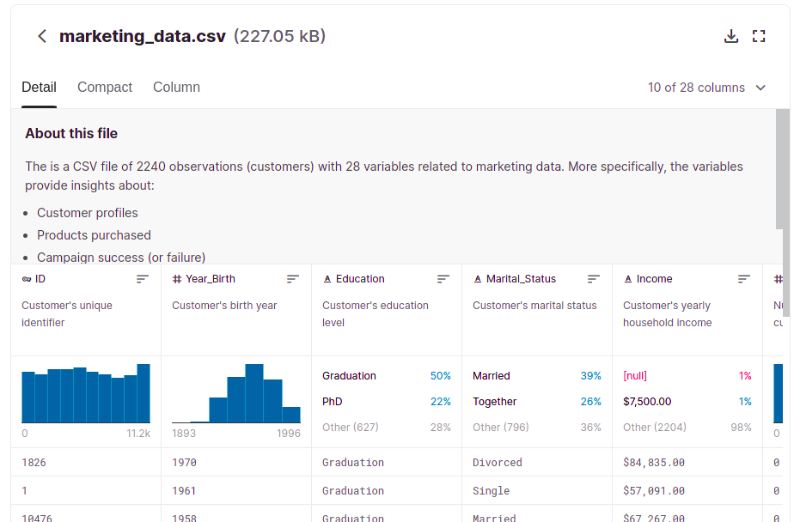
Recommender System
Working Principle

Slide 9
Recommender System
REST API
URL: http://endpoint/infer
Method: POST
Request Body: Product Profile
Response Body: Recommendation Plan

Slide 10
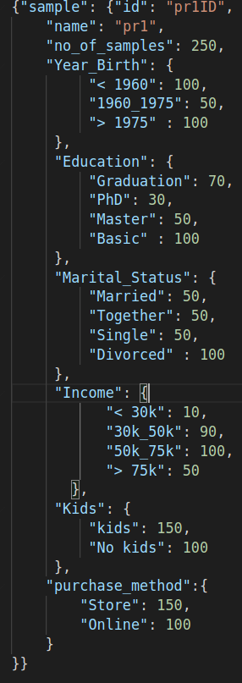
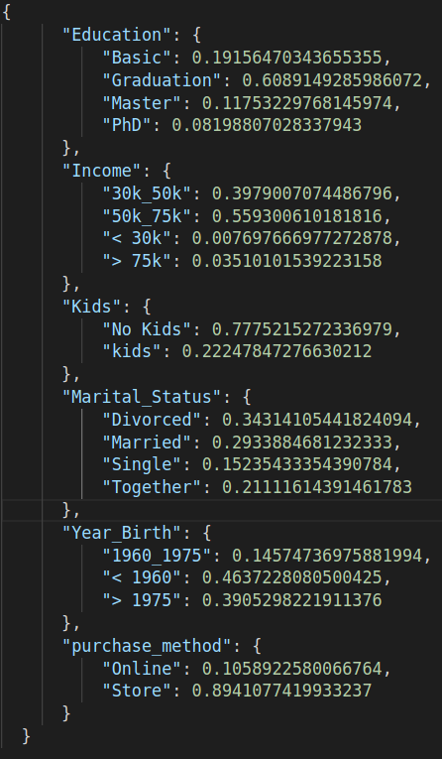
Recommender System
REST API
Input
Output

Slide 11
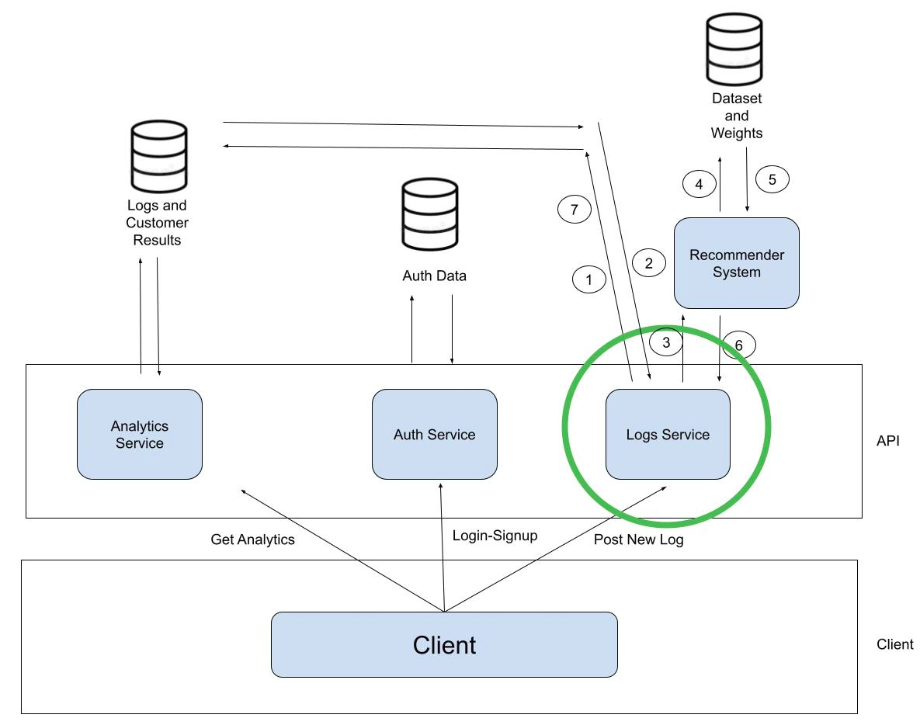
System Design Overview

Slide 12
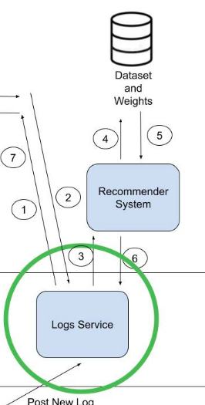
Logging Service
Working Principle (on Receiving log)
Searches for the corresponding product profile in DB or creates new profile if not found
Checks product profile last inference, if it is not recently updated, it invokes the recommender system
Writes the log with the new/updated product profile in the database

Slide 13
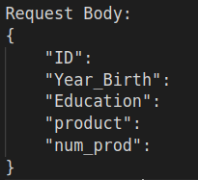
Logging Service
REST API
URL: endpoint/logs/new/:projectName
Method: POST
Request Body: Log
Response Body: -

Slide 14
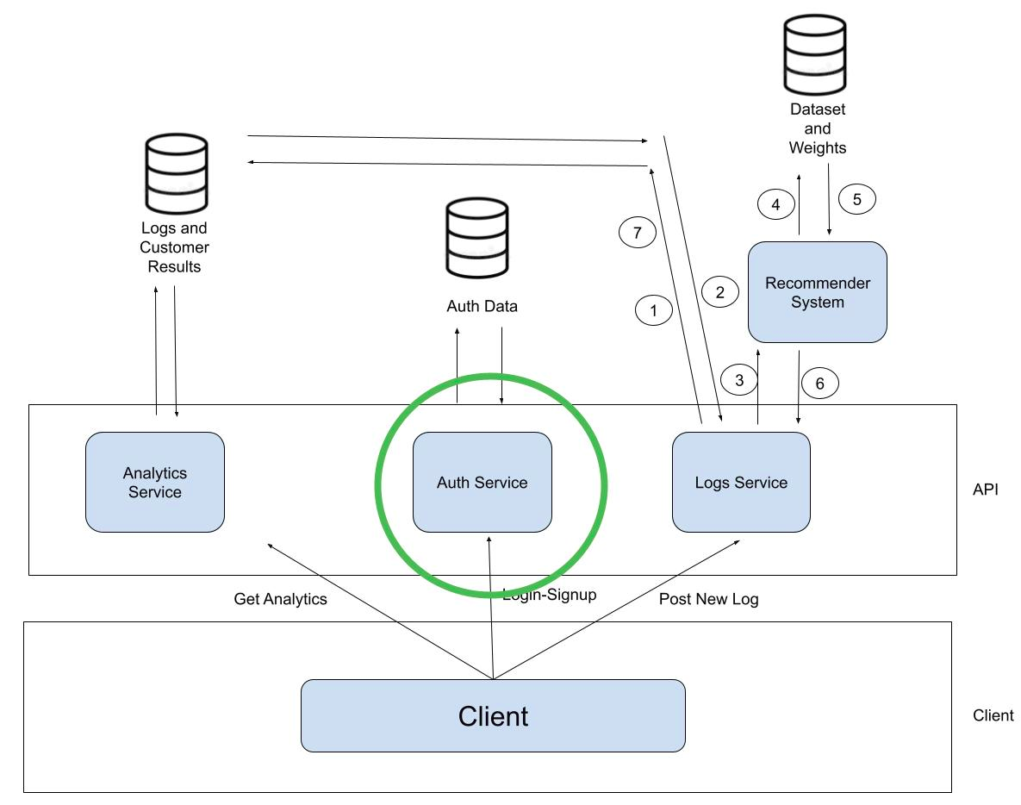
System Design Overview

Slide 15
Authentication Service
Working Principle (JWT)
Sign-up/Log-in: it responds with a token to the client to use it for all APIs
The token should be included in the request header “Authorization” prefixed by “Bearer” and space as follows:
{Authorization: Bearer <Token>}

Slide 16
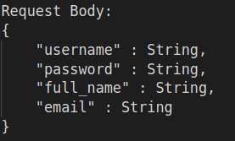
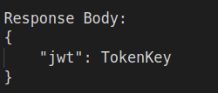
Authentication Service
REST API
URL: endpoint/auth/signup
Method: POST
Request Body: user-info
Response Body: token

Slide 17
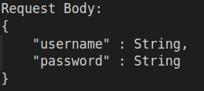
Authentication Service
REST API
URL: endpoint/auth/login
Method: POST
Request Body: user-info
Response Body: token

Slide 18
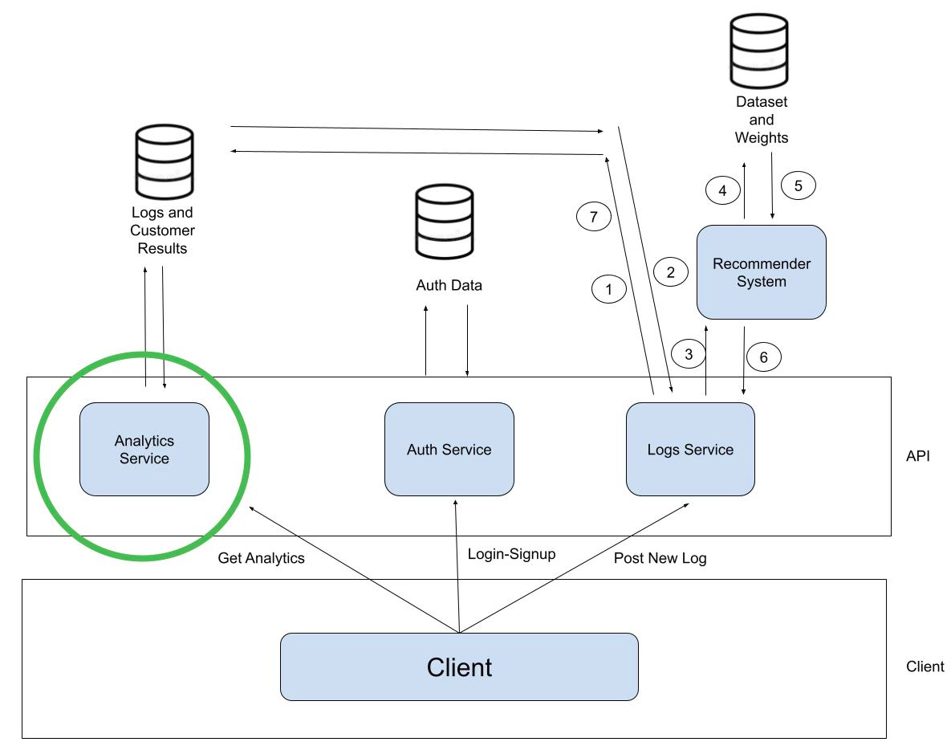
System Design Overview

Slide 19
Analytics Service
Working Principle
Creates new projects for the client
Automatically creates a default project “Food Recommendation” for the client
Retrieves Recommendations for any project which posted logs before (inferred by the recommender service and saved in the DB by the logs service)
Computes Analytics for any project which posted logs before

Slide 20
Analytics Service
Working Principle (Analytics)
Provides the product owner with a ranking of products from the best selling to the worst selling products
provides information about the most frequent customer together with the number of the products he purchased
provides information about a given customer with the products he purchased the most/least

Slide 21
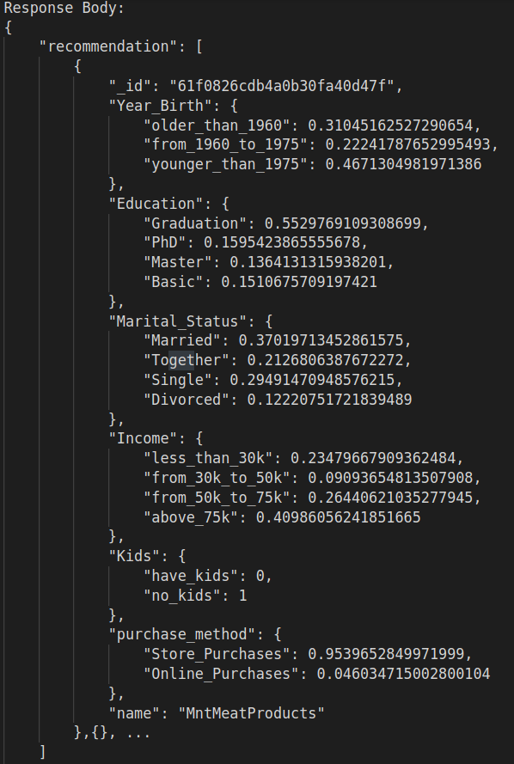
Analytics Service
REST API
URL: endpoint/recommendation/:projectName
Method: GET
Request Body: -
Response Body: Recommendations for every product

Slide 22
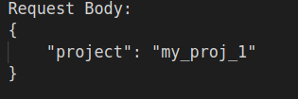
Analytics Service
REST API
URL: endpoint/projects/new
Method: POST
Request Body: project name
Response Body: -

Slide 23
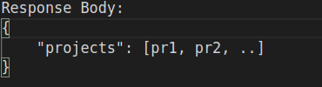
Analytics Service
REST API
URL: endpoint/projects
Method: GET
Request Body: -
Response Body: list of projects for the user

Slide 24
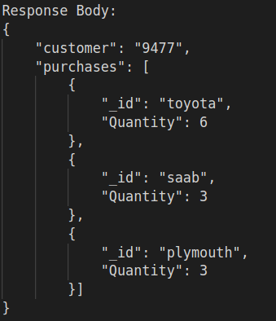
Analytics Service
REST API
URL: endpoint/analytics/:projectName/customer/:id
Method: GET
Request Body: -
Response Body: list of customer purchases sorted from the most to the least

Slide 25
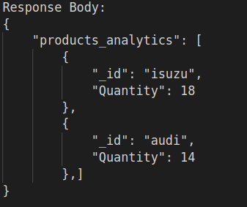
Analytics Service
REST API
URL: endpoint/analytics/:projectName/stat/products
Method: GET
Request Body: -
Response Body: list of products sorted by the most selling

Slide 26
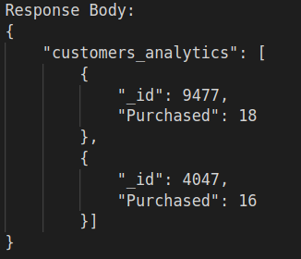
Analytics Service
REST API
URL: endpoint/analytics/:projectName/stat/customers
Method: GET
Request Body: -
Response Body: list of customer sorted by number of purchases

Slide 27
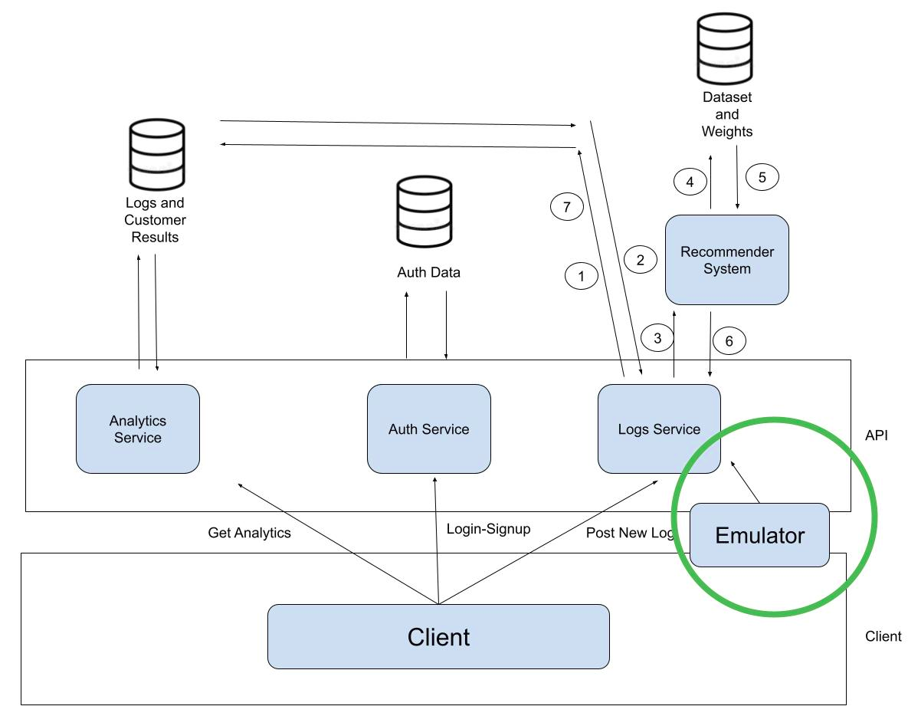
System Design Overview

Slide 28
Emulator
Working Principle
The Emulator is the part of the systems that emulates the process of sending logs to the other parts of the system on behalf of the client
All the information used by the Emulator are taken from 3 different databases: Marketing data - Automobile data - Electronics data
Automotive Data: It provides the Emulator with only a list of automobile products (audi-gas, alfa-romeo-gas, bmw-gas …)

Slide 29
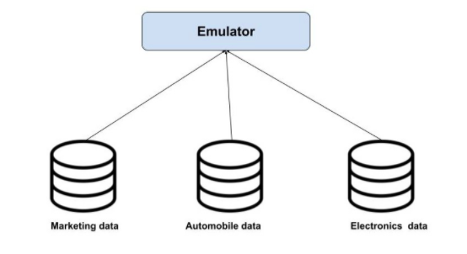
Emulator
Working Principle

Slide 30
Emulator
Working Principle
Marketing Data: This is where all the customers data are taken from. More specifically, for every customer we take one or more of the list of following attributes:{ID, Year_birth, Education, Marital_status, Income, Kids, Purchase_method}
Electronics Data: It provides the Emulator with only a list of electronic products (USB-C charging cable, AA batteries, iPhone)

Slide 31
Emulator
Working Principle
The Emulator reads randomly from the databases one line at the time, merges the results in order to create a log
It also adds “num_prod”, defining the number of times that the customer has bought a certain product
The Emulator sends the log created to the Log Service with a defined rate The default rate is 2 logs/second

Slide 32
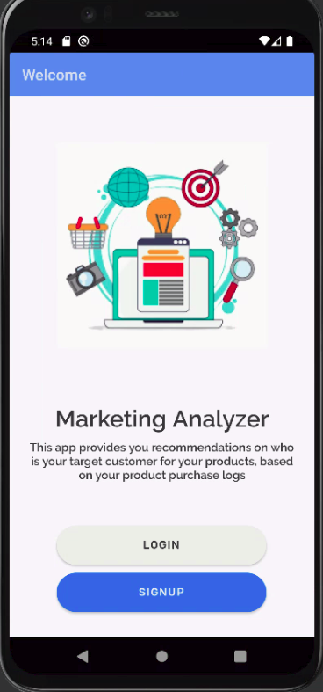
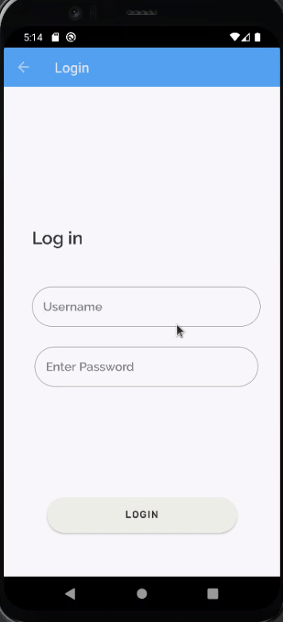
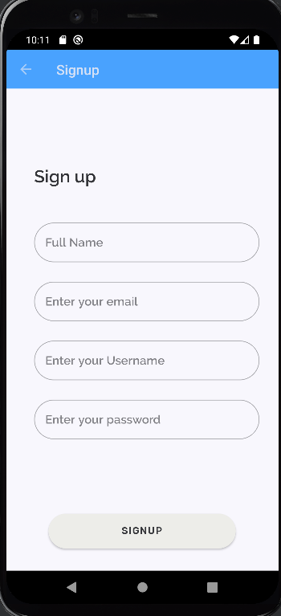
Mobile App (Android)

Slide 33
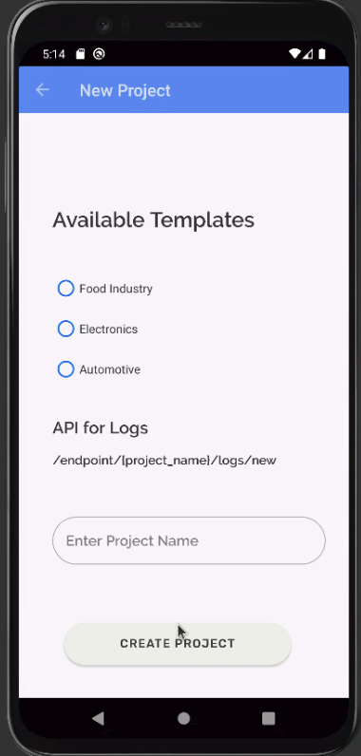
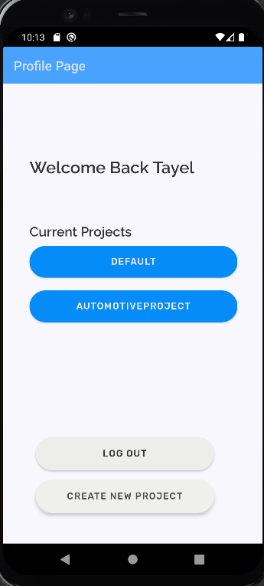
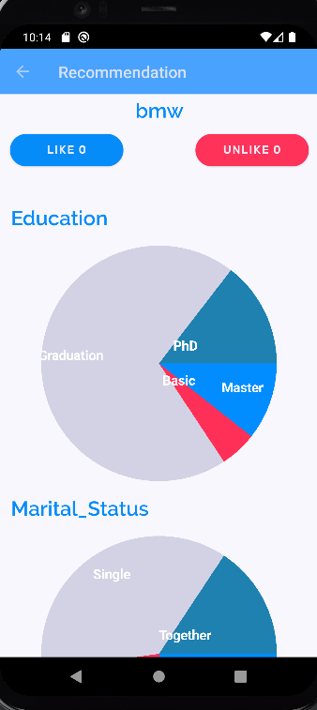
Mobile App (Android)

Slide 34
Scrum Process
CASE STUDY: Process Model with Bpmn.io
Customer requirements definition
Creating tasks backlog
Calculating tasks time with function points
Updating sprint sheet and burn-down chart

Slide 35
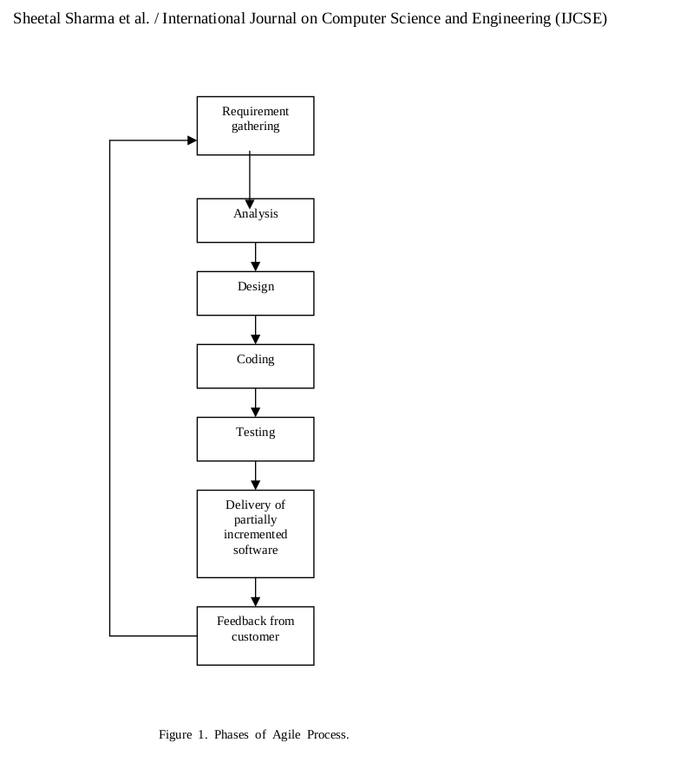
Scrum Process Overview

Slide 36
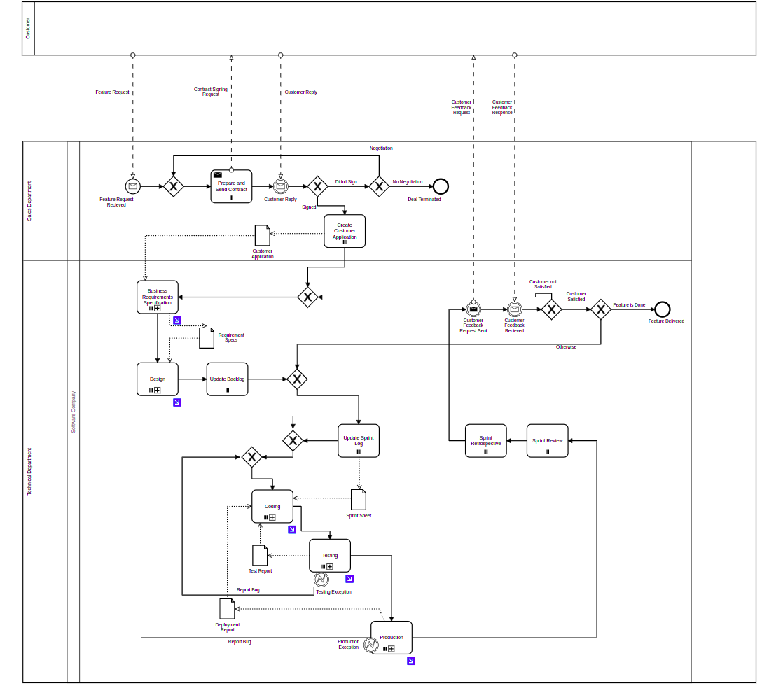
Process
Model

Slide 37
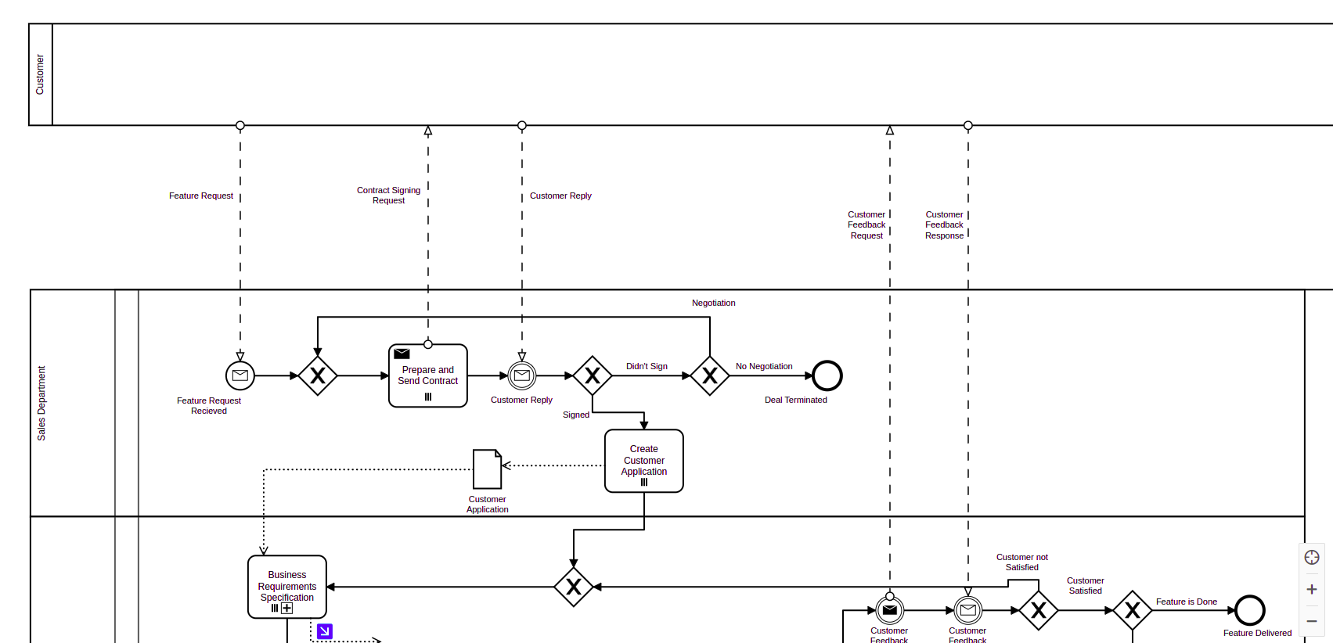
Model – Main Process

Slide 38
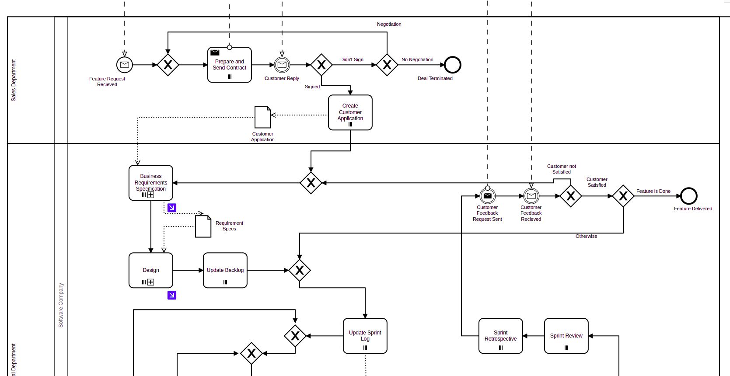
Model – Main Process

Slide 39
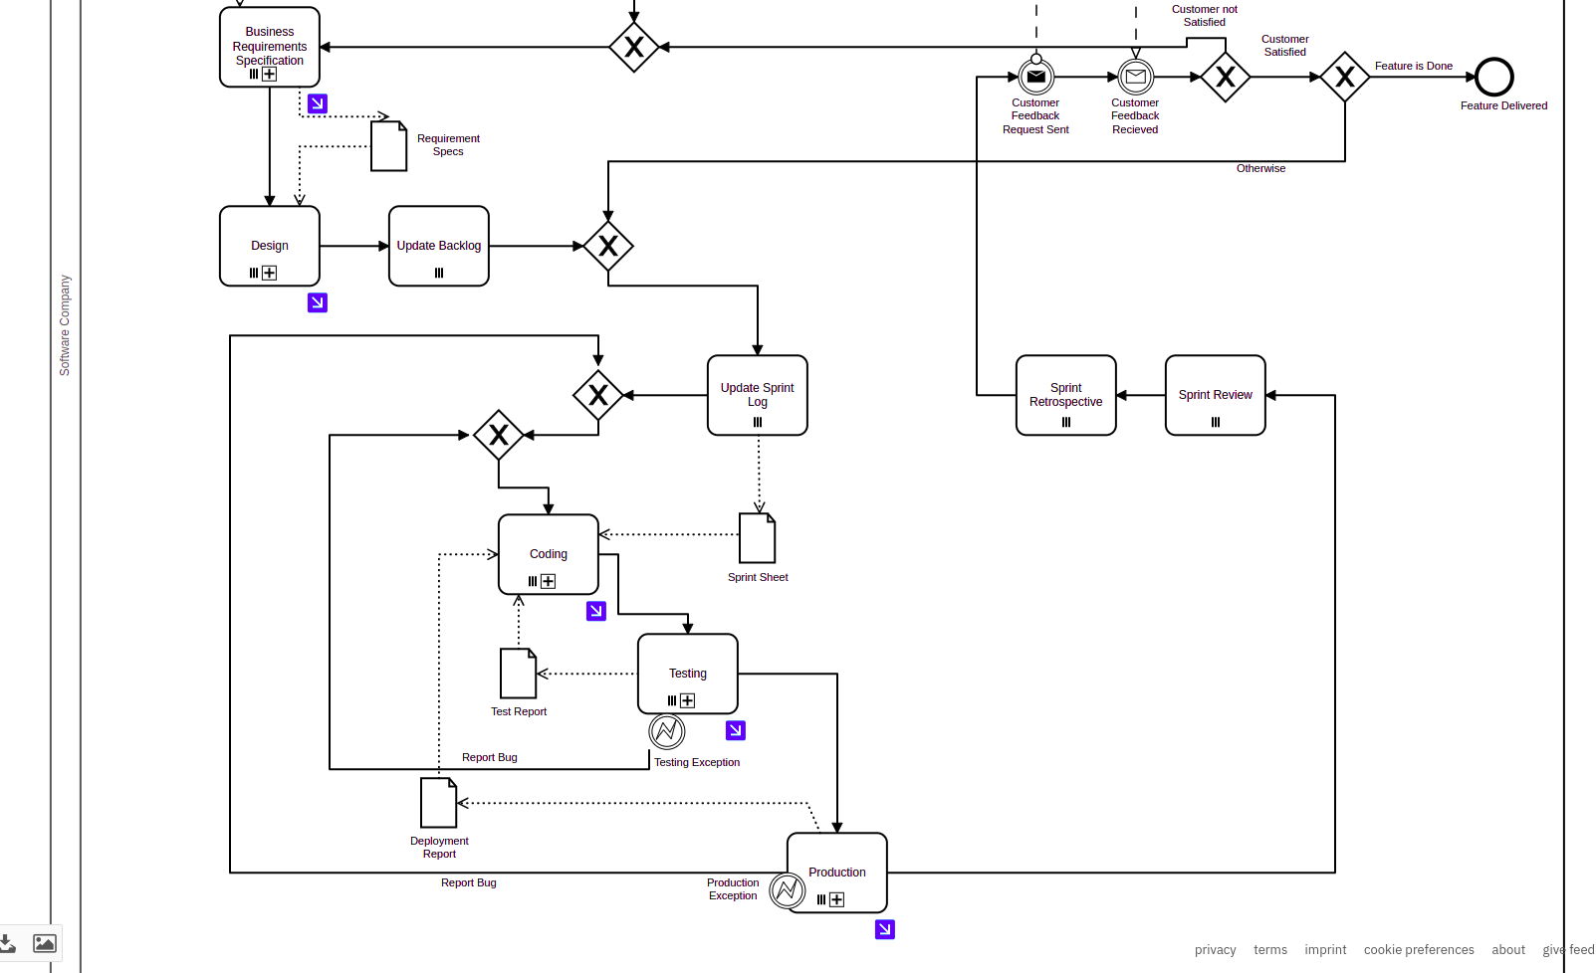
Model – Main Process

Slide 40
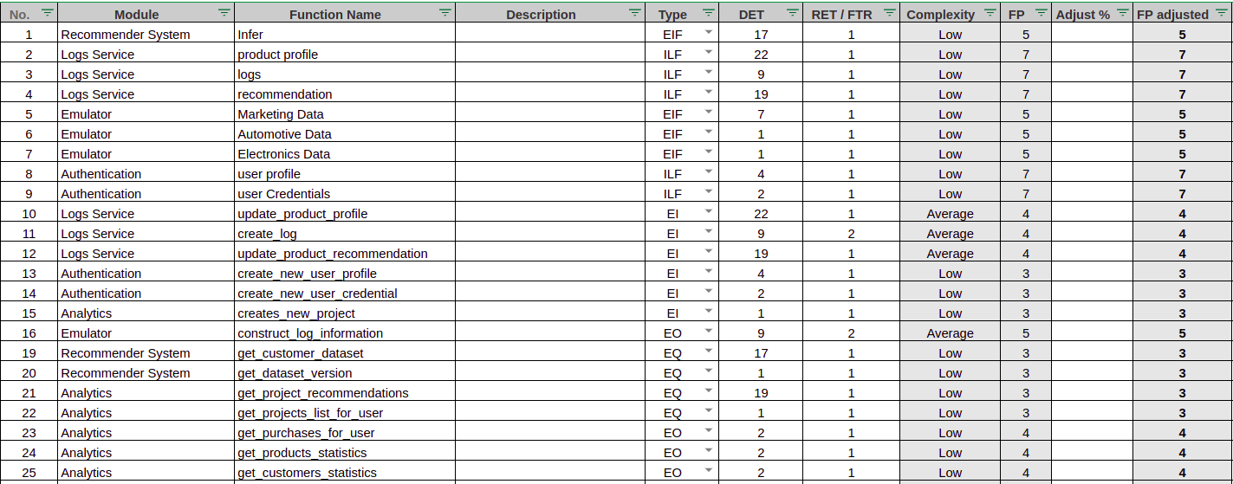
Function Points

Slide 41
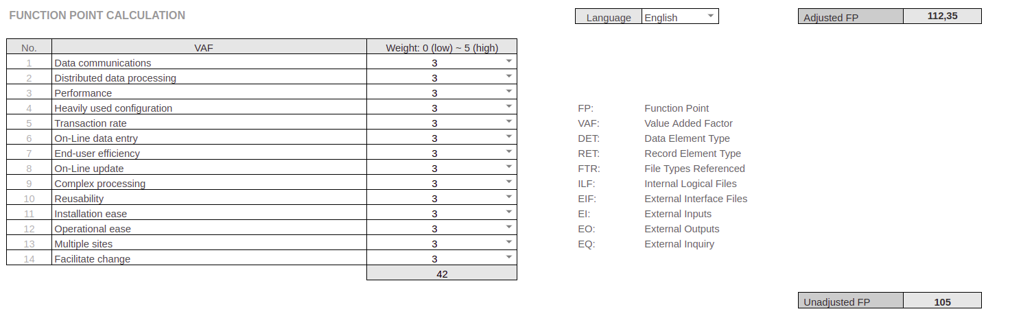
Function Points

Slide 42
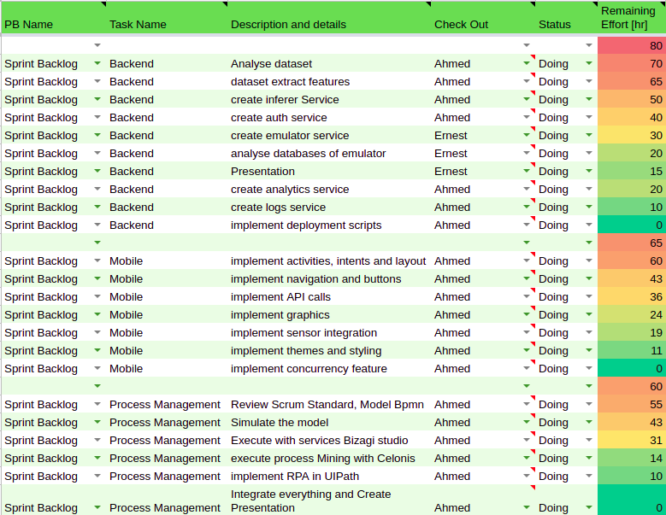
Sprint Sheet

Slide 43
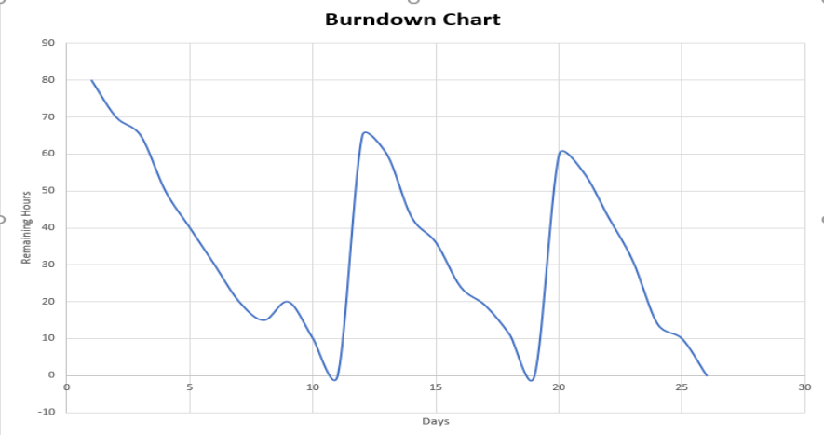
Burn-down Chart

Slide 44
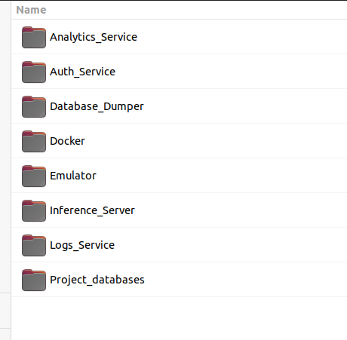
How to Run (Back-End)
Prerequisite: Docker/ Docker Compose/ nodeJs
Create a database Cluster on MongoDB and update the database_uri in the environment file: Docker/.env

Slide 45
How to Run (Back-End)
In “Database_Dumper” Folder (One time Action) open terminal:
$npm install
$npm start
In “Docker” Folder (Every-time to Run the System)
$docker-compose up --

Slide 46
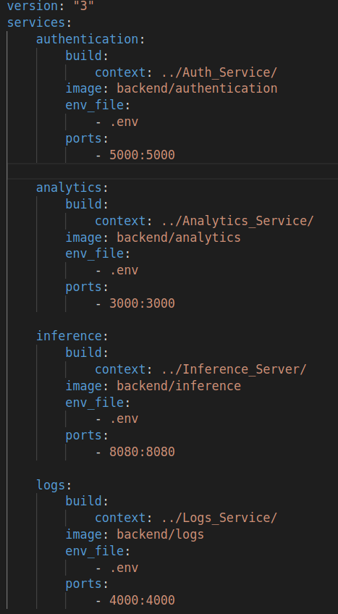
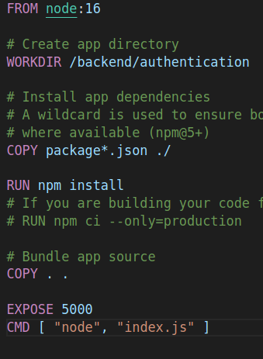
How to Run (Back-End)

Slide 47
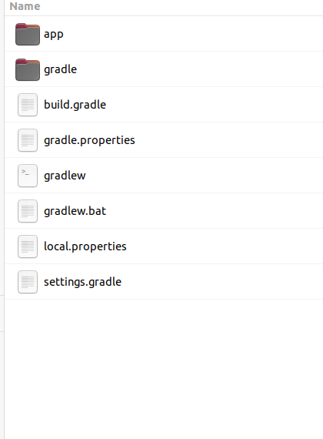
How to Run (Mobile App)
Prerequisite: Android Studio
Just open the Project with Android Studio and run the emulator with any device

Slide 48
Thank you!

