Slide 1

Multi-omics feature extractor Bioinformatics project
Student
Giovanni Gerratana
Giuliano Angelo Giufrè
Supervisor
Eng. Marta Lovino
Prof. Elisa Ficarra

Slide 2
Introduction
This project aims to find features selection methods that permits to infer relevant biological information from mRNA and miRNA expression data of kidney cancer.
Main parts:
Download and
Pre-processing
Features Selection
Methods
Classification and
Validation

Slide 3
Common case id
Common case id
Create dataset
Create dataset
Pre-processing
Pre-processing
Classic FS
Classic FS
Multi-view FS
Multi-view FS
Classification
Classification
Validation
Validation

Slide 4
Download
This first part of the project is devoted to collect and prepare the data for feature selection and the classification.
Download the json and manifest files concerning the mRNA and miRNA expression and select the only common case id.

Slide 5
Pre-processing
Features
Create Dataset
Dataset
labels
Remove ‘zero colums’
‘Zero-mean’ rescale
‘Min-Max’ rescale
Pre-processing

Slide 6
Features Selection Methods
Two different approaches have been chosen for the data features selection:
Classic and multi-view method indipendently
Two steps FS: After Classic FS Multi-view FS
Classic FS
Multi-view FS
Classic FS
Multi-view FS

Slide 7
Classic Features selection
Classic methods:
Decision tree
Random Forest
XGBoost
KNeighborsRegressor
Recursive Features Elimination with Cross Validation

Slide 8
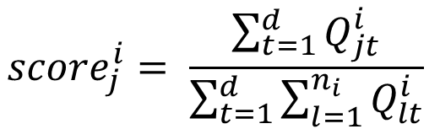
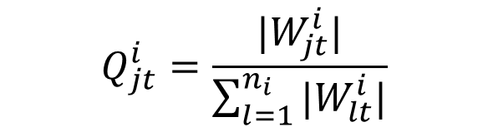
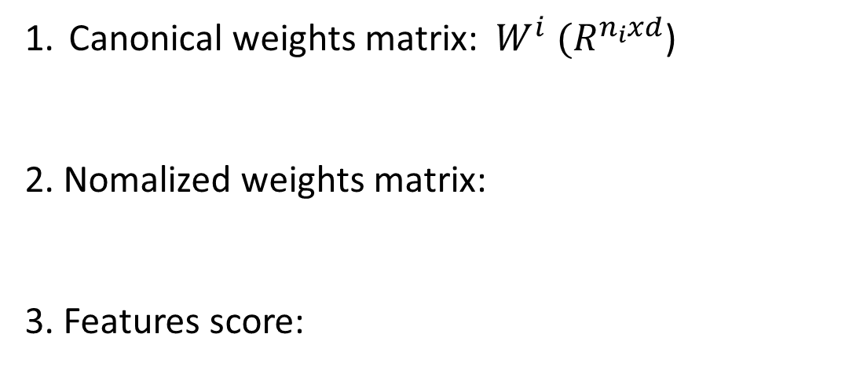
Multi-view features selection
To implement a multi-view features selection, a Canonical Correlation Analysis based method is implemented.
It’s possible to choose between supervised and unsupervised version.
System of features scoring:
Canonical weights matrix: $W^{i} (R^{n_{i}xd}$)
2. Nomalized weights matrix:
3. Features score:
i: number of the view
n: number of features
d: Cca components
$$Q_{jt}^{i}=\frac{|W_{jt}^{i}|}{\sum_{l=1}^{n_{i}}{{|W}_{lt}^{i}|}}$$
t: 1 to d j: 1 to n
$${score}_{j}^{i}= \frac{\sum_{t=1}^{d}{Q_{jt}^{i}}}{\sum_{t=1}^{d}{\sum_{l=1}^{n_{i}}{Q_{lt}^{i}}}}$$

Slide 9
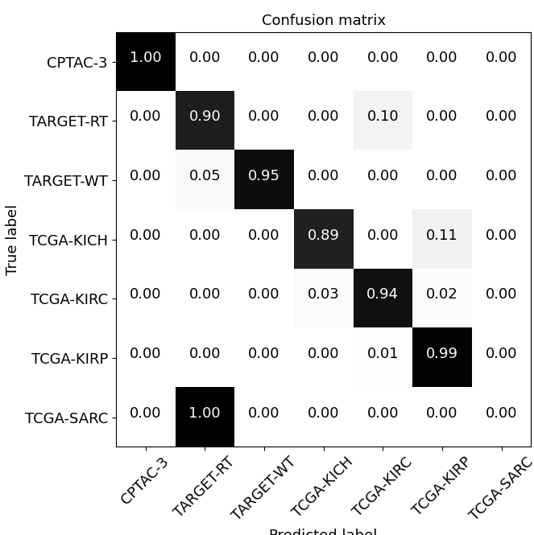


Classification-CNN
To asses best approaches between supervised and unsupervised method and which kernel in cca choose the result confusion matrix od CNN are shown.
Supervised:
Gaussian kernel
Linear kernel
Poly kernel

Slide 10
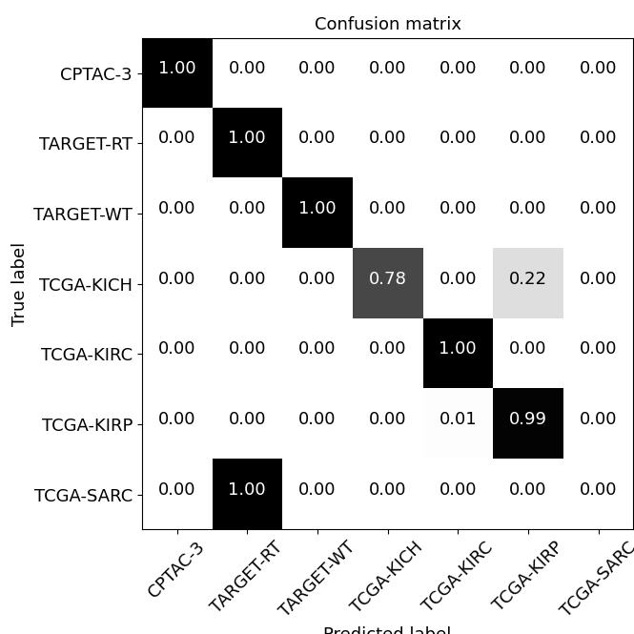


Classification-CNN
Unsupervised
Gaussian kernel
Linear kernel
Poly kernel

Slide 11
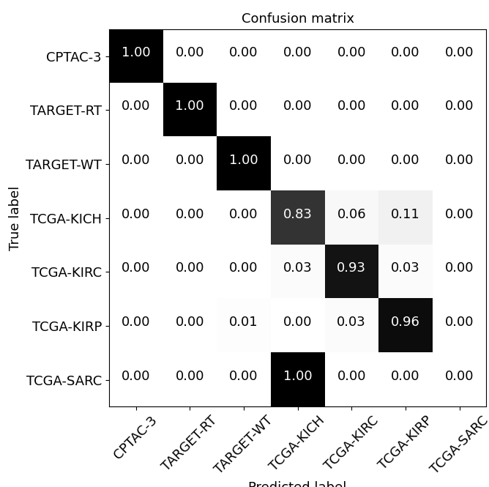
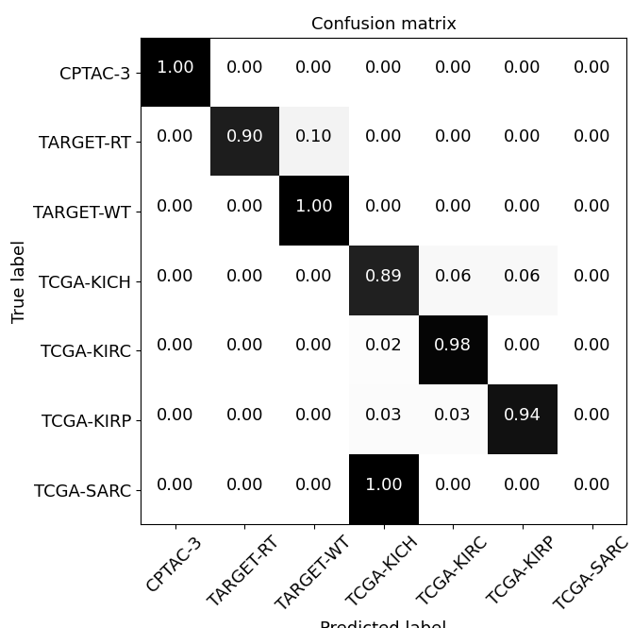

Classification-CNN
To evaluate also the performance of the two-step FS a supervised CCA with polynomial kernel is choosen.
Decision Tree
Random forest
XGBoost

Slide 12
Validation
The performance provided by the CNN does not differ so much among the proposed methods.
To have another term of comparison a search in literature was made to verify the selected features:
For mRNA was used the “Atlas of human proteins”.
For miRNA different papers have been analyzed to create a small dataset of 56 samples.

Slide 13
Validation
Over the best 20 features for each method the number of the prognostic one by literature is reported.

Slide 14
Conclusion
The best performance in terms of classification and validation have been obtained from:
Supervised CCA with polynomial kernel on the original dataset.
Two-step FS ( xgboost → CCA).
The prognostic mRNA and miRNA found are:
mRNA | miRNA
TMEM115 | hsa-mir-30a
TOLLIP | hsa-mir-126
ZNF768 | hsa-mir-21
EMC10 | hsa-mir-210
LYPLA2 | hsa-mir-182
RTCB
DNAJC27
ABHD14B
GRB7
SUGT1P1
C4orf3
HELQ
mRNA | miRNA
ACAD9 | hsa-mir-30a
MCRS1 | hsa-mir-126
ZER1 | hsa-mir-21
NAIF1 | hsa-mir-210
EXD2
RPUSD2
ELP6
MECR
INTS5
VPS11
ASB8
USP20

Slide 15
Thank you for the attention

