Slide 1
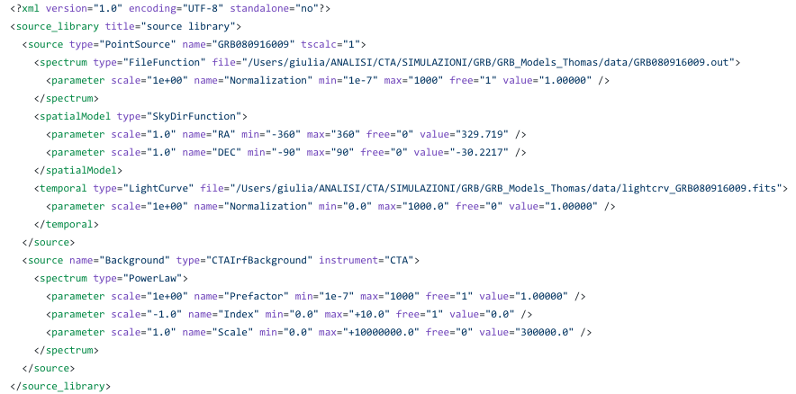
Simulating GRB 080916
http://cta.irap.omp.eu/ctools/users/user_manual/getting_started/models.html
Input xml model for ctools “obssim”

Slide 2
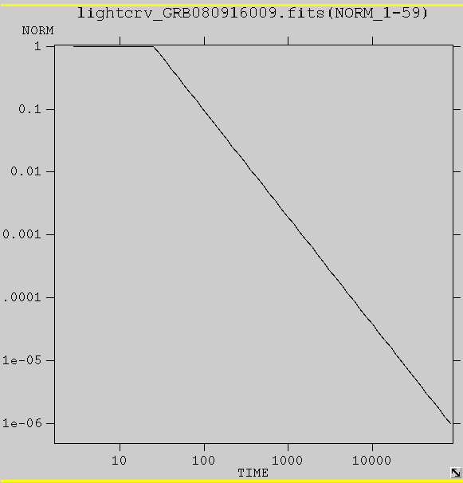
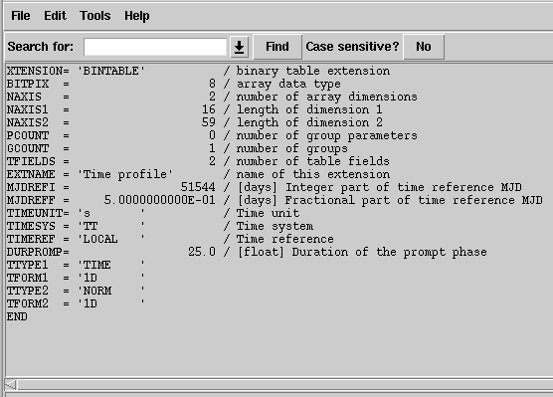
Input light curve
Lightcurve: fits file (normalization Vs time (seconds) from a reference time defined in the header)
The burst is approximeted as constant during first 25 s and then decays as PL with alpha=-1.7
Thomas Gasparetto’s database of simulated GRBs
Notes:
http://cta.irap.omp.eu/ctools/users/user_manual/getting_started/models.html

Slide 3
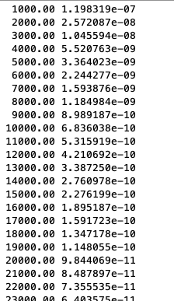
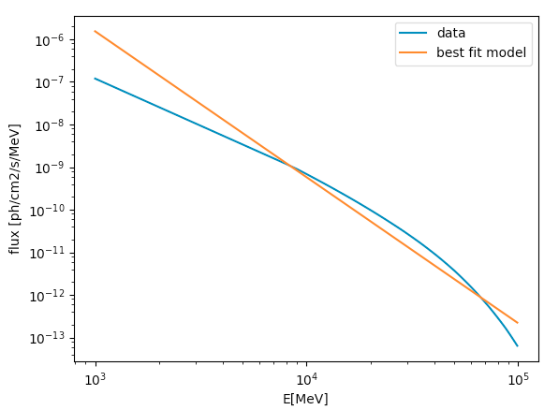
Input spectrum
Spectrum: ascii file with the energy (MeV) in first column and fluxes in second column (ph/cm2sMeV)
Burst spectrum is assumed to be an EBL-absorbed PL
Thomas Gasparetto’s database of simulated GRBs

Slide 4
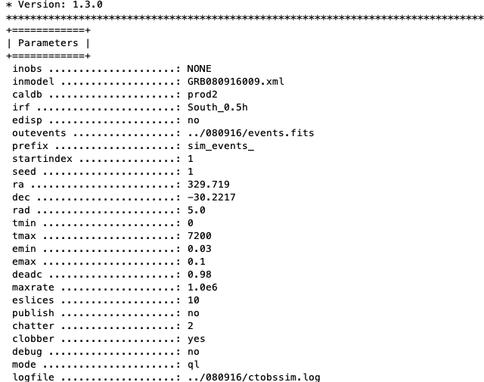
Monte Carlo simulation

Slide 5
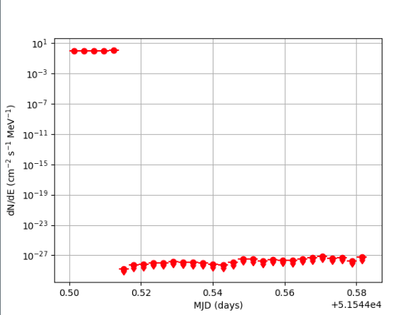
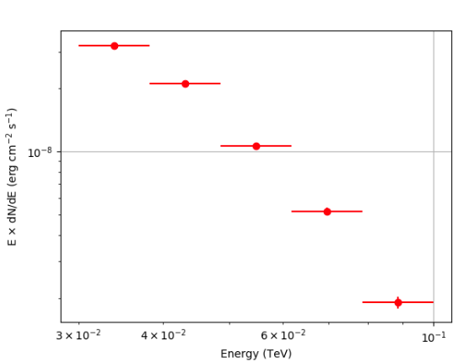
Output light curve and spectrum
Obtained using the simulated event file as input to ctools “cslightcrv” for light curve extraction and “csspec” for spectrum extraction

Slide 6
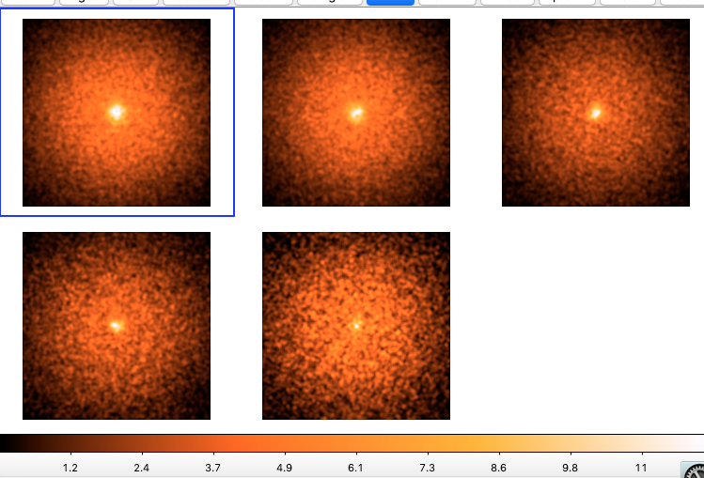
3D cube
Ctools “ctbins” create a 3D cube with RA,Dec, Energy
5 logspaced energy bins: 30-38, 38-48, 48-62, 62-79, 70-100 GeV

Slide 7
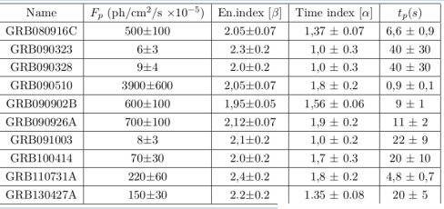
Fermi/LAT GRBs
Credit: Bissaldi

