Slide 1
CUSP GEANT4 Mass Model
Giovanni De Cesare
Status - Updated November 22 2023

Slide 2
CUSP GEANT4 Status
The gdml mass model has been exported from CAD and imported in the GEANT4 model (last version CUSP_GEANT4_20231013 in progress)
The Monte carlo simulations works as expected (see https://github.com/giovixo/g4cusp/tree/main/notebooks)
Stay tuned for the scientific results

Slide 3
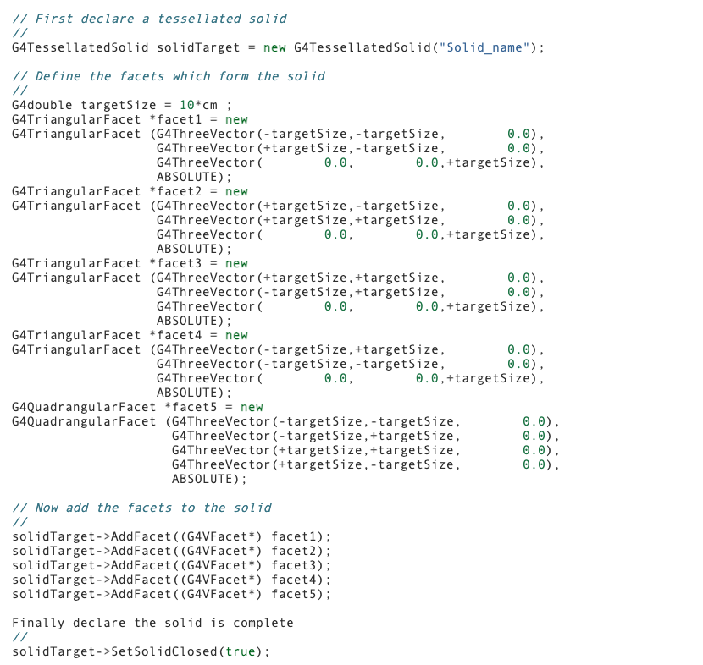
GEANT4 Mass Model
Geometries are imported
from CAD system and
converted to tessellated solids

Slide 4
CAD exported mass model release (1)
cusp_payload_GEANT4-worldVOL.gdml
cusp_payload_GEANT4-worldVOL-structure.xml
cusp_payload_GEANT4-worldVOL-solids.xml
define.xml
+ some prescription (see next slide)

Slide 5
gdml mass model release (2)
file generated by: Giovanni Lombardi
date: 13/10/2023
news:
- material in each part of the step file:
- G4_Galactic: World
- G4_Al: metallic frame; if_platform_payload; spacer; absorber_filter_al; scatterer_filter_al
- G4_Glass_Plate: MAPMT
- G4_Plexiglass: Gyroscope; abs_scatt_frame
- G4_W: short_side_W_cover; side_W_cover; Absorber_filter_W
- G4_W: absorber_collimator; scatterer_collimator -> in this case the W is the material but you have to reduce the density of these parts of 90%
- G4_PolytrifluoroChloroethylene: PCB; apd_sensor_pcb; apd; apd_pcb -> you have to convert that in FR4
- G4_Plastic_SC_Vinyltoluene: Scatterer_box
- G4_Ti: Aborber_filter_Ti; scatterer_filter_Ti
- G4_A-150_TISSUE: Absorber_box -> look the material missing note
- material missing:
- Absorber: custom material "GaGG" is not included in the NIST library, it shall be added manually in the simulator with this properties:
GAGG: gadolinium-aluminium-gallium, 4 chemical elements Gd3Al2Ga3O12.density 6.63 g/c

Slide 6
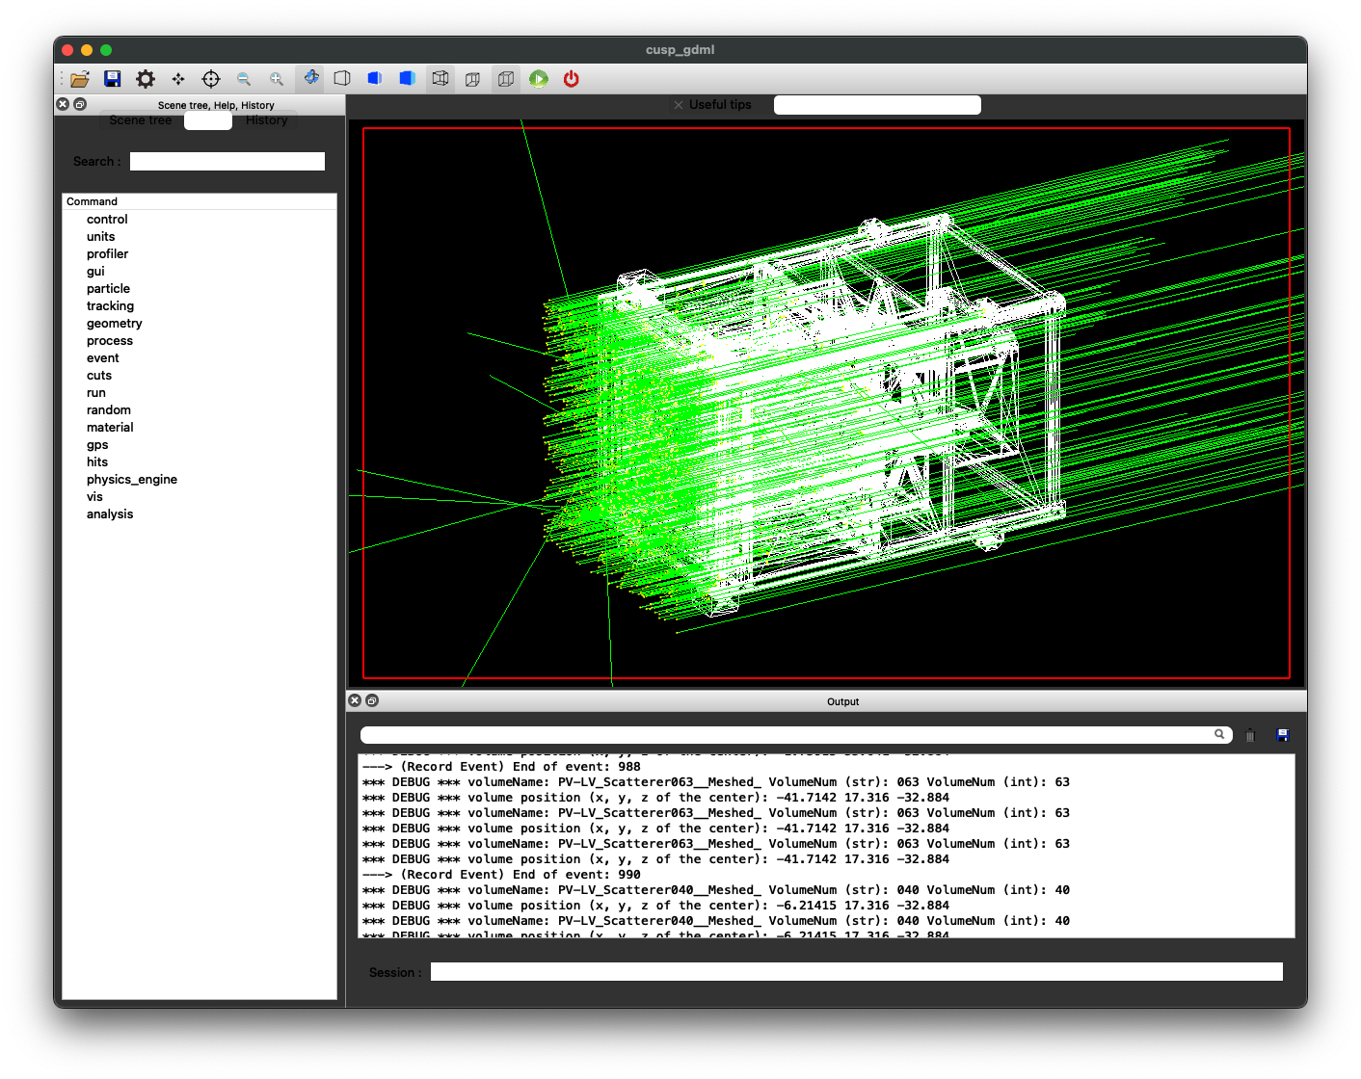
Screenshots (Qt GUI) (1)

Slide 7
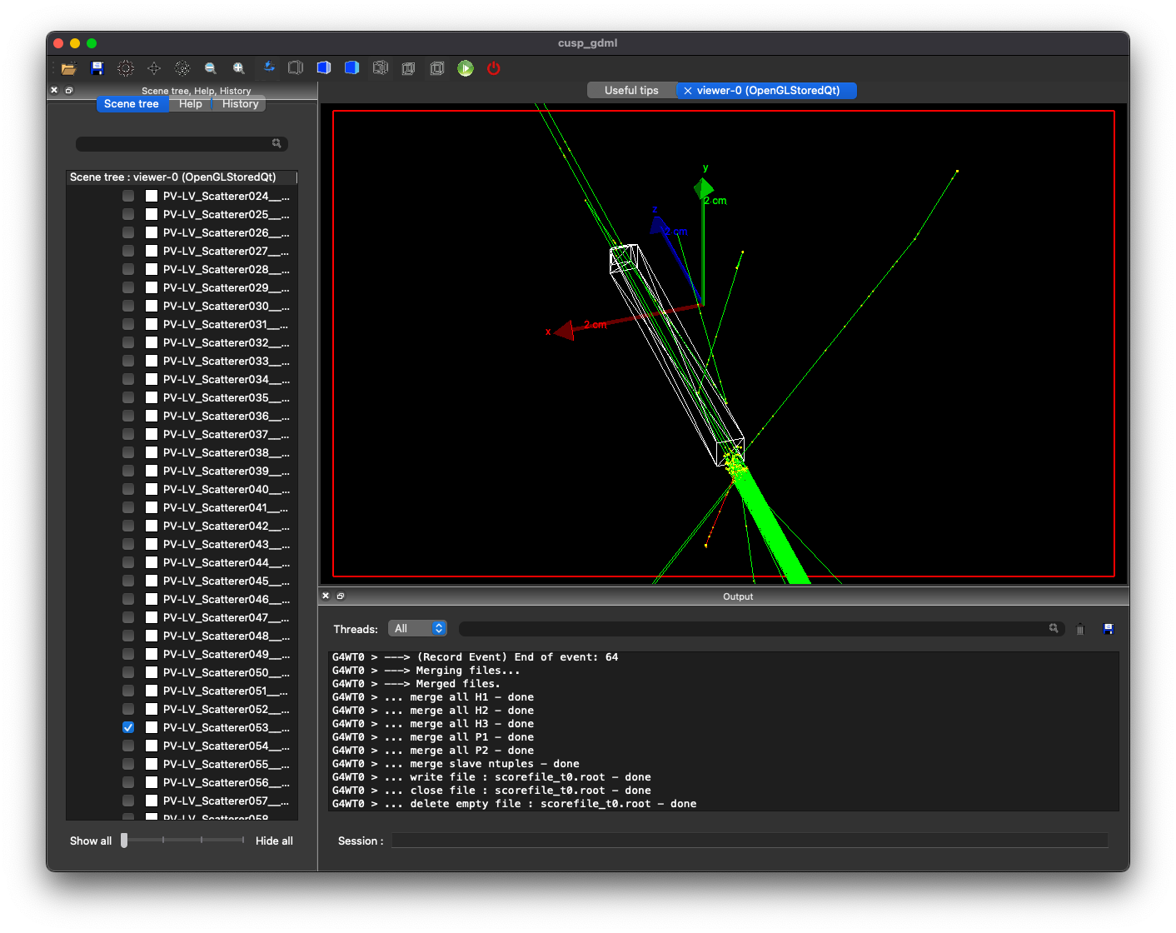
Screenshots (2)

Slide 8
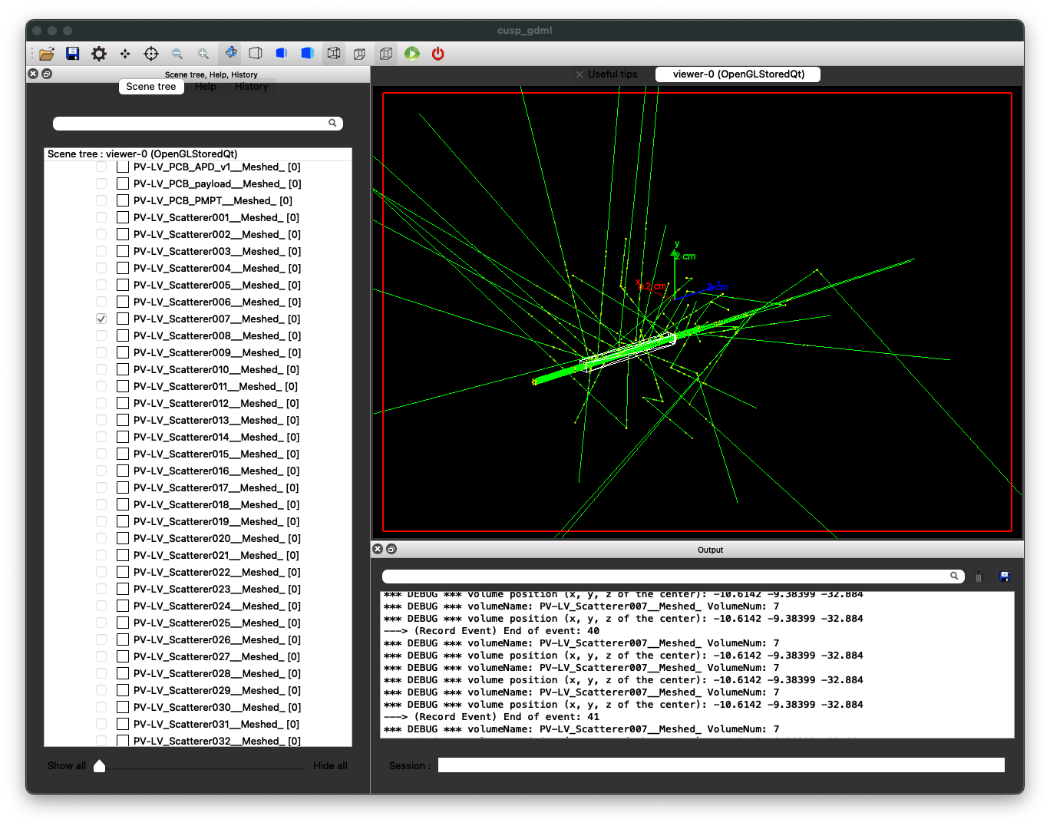
Screenshots (3)

Slide 9
gdml Mass Model
File xxx-structure.xml
<volume name="LV_Scatterer_v064__Meshed_">
<materialref ref="G4_PLASTIC_SC_VINYLTOLUENE"/>
<solidref ref="Mesh2Tess109"/>
<auxiliary auxtype="Color" auxvalue="#80808000"/>
</volume>
File xxx-solids.xml
<tessellated name="Mesh2Tess109">
<triangular type="ABSOLUTE" vertex1="Mesh2Tess109_10" vertex2="Mesh2Tess109_6" vertex3="Mesh2Tess109_1"/>
<triangular type="ABSOLUTE" vertex1="Mesh2Tess109_1" vertex2="Mesh2Tess109_6" vertex3="Mesh2Tess109_2"/>
<triangular type="ABSOLUTE" vertex1="Mesh2Tess109_5" vertex2="Mesh2Tess109_10" vertex3="Mesh2Tess109_9"/>
<triangular type="ABSOLUTE" vertex1="Mesh2Tess109_6" vertex2="Mesh2Tess109_10" vertex3="Mesh2Tess109_5"/>
<triangular type="ABSOLUTE" vertex1="Mesh2Tess109_11" vertex2="Mesh2Tess109_9" vertex3="Mesh2Tess109_0"/>
<triangular type="ABSOLUTE" vertex1="Mesh2Tess109_5" vertex2="Mesh2Tess109_9" vertex3="Mesh2Tess109_11"/>
<triangular type="ABSOLUTE" vertex1="Mesh2Tess109_1" vertex2="Mesh2Tess109_2" vertex3="Mesh2Tess109_0"/>
<triangular type="ABSOLUTE" vertex1="Mesh2Tess109_0" vertex2="Mesh2Tess109_2" vertex3="Mesh2Tess109_11"/>
<triangular type="ABSOLUTE" vertex1="Mesh2Tess109_9" vertex2="Mesh2Tess109_10" vertex3="Mesh2Tess109_1"/>
<triangular type="ABSOLUTE" vertex1="Mesh2Tess109_9" vertex2="Mesh2Tess109_1" vertex3="Mesh2Tess109_0"/>
<triangular type="ABSOLUTE" vertex1="Mesh2Tess109_6" vertex2="Mesh2Tess109_7" vertex3="Mesh2Tess109_3"/>
<triangular type="ABSOLUTE" vertex1="Mesh2Tess109_6" vertex2="Mesh2Tess109_3" vertex3="Mesh2Tess109_2"/>
<triangular type="ABSOLUTE" vertex1="Mesh2Tess109_2" vertex2="Mesh2Tess109_3" vertex3="Mesh2Tess109_8"/>
<triangular type="ABSOLUTE" vertex1="Mesh2Tess109_2" vertex2="Mesh2Tess109_8" vertex3="Mesh2Tess109_11"/>
<triangular type="ABSOLUTE" vertex1="Mesh2Tess109_4" vertex2="Mesh2Tess109_11" vertex3="Mesh2Tess109_8"/>
<triangular type="ABSOLUTE" vertex1="Mesh2Tess109_4" vertex2="Mesh2Tess109_5" vertex3="Mesh2Tess109_11"/>
<triangular type="ABSOLUTE" vertex1="Mesh2Tess109_7" vertex2="Mesh2Tess109_5" vertex3="Mesh2Tess109_4"/>
<triangular type="ABSOLUTE" vertex1="Mesh2Tess109_7" vertex2="Mesh2Tess109_6" vertex3="Mesh2Tess109_5"/>
<triangular type="ABSOLUTE" vertex1="Mesh2Tess109_3" vertex2="Mesh2Tess109_4" vertex3="Mesh2Tess109_8"/>
<triangular type="ABSOLUTE" vertex1="Mesh2Tess109_7" vertex2="Mesh2Tess109_4" vertex3="Mesh2Tess109_3"/>
</tessellated>

Slide 10
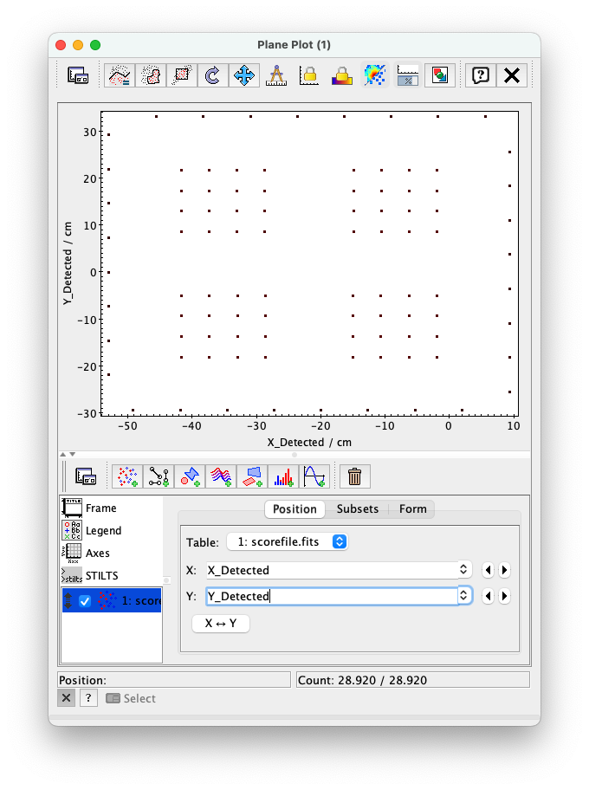
Screenshots (4)

Slide 11
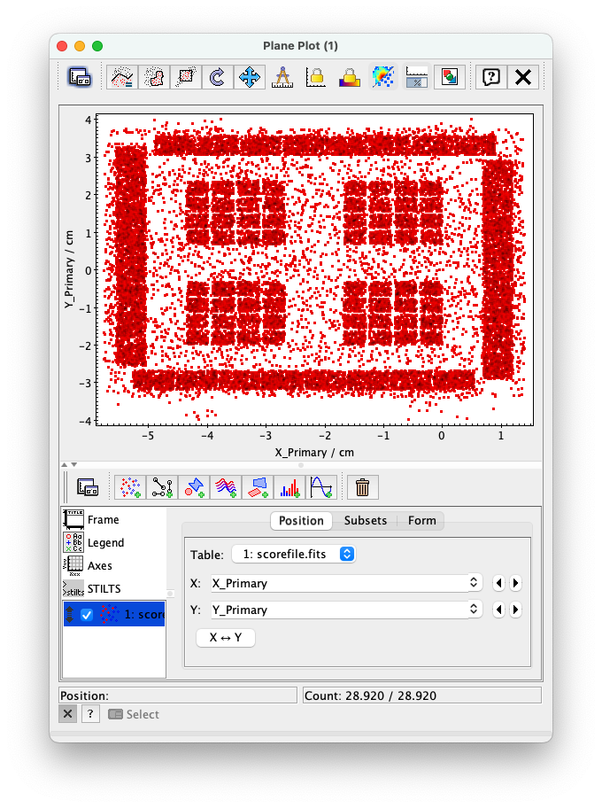
Screenshots (5)

Slide 12
Scientific validation and results To do list
Effective area
Spurious polarization
Polarimetry
Etc…

