Slide 1

G2M Case Study
Virtual Internship
Gifty Osei
14-June-2023

Slide 2

Week 3- Presentation
By Gifty Osei
06/14/2023

Slide 3
Introduction and Objectives
US-based private equity company XYZ is preparing to invest in the taxi industry. This is a result of the sector's impressive recent expansion and the presence of numerous major competitors in the market.
Goal: Help XYZ firm choose the best company for investment by providing supporting evidence.
Data description
EDA
Model
Recommendations

Slide 4
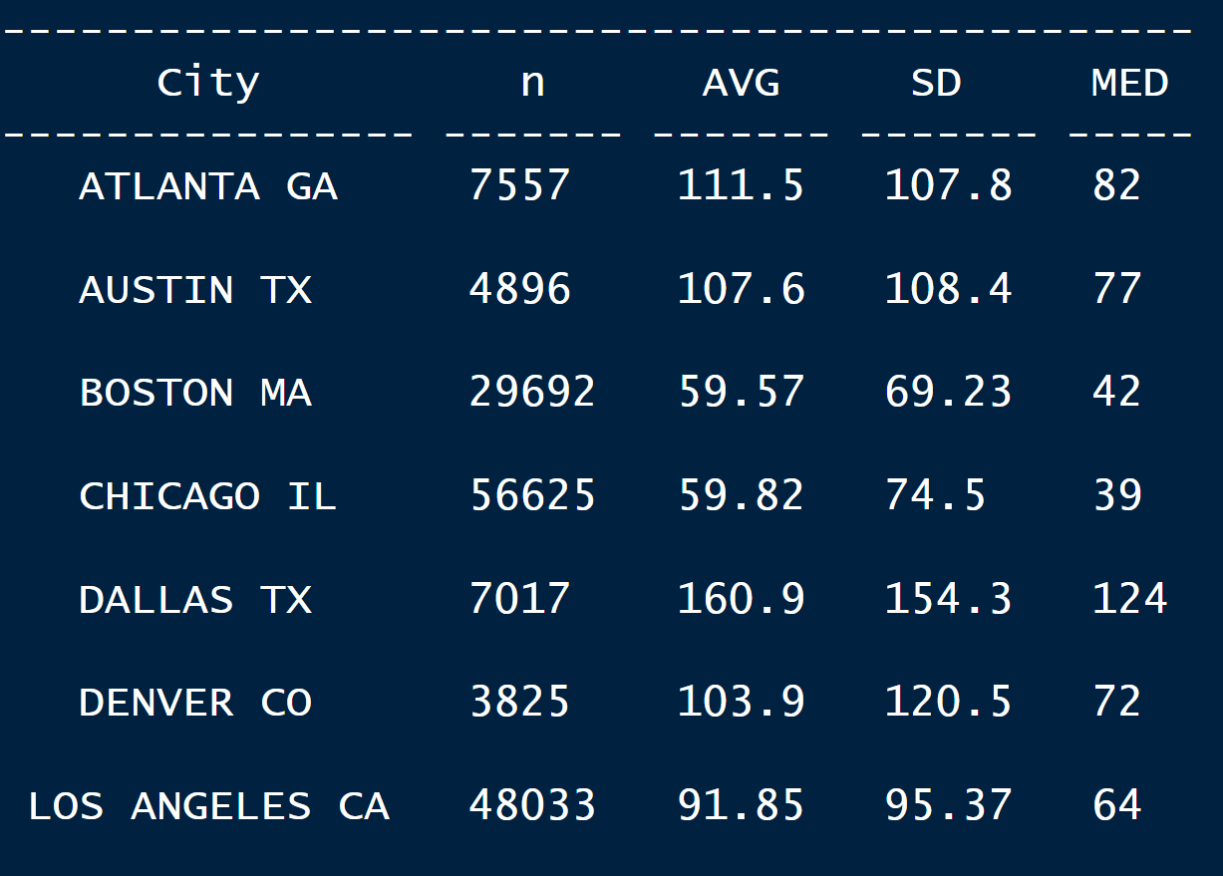
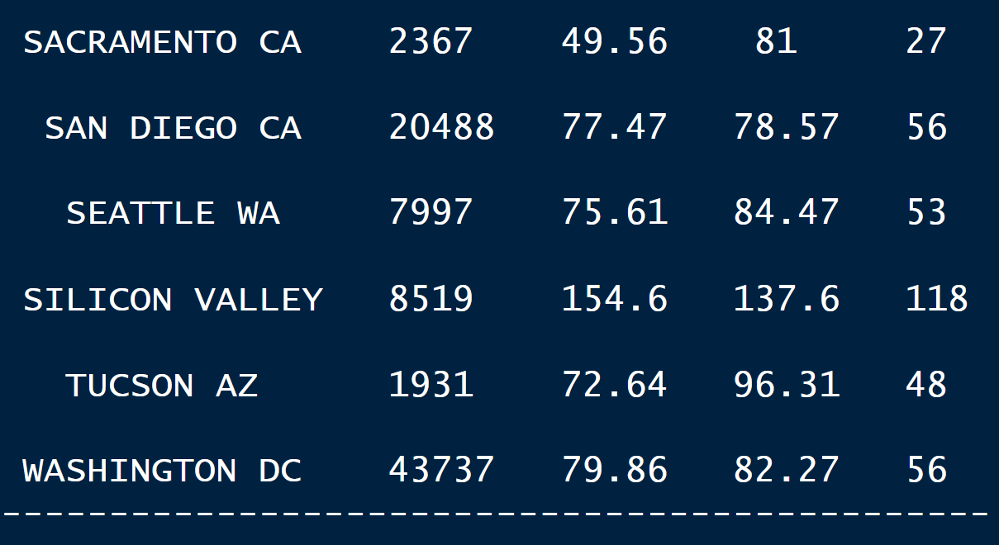
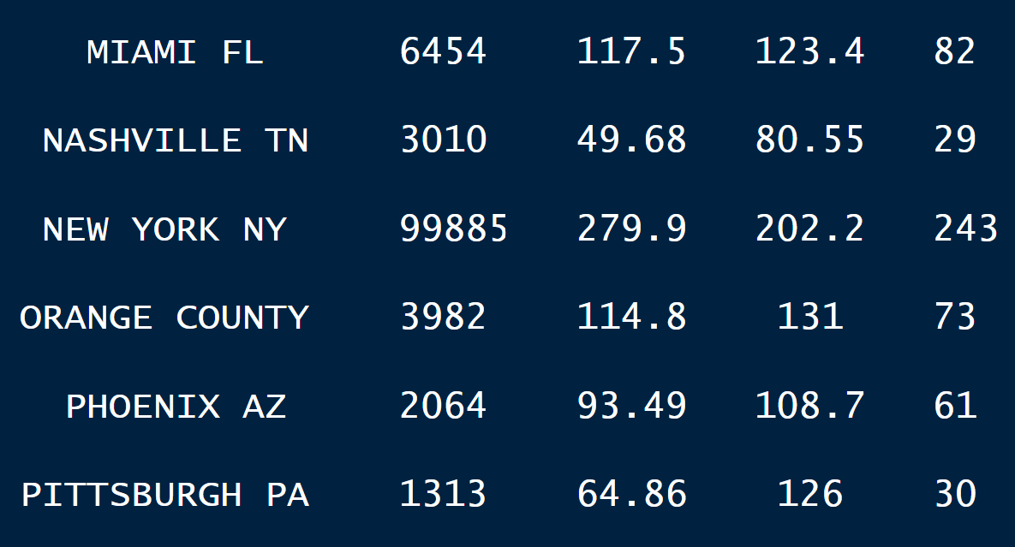
Data Description
24 variables with 359392 observations
No influential or highly disturbing outliers were found.
Profit was calculated using the price and cost of the trip variable.
Silicon Valley has the highest average profit whiles Sacramento records the lowest.

Slide 5
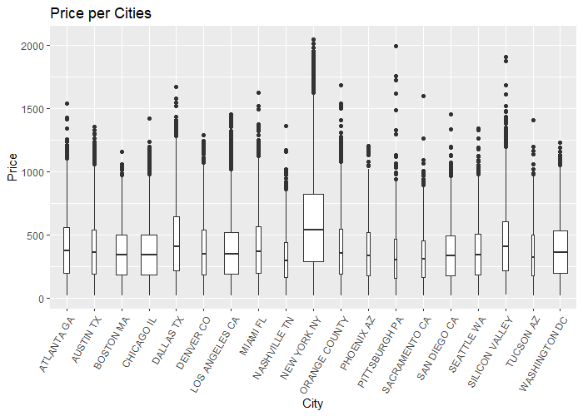
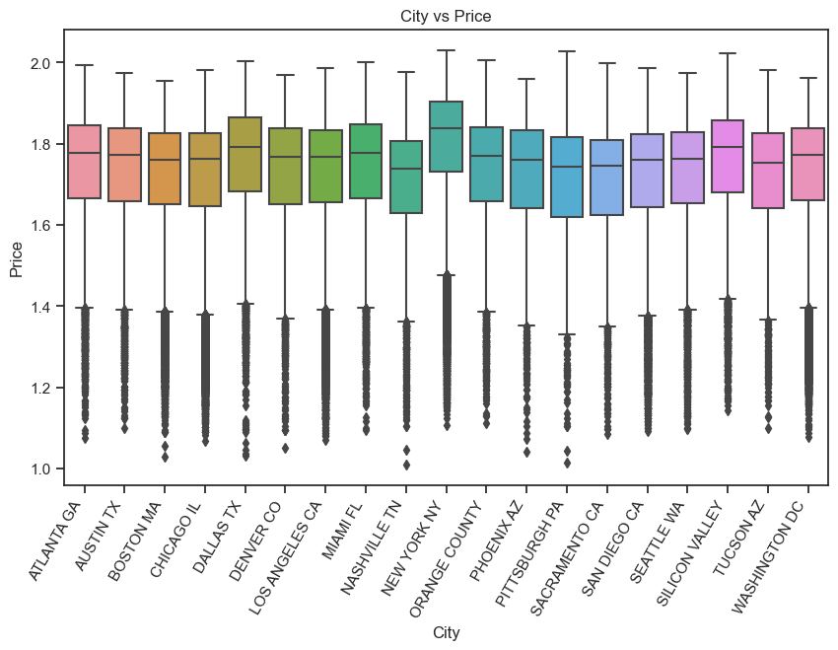
Price and City Analysis
Considering how the City affects the price of the trip, we see that New York has the highest variability and the median is higher than all the other cities.

Slide 6
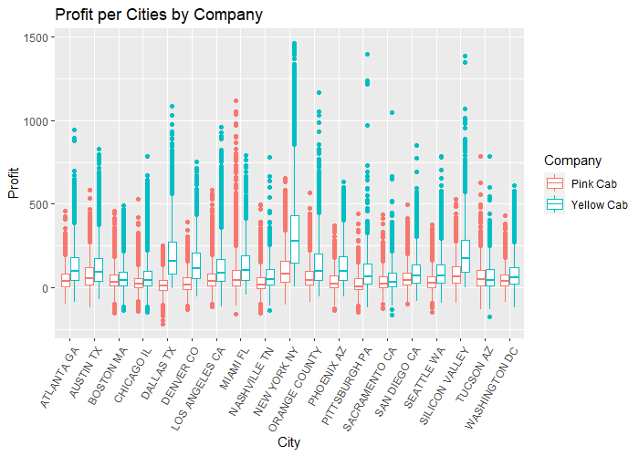
Price Vs City by Company Type
. For New York City, we see that yellow cabs do much better than pink cabs although that is the city with the highest median.

Slide 7
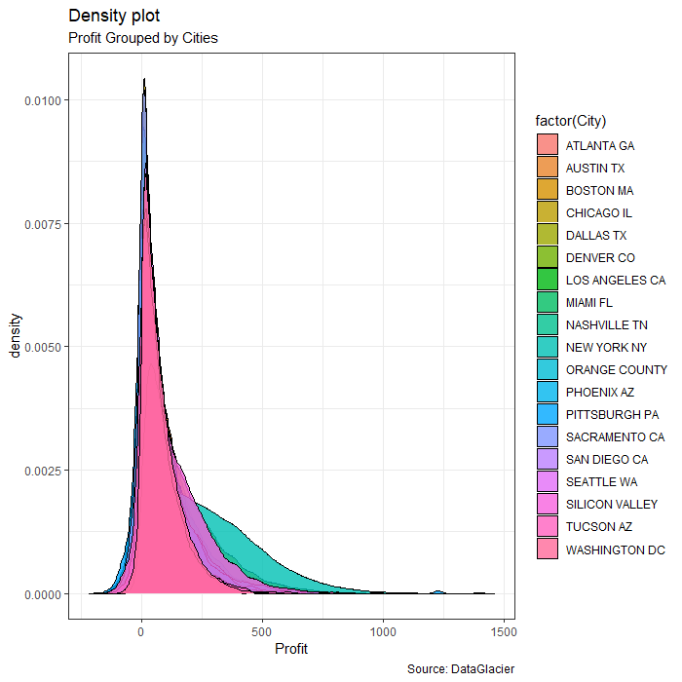
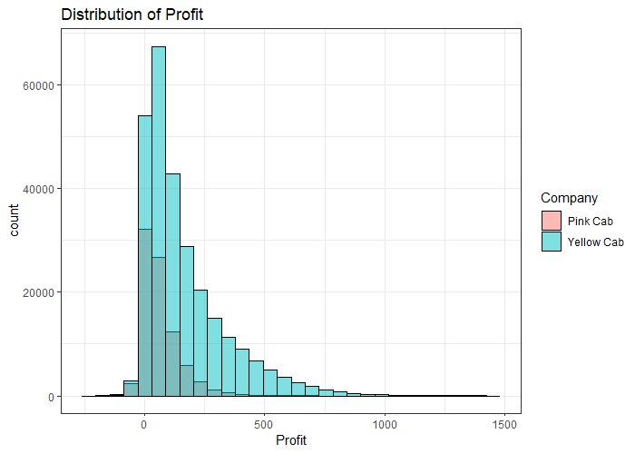
Profit Analysis
We see that Profit if right skewed and this may be due to the huge differences in with income from cities.

Slide 8
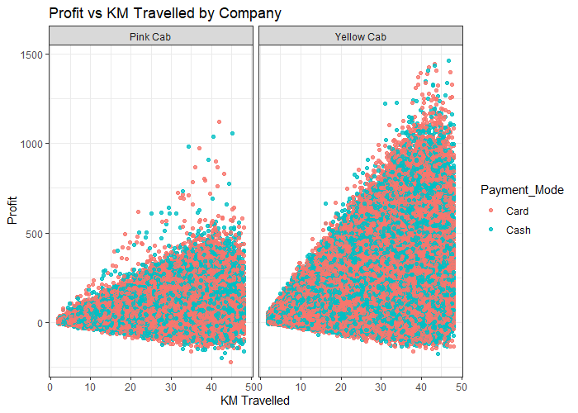
Profit by Distance
We see that Yellow Cab are more profitatble as distance travelled increases

Slide 9
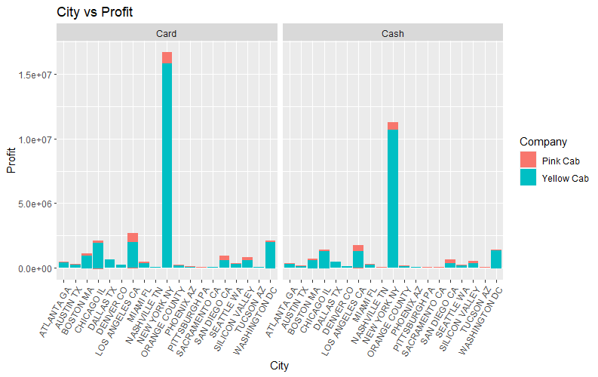
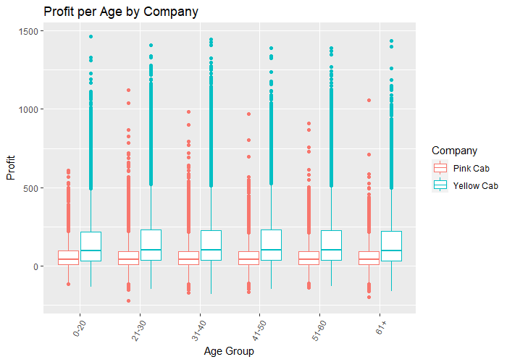
Profit and Age Group/City
Pink cab has a small percentage of all profits made in each city
Age is not significant because we see no significant difference within these groups regarding profit. Everybody uses a Cab.

Slide 10
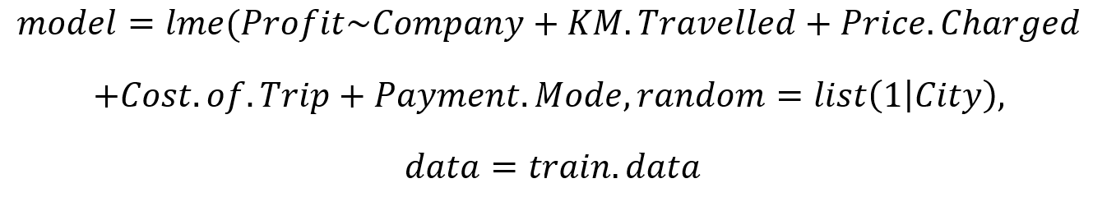
Statistical Method
The goal is to predict profit accurately
Models: Mixed Models with City as Random
Some variables were insignificant in predicting profit. The remaining are the significant variables that make some logical sense as the distance traveled has an impact on the profit made.

Slide 11
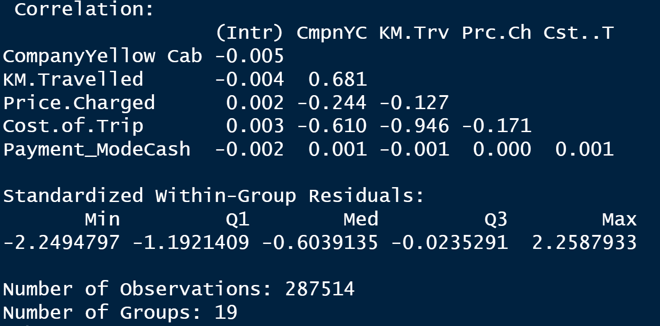
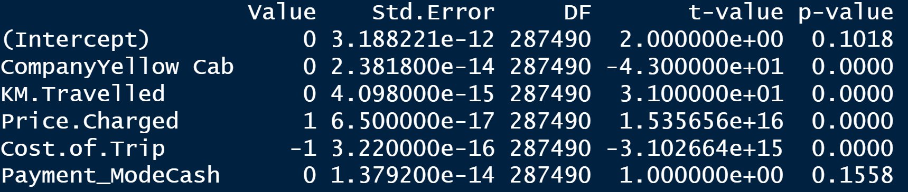
Model Results
We see that company, distance traveled, price charged and cost of the trip are all significant in predicting Profit.
Profit prediction is important in the decision of which company to invest.
We see a high correlation between the distance traveled and the cost of the trip.

Slide 12

Recommendations
Based on all the EDA, it will be more profitable to invest in the Yellow cab company.
In terms of age, we see yellow cab doing better throughout all the age groups.
The longer the distance traveled, the higher the price charged hence the higher the profit.
I will recommend investment in the Yellow cab company.

Slide 13

THANK YOU!

