Slide 1




EMOFAKE
Girish - 500109971
Yash Kesarwani - 500109497
Aryan Singh Payaal - 500093654

Slide 2

EmoFake (EF): Audio deepfakes altering emotions
while preserving identity and content.
Hypothesis: Multilingual Speech Foundation Models (SFMs) excel in EF Detection (EFD).
Results: SFMs outperformed individual models and previous SOTA methods.
Abstract

Slide 3


Overview
EmoFake: Alters emotion in speech subtly, impacting trust
and communication.
Implications: Misuse can distort perceptions, cause manipulation, and erode trust.
Challenge: Existing ADD methods fail to detect emotional changes effectively.

Slide 4


Related Work
ADD Advances: Progress in detecting identity-based deepfakes.
EmoFake Challenges: Limited research on emotion-specific detection.
Key Models: Success of multilingual SFMs (e.g., UniSpeech-SAT,Wav2vec2) in cross-linguistic tasks.

Slide 5


Problem Statement
New Threat: EF modifies emotion, preserving voice and content.
Need: Specialized detection methods for subtle emotional changes.
Current Gap: Traditional ADD methods fall short.

Slide 6


Goals
Framework: Build and test a model for EFD using SFMs.
Comparison: Evaluate individual vs. fused models.
Outcome: Propose a benchmark for EFD using SFM fusion.

Slide 7
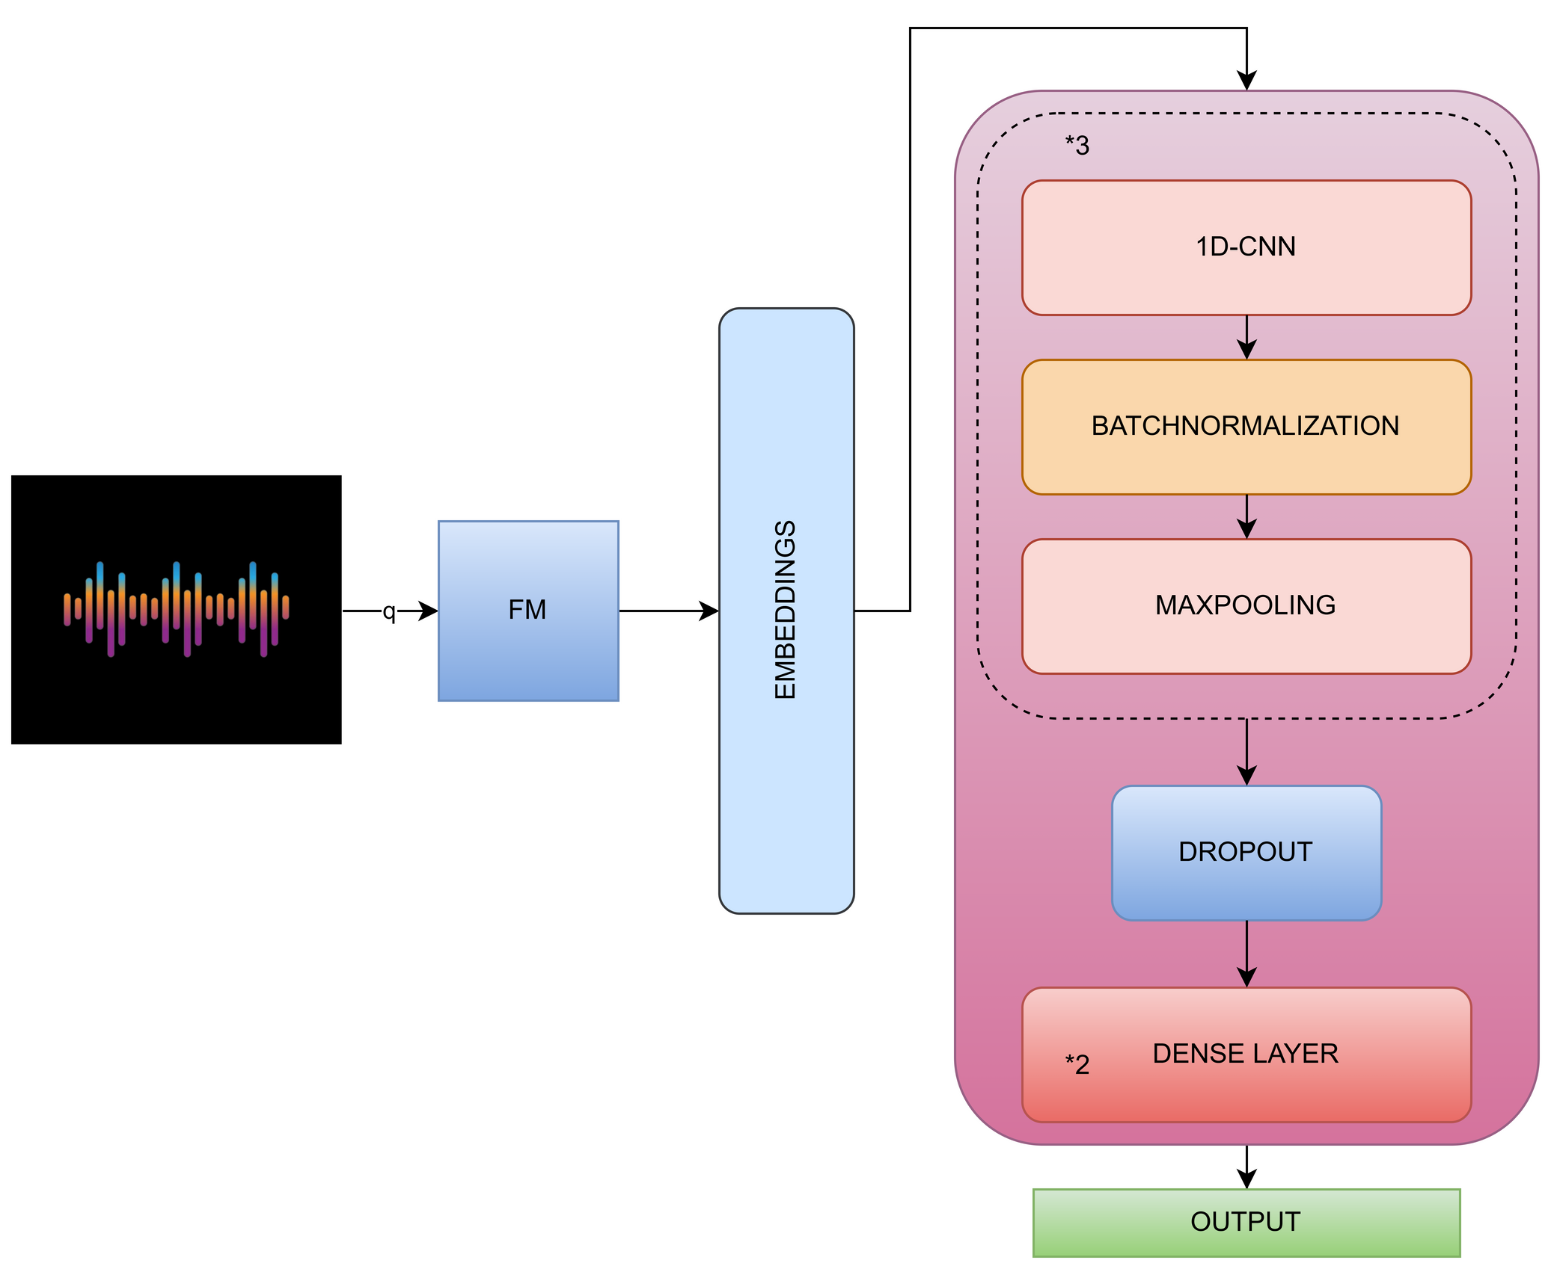

Slide 8


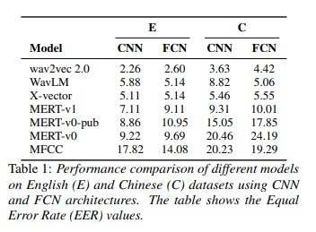

Validation: Multilingual SFMs proved effective for EFD.
Models: Outperformed individual SFMs and existing SOTA.
Key Metrics: Higher precision, recall, and F1-scores.
Robustness: Consistent results across different languages and conditions.
Results

Slide 9
