Slide 1
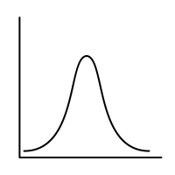
Lec.3: Conditional Probability
MSAI Probability Fall 2021

