Slide 1
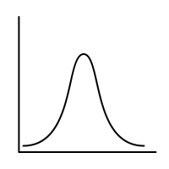
Probability Fall 2021
Lecture 1: Probability and counting

