Slide 1
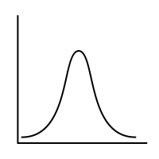
Lec.7: Continuous Random Variables
MSAI Probability Fall 2021

