Slide 1
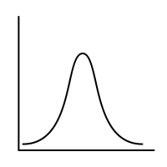
Sem.3: Conditional Probability
MSAI Probability Fall 2021

