Slide 1
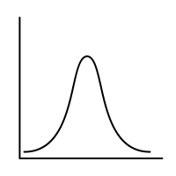
Sem.6: Expectation
MSAI Probability Fall 2021

