Slide 1
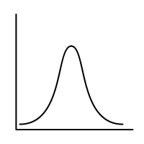
Lec.5: Random Variables & Their Distributions – 2
MSAI Probability Fall 2021

