Slide 1
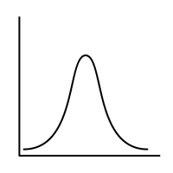
Lec.2: Probability & Counting-2
MSAI Probability Fall 2021

