Slide 1
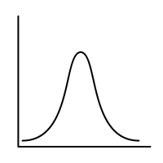
Sem.4-5: Random Variables & Their Distributions
MSAI Probability Fall 2021

