Slide 1
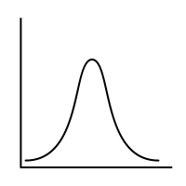
Sem.1: Probability & Counting
MSAI Probability Fall 2021

