Slide 1

Extracting system metrics from kernel trace
Francis Giraldeau francis.giraldeau@rlnx.com
Mathieu Desnoyers mathieu.desnoyers@efficios.com
David Goulet dgoulet@ev0ke.net
Julien Desfossez ju@klipix.org
Michel Dagenais michel.dagenais@polymtl.ca
Linux Symposium 2011

Slide 2
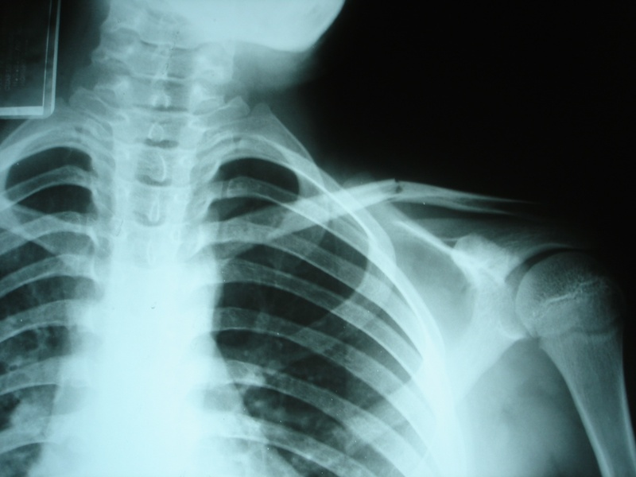

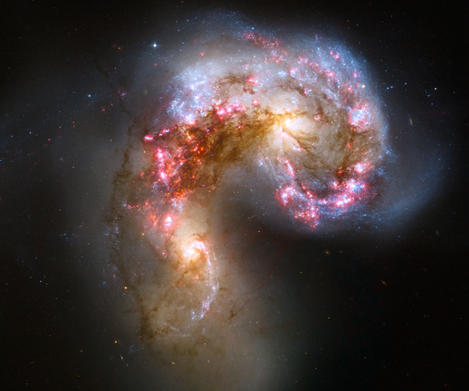
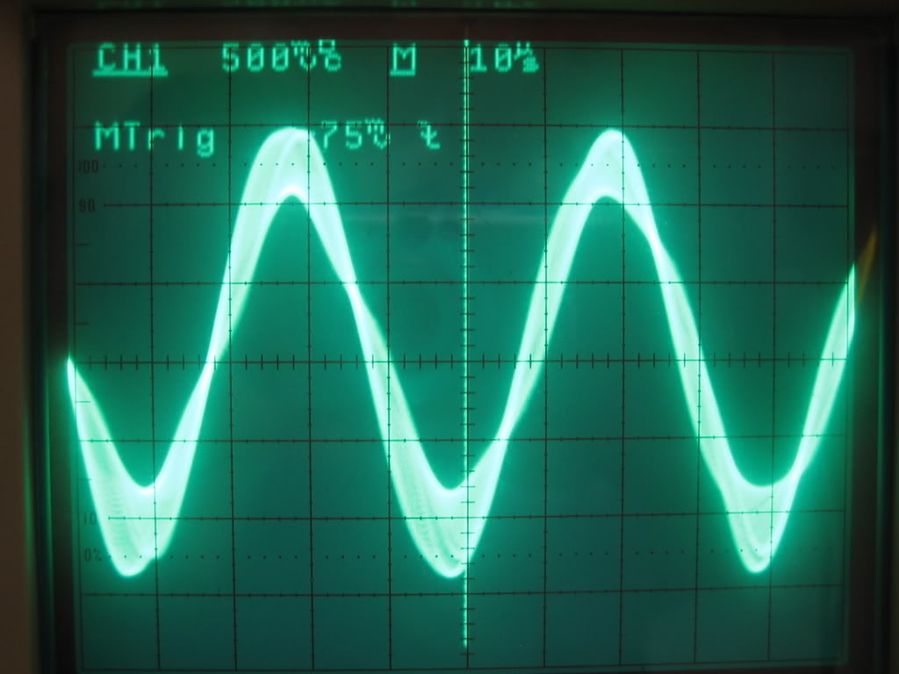
Notes:
In other fields of engineering, they have powerfull tools to uncover the invisible and understand what is actualy going on, from the atoms to galaxy

Slide 3

Notes:
But, in Computer Engineering, I have sometime the feeling that we are in the stone age for such instrumentation

Slide 4
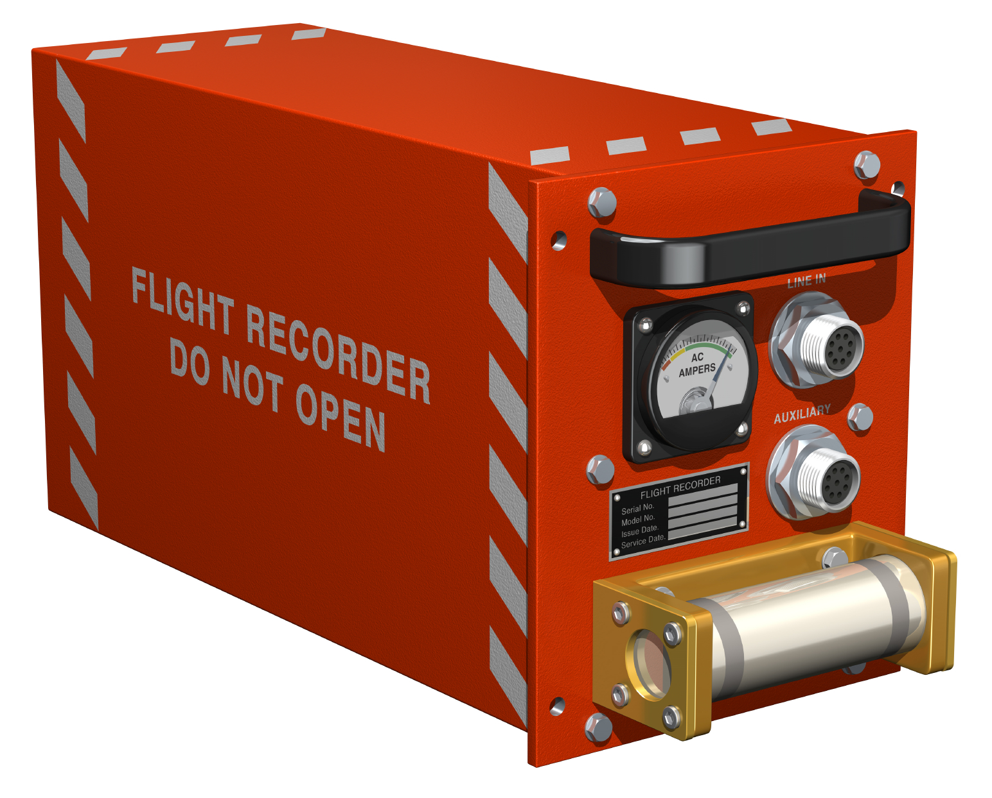

Slide 5
Content
About tracing
LTTng tracing facilities
Event analysis
Tools demo

Slide 6
About tracing
LTTng tracing facilities
Event analysis
Tools demo

Slide 7
What is a trace?
Ordered list of events
Composed of a time stamp and a payload
Recorded at runtime execution

Slide 8
Software observation
Sampling
Counters
Interactive debugging
Tracing

Slide 9
Data sources
User space
Kernel
Hardware

Slide 10
About tracing
LTTng tracing facilities
Event analysis
Tools demo

Slide 11
Components
Trace points in source code
Reliable time source
Ring buffer
Data transport daemon

Slide 12
Features
64-bit time-stamps
Per-CPU buffers
Flight recorder mode
Live reading mode
User space and kernel

Slide 13
Properties
Lock less
Low overhead
Efficient storage
System wide

Slide 14
Linux-2.6.38/kernel/sched.c
/*
* context_switch - switch to the new MM and the new
* thread's register state.
*/
static inline void
context_switch(struct rq *rq, struct task_struct *prev,
struct task_struct *next)
{
struct mm_struct *mm, *oldmm;
prepare_task_switch(rq, prev, next);
trace_sched_switch(prev, next);
mm = next->mm;
oldmm = prev->active_mm;
...
1649.424856148 kernel.sched_schedule { prev_pid = 24, next_pid = 1765 }
Time stamp
Event type
Payload

Slide 15
Trace directory
[francis@berta traces]$ ls -ash1 sleep-1x-1sec/
total 1,1M
4,0K .
4,0K ..
96K kernel_0
116K kernel_1
16K metadata_0
4,0K metadata_1
[...]
Per-CPU file

Slide 16
Trace reading
kernel_0
1:A
4:C
kernel_1
3:B
kernel_*
A
B
C
t
0
1
2
3
4
int ltt_tracefile_read(LttTracefile *tf)
Event | Time | File | Offset
A | 1 | kernel_0 | 0
B | 3 | kernel_1 | 0
C | 4 | kernel_0 | 1

Slide 17
About tracing
LTTng tracing facilities
Event analysis
Tools demo

Slide 18
156 available kernel events*
Metadata
System calls
IRQ, SoftIRQ
Page fault
Scheduling
Block I/O
Network events
Input events
Memory management
Printk events
File operation
And much more!
*linux-2.6.38.6 lttng-0.249

Slide 19
Recover process information
1649.424856148 kernel.syscall_entry { syscall_id = 3 }
cpu = ? pid = ? cmd = ? ...
Time stamp
Event type
Payload
CPU is known from trace file
kernel.sched_schedule { next_pid, prev_pid }
fs.exec { filename }

Slide 20
CPU usage

Slide 21
Memory usage

Slide 22
File I/O
fs.open { fd, filename }
fs.close { fd }
fs.read { fd, count }
fs.write { fd, count }

Slide 23
Disk I/O
block.bio_remap { from, to }
block.bio_queue { sector }
block.rq_insert_fs { hard_sector, rw, errors }
block.rq_complete_fs { hard_sector, rw, errors }
Front and backmerge

Slide 24
Network I/O
net.dev_xmit_extended
  { network_protocol, transport_protocol, saddr, daddr, tot_len, ihl, source, dest, seq, ack_seq, doff, ack, rst, syn, fin }
net.tcpv4_rcv_extended
  { saddr, daddr, tot_len, ihl, source, dest, seq, ack_seq, doff, ack, rst, syn, fin }
Net.udpv4_rcv_extended
  { saddr, daddr, unicast, ulen, source, dest }

Slide 25
About tracing
LTTng tracing facilities
Event analysis
Tools demo

Slide 26
Analysis tools
Linux Trace Toolkit Viewer (lttv)
LTTng Eclipse plugin
Prototype of analysis modules

Slide 27
Demo

Slide 28
Upcoming LTTng 2.0
Works on vanilla kernel
Support for new Common Trace Format
Common tools for kernel and user space
Better trace session management
Integration of perf counters
Customizable context
Ship in next Ubuntu LTS

Slide 29
Conclusion
Ubuntu packages available on launchpad
Special thanks to the LTTng team!
Useful links
  lttng.org
  multivax.blogspot.com

