Slide 1

6G use cases for AI agent communication protocols draft-stephan-ai-agent-6g-02
March 2026
E. Stephan (Orange), R. Schott (Deutsche Telekom),
D. Lopez (Telefonica), X. Duan (China Mobile), L. Morand (Huawei)

Slide 2

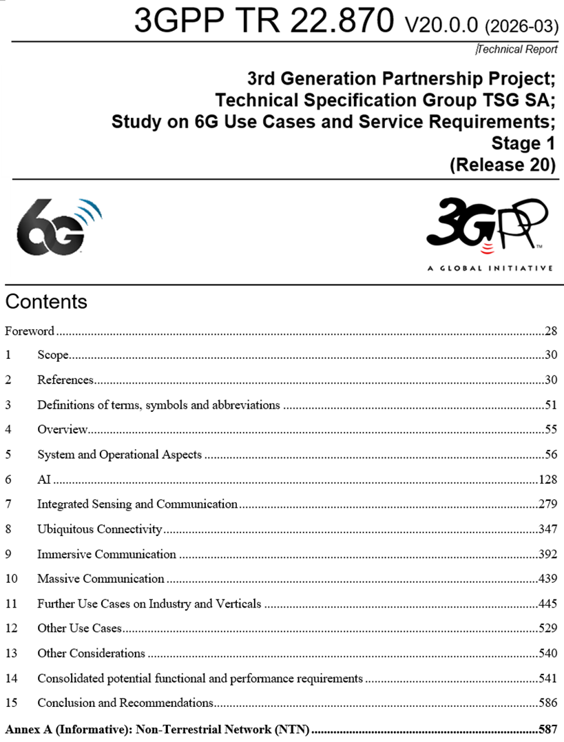
Study on 6G Use Cases and Service Requirements
6G Use Cases and Service Requirements captured in 3GPP TR 22.870
15-month study report published in 2026/03
https://www.3gpp.org/dynareport/22870.htm
Objectives:
Identify high level principles and use cases
Define potential requirements for 6G system to support new/enhanced services
Useful insights on the potential foundation pillars of the new 6G system.
AI and AI agents are clearly hot topics

Slide 3
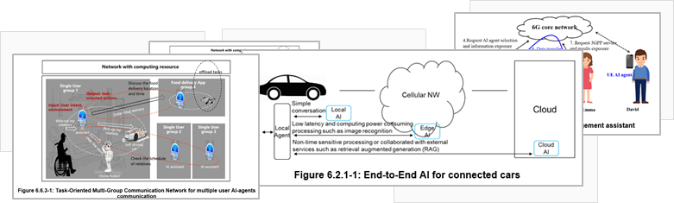
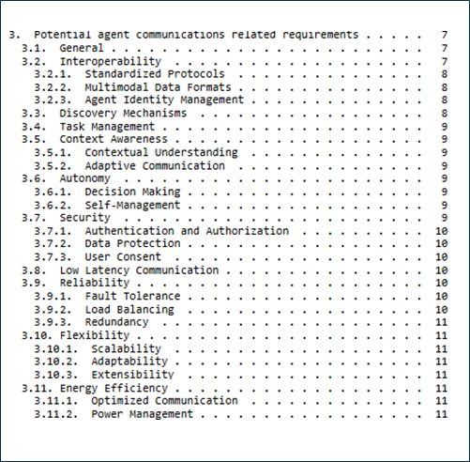


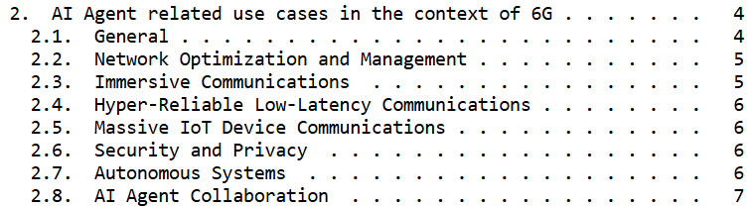
Pragmatic approach

Slide 4



Potential Key Requirements 1/3
Interoperability
Standardized Protocols: Ensuring seamless interaction across platforms.
Multimodal Data Formats: Supporting text, files, audio, and video.
Agent Identity Management: Secure identification and verification.
Discovery Mechanisms
Dynamic identification and location of AI agents and tools.
Combining multiple discovery mechanisms for efficiency.
Task Management
Task decomposition, assignment, scheduling, and coordination.
Importance of seamless collaboration among agents.

Slide 5



Potential Key Requirements 2/3
Context Awareness
Contextual Understanding: Awareness of operational context.
Adaptive Communication: Adapting communication based on context.
Autonomy
Decision Making: Autonomous and collaborative decisions.
Self-Management: Self-configuration, optimization, and healing.
Security
Authentication and Authorization: Identity verification and access control.
Data Protection: Encryption for privacy and confidentiality.
User Consent: Mechanisms for secure data exchange.

Slide 6




Potential Key Requirements 3/3
Low Latency Communication
Importance of minimal delay in data transmission.
Critical for real-time applications.
Reliability
Fault Tolerance: Detecting, mitigating, and recovering from anomalies.
Load Balancing: Distributing tasks to prevent bottlenecks.
Redundancy: Ensuring high reliability and service continuity.
Flexibility
Scalability: Accommodating increasing network sizes and data volumes.
Adaptability: Adjusting to various contexts and transmission methods.
Extensibility: Evolving with new technologies.
Energy Efficiency
Optimized Communication: Reducing energy consumption.
Power Management: Extending operational life of devices.

Slide 7
Related topics of special interest in SA2 study
Study on Architecture for 6G System captured in TR 23.801-1 (still draft)
https://www.3gpp.org/dynareport/23801-1.htm
To be completed by 2027/03
2 key issues of special interest
Key Issue #18: AI for 6G architecture
Study how to enable AI capable entities (e.g. AI agent, AI-enabled NFs) in 6G CN to dynamically address UE or application requests
Already 46 proposed solutions to be analyzed
Key Issue #19: 6G Network for AI
Study how to support an AI agent on a UE to discover another AI agent on a different UE via the 6G network(s) and enable communication for AI agents on different UEs via the 6G network(s) e.g. identification and authorization of an AI agent on a UE.
Already 37 proposed solutions to be analyzed
Based on the SA2 conclusions, Study on protocol aspects aspects to be done by 2027/09

Slide 8
Summary
The study identifies the potential of AI agent communication in the scope of 6G.
Study on architecture and functional aspects has been launched in 3GPP SA2 WG
If a multi-AI agent-based system is formally adopted by 3GPP in the scope of 6G, standard solutions will be required to support secure and reliable communication between agents and between agents and external tools.
Standard solutions for intra-network but also for interaction between operator networks and with 3rd-party AI ecosytems.
Authors consider that IETF is the right place for such standard effort.
Close coordination between IETF and 3GPP is expected

