Slide 1
Tittle : 🌍 World’s Largest Companies Dashboard Visualizing Revenue, Profit & Global Insights Created by: Nikita Giramkar MSc IT | Pune, India Tools: Power BI | Dataset: Kaggle Updated: June 5, 2025

Slide 2
Objective & Dataset
🎯 Objective: Create an interactive dashboard for business stakeholders
📂 Dataset: World’s Largest Companies (Kaggle, 2025)
📊 Tool: Microsoft Power BI
🎯 Outcome: Provide visual insights on company revenue, profit, and rank

Slide 3
Key Performance Indicators (KPIs)
📈 Total Revenue
💰 Total Profit
📊 Average Market Value
🏢 Total Number of Companies

Slide 4
Visuals in the Dashboard
📌 Cards: Summary KPIs
📊 Bar Chart: Top 10 Companies by Revenue & Profit
📍 Pie Chart: Country-wise Company Distribution
📈 Line/Area Chart: Time-series Analysis (if applicable)
📉 Scatter Plot: Revenue vs Profit
🗺️ Map View (Optional): Country-based Analysis

Slide 5
Interactivity & Filters
🎛️ Slicers: Country, Industry, Revenue Range
📋 Tooltips: Hover to view company-level details
🔁 Buttons/Navigation (Optional): Switch between pages

Slide 6
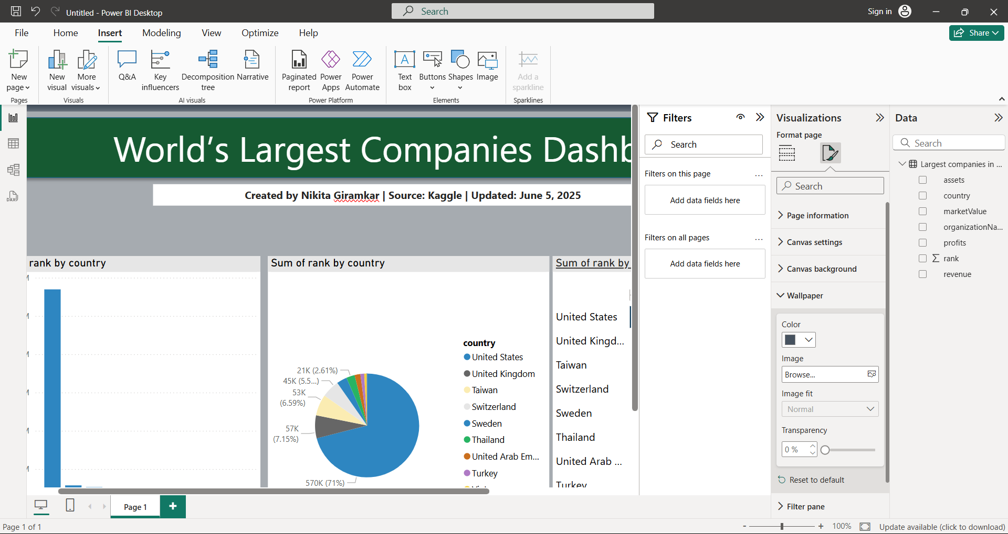
Screenshot

