Slide 1
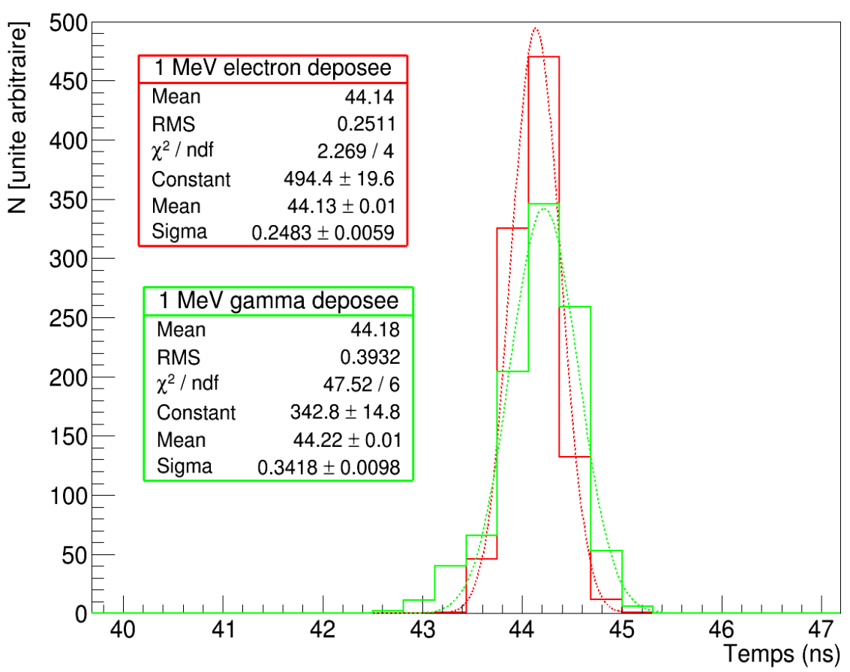
Electron
# Counts
Gamma
Time (ns)

