Slide 1
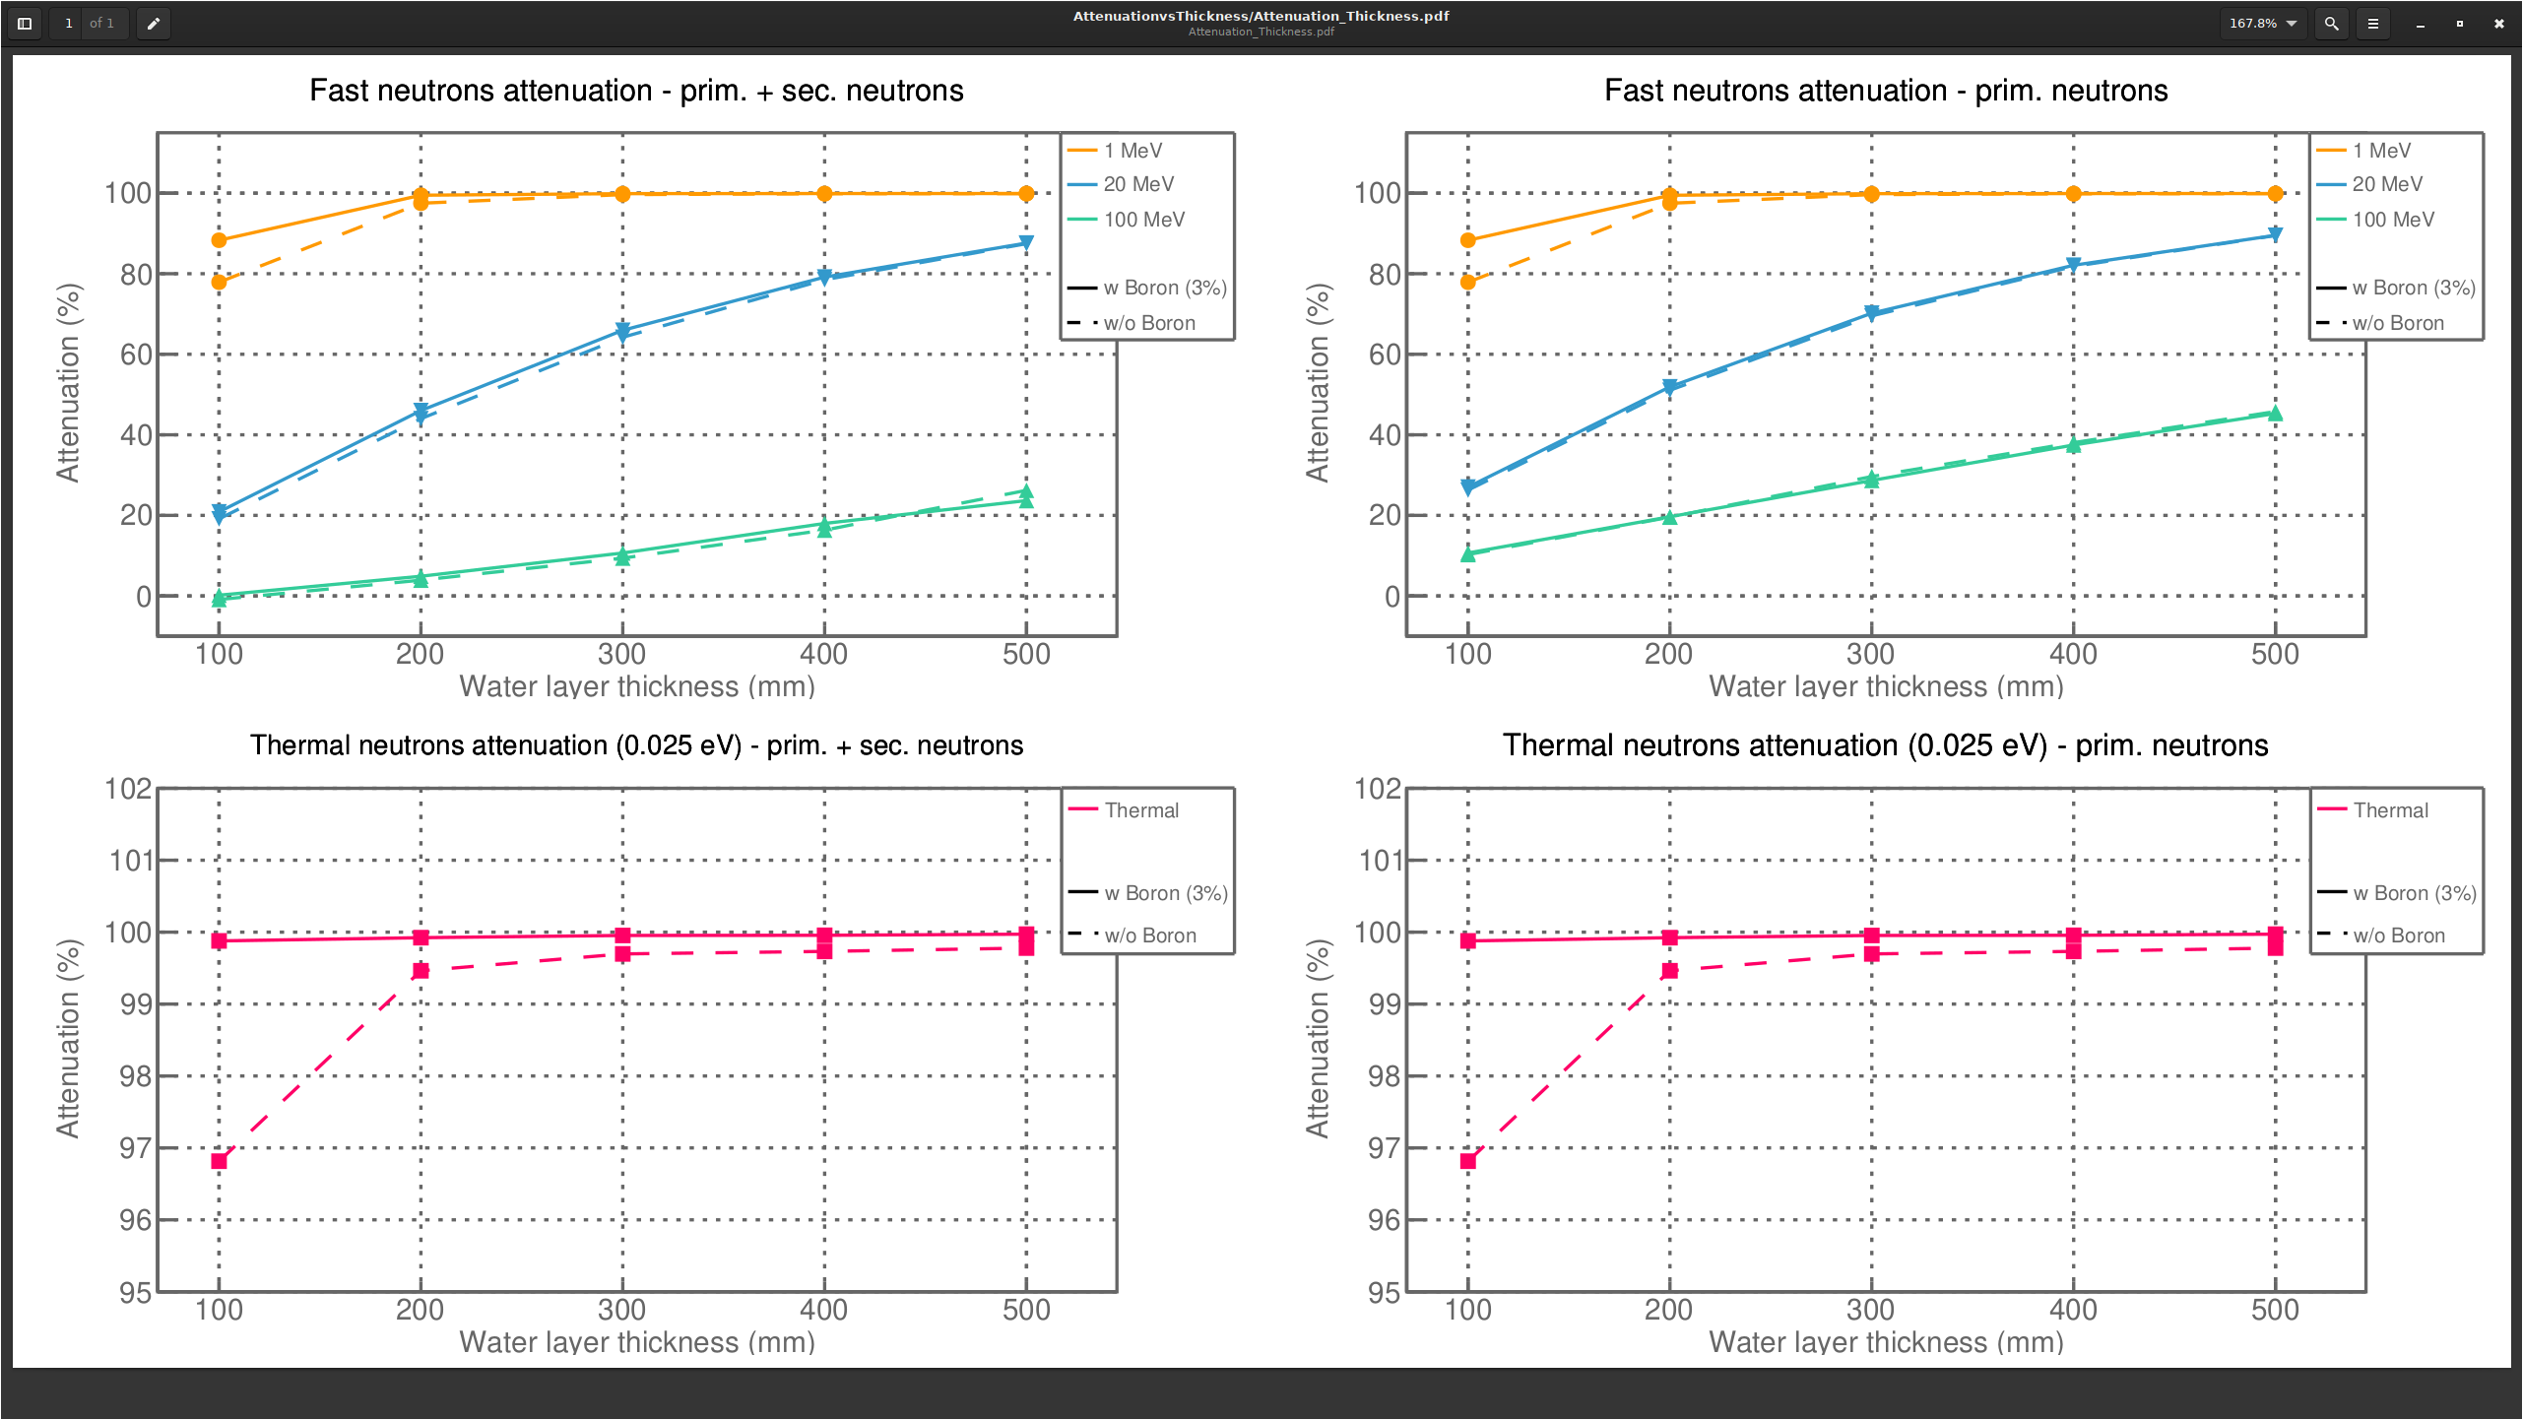
Bwater thickness attenuation no concrete no iron

Slide 2
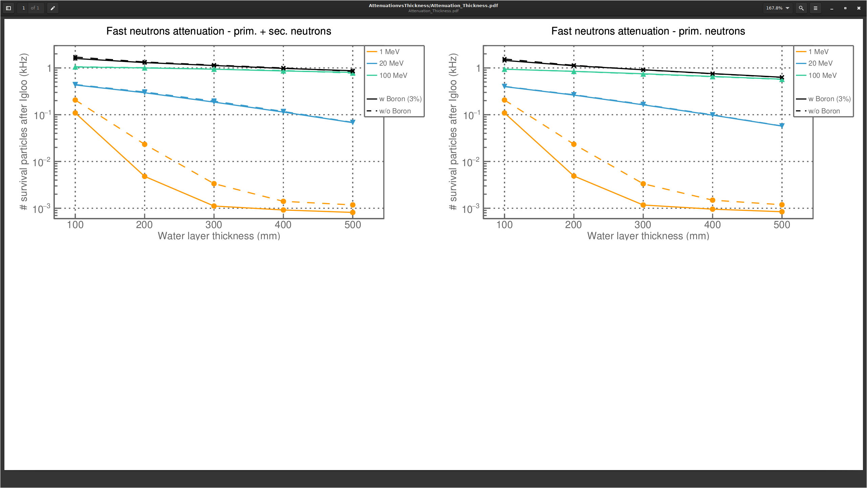
Bwater thickness flux no concrete no iron

Slide 3
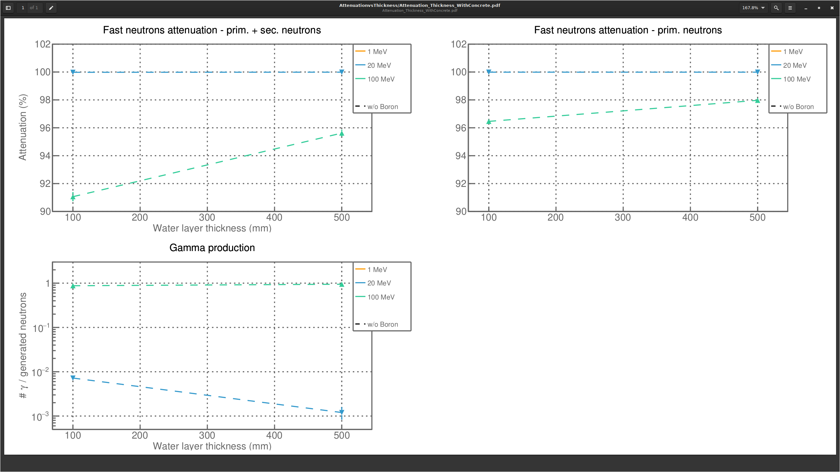
Bwater thickness attenuation concrete iron top

Slide 4
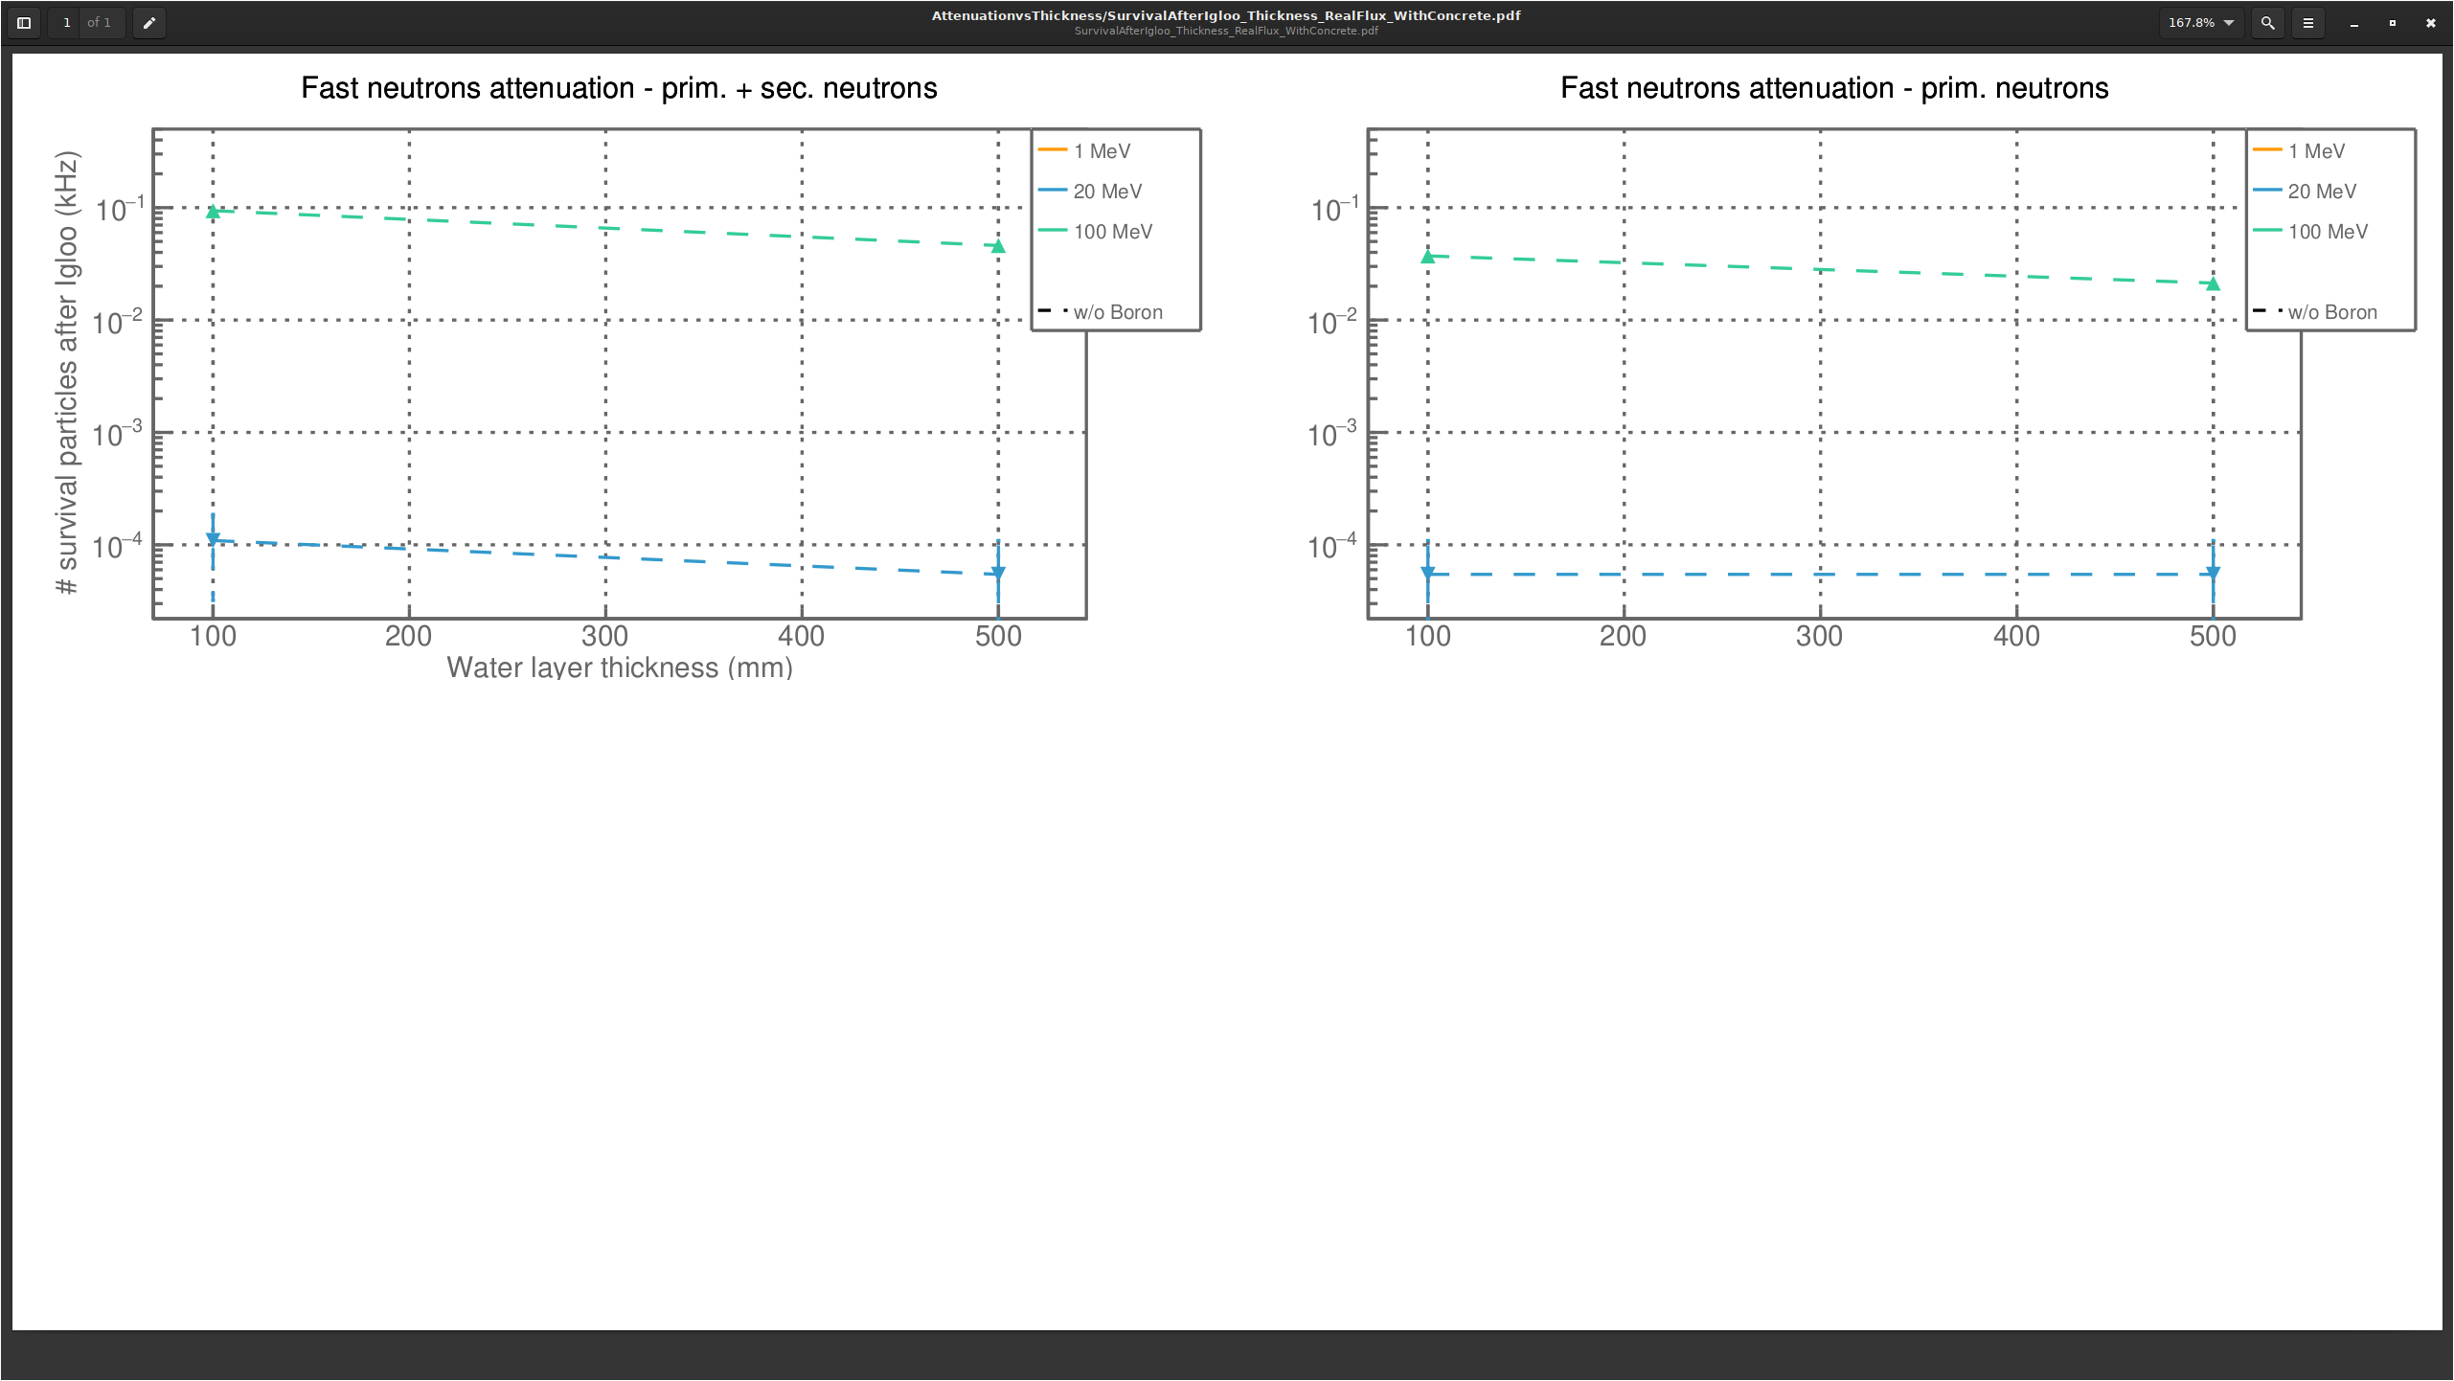
Bwater thickness flux concrete iron top

Slide 5
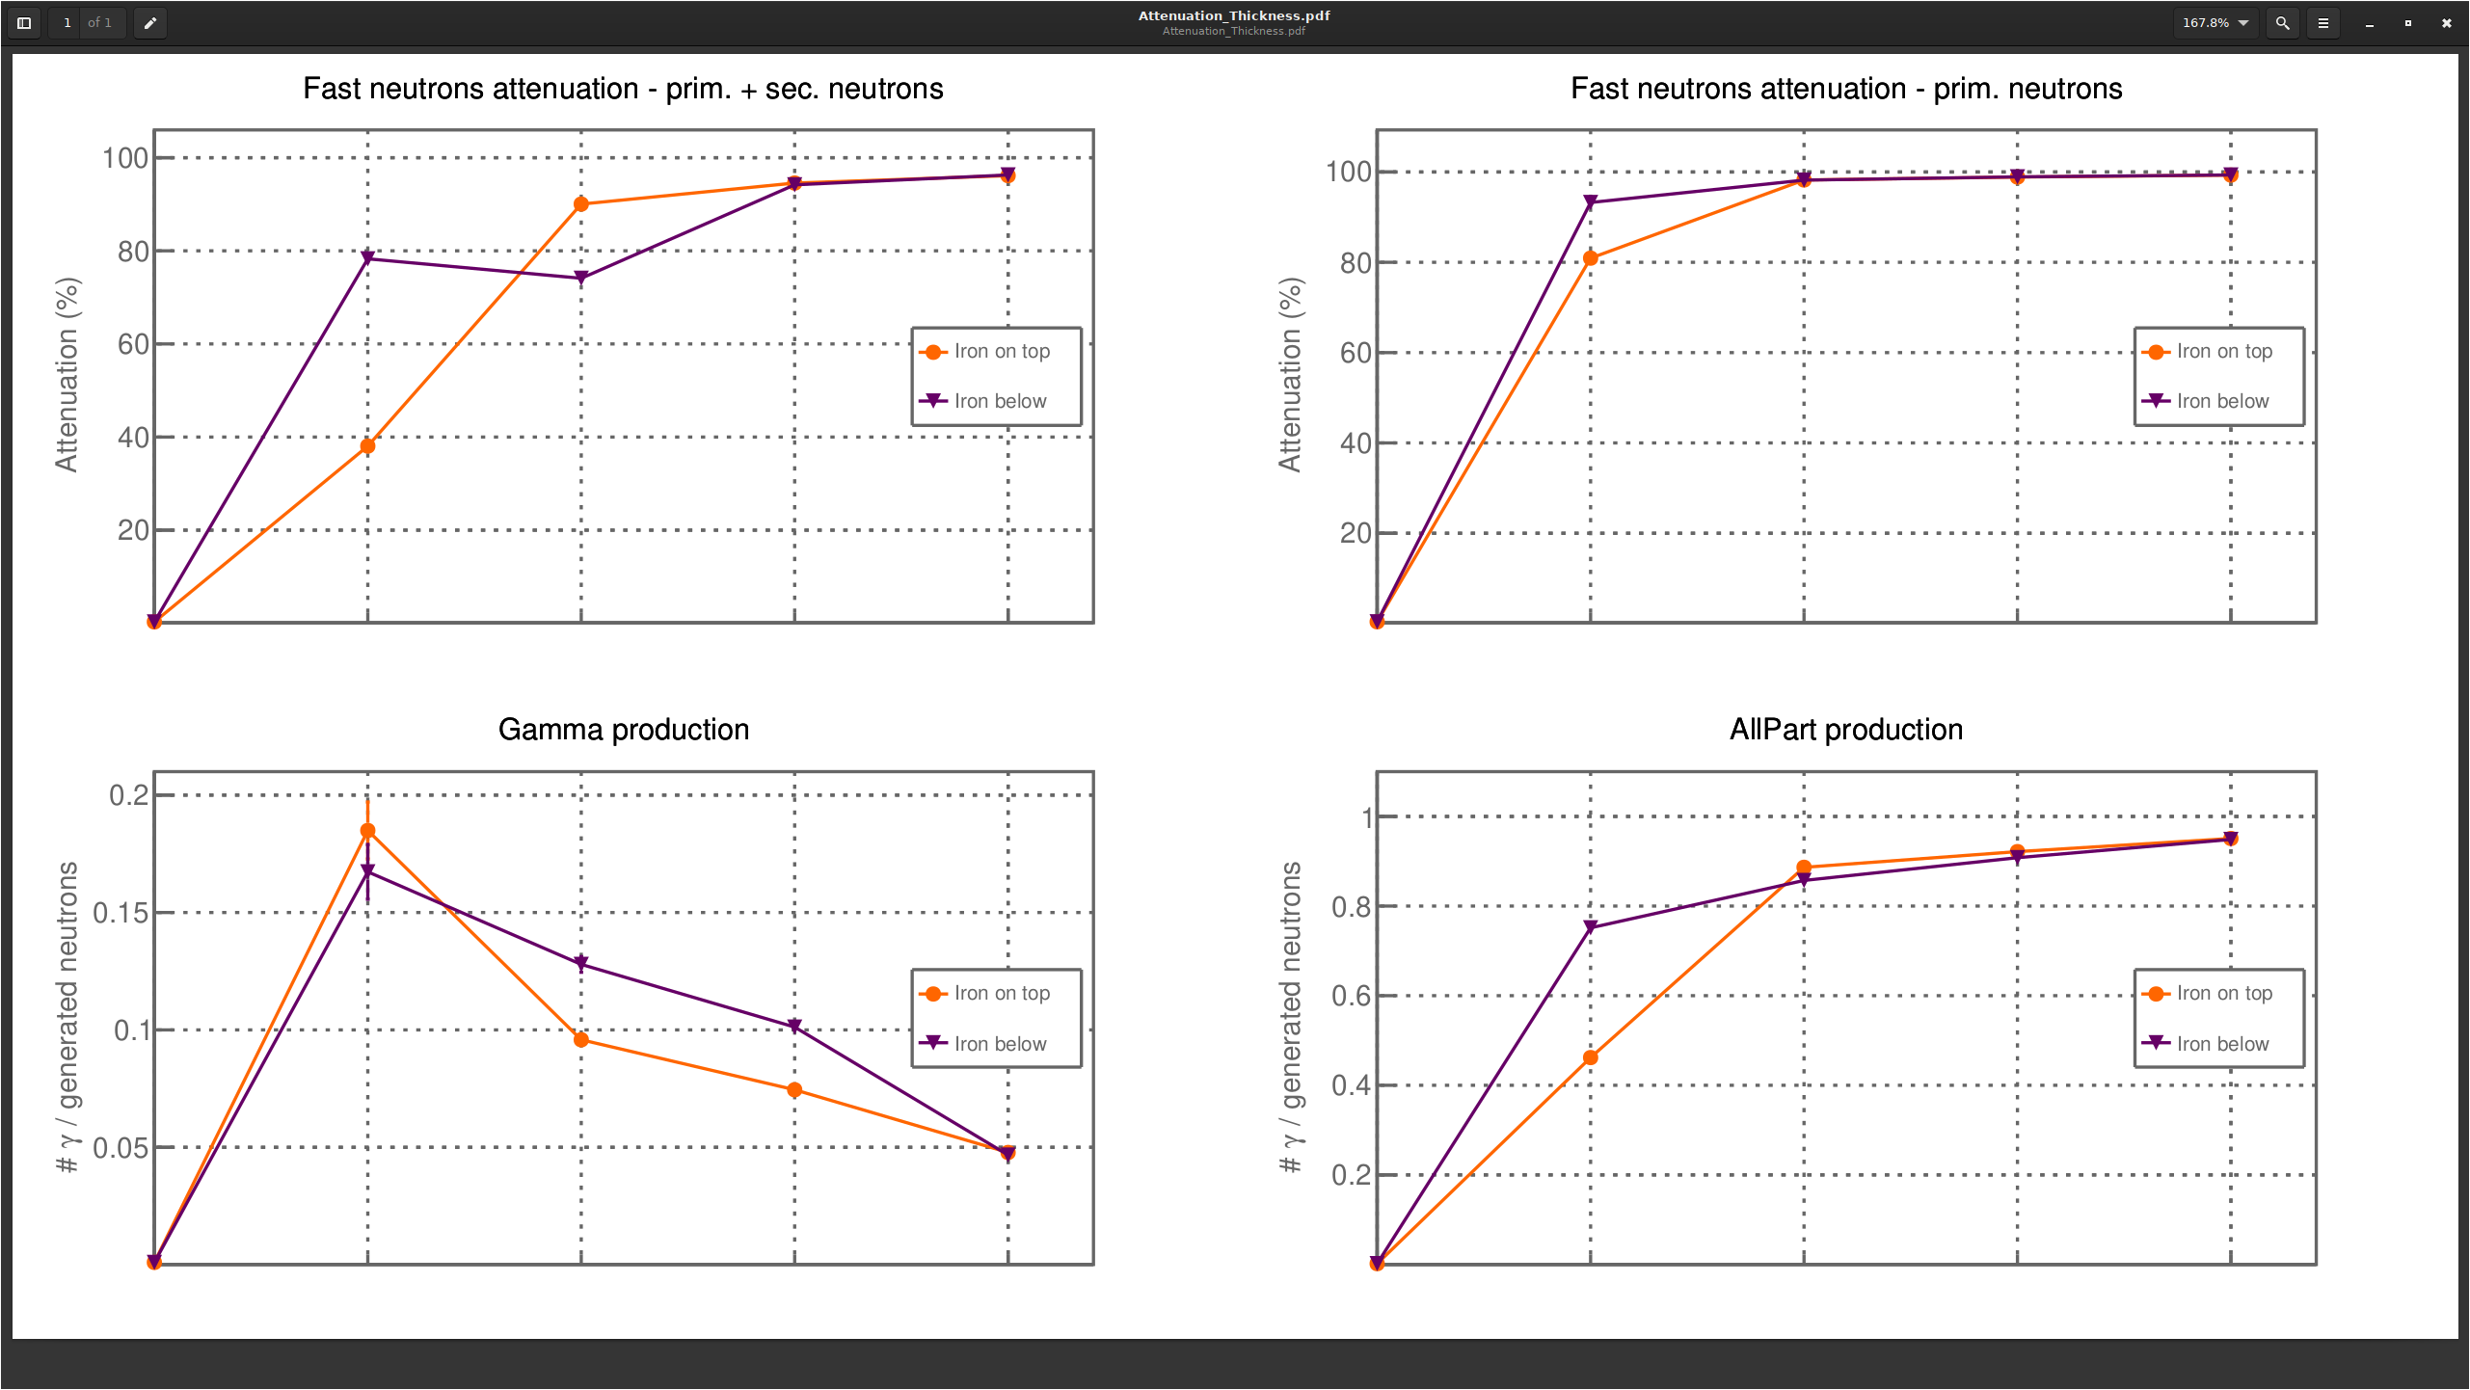
Iron
or
Concrete
Total
Igloo
No shielding
Water
OV

Slide 6
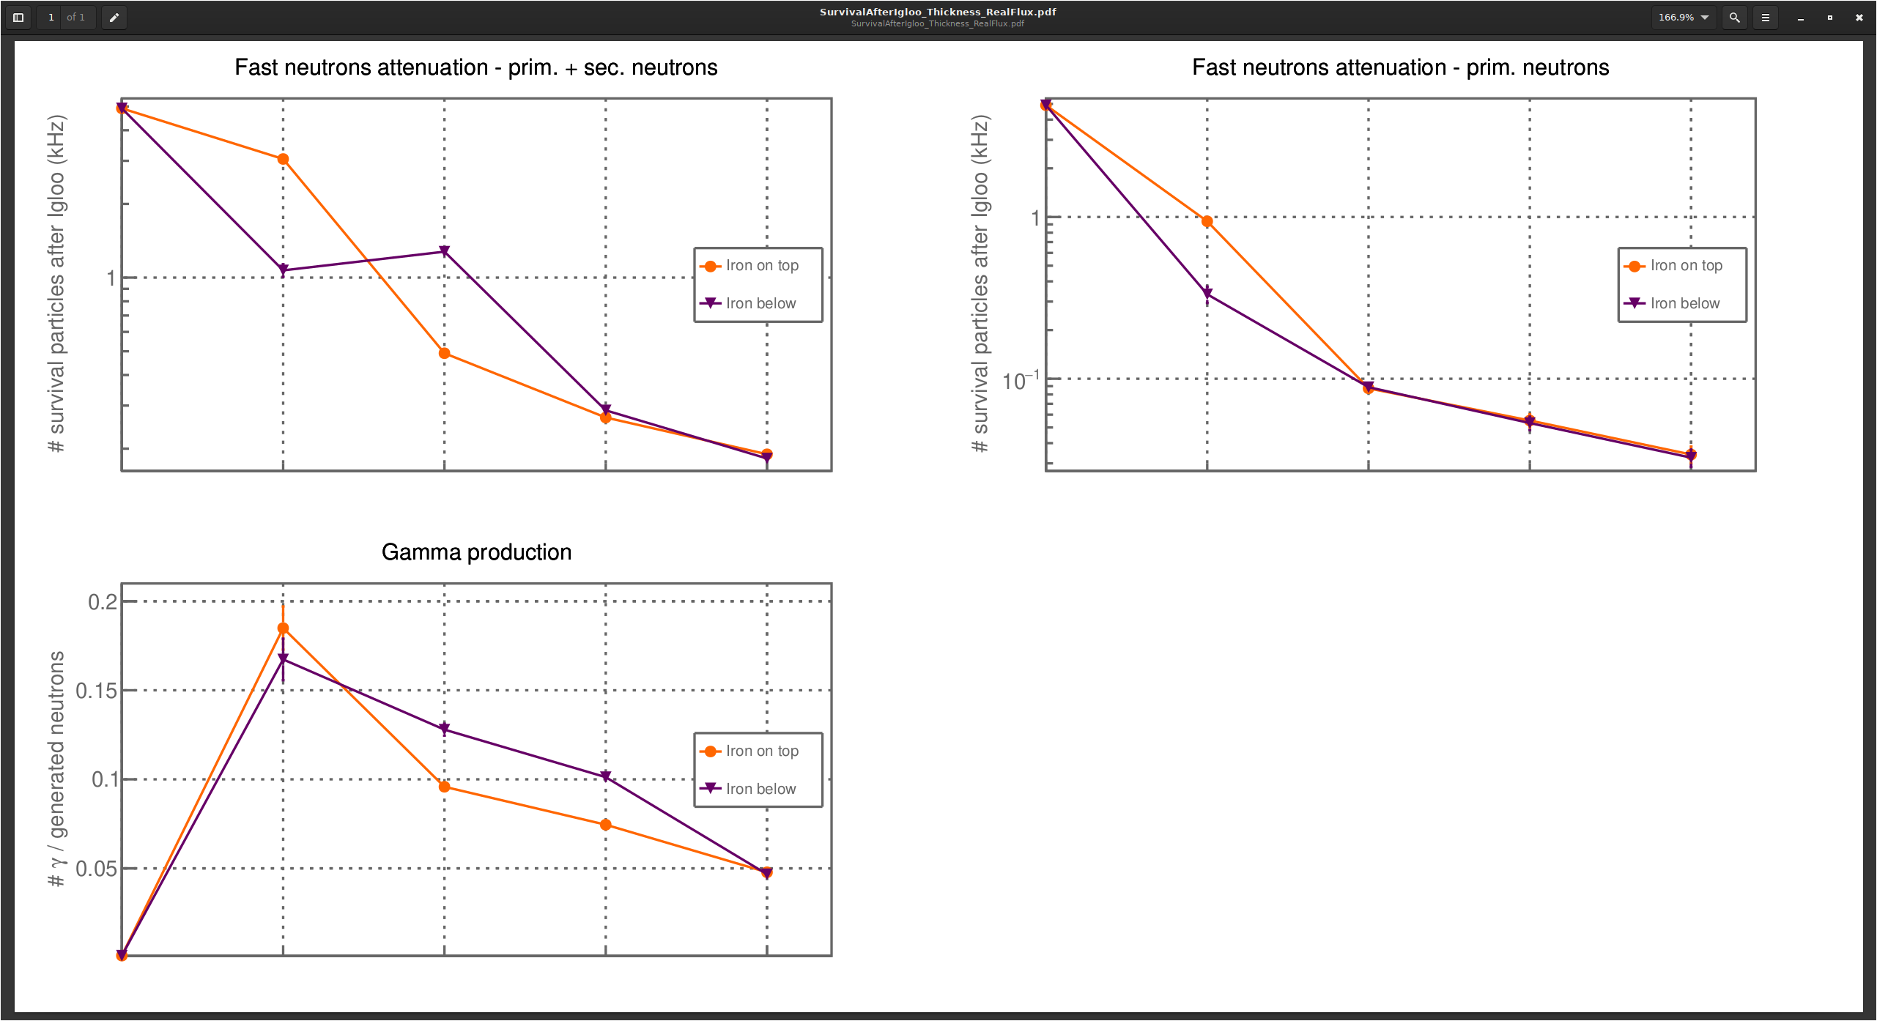
Bwater thickness attenuation concrete iron

