Slide 1
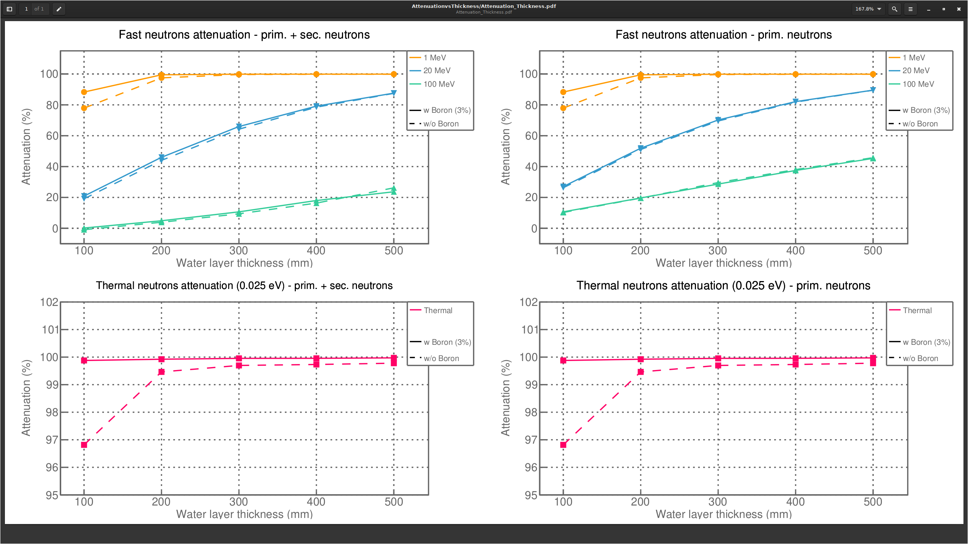
Bwater thickness attenuation no concrete no iron

Slide 2
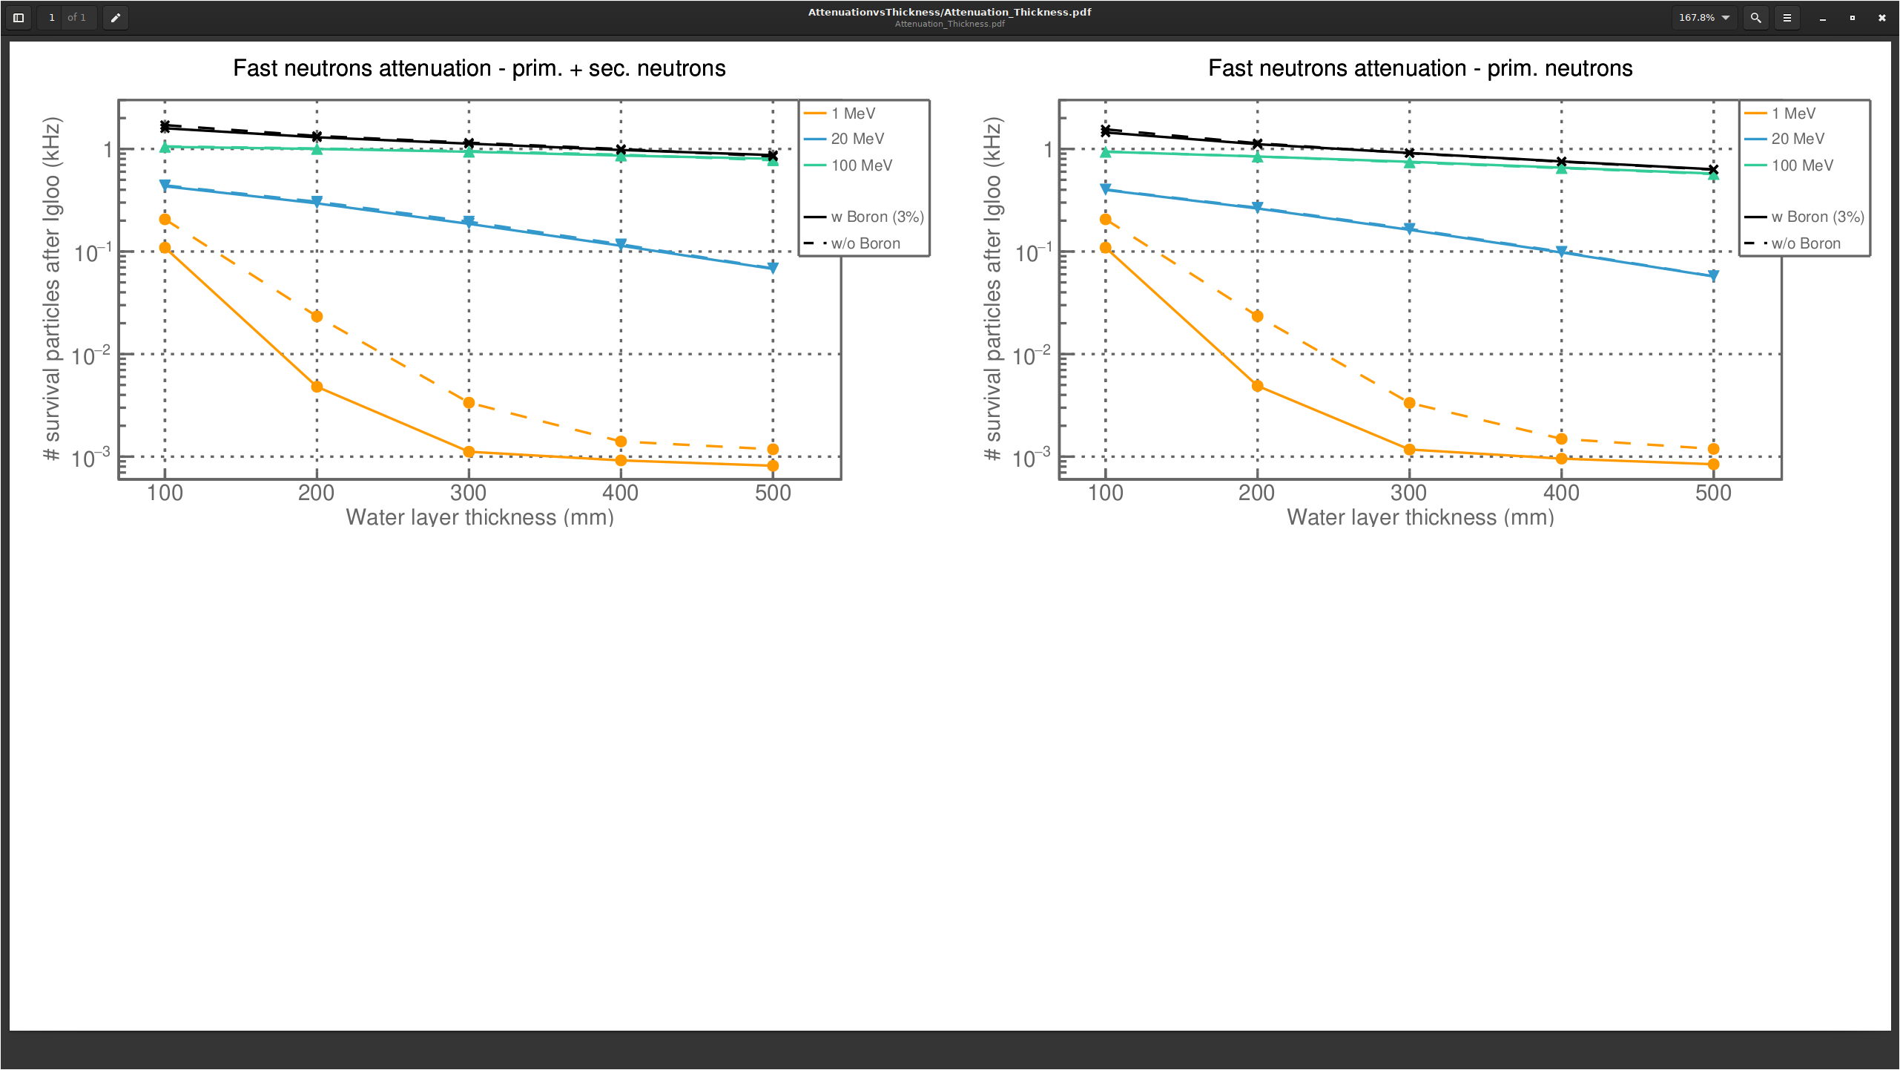
Bwater thickness flux no concrete no iron

Slide 3
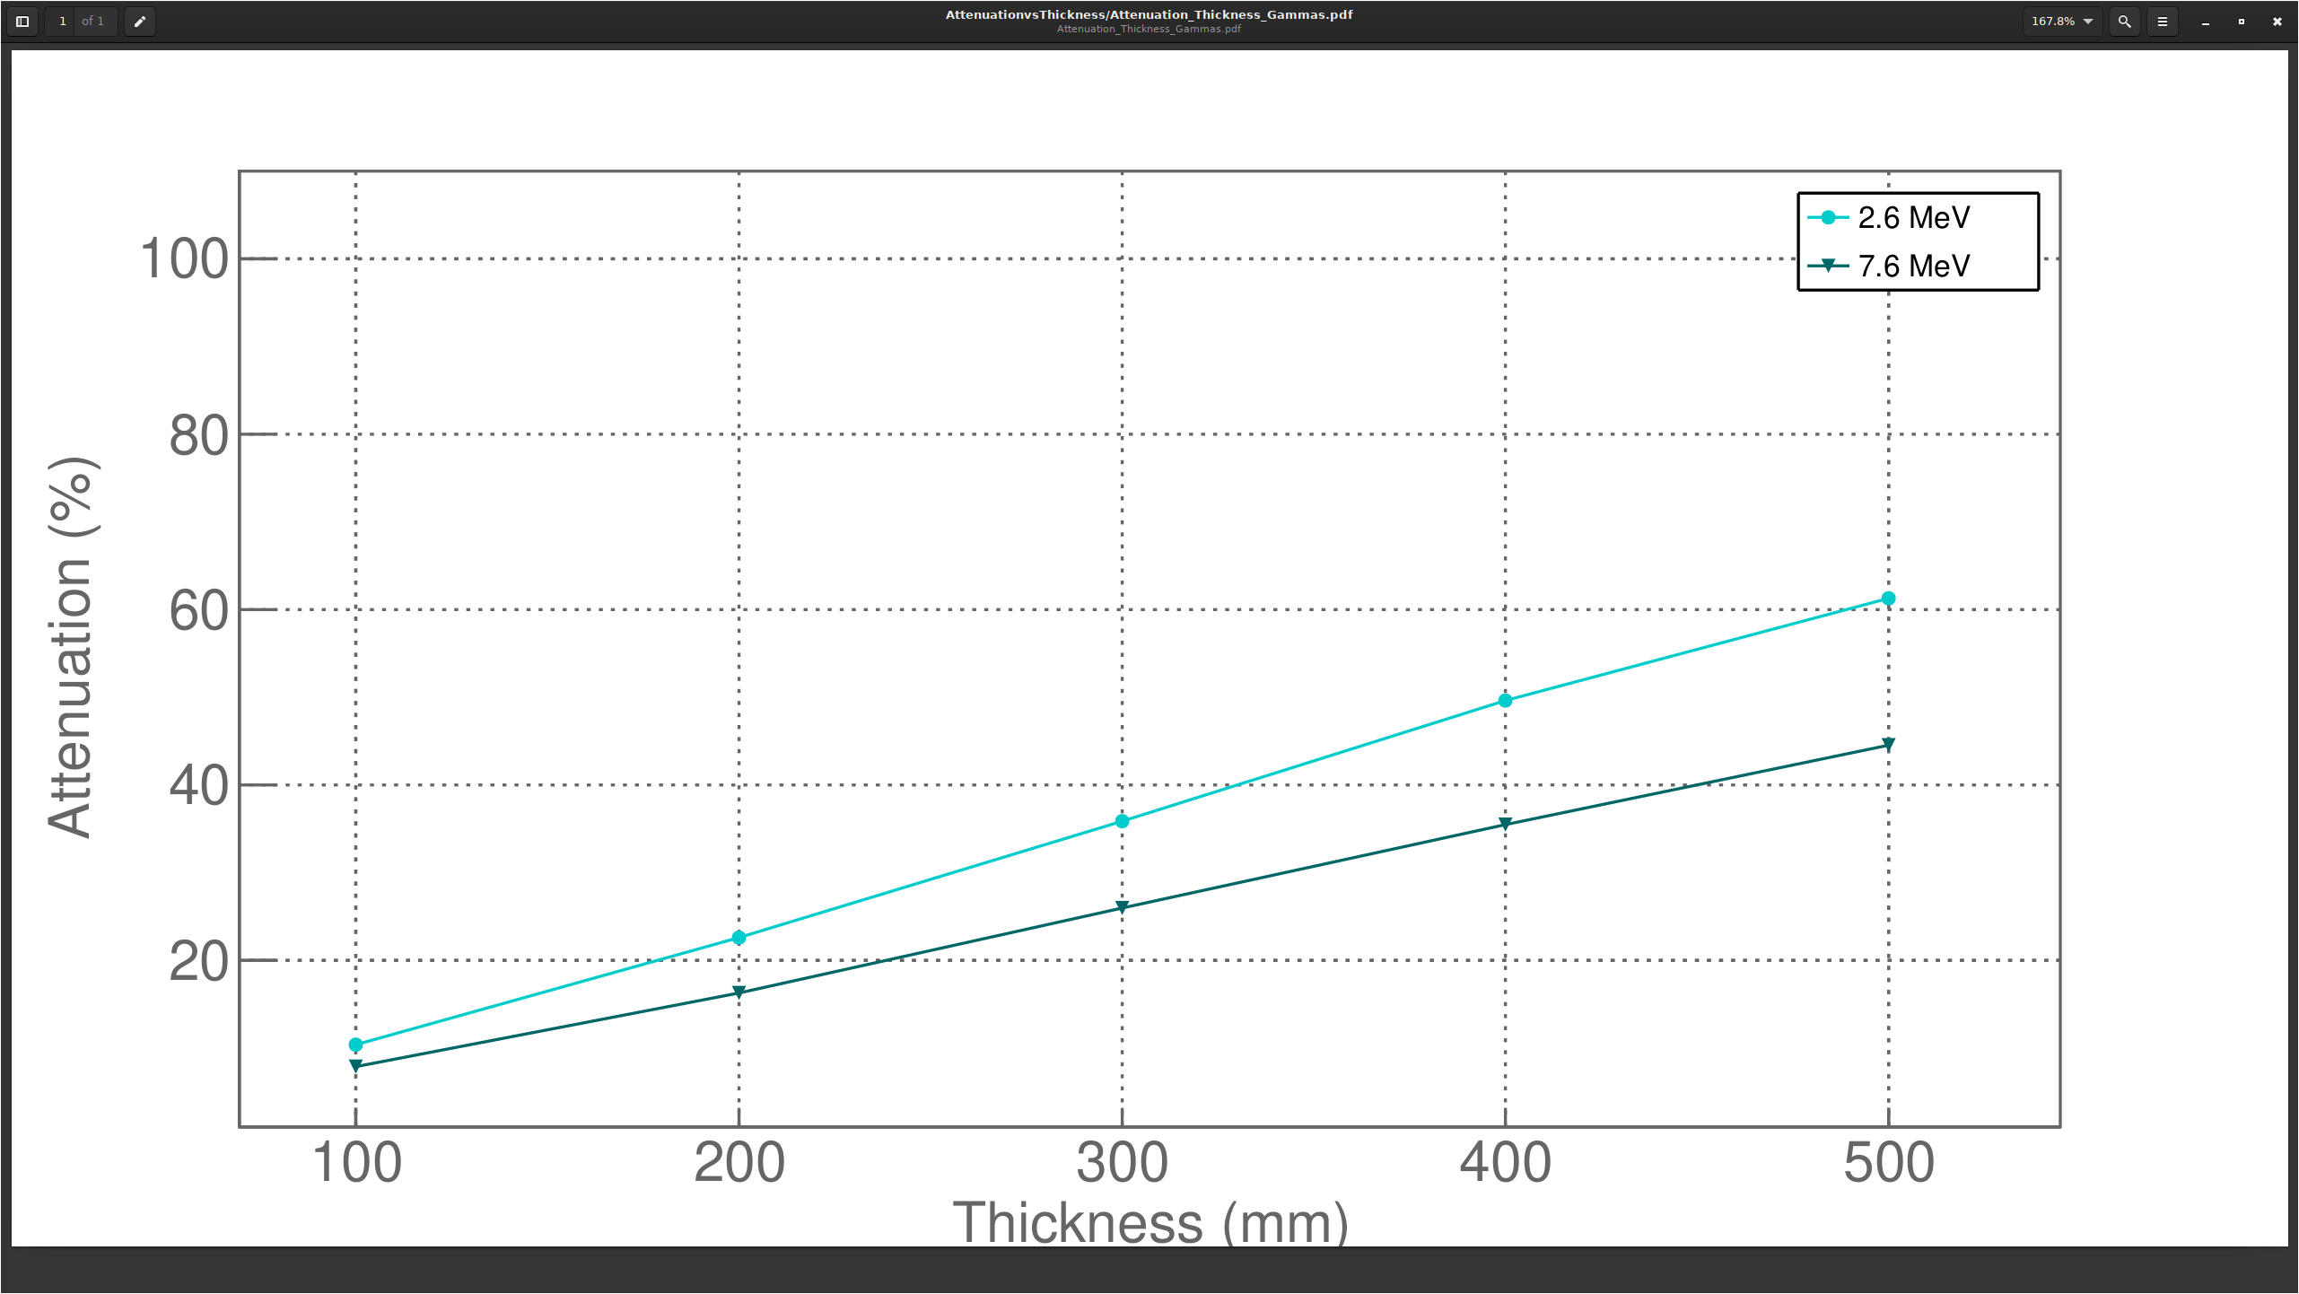
Bwater thickness attenuation gamma no concrete no iron

Slide 4
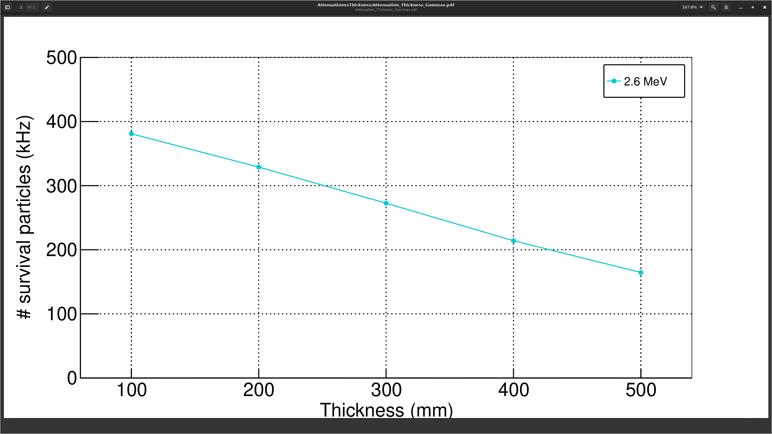

Slide 5
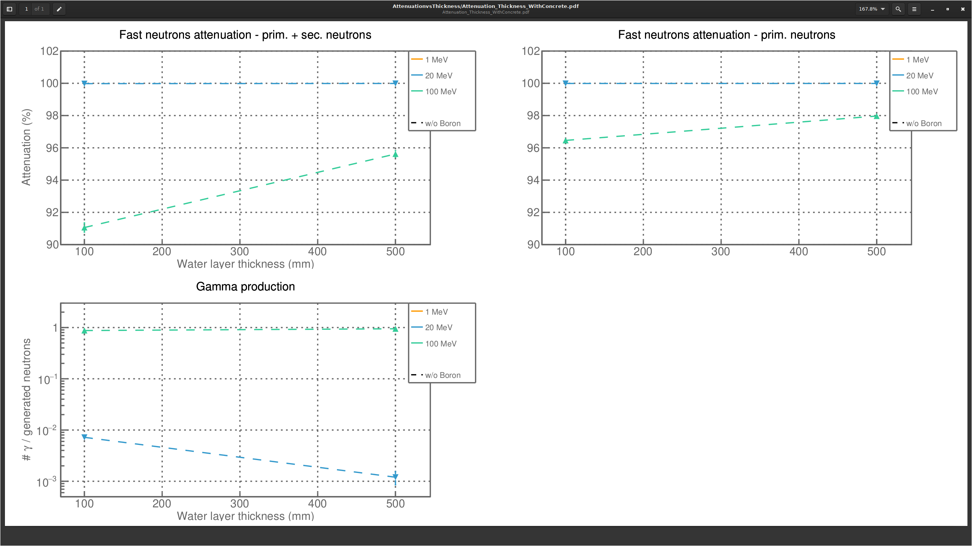
Bwater thickness attenuation concrete iron top

Slide 6
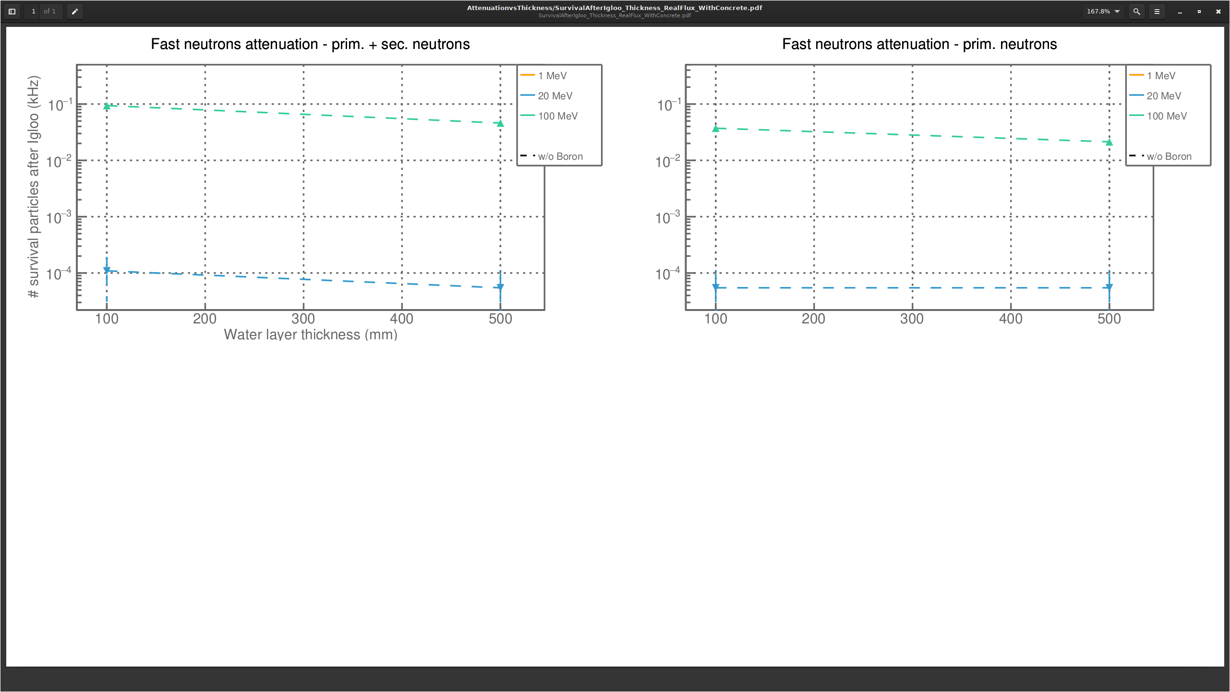
Bwater thickness flux concrete iron top

Slide 7
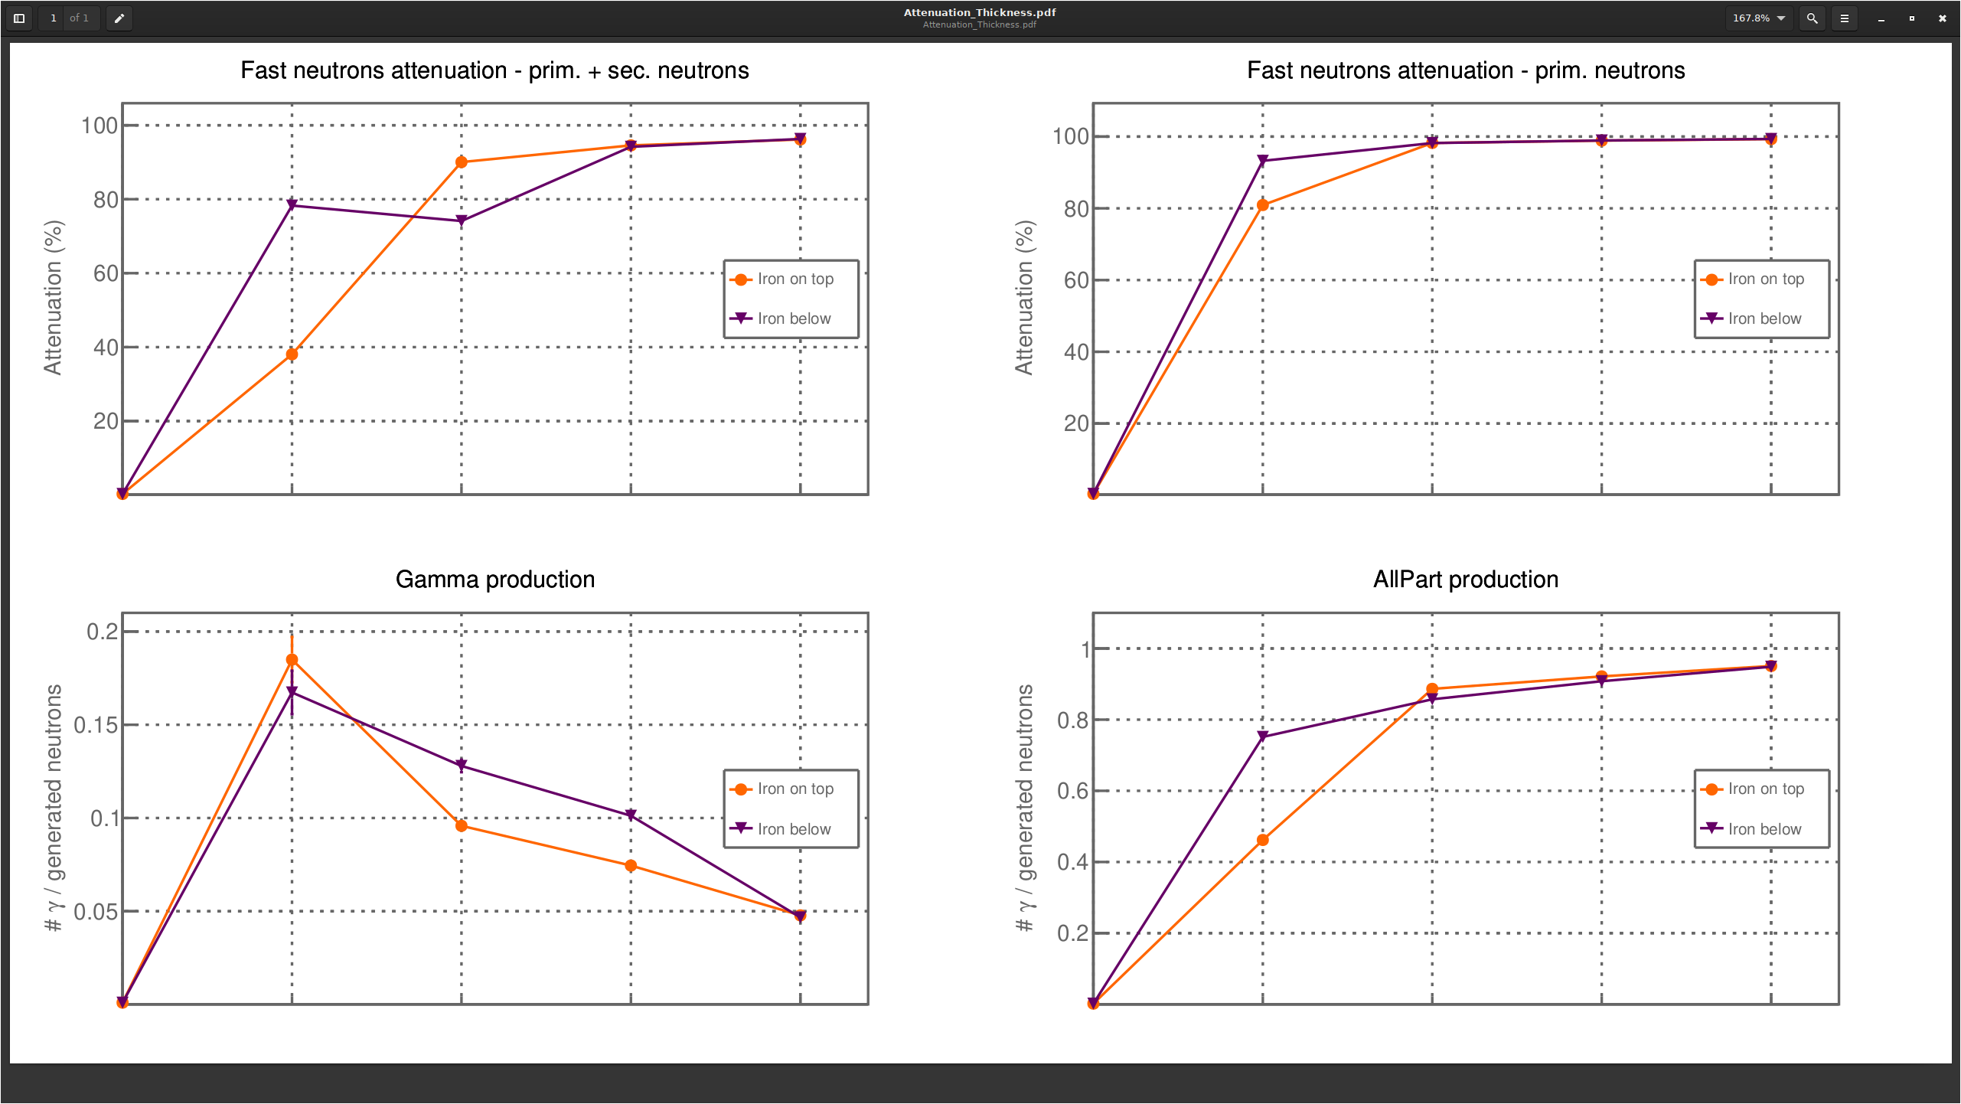
Iron
or
Concrete
Total
Igloo
No shielding
Water
OV

Slide 8
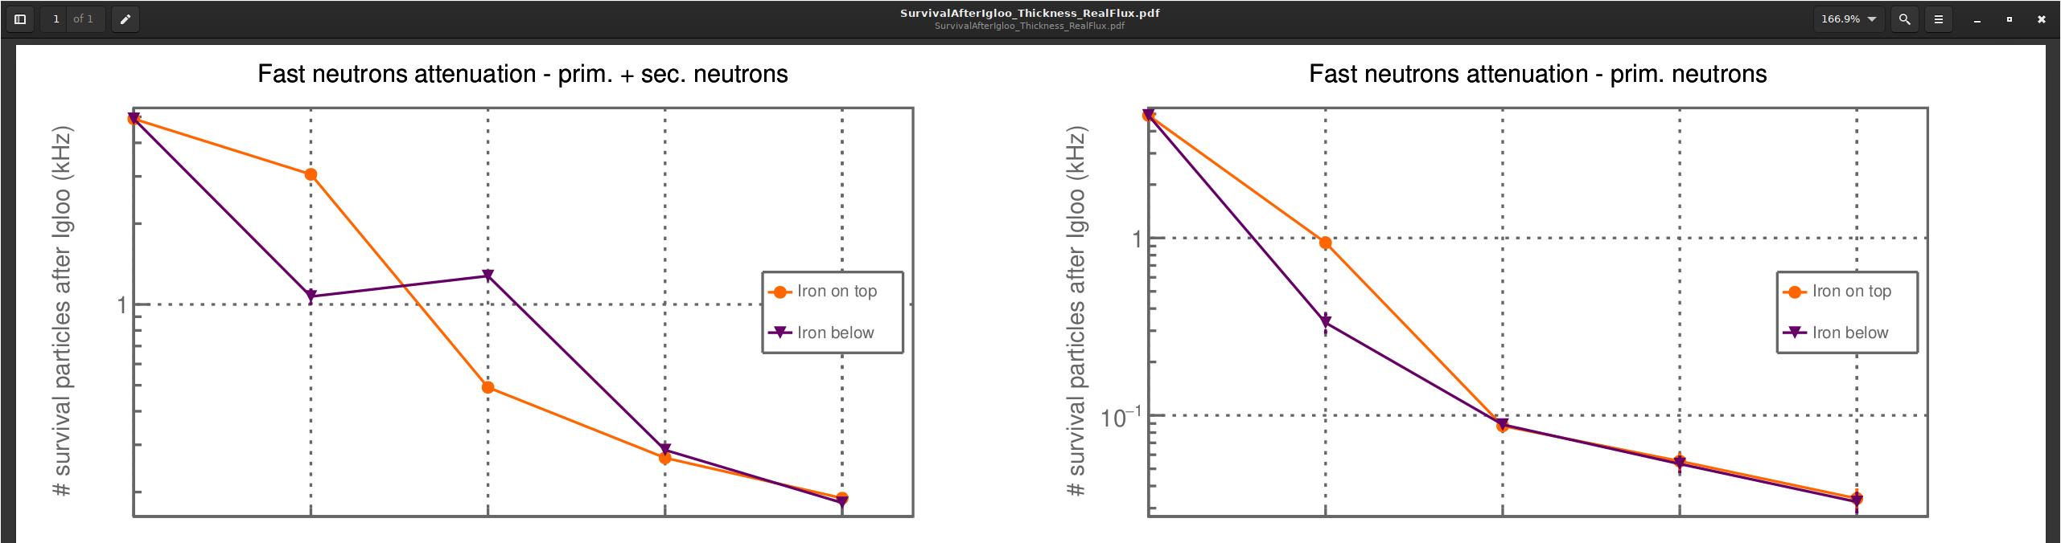
Bwater thickness attenuation concrete iron

Slide 9
