Slide 1
Syntactic Recurrent Neural Network for Authorship Attribution
By team 37,
Danish Mukhtar
Monu Tayal
Sivangi Singh
Giridhari Lal Gupta

Slide 2
Data pre-processing

Slide 3
Given dataset
12ItrainA1.TXT 12ItrainA2.TXT 12ItrainA3.TXT 12ItrainB1.TXT
12ItrainB2.TXT 12ItrainC1.TXT 12ItrainC2.TXT 12ItrainD1.TXT
12ItrainD2.TXT 12ItrainE1.TXT 12ItrainE2.TXT 12ItrainF1.TXT
12ItrainF2.TXT 12ItrainG1.TXT 12ItrainG2.TXT 12ItrainH1.TXT
12ItrainH2.TXT 12ItrainI1.TXT 12ItrainI2.TXT 12ItrainJ1.TXT
12ItrainJ2.TXT 12ItrainK1.TXT 12ItrainK2.TXT 12ItrainK3.TXT
12ItrainL1.TXT 12ItrainL2.TXT 12ItrainL3.TXT 12ItrainM1.TXT
12ItrainM2.TXT 12ItrainM3.TXT 12ItrainN1.TXT 12ItrainN2.TXT
12ItrainN3.TXT

Slide 4
Given dataset
Author name
12ItrainA1.TXT 12ItrainA2.TXT 12ItrainA3.TXT 12ItrainB1.TXT
12ItrainB2.TXT 12ItrainC1.TXT 12ItrainC2.TXT 12ItrainD1.TXT
12ItrainD2.TXT 12ItrainE1.TXT 12ItrainE2.TXT 12ItrainF1.TXT
12ItrainF2.TXT 12ItrainG1.TXT 12ItrainG2.TXT 12ItrainH1.TXT
12ItrainH2.TXT 12ItrainI1.TXT 12ItrainI2.TXT 12ItrainJ1.TXT
12ItrainJ2.TXT 12ItrainK1.TXT 12ItrainK2.TXT 12ItrainK3.TXT
12ItrainL1.TXT 12ItrainL2.TXT 12ItrainL3.TXT 12ItrainM1.TXT
12ItrainM2.TXT 12ItrainM3.TXT 12ItrainN1.TXT 12ItrainN2.TXT
12ItrainN3.TXT

Slide 5
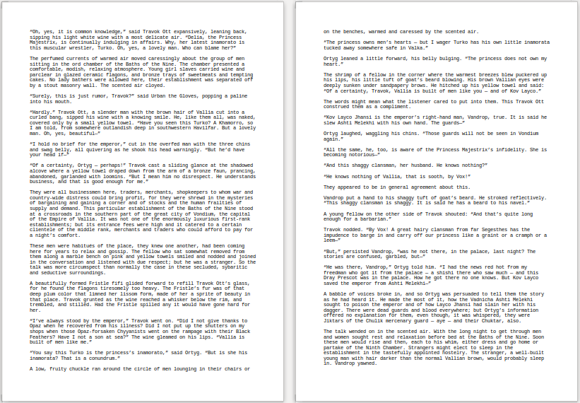
Given dataset
12ItrainA1.TXT
...

Slide 6
Loading novel
“Oh, yes, it is common knowledge,” said Travok Ott expansively, leaning back, sipping his light white wine with a most delicate air. “Delia, the Princess Majestrix, is continually indulging in affairs. Why, her latest inamorato is this muscular wrestler, Turko. Oh, yes, a lovely man. Who can blame her?”
The perfumed currents of warmed air moved caressingly about the group of men sitting in the ord chamber of the Baths of the Nine.
⋮

Slide 7
Loading novel
“Oh, yes, it is common knowledge,” said Travok Ott expansively, leaning back, sipping his light white wine with a most delicate air. “Delia, the Princess Majestrix, is continually indulging in affairs. Why, her latest inamorato is this muscular wrestler, Turko. Oh, yes, a lovely man. Who can blame her?”
The perfumed currents of warmed air moved caressingly about the group of men sitting in the ord chamber of the Baths of the Nine.
⋮
['“', 'Oh', ',', 'yes', ',', 'it', 'is', 'common', 'knowledge', ',', '”', 'said', 'Travok', 'Ott', 'expansively', ',', 'leaning', 'back', ',', 'sipping', 'his', 'light', 'white', 'wine', 'with', 'a', 'most', 'delicate', 'air', '.']
['“', 'Delia', ',', 'the', 'Princess', 'Majestrix', ',', 'is', 'continually', 'indulging', 'in', 'affairs', '.']
['Why', ',', 'her', 'latest', 'inamorato', 'is', 'this', 'muscular', 'wrestler', ',', 'Turko', '.']
['Oh', ',', 'yes', ',', 'a', 'lovely', 'man', '.']
['Who', 'can', 'blame', 'her', '?', '”', 'The', 'perfumed', 'currents', 'of', 'warmed', 'air', 'moved', 'caressingly', 'about', 'the', 'group', 'of', 'men', 'sitting', 'in', 'the', 'ord', 'chamber', 'of', 'the', 'Baths', 'of', 'the', 'Nine', '.']
⋮

Slide 8
Removing stop words
['“', 'Oh', ',', 'yes', ',', 'it', 'is', 'common', 'knowledge', ',', '”', 'said', 'Travok', 'Ott', 'expansively', ',', 'leaning', 'back', ',', 'sipping', 'his', 'light', 'white', 'wine', 'with', 'a', 'most', 'delicate', 'air', '.']
['“', 'Delia', ',', 'the', 'Princess', 'Majestrix', ',', 'is', 'continually', 'indulging', 'in', 'affairs', '.']
['Why', ',', 'her', 'latest', 'inamorato', 'is', 'this', 'muscular', 'wrestler', ',', 'Turko', '.']
['Oh', ',', 'yes', ',', 'a', 'lovely', 'man', '.']
⋮

Slide 9
Removing stop words
['“', 'Oh', ',', 'yes', ',', 'it', 'is', 'common', 'knowledge', ',', '”', 'said', 'Travok', 'Ott', 'expansively', ',', 'leaning', 'back', ',', 'sipping', 'his', 'light', 'white', 'wine', 'with', 'a', 'most', 'delicate', 'air', '.']
['“', 'Delia', ',', 'the', 'Princess', 'Majestrix', ',', 'is', 'continually', 'indulging', 'in', 'affairs', '.']
['Why', ',', 'her', 'latest', 'inamorato', 'is', 'this', 'muscular', 'wrestler', ',', 'Turko', '.']
['Oh', ',', 'yes', ',', 'a', 'lovely', 'man', '.']
⋮

Slide 10
Removing stop words
['“', 'Oh', ',', 'yes', ',', 'it', 'is', 'common', 'knowledge', ',', '”', 'said', 'Travok', 'Ott', 'expansively', ',', 'leaning', 'back', ',', 'sipping', 'his', 'light', 'white', 'wine', 'with', 'a', 'most', 'delicate', 'air', '.']
['“', 'Delia', ',', 'the', 'Princess', 'Majestrix', ',', 'is', 'continually', 'indulging', 'in', 'affairs', '.']
['Why', ',', 'her', 'latest', 'inamorato', 'is', 'this', 'muscular', 'wrestler', ',', 'Turko', '.']
['Oh', ',', 'yes', ',', 'a', 'lovely', 'man', '.']
⋮
['“', 'Oh', ',', 'yes', ',', 'common', 'knowledge', ',', '”', 'said', 'Travok', 'Ott', 'expansively', ',', 'leaning', 'back', ',', 'sipping', 'light', 'white', 'wine', 'delicate', 'air', '.']
['“', 'Delia', ',', 'Princess', 'Majestrix', ',', 'continually', 'indulging', 'affairs', '.']
['Why', ',', 'latest', 'inamorato', 'muscular', 'wrestler', ',', 'Turko', '.']
['Oh', ',', 'yes', ',', 'lovely', 'man', '.']
⋮

Slide 11
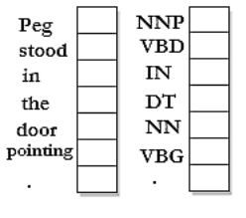
Changing every word to part-of-speech tag
Input Sentences
POS Tags

Slide 12
Changing every word to part-of-speech tag
['“', 'Oh', ',', 'yes', ',', 'common', 'knowledge', ',', '”', 'said', 'Travok', 'Ott', 'expansively', ',', 'leaning', 'back', ',', 'sipping', 'light', 'white', 'wine', 'delicate', 'air', '.']
['“', 'Delia', ',', 'Princess', 'Majestrix', ',', 'continually', 'indulging', 'affairs', '.']
['Why', ',', 'latest', 'inamorato', 'muscular', 'wrestler', ',', 'Turko', '.']
['Oh', ',', 'yes', ',', 'lovely', 'man', '.']
⋮

Slide 13
Changing every word to part-of-speech tag
['“', 'Oh', ',', 'yes', ',', 'common', 'knowledge', ',', '”', 'said', 'Travok', 'Ott', 'expansively', ',', 'leaning', 'back', ',', 'sipping', 'light', 'white', 'wine', 'delicate', 'air', '.']
['“', 'Delia', ',', 'Princess', 'Majestrix', ',', 'continually', 'indulging', 'affairs', '.']
['Why', ',', 'latest', 'inamorato', 'muscular', 'wrestler', ',', 'Turko', '.']
['Oh', ',', 'yes', ',', 'lovely', 'man', '.']
⋮
['NN', 'NNP', ',', 'UH', ',', 'JJ', 'NN', ',', 'NNP', 'VBD', 'NNP', 'NNP', 'RB', ',', 'VBG', 'RB', ',', 'VBG', 'JJ', 'JJ', 'NN', 'NN', 'NN', '.']
['NN', 'NNP', ',', 'NNP', 'NNP', ',', 'RB', 'VBG', 'NNS', '.']
['WRB', ',', 'JJS', 'NN', 'JJ', 'NN', ',', 'NNP', '.']
['UH', ',', 'UH', ',', 'JJ', 'NN', '.']
⋮

Slide 14
Changing every POS tag to sequence number
['PRP', 'NN', 'NN', ',', 'NN', 'VBD', ',', 'JJ', 'NNS', 'MD', 'VB', 'JJ', 'NN', 'JJ', 'VBZ', '.']
['VB', 'WRB', 'JJ', 'IN', 'JJ', 'VBD', '.', 'JJ', 'NNP', 'VBD', '.']
['PRP', 'VBD', 'NNP', 'VBD', '.']
['RB', 'NNP', 'RB', 'VBD', '.']
['PRP', 'VBP', 'RB', ',', 'JJ', 'VBG', 'NN', ',', 'NN', 'VBD', 'NNP', 'RB', 'JJ', 'RB', '.']
⋮

Slide 15
Changing every POS tag to sequence number
['PRP', 'NN', 'NN', ',', 'NN', 'VBD', ',', 'JJ', 'NNS', 'MD', 'VB', 'JJ', 'NN', 'JJ', 'VBZ', '.']
['VB', 'WRB', 'JJ', 'IN', 'JJ', 'VBD', '.', 'JJ', 'NNP', 'VBD', '.']
['PRP', 'VBD', 'NNP', 'VBD', '.']
['RB', 'NNP', 'RB', 'VBD', '.']
['PRP', 'VBP', 'RB', ',', 'JJ', 'VBG', 'NN', ',', 'NN', 'VBD', 'NNP', 'RB', 'JJ', 'RB', '.']
⋮
[34, 26, 26, 16, 26, 7, 16, 8, 1, 20, 32, 8, 26, 8, 10, 44]
[32, 33, 8, 40, 8, 7, 44, 8, 15, 7, 44]
[34, 7, 15, 7, 44]
[30, 15, 30, 7, 44]
[34, 29, 30, 16, 8, 17, 26, 16, 26, 7, 15, 30, 8, 30, 44]
⋮

Slide 16
Padding every sentence with zeros
[34, 26, 26, 16, 26, 7, 16, 8, 1, 20, 32, 8, 26, 8, 10, 44]
[32, 33, 8, 40, 8, 7, 44, 8, 15, 7, 44]
[34, 7, 15, 7, 44]
[30, 15, 30, 7, 44]
[34, 29, 30, 16, 8, 17, 26, 16, 26, 7, 15, 30, 8, 30, 44]
⋮

Slide 17
Padding every sentence with zeros
[34, 26, 26, 16, 26, 7, 16, 8, 1, 20, 32, 8, 26, 8, 10, 44]
[32, 33, 8, 40, 8, 7, 44, 8, 15, 7, 44]
[34, 7, 15, 7, 44]
[30, 15, 30, 7, 44]
[34, 29, 30, 16, 8, 17, 26, 16, 26, 7, 15, 30, 8, 30, 44]
⋮
[34 26 26 16 26 7 16 8 1 20 32 8 26 8 10 44 0 0 0 0 0 0 0 0 0 0 0 0 0 0]
[32 33 8 40 8 7 44 8 15 7 44 0 0 0 0 0 0 0 0 0 0 0 0 0 0 0 0 0 0 0]
[34 7 15 7 44 0 0 0 0 0 0 0 0 0 0 0 0 0 0 0 0 0 0 0 0 0 0 0 0 0]
[30 15 30 7 44 0 0 0 0 0 0 0 0 0 0 0 0 0 0 0 0 0 0 0 0 0 0 0 0 0]
[34 29 30 16 8 17 26 16 26 7 15 30 8 30 44 0 0 0 0 0 0 0 0 0 0 0 0 0 0 0]
⋮

Slide 18
POS Embedding Layer
Embedding(input_dim, output_dim, input_length=None)
30
128

Slide 19
Model preparation

Slide 20
Final X and Y
X =
[
[ [ ]₃₀ [ ]₃₀ [ ]₃₀ [ ]₃₀ [ ]₃₀ [ ]₃₀ ……………………………….[ ]₃₀ ]_{no of novel}
[ [ ]₃₀ [ ]₃₀ [ ]₃₀ [ ]₃₀ [ ]₃₀ [ ]₃₀ ……………………………….[ ]₃₀ ]_{no of novel}
[ [ ]₃₀ [ ]₃₀ [ ]₃₀ [ ]₃₀ [ ]₃₀ [ ]₃₀ ……………………………….[ ]₃₀ ]_{no of novel}
⋮
⋮
⋮
[ [ ]₃₀ [ ]₃₀ [ ]₃₀ [ ]₃₀ [ ]₃₀ [ ]₃₀ ……………………………….[ ]₃₀ ]_{no of novel}
]₁₀₀
Y = [ [ ]_{One hot encoding}, [ ]_{One hot encoding},……………………………………….]_{no of novel}

Slide 21
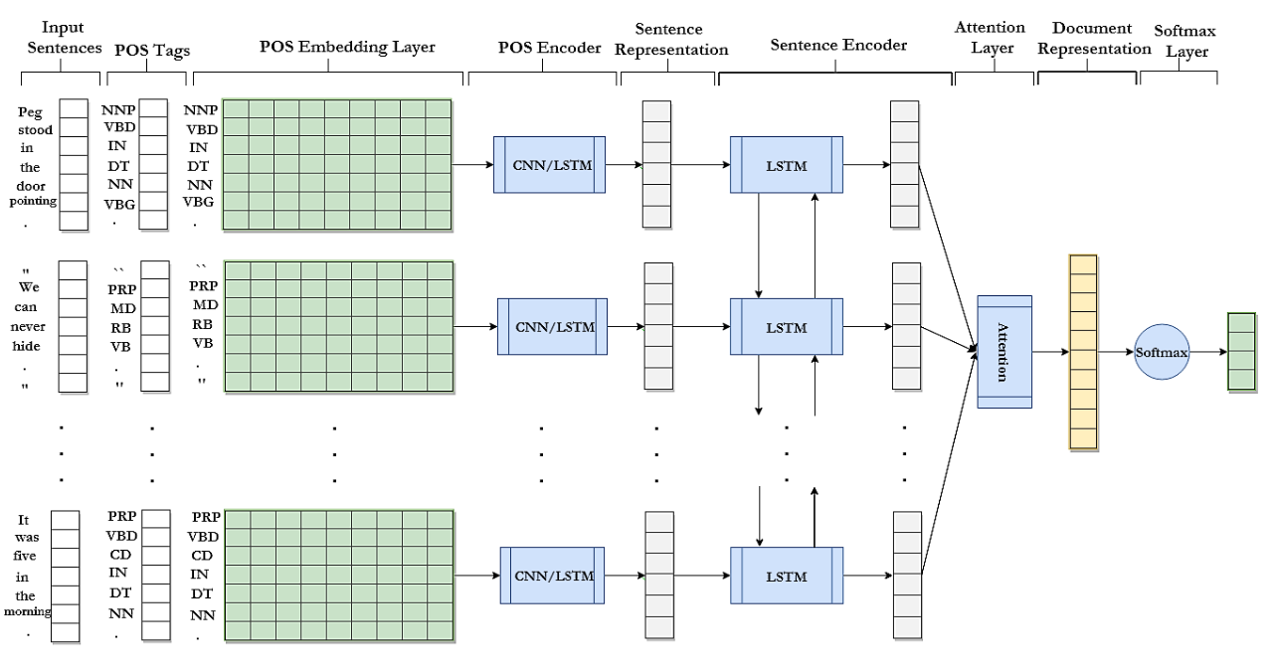
The Overall Architecture of Syntactic Recurrent Neural Network for Style-based Text Classification

Slide 22
Results

Slide 23
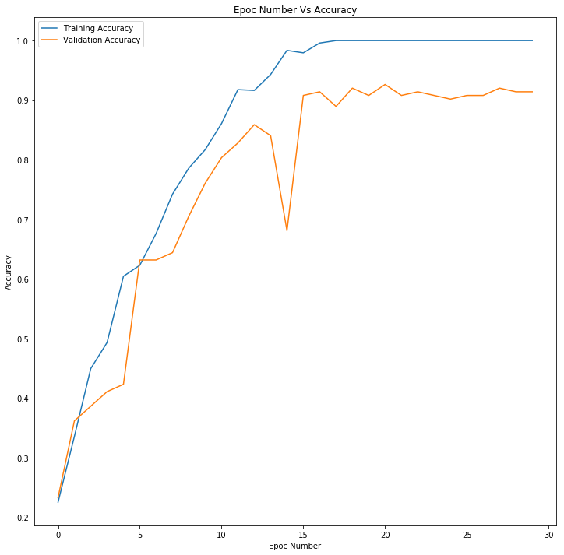
Training and Validation Accuracy for LSTM LSTM

Slide 24
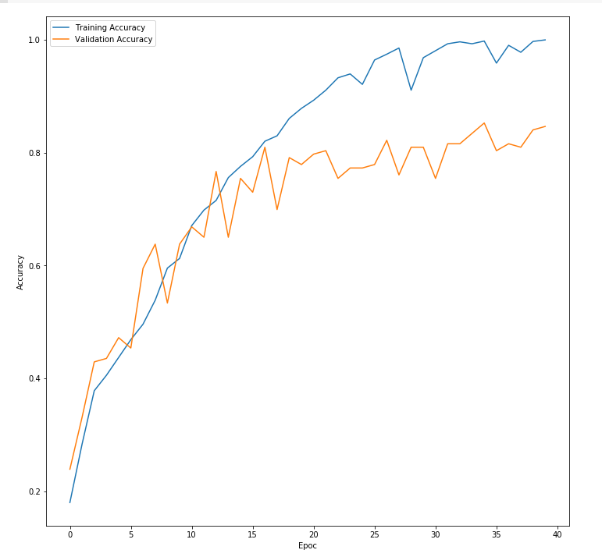
Training and Validation Accuracy for CNN LSTM

Slide 25
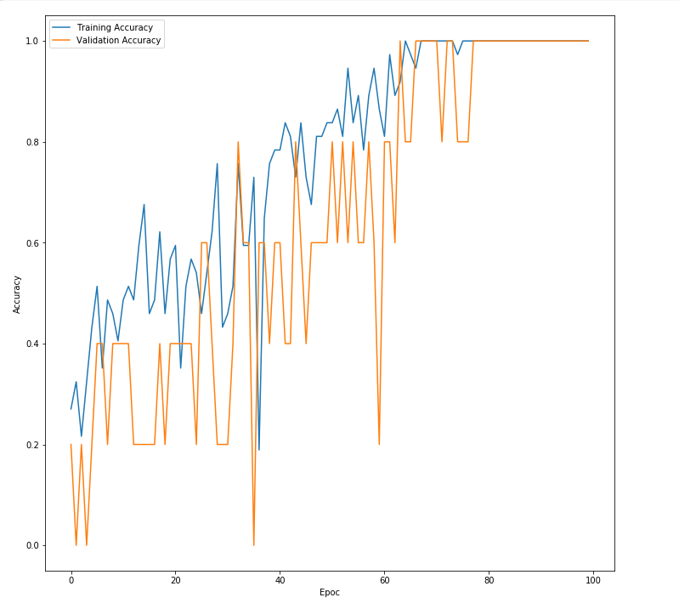
Training and Validation Accuracy for LSTM LSTM Hindi dataset

Slide 26
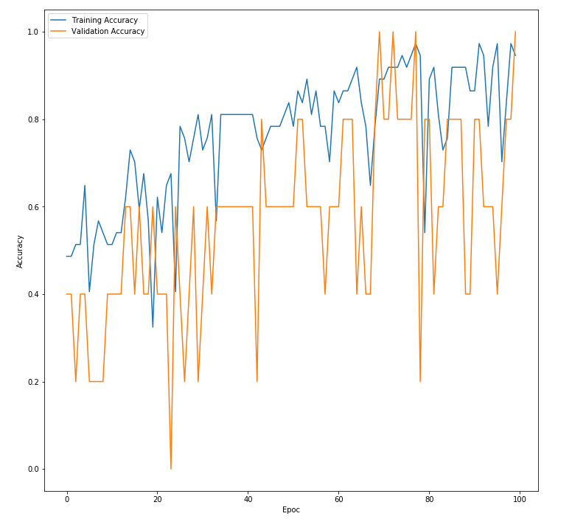
Training and Validation Accuracy for CNN LSTM Hindi Dataset

Slide 27
Thank you

