Slide 1
WeFun
An A+ Application created by Brandon, Gireesh, and SharmaTech ©

Slide 2
Sprint Overview
Familiarize with XCode
Built Maps Interface
Create Events
Directions
Accounts
Friends
RSVP
Touchups
Constant Annoyance: Dealing with database quirks

Slide 3
Expectations vs. Reality
Super slick-looking app with all sorts of cool features, like chatting with friends, rating events, machine algorithms to recommend future events, spots for ads.
We made an app that allows you to create events, add/view friends, RSVP to events, and edit profiles. Firebase + XCode proved to be a potent duo and slowed progress.

Slide 4
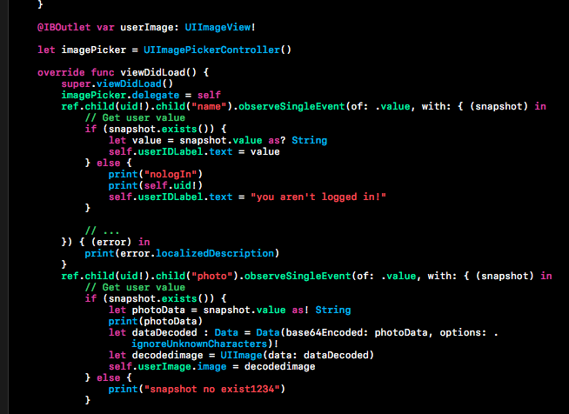
Interesting Piece of Code
Converting Images

Slide 5
Other Interesting Parts
ChronJon
Creating Friends
RSVPing
Searching

Slide 6
Testing
Talking with users
The design of the app, such as the gradient color
Usability of app
Bug checking
User Interface Testing

Slide 7
What we learned!
Various features of IOS development
Swift Language
Working with Maps API
Firebase
Managing Accounts
JSON Tree Structure

Slide 8
Challenges
Database Structure
Initially did it by name, realized duplicates would destroy everything, so we shifted to an ID based system.
Learning XCode on the spot
Integration
Profile Photos
Nitty gritty details
Inconsistency between lower/upper cased UIDs almost destroyed the entire project

Slide 9
Future Work
Clean up app
Make it slicker
Recommendation Algorithm
Based on users’ past events, recommend events that are a good fit
Rating system
Monetization
Revenue would be from people/companies paying money to have their events be “featured”

