Slide 1

Polycystic Ovary Syndrome Detection & Prediction System using Random forest and Convolutional Neural Networks
Project Guide
Ms. R. Sri Devi
Assistant Professor
IT Department
Project Members:
20JG1A1225-K.B.S Anjali
20JG1A1258-V. Gireeshma
20JG1A1246- Ruksar Begum
20JG1A1206-D. Yashaswini
GAYATRI VIDYA PARISHAD COLLEGE OF ENGINEERING FOR WOMEN
[Approved by AICTE NEW DELHI, Affiliated to JNTUK Kakinada]
[Accredited by National Board of Accreditation(NBA) for B.Tech. CSE, ECE & IT – valid from 2019-22 and 2022-25]
[Accredited by National Assessment and Accreditation Council (NAAC) with A Grade – valid from 2022-27]
Kommadhi, Madhurwada, Visakhapatnam – 530048
Academic Batch : 2020 – 2024
Project Batch- 09

Slide 2

CONTENTS
Abstract
Existing System
Disadvantages of Existing System
Proposed System
Advantages of Proposed System
Datasets Used
Applications
Software and Hardware Requirements
Dataflow Diagrams
List of Modules
Use case Diagram
Algorithm
I/O and O/P Screenshots
Modules with status
Reference Links

Slide 3

ABSTRACT
Polycystic Ovary Syndrome (PCOS) is a prevalent endocrine disorder causes female fertility, affecting women in their fertilization age, even steady far off the reproductive age. Capitalizing machine learning algorithms and a comprehensive dataset comprising clinical hormonal and imaging parameters. Our model aims for automated detection and prediction of PCOS in individuals. Additionally, we propose a novel detection system that integrates medical imaging analysis, such as ultrasound scans with advanced pattern recognition techniques to enhance the accuracy of PCOS diagnosis. Our hybrid model aims to accurately classify individuals with PCOS and predict its onset in at-risk populations. Through rigorous evaluation, our framework demonstrates promising results, offering a potential tool for clinicians to enhance early diagnosis and personalized treatment strategies for PCOS.

Slide 4

EXISTING SYSTEM
Existing systems for PCOS detection and prediction harness the power of both machine learning (ML) and deep learning (DL) methodologies to analyze diverse datasets encompassing medical imaging data, patient demographics, and clinical indicators.
Current methods of diagnosing PCOS often involve clinical tests and expert consultation, which may lead to delayed detection.
There is a lack of easily accessible tools for individuals to assess their risk of PCOS early on, contributing to potential health complications.
Moreover, DL architectures such as Support Vector Machines are employed to extract intricate patterns and features from medical images.

Slide 5

DISADVANTAGES OF EXISTING SYSTEM
Manual Diagnosis: The current diagnostic process for PCOS often relies on manual assessment which can be time-consuming and prone to human error.
Limited Accuracy: Traditional diagnostic methods may lack precision and accuracy, leading to misdiagnosis or delayed diagnosis of PCOS.
Costly and Invasive Tests: Some diagnostic tests for PCOS, such as hormonal assays and transvaginal ultrasound, can be costly and invasive.
Lack of Predictive Capability: The current approach may focus primarily on diagnosing existing symptoms rather than predicting the risk of developing PCOS.

Slide 6


PROPOSED SYSTEM
A proposed system for PCOS detection and prediction using machine learning (ML) and deep learning (DL) techniques involves the development of a comprehensive platform that integrates diverse datasets comprising medical imaging data.
The proposed system introduces an innovative approach by machine learning algorithms to analyze user-provided health data for early PCOS detection.
The system provides a user-friendly interface that allows the clinicians to assess the risk and help them in proper understanding.
Including the preprocessing and feature extraction, relevant information is extracted from the datasets which is then utilized to train ML algorithms i.e Random Forests alongside DL architectures i.e convolutional neural networks (CNNs).

Slide 7

ADVANTAGES OF PROPOSED SYSTEM
High Accuracy: Many proposed systems achieve high accuracy in PCOS detection, often outperforming traditional diagnostic methods.
Automation: ML and DL-based systems automate the process of PCOS detection, reducing the need for manual interpretation of medical images and data.
Early Detection: By leveraging advanced algorithms, proposed systems can detect PCOS at an earlier stage, enabling timely intervention and treatment.
Scalability: ML and DL techniques allow for scalability, meaning the systems can handle large volumes of data efficiently.

Slide 8

DATASETS USED
pcos-detection-using-ultrasound-images:
This dataset included ultrasound pictures of healthy ovaries as well as cystic ovaries. The ultrasound photos that showed infected cysts on the ovary were given the label 'infected' while the ultrasound images that showed a healthy ovary were given the label 'not infected’.
Reference:https://www.kaggle.com/datasets/anaghachoudhari/pcos-detection-using-ultrasound-images
polycystic-ovary-syndrome-pcos:
This dataset includes 2 csv files, 1 file data contains patient’s details with infertility problem and other is without infertility problem which shows us both infected and not infected patient’s with PCOS.
Reference:https://www.kaggle.com/datasets/prasoonkottarathil/polycystic-ovary-syndrome-pcos

Slide 9

APPLICATIONS
Clinical Healthcare
Reproductive Health
Research and Development
Educational Institutions
Public Health Programs
Fertility Management

Slide 10

REQUIREMENTS
HARDWARE REQUIREMENTS:
Storage: Sufficient storage space is required to store the PCOS records or datasets, model files and other resources.
Computers or Mobile Devices: End-users will require computers, laptops, or mobile devices with internet access to interact with the application.
Memory (RAM): Sufficient RAM is crucial, especially when working with large datasets and at least 16 GB of RAM is recommended.

Slide 11

SOFTWARE REQUIREMENTS
Python: Python is the primary programming language for implementing ML and DL algorithms due to its extensive libraries that we used here .
Machine Learning Libraries: Libraries like keras, shutil and glob libraries provide a wide range of ML algorithms for pre-processing, manipulation tasks and model training.
Data Visualization Tools: Libraries like Matplotlib and seaborn are used for visualizing data distributions and feature importance .
Development Environments: Integrated development environment like Google Collab provides a conducive environment for coding, experimenting with algorithms and visualizing results.

Slide 12
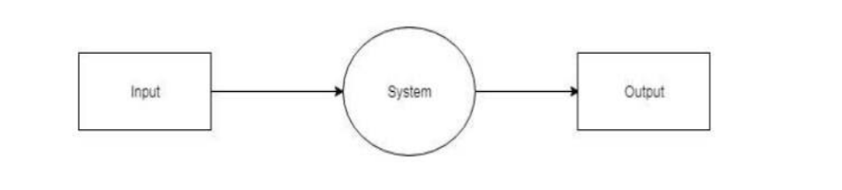
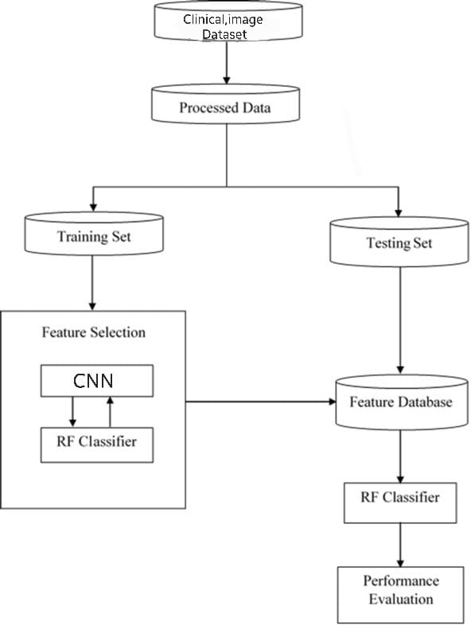

DATAFLOW DIAGRAM
LEVEL-0:
LEVEL-1:
CNN

Slide 13

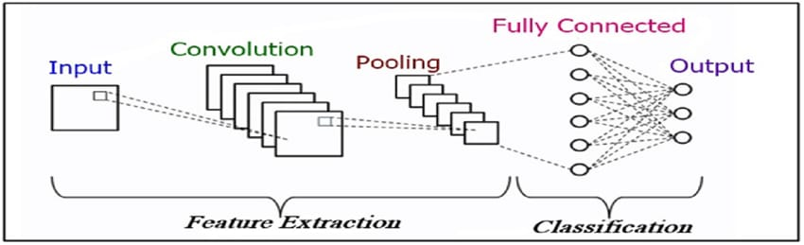
LIST OF MODULES
MODULE-1:Data Collection & Preprocessing
Data Collection: Gather data from various sources such as medical records, surveys, imaging studies (ultrasound) and hormonal tests..
Data Preprocessing: Data preprocessing for PCOS detection involves cleaning and organizing collected data by selecting relevant features and splitting the dataset for training and testing.
MODULE-2:Feature Extraction
This includes extracting key features such as hormonal levels, menstrual cycle irregularities, ovarian morphology from ultrasound images . These features serve as input for machine learning algorithms to distinguish between individuals with and without PCOS.

Slide 14
LIST OF MODULES
MODULE-3:Training Module
This module typically entails selecting an appropriate machine learning or statistical model like random forests with the data that will be analyzed by RF classifier and adjusting its parameters to optimize performance in accurately identifying PCOS cases based on input features such as hormonal levels like beta-levels and ultrasound results. This trained model is then evaluated using separate test data to assess its effectiveness in detecting PCOS.
MODULE-4:Model Testing
In PCOS detection, model testing involves assessing the performance of the trained algorithm using independent test data. Its predictions are compared against known outcomes to measure various metrics such as accuracy, sensitivity, specificity.
MODULE-5:Interactive Webpage
An interactive webpage for a PCOS detection system provides users with a user-friendly interface to input relevant information such as demographic details, symptoms, and test results. Overall, the webpage enhances accessibility and usability, facilitating informed decision-making and support for individuals concerned about PCOS.

Slide 15
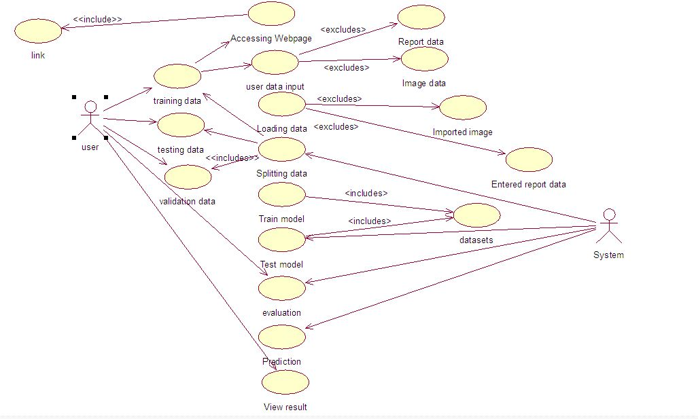

USE CASE DIAGRAM

Slide 16
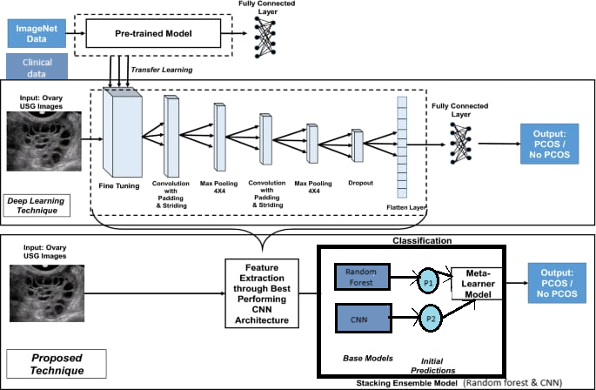
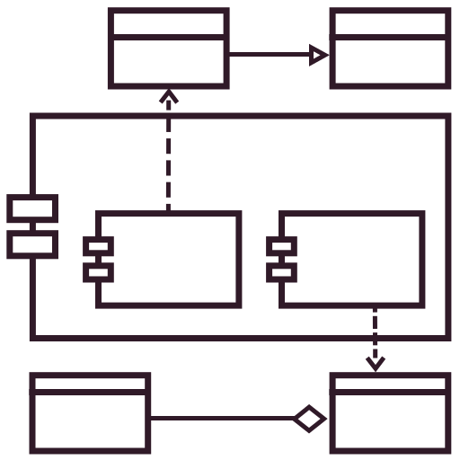
ARCHITECTURE

Slide 17

ALGORITHMS
STEP-1:DEFINE THE MODEL:
A function named base_model is defined to create a convolutional neural network (CNN) model using Keras . This function takes input_shape (the shape of input data) as parameter.
STEP-2:CREATE THE CNN MODEL:
The function is called to create the CNN model using the specified input_shape . The model consists of several convolutional layers followed by max-pooling layers for flatten layer, dense layers, dropout layers for regularization, and an output layer with sigmoid activation for classification. The random forest classifier is used to build the model to work on the report data.
STEP-3:COMPILE THE MODEL:
The model is compiled using the compile method, where the optimizer is set to ‘rmsprop', the loss function is set to ‘binary_crossentropy', and the evaluation metric is set to 'accuracy’.

Slide 18
ALGORITHMS
STEP-4:TRAIN THE MODEL:
The model is trained using the fit method for cnn. Training is performed for 30 epochs with steps per epoch 10. The training data (X_train, y_train) and the validation data (X_val, y_val) are provided for training for random forest model.
STEP-5:EVALUATE THE MODEL:
After training, the model is evaluated on the test data (X_test, y_test) using the evaluate method. This computes the test loss and test accuracy of the trained random forest model.
STEP-6:PRINT MODEL SUMMARY:
The summary method is called on the model to print a summary of the model accuracy, precision confusion matrix, F1 score for random forest model.

Slide 19
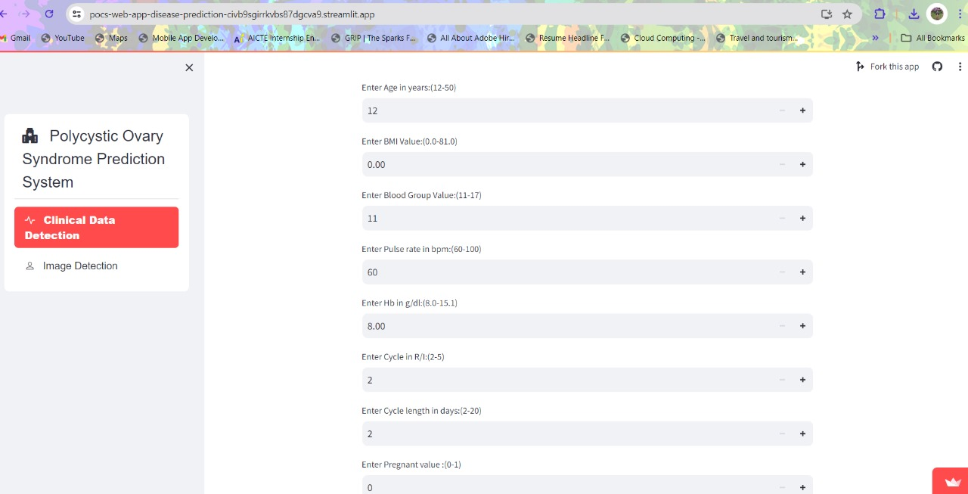
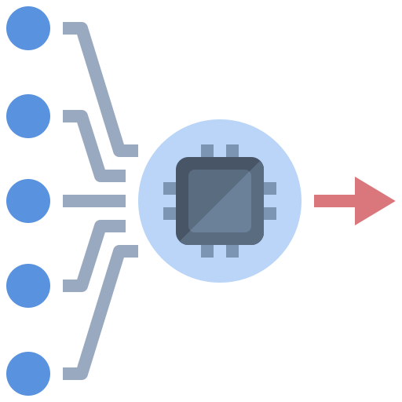
INPUT SLIDES

Slide 20
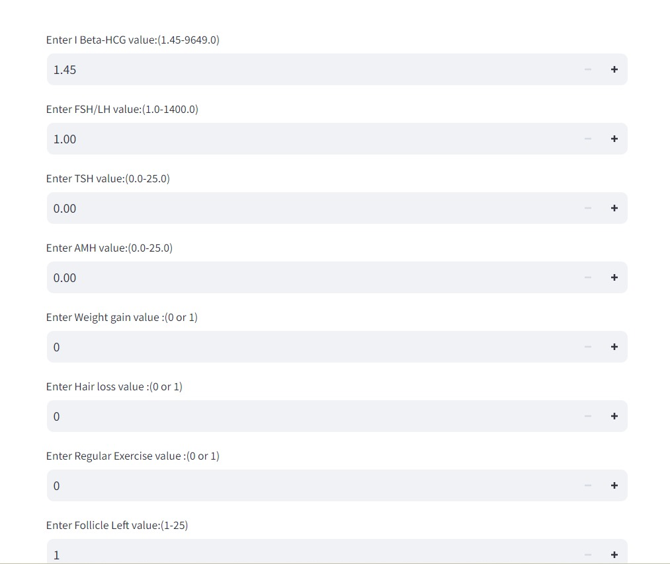
INPUT SLIDES

Slide 21
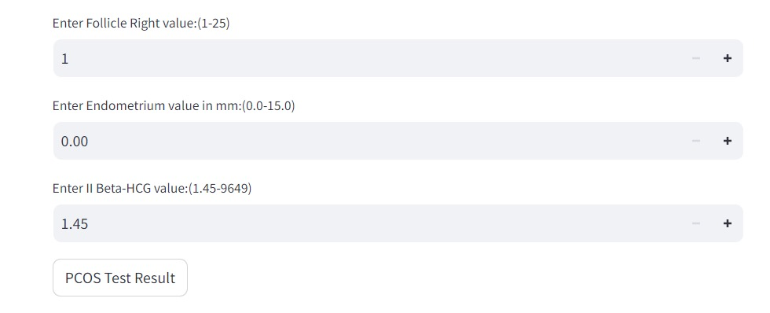
INPUT SLIDES

Slide 22
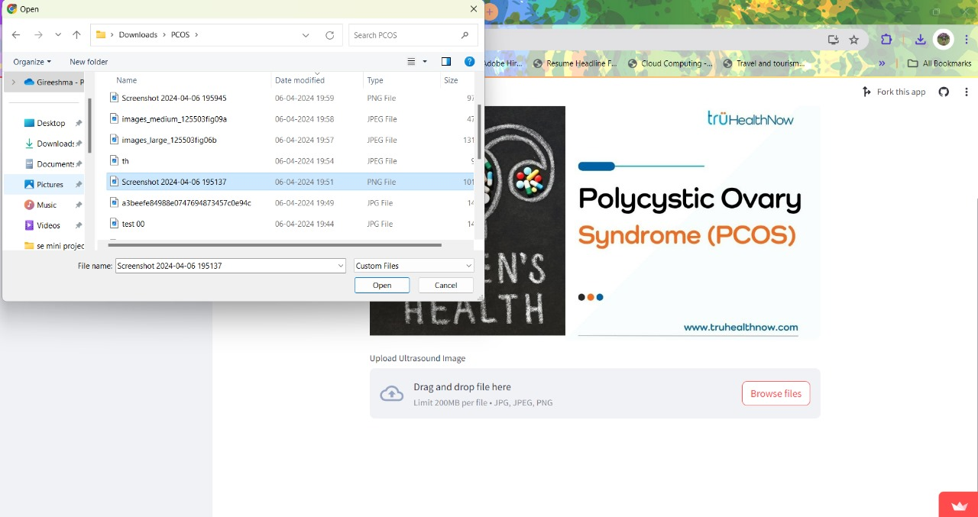
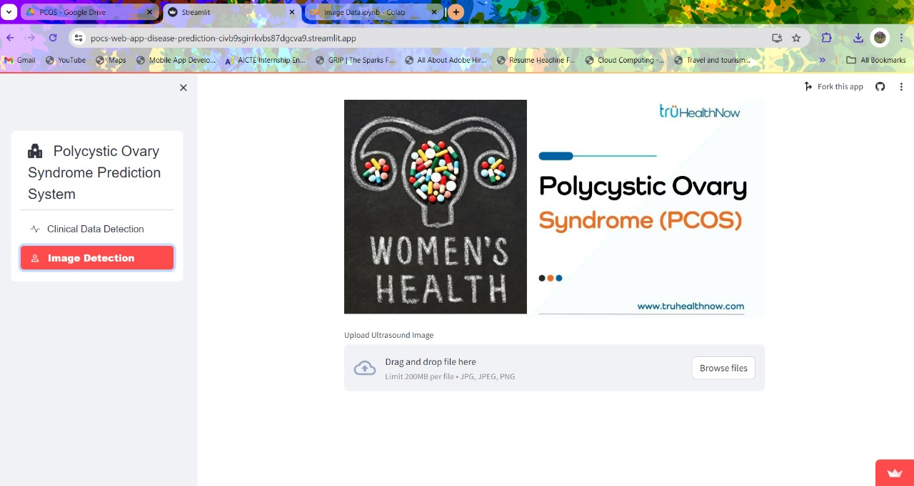
INPUT SLIDES

Slide 23
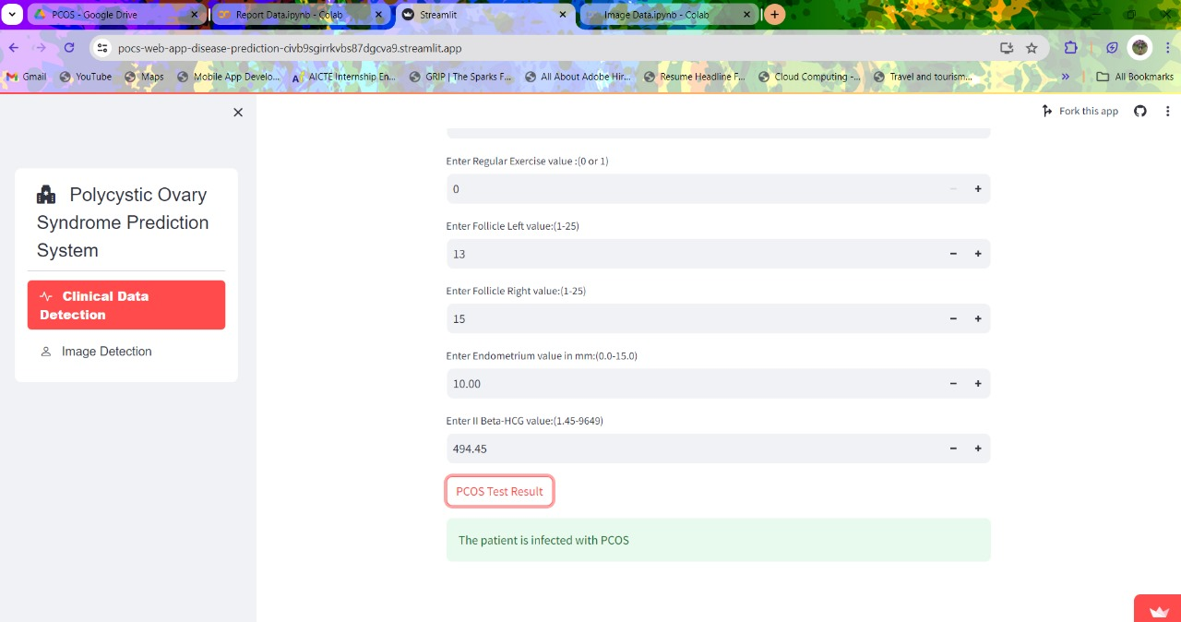

OUTPUT SLIDES

Slide 24
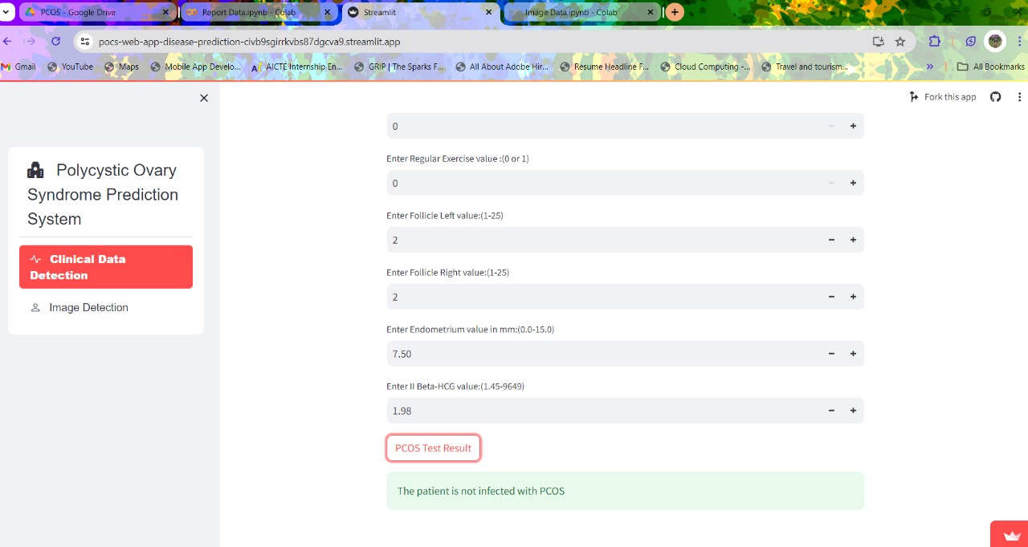
OUTPUT SLIDES

Slide 25
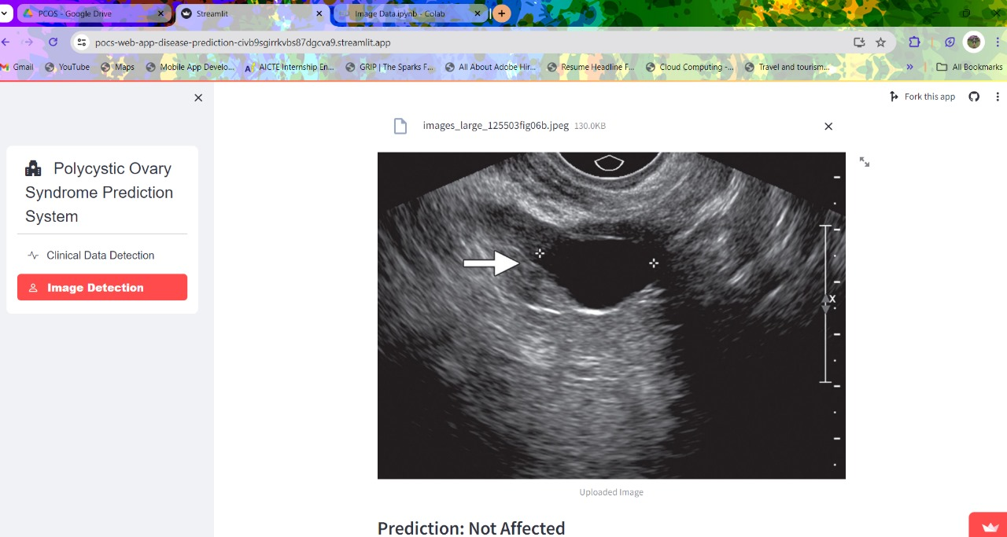
OUTPUT SLIDES

Slide 26
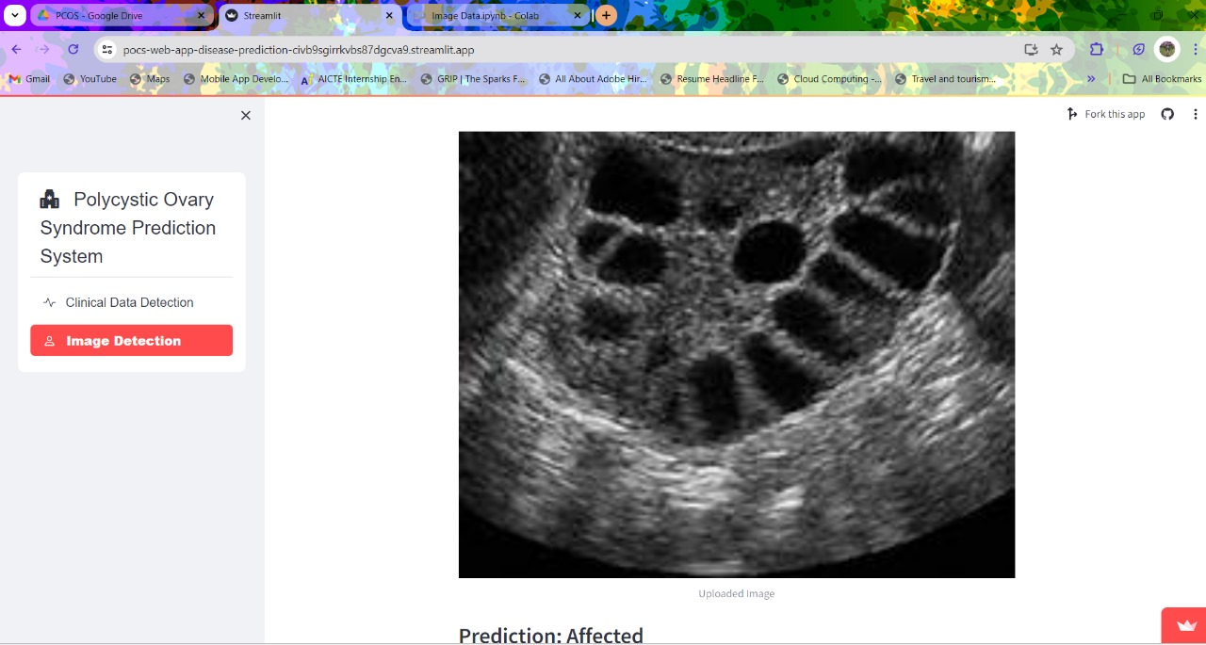
OUTPUT SLIDES

Slide 27

PERFORMANCE ANALYSIS
TYPE OF DATASETS | REPORT DATA |  |  | IMAGE DATA
SYSTEMS | Existing System |  | Proposed system | Existing System | Proposed system
ALGORITHMS | SVM | XGBOOST | Random Forest | Inception V3 | Mobile Net
ACCURACY | 85.2% | 85.89% | 91.4% | 77.9% | 99.4%
PRECISION | 88.1% | 78.5% | 87.5% | 78% | 99.45%

Slide 28

MODULES WITH STATUS
MODULE-1:
Data Collection & Preprocessing– 100% Achieved
MODULE-2:
Feature Extraction – 100% Achieved
MODULE-3:
Training Module– 100% Achieved
MODULE-4:
Model Testing – 100% Achieved
MODULE-5:
Interactive Webpage – 100% achieved

Slide 29

REFERENCE LINKS
[1] S. A. Bhat and R. Gupta. (2021). National College of Ireland Project Submission Sheet School of Computing. Accessed: May 16, 2022. [Online].Available: http://norma.ncirl.ie/5137/1/shakoorahmadbhat.pdf
[2] C. Bento. (Sep. 21, 2021). Multilayer Perceptron Explained With aReal-Life Example and Python Code Towards Data Science. Accessed: May 16, 2022. [Online].Available: https://towardsdatascience.com/multilayer-perceptron-explained-with-areal-life-example-and-python-code-sentiment-analysis-cb408ee93141

Slide 30



