Slide 1

Steam Games Market Analysis Dashboard
Data Visualization Final Project
GIREESH CHOWDARY TRIPURANENI
PYTHON · STREAMLIT · PLOTLY · PANDAS

Slide 2
Project Overview & Dataset
Objective
Key Dataset Features
Interactive dashboard to analyze Steam game data — exploring market trends, genres, pricing, and user engagement.
Genre
Price
Source
Reviews
Peak CCU
Steam Games Dataset — Kaggle
https://www.kaggle.com/datasets/fronkongames/steam-games-dataset/data
Metacritic
Platform

Slide 3

Data Preparation & Architecture
Handle Missing
Convert Numeric
Date & Dedupe
Raw Data
Dashboard
Built on a clean three-layer stack: Pandas for preprocessing, Plotly for interactive charts, and Streamlit for the web interface — featuring sidebar filters, KPI cards, and 4 interactive tabs.

Slide 4
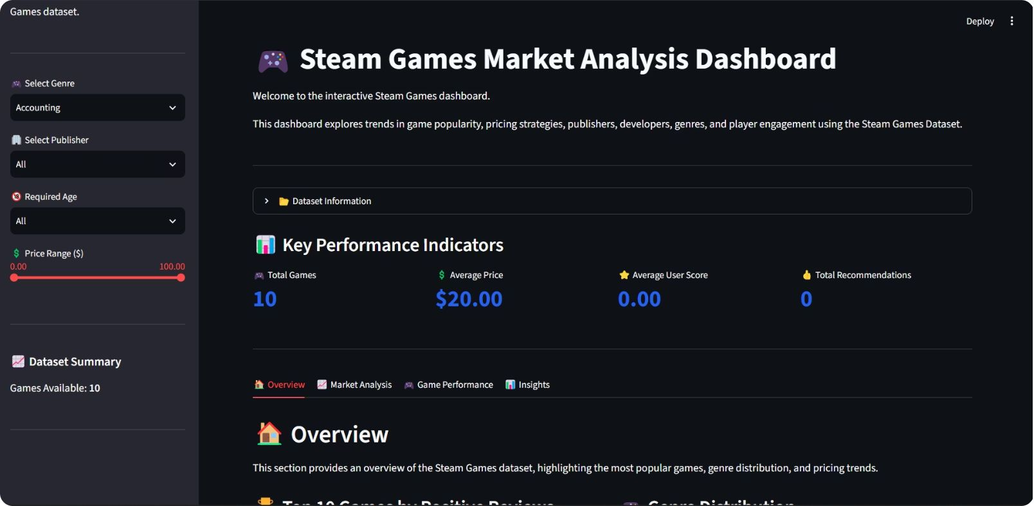
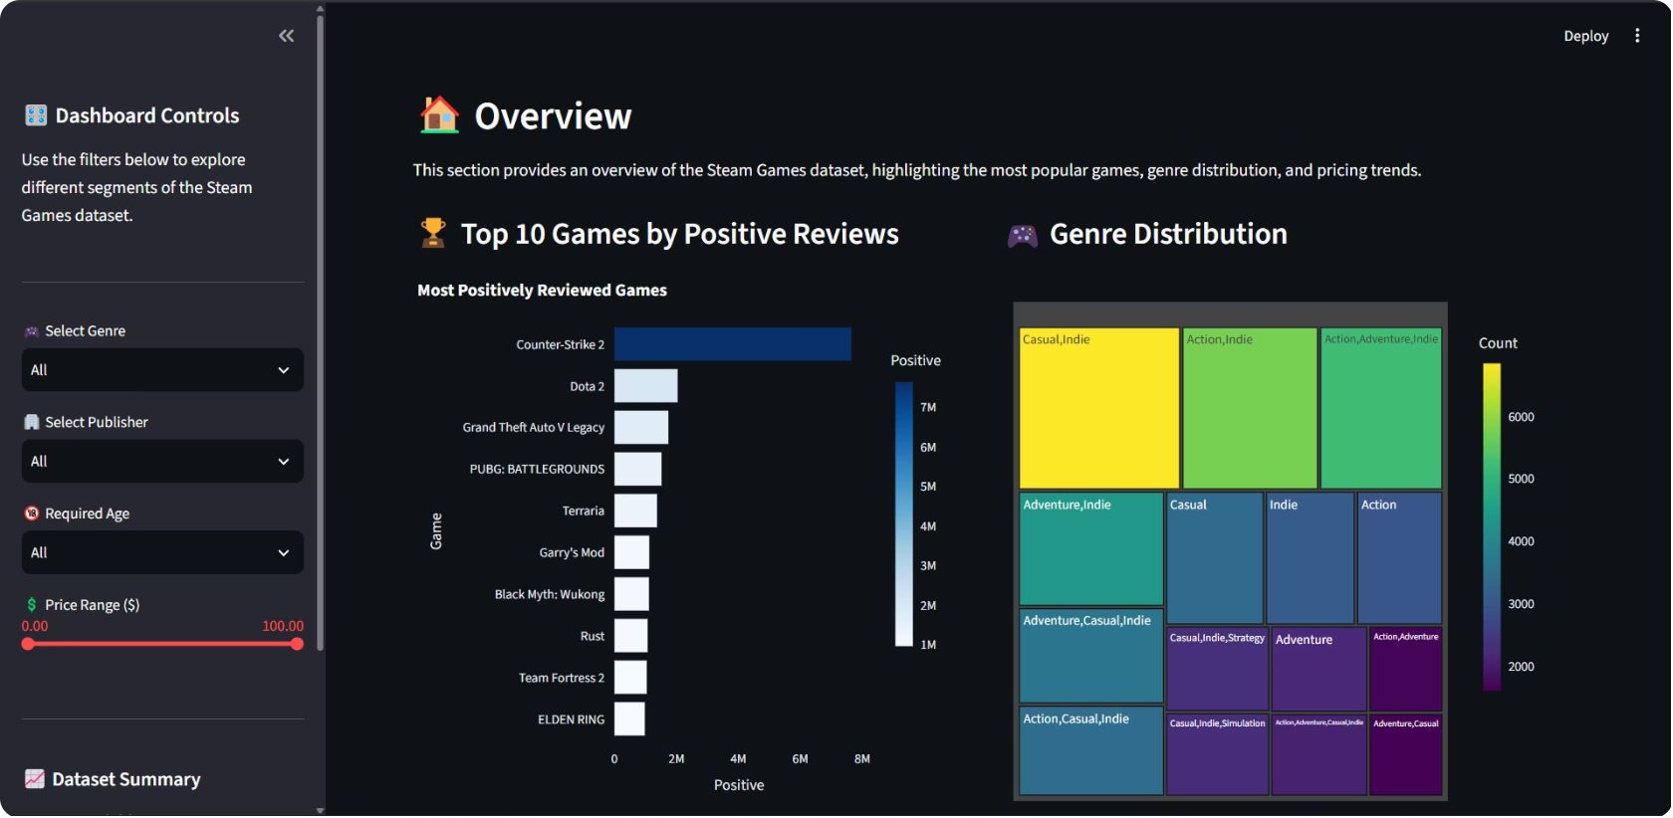
Dashboard Overview
Overview
Market Analysis
Game Performance
Insights
Sidebar filters for genre, platform, price range, and date — KPI cards surface top-level metrics at a glance.

Slide 5
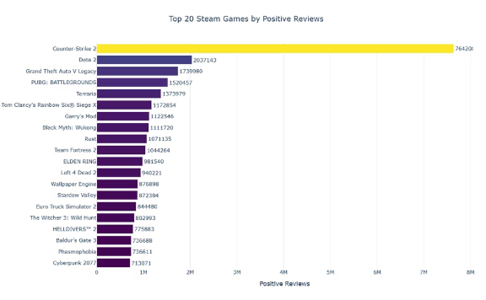
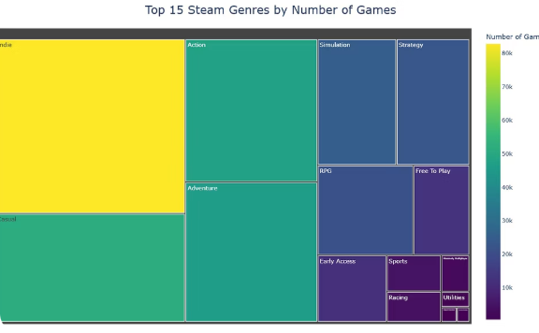
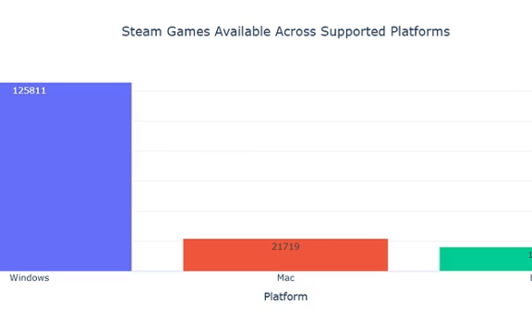
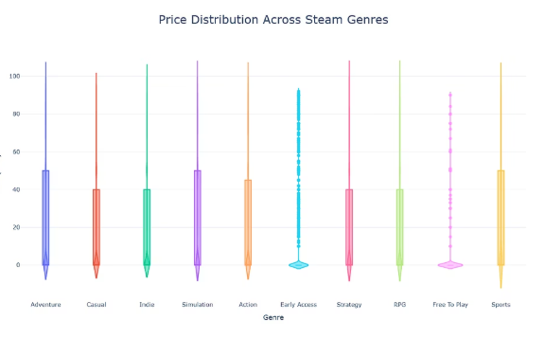
Key Visualizations
Top Reviewed Games
Genre Distribution
Platform Support
Engagement Trends
Counter-Strike 2 leads with 7.6M+ positive reviews
Indie & Action dominate the Steam catalog
Windows: 125K+ games · Mac: 21K · Linux: 16K
Peak CCU and review volume across titles

Slide 6
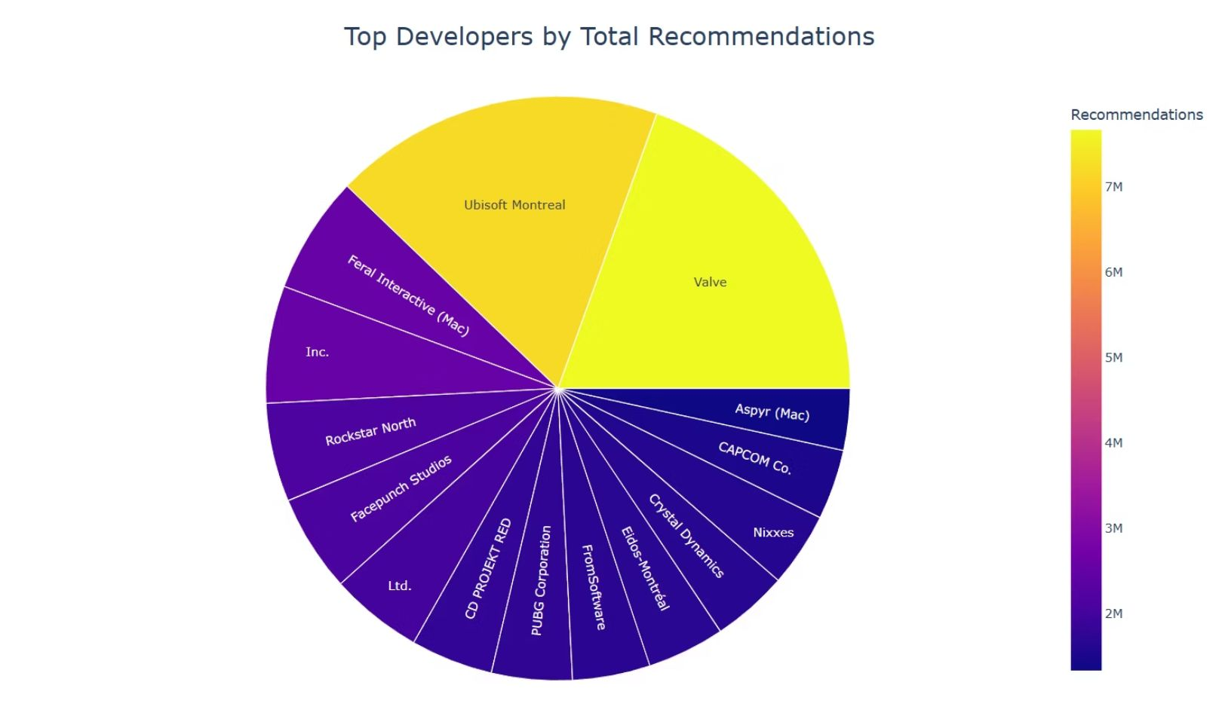
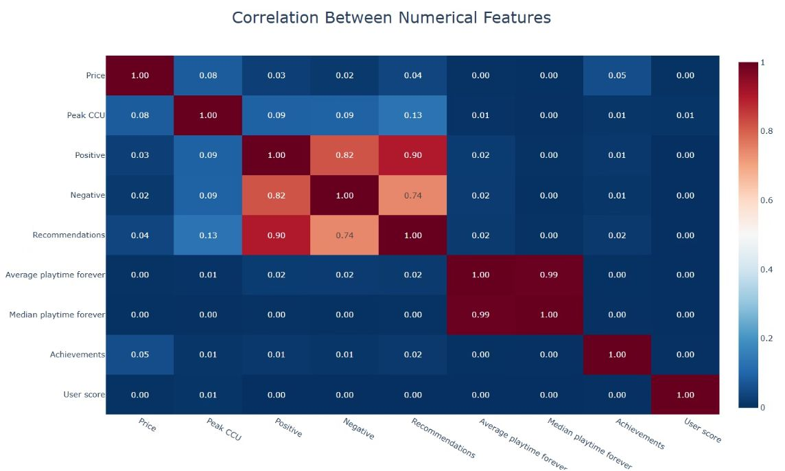
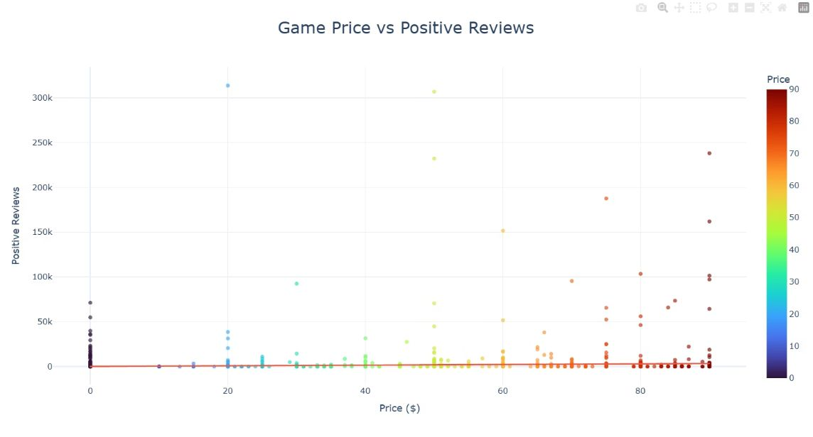
Market & Performance Analysis
Key Findings
Positive reviews strongly correlate with recommendations (r = 0.74)
Valve leads developer recommendations; Ubisoft Montreal close second
Most high-review games are priced under $20

Slide 7

Key Insights
Platform Dominance
Genre Landscape
Review → Recommendation
Windows dominates platform support across the entire Steam catalog
Indie & Action are the most common genres by volume
More positive reviews consistently drive more recommendations
Engagement Variance
Dynamic Exploration
User engagement varies significantly across titles — a few outliers dominate
Sidebar filters enable efficient, real-time dataset exploration

Slide 8

Conclusion
01
02
Built
Applied
Fully interactive Steam Games dashboard with Streamlit & Plotly
Preprocessing pipelines, KPI cards, and multi-tab visualization
03
Future
Steam API integration, real-time updates, and ML-powered recommendations
Thank You — Questions?

Slide 9
Links:
Github: https://github.com/gireeshtripuraneni/Steam-Games-Market-Analysis
Streamlit: https://steam-games-market-analysis-3gpotck5qp9gsnxpxexdyq.streamlit.app/
Dataset: https://drive.usercontent.google.com/download?id=17X7MhTvbqW3N6YeuATl0TOKxEYyOqwUm&export=download&authuser=0

